Slide 1
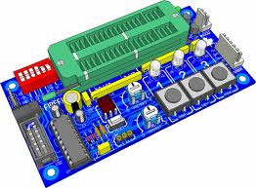
ECE 404
PCB Design Presentation
-Binod Pant

Slide 2
Introduction
Printed circuit board
Mechanical support
Electrically connect electronic components using conductive pathways, or traces
PCB populated with electronic components is a printed circuit assembly (PCA)

Slide 3
Why PCB?
Rugged, inexpensive, and can be highly reliable
Faster (due to automation) and consistent in high volume production
Professional(more neater look)

Slide 4
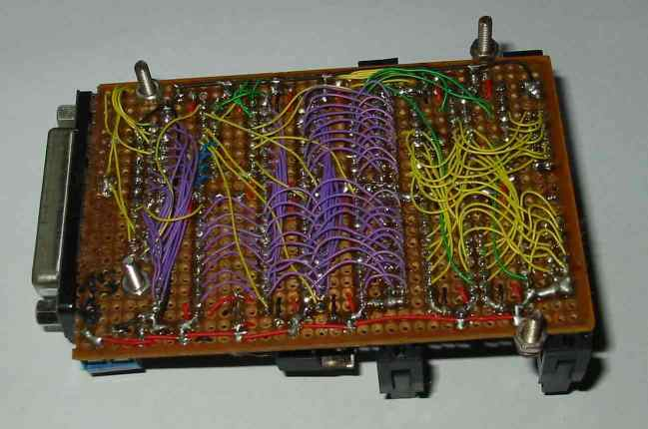
Example of wire wrapping circuit board

Slide 5
Materials of PCB
Conducting layers are typically made of thin copper foil.
The board is typically coated with a solder mask that is green in color. Other colors that are normally available are blue and red.
Unwanted copper is removed from the substrate after etching leaving only the desired copper traces or pathways

Slide 6
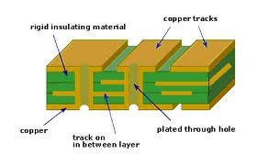
Different Layers

Slide 7
Parts of a PCB
Components
Pads
Traces
Vias
Top Metal Layer
Bottom Metal Layer

Slide 8
Components
Components are the actual devices used in the circuit.
This includes input/output connections.
I/O ports, including power supply connections, are also important in the PCB design.

Slide 9
Pads
Location that components connect to.
You will solder components to the pads on the PCB.
Pads will connect to traces.
Pads have an inner diameter and outer diameter.

Slide 10
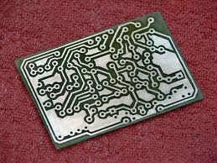
Pads and Trace

Slide 11
Traces
Traces connect pads together.
Traces are essentially the wiring of the PCB.
Equivalent to wire for conducting signals
Traces sometimes connect to vias.
High current traces should be wide.
Signal traces usually narrower than power or ground traces

Slide 12
Vias
Pad with a plated hole connecting traces from one layer of board to other layers.
Attempt to minimize via use in your PCBs.
Some component leads can be used as vias.

Slide 13
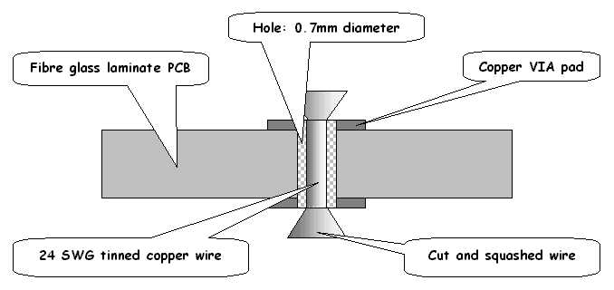
Vias

Slide 14
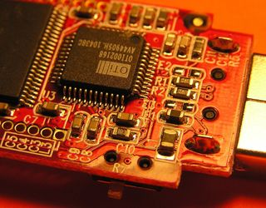
Top Metal Layer
Most of the components reside on the top layer
Fewer traces on the top layer
Components are soldered to the pads on the top layer of PCB
Higher circuit densities

Slide 15
Bottom Metal Layer
Few components on this layer.
Many traces on this layer.
Most soldering done on this layer.

Slide 16
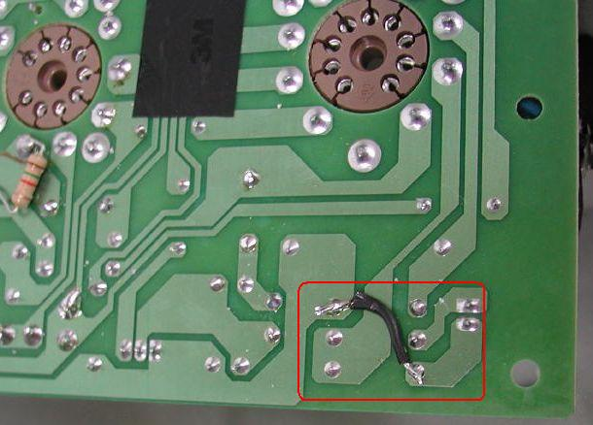
Jumpers
Often, many signal wires need to exist in too small of a space and must overlap.
Running traces on different PCB layers is an option.
Multilayer PCBs are often expensive.
Solution: use jumpers

Slide 17
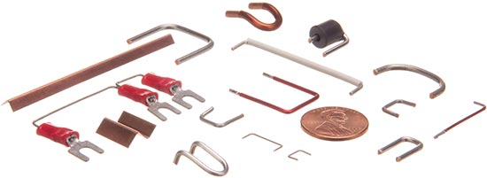
Jumpers

Slide 18
Solder Mask
Protect copper traces on outer layers from corrosion
Areas that shouldn't be soldered may be covered with polymer resist solder mask coating
Designed to keep solder only in certain areas
Prevents solder form binding between conductors and thereby creating short circuits(i.e. hides traces from solder)

Slide 19
Soldering
Wave Soldering- for through hole and SMT
Reflow Soldering- for SMT

Slide 20
Silkscreen
Printing on the solder mask to designate component locations
Readable information about component part numbers and placement.
Helpful in assembling, testing and servicing the circuit board.

Slide 21
Multilayer PCBs
More then a top and bottom layer.
Typically there will be a power plane, ground plane, top layer, and bottom layer.
Sometimes signal layers are added as needed.
Sometimes RF planes made of more expensive materials are added.

Slide 22
Physical Design Issues
Component Size
Heat Dissipation
Input and Output
Mounting Points

Slide 23
Component Size
Make sure components will actually fit.
This especially applies for circuits that require high component densities.
Some components come in multiple sizes. SMT vs Through Hole
Sometimes you can get tall and narrow caps or short and wide capacitors.

Slide 24
Heat Dissipation-Heat Sinks
Heat sink dissipates heat off the component
Doesn’t remove the heat just moves it
Some components may get hot. Make sure you get a large enough heat sink.
Data sheets specify the size of the heat sink
A short circuit may result when two devices share the same heat sink

Slide 25
Mounting Points
The PCB needs to be mechanically secured to something.
Could be the chassis-consist of metal frame on which the circuit boards and other electronic components are mounted.
Could be another PCB/socket on PCB.
Could be attachments to a heatsink.

Slide 26
Parasitics
High frequency circuits
Series Inductance
Shunt Capacitance
Inductive Coupling
Capacitive Coupling

Slide 27
Series Inductance
Not an issue for low frequency circuits(<10 Mhz)
The inductance of a trace may be signifigant.
For power connections, a shunt capacitor is added to counter the series inductance of a long trace.
A capacitor has a low AC impedance source
A 100nF capacitor is often used along with a larger capacitor. 100 nF ceramics have very low impedance at higher frequencies.

Slide 28
Shunt Capacitance
Result of wide wires over a ground plane.
Limits speed of circuits, including digital circuits
Typically insignificant for low performance circuits.
To minimize place a capacitor from voltage to ground

Slide 29
Inductive Coupling
Transfer of energy from one circuit component to another through shared magnetic field
Change in current flow through one device induces current flow in other device
Current flow in one trace induces current in another trace
Minimize the long parallel runs of traces
Run traces perpendicular to each other

Slide 30
Capacitive Coupling
Transfer of energy in electrical n/w due to capacitance between circuit nodes
Minimizing long traces on adjacent layers will reduce capacitive coupling
Ground planes are run between the signals that might affect each other.

Slide 31
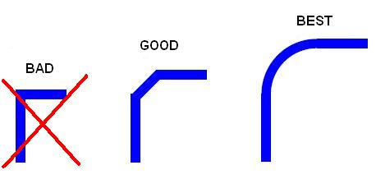
Routing

Slide 32
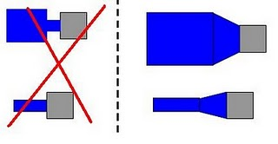
Trace connection with Pads

Slide 33
Pre-work
Thoroughly simulate your circuit-make sure the circuit worked in simulations
Thoroughly test the prototype-make sure the circuit worked on the bread board
Have all the data sheets handy for every components
Play around with the placement of the components

Slide 34
Simulations
Important to simulate the circuits before building them
Allow margin for component tolerances
Avoid using precise components. e.g a PWM controller that requires exact 10 V DC to work and will fail if there is 10.01V
High performance circuits or SMT devices require PCBs and should be simulated extensively first.

Slide 35
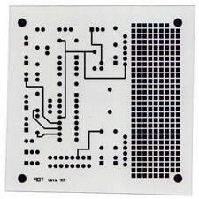
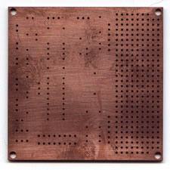
Steps in PCB design
Film Generation
2. Shear Raw Material
3. Drill Holes
Industry standard 0.059" thick, copper clad, two sides

Slide 36
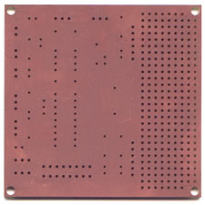
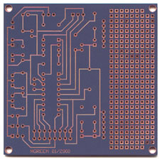
Steps in PCB design
4. Electrolus copper
5. Apply Image
Apply copper in hole barrels
Apply Photosensitive Material to develop selected areas from panel

Slide 37
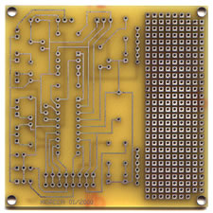
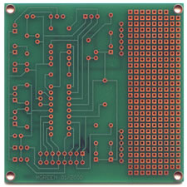
Steps in PCB Design
6. Strip and Etch
7. Solder Mask
Remove dryfilm, then etch exposed copper
Tin protects the copper circuitry from being etched
Apply solder mask area to entire board with the exception of solder pads

Slide 38
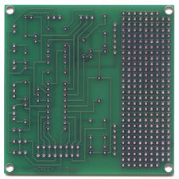
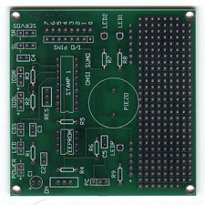
Steps in PCB Design
8. Solder Coat
9. Silkscreen
Apply solder to pads
Apply white letter marking using screen printing process
http://www.youtube.com/watch?v=Q6WJqjVleG0&feature=related
http://www.advancedcircuits.com/

Slide 39
Design Software
PCB Artist
EAGLE
OrCAD etc
Gerber files : describe the images of a printed circuit board (copper layers, solder mask, legend, etc.) as well as the drilling and milling data

Slide 40
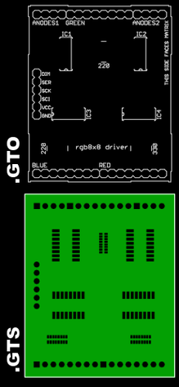
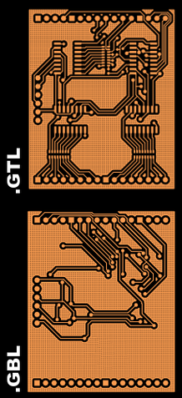
Example Gerber layers
Notes:
Example Gerber layers, showing the top overlay (legend), top solder resist (protective film), top layer copper traces, and bottom layer copper traces of a printed circuit board.

Slide 41
Transferring your design to a board
Direct Transfer using marker
"Press-N-Peel" sheets and Variations use of heat
Blender pen
Photolithography use of UV light

Slide 42
WEBSITES
http://www.advancedcircuits.com
How to download the software (EAGLE Layout editor)
Go to http://www.cadsoftusa.com
Click ‘Freeware’
Click ‘Download’
Find the correct version (Windows/Linux,English)
Also download Manual and Tutorial

Slide 43
References
PCB Design slides by Jakia Afruz
www.wikipedia.org
www.pcbexpress.com
A Practical Guide to high-speed printed circuit board layout

