Slide 1

ECE 404 PCB Design.

Slide 2
By
Jaimil Shastri
Department of Electrical & Computer Engineering.
Guided by
Dr. Scott Umbaugh
Graduate Program Director
Department of Electrical & Computer Engineering

Slide 3
Overview
Introduction – Why PCB?
Materials of PCB
Parts of PCB
Jumpers
Solder Mask
Silkscreen
Multilayer PCB
Physical Design Issues
Design Software
Material Required to Design PCB
Steps in PCB Design

Slide 4
Introduction
Printed circuit board
Mechanical support
Electrically connect electronic components using conductive pathways, or traces
PCB populated with electronic components is a printed circuit assembly (PCA)

Slide 5
Why PCB?
Rugged, inexpensive, and can be highly reliable
Faster (due to automation) and consistent in high volume production
Professional(more neater look)

Slide 6
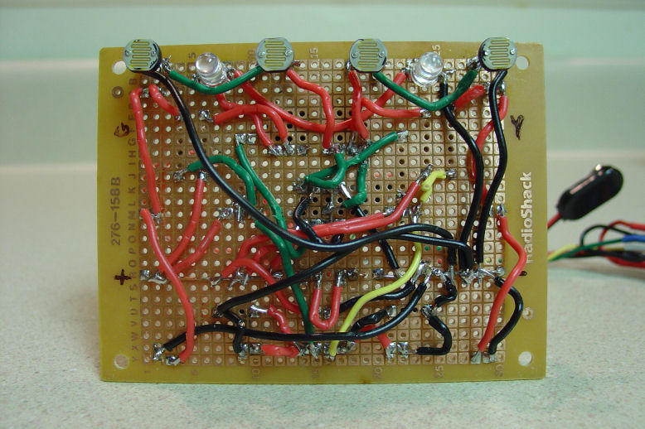
Wire wrapping circuit board

Slide 7
Materials of PCB
Conducting layers are typically made of thin copper foil.
The board is typically coated with a solder mask that is green in color. Other colors that are normally available are blue and red.
Unwanted copper is removed from the substrate after etching leaving only the desired copper traces or pathways

Slide 8
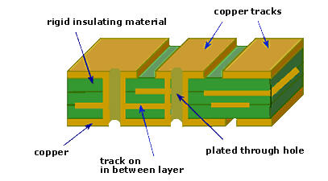
Different Layers of PCB

Slide 9
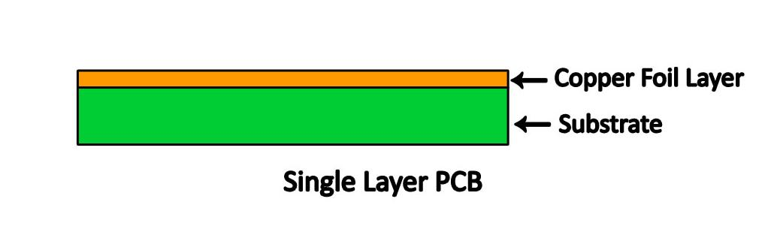
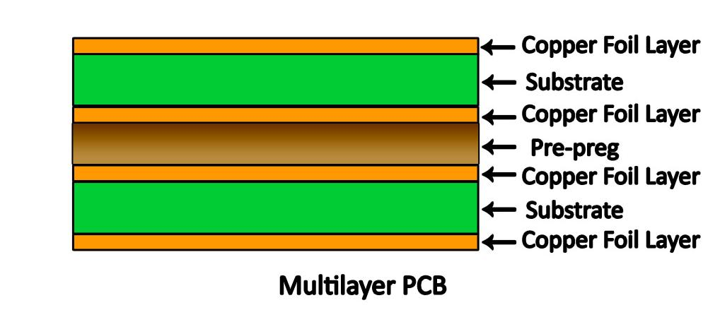

Slide 10
Parts of a PCB
Components
Pads
Traces
Vias
Top Metal Layer
Bottom Metal Layer

Slide 11
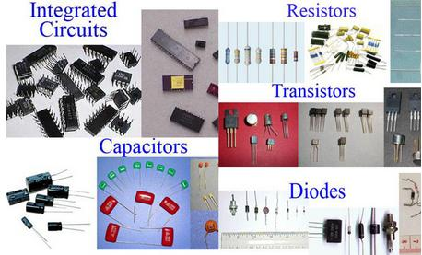
Components
Components are the actual devices used in the circuit.
This includes input/output connections.
I/O ports, including power supply connections, are also important in the PCB design.

Slide 12
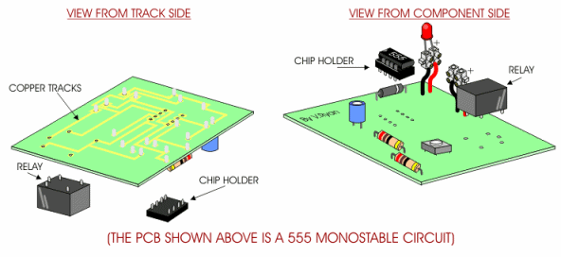
Components

Slide 13
Pads
Location that components connect to.
You will solder components to the pads on the PCB.
Pads will connect to traces.
Pads have an inner diameter and outer diameter.

Slide 14

Pads and Trace

Slide 15
Traces
Traces connect pads together.
Traces are essentially the wiring of the PCB.
Equivalent to wire for conducting signals
Traces sometimes connect to vias.
High current traces should be wide.
Signal traces usually narrower than power or ground traces

Slide 16
Vias
Pad with a plated hole connecting traces from one layer of board to other layers.
Attempt to minimize via use in your PCBs.
Some component leads can be used as vias.

Slide 17
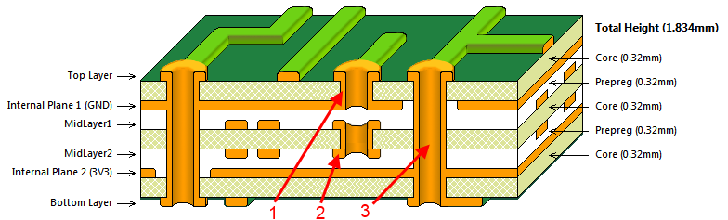
Vias
Blind Via
Buried Via
Through hole Via

Slide 18
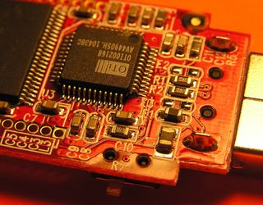
Top Metal Layer
Most of the components reside on the top layer
Fewer traces on the top layer
Components are soldered to the pads on the top layer of PCB
Higher circuit densities

Slide 19
Bottom Metal Layer
Few components on this layer.
Many traces on this layer.
Most soldering done on this layer.

Slide 20
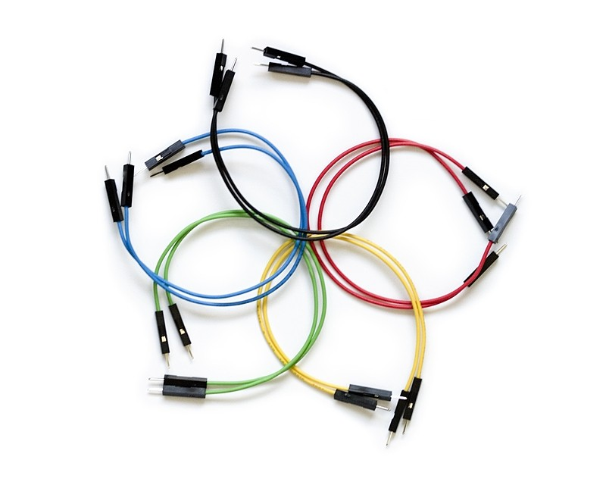
Jumpers
Often, many signal wires need to exist in too small of a space and must overlap.
Running traces on different PCB layers is an option.
Multilayer PCBs are often expensive.
Solution: Use jumpers

Slide 21
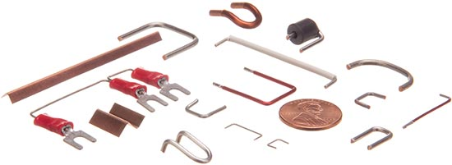
Jumpers

Slide 22
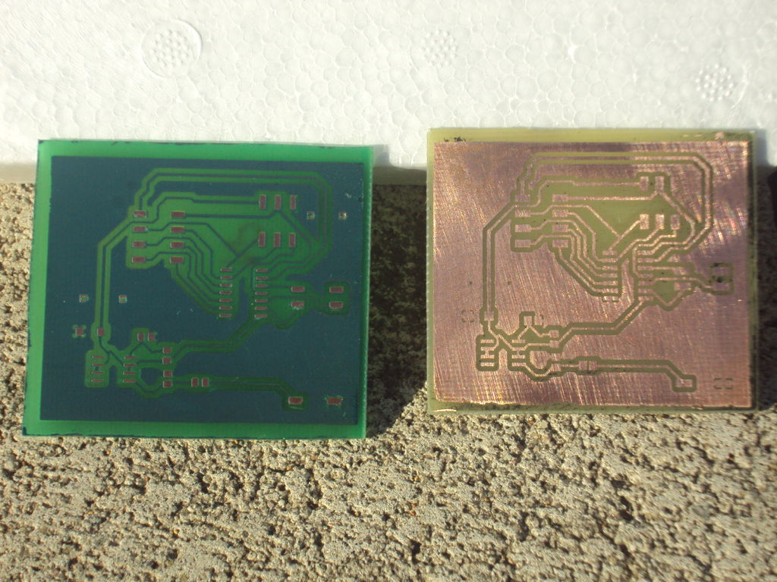
Solder Mask
Protect copper traces on outer layers from corrosion
Areas that shouldn't be soldered may be covered with polymer resist solder mask coating
Designed to keep solder only in certain areas
Prevents solder form binding between conductors and thereby creating short circuits(i.e. hides traces from solder)

Slide 23
Soldering
Wave Soldering- for through hole and SMT
Reflow Soldering- for SMT

Slide 24
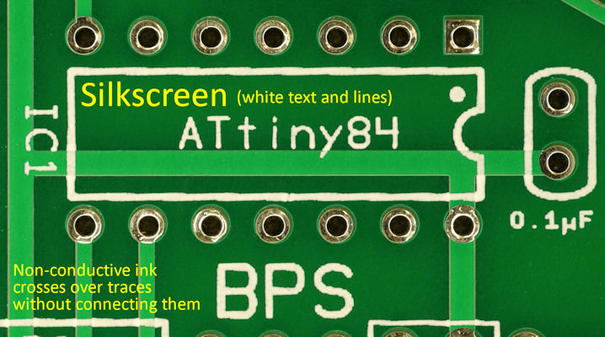
Silkscreen
Printing on the solder mask to designate component locations
Readable information about component part numbers and placement.
Helpful in assembling, testing and servicing the circuit board.

Slide 25
Multilayer PCBs
More then a top and bottom layer.
Typically there will be a power plane, ground plane, top layer, and bottom layer.
Sometimes signal layers are added as needed.
Sometimes RF planes made of more expensive materials are added.

Slide 26
Physical Design Issues
Component Size
Heat Dissipation
Input and Output
Mounting Points

Slide 27
Component Size
Make sure components will actually fit.
This especially applies for circuits that require high component densities.
Some components come in multiple sizes. SMT vs Through Hole
Sometimes you can get tall and narrow caps or short and wide capacitors.

Slide 28
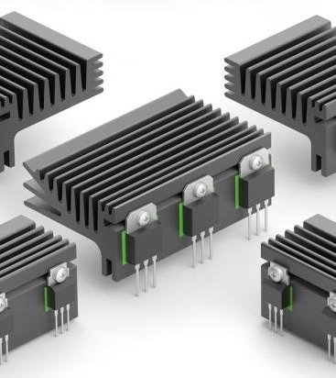
Heat Dissipation-Heat Sinks
Heat sink dissipates heat off the component
Does not remove heat, just moves it
Some components get hot, requiring heat sink
Data sheets specify the size of the heat sink
A short circuit may result when two devices share the same heat sink

Slide 29
Mounting Points
PCB needs to be mechanically secured
  To chassis-consist of metal frame on which the circuit boards and other electronic components are mounted
  To another PCB/socket on PCB
  To attachments to a heatsink

Slide 30
Parasitics
High frequency circuits
  Series Inductance
  Shunt Capacitance
  Inductive Coupling
  Capacitive Coupling

Slide 31
Series Inductance
Not an issue for low frequency circuits(<10 Mhz)
Inductance of a trace may be significant
Power connections - add shunt capacitor to counter the series inductance of a long trace
Capacitor has a low AC impedance
A 100nF capacitor is often used along with a larger capacitor. 100 nF ceramics have very low impedance at higher frequencies.

Slide 32
Shunt Capacitance
Result of wide wires over a ground plane.
Limits speed of circuits, including digital circuits
Insignificant for low performance circuits
Capacitor from voltage to ground will minimize

Slide 33
Inductive Coupling
Transfer of energy from one circuit component to another through shared magnetic field
Change in current flow through one device induces current flow in other device
Current flow in one trace induces current in another trace
  Minimize the long parallel runs of traces
  Run traces perpendicular to each other

Slide 34
Capacitive Coupling
Transfer of energy in electrical network due to capacitance between circuit nodes
Minimizing long traces on adjacent layers will reduce capacitive coupling
Ground planes are run between the signals that might affect each other.

Slide 35
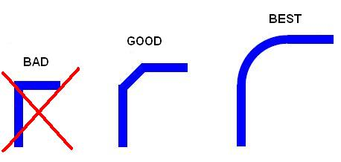
Routing

Slide 36
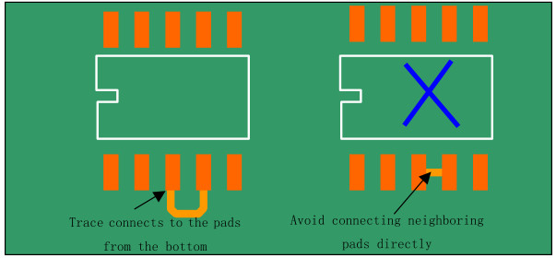
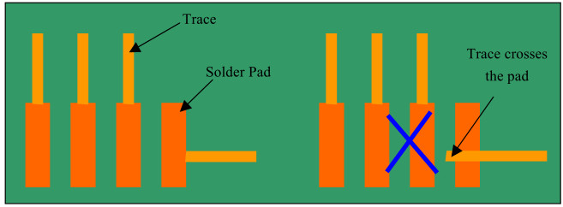
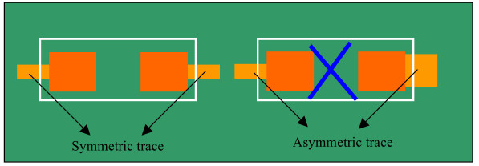
Trace connection with Pads

Slide 37
Pre-work
Thoroughly simulate your circuit-make sure the circuit worked in simulations
Thoroughly test the prototype-make sure the circuit worked on the bread board
Have all the data sheets handy for all components
Try various component configurations

Slide 38
Simulations
Important to simulate the circuits before building them
Allow margin for component tolerances
Avoid using precise components. e.g a PWM controller that requires exact 10 V DC to work and will fail if there is 10.01V
High performance circuits or SMT devices require PCBs and should be simulated extensively first

Slide 39
Transferring your design to a board
Direct Transfer using marker
"Press-N-Peel" sheets and Variations use of heat
Blender pen
Photolithography use of UV light

Slide 40
Design Software
PCB Artist
CADSoft EAGLE
PCBWizard
OrCAD etc
Gerber files:
Describe the images of a printed circuit board (copper layers, solder mask, legend, etc.) as well as the drilling and milling data, de facto standard used by industry to describe PCB images

Slide 41
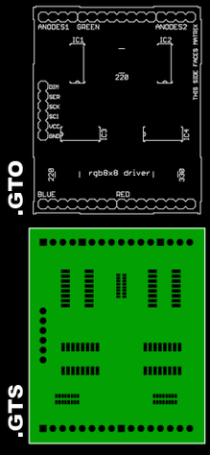
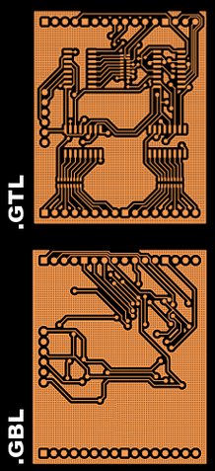
Example Gerber files
Notes:
Example Gerber layers, showing the top overlay (legend), top solder resist (protective film), top layer copper traces, and bottom layer copper traces of a printed circuit board.

Slide 42
Materials Required to make PCB
Drill machine.
Cloth Iron.
Laser Printer.
Photo paper / Glossy paper.
Gloves.
Ferric Chloride (Etching solution)
PCB board.
Black permanent Marker.
Notes:
Other Materials: Permanent black marker, blade cutter, sandpaper, kitchen paper, cotton wool, some old clothes.

Slide 43
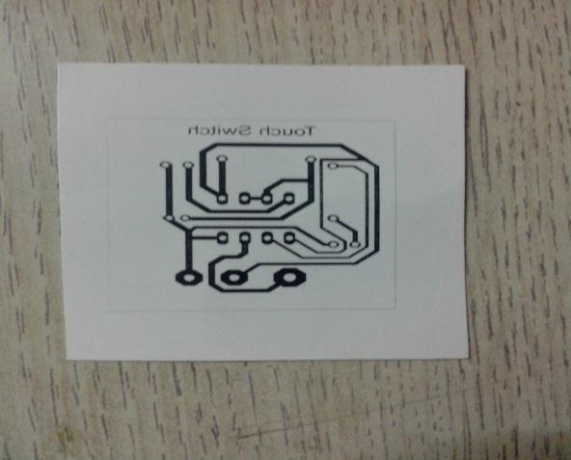
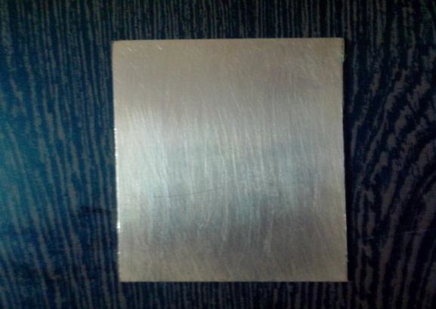
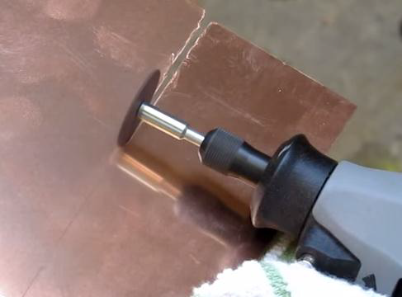
Steps in PCB design
Step 1: Take printout of PCB layout
Using laser printer & glossy paper
Mirror image
Step 2: Cutting the copper plate

Slide 44
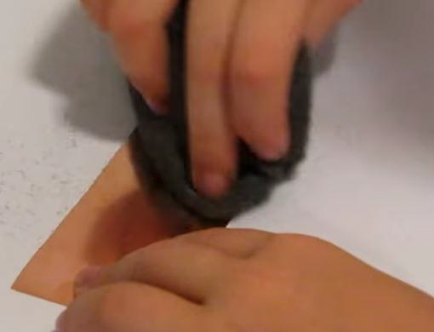
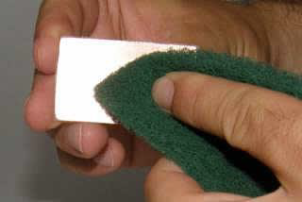
Steps in PCB design
Step 3: Make it smooth
Rub the copper side
Removes top oxide layer and photo resist layer
Sanded surface allow image to stick better

Slide 45
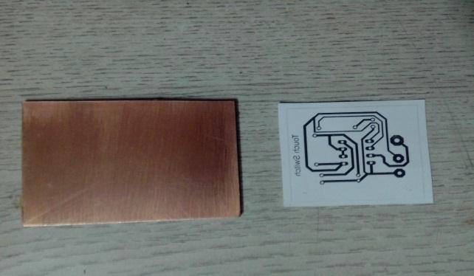
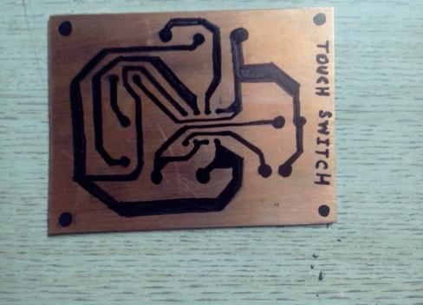
Steps in PCB design
Step 4: Printing Design layout to board
Method 1: Iron on glossy paper ( transfers the toner)
Method 2: Circuit by hand (using marker)

Slide 46
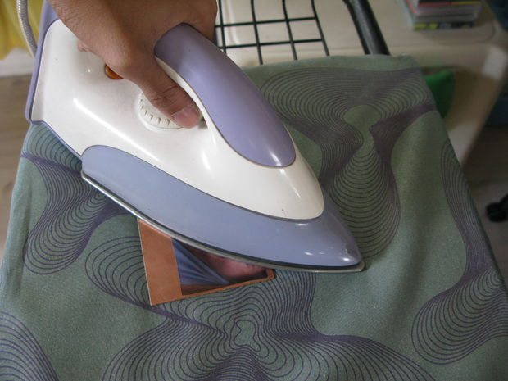
Steps in PCB design
Step 5: Apply heat (Iron it !!)
Iron it image down to copper side
Apply little pressure for 10-15 min
Iron heat transfer toner to cooper plate
CAUTION: Do not directly touch copper plate because it is very hot due to ironing.

Slide 47
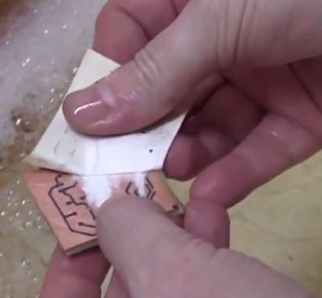
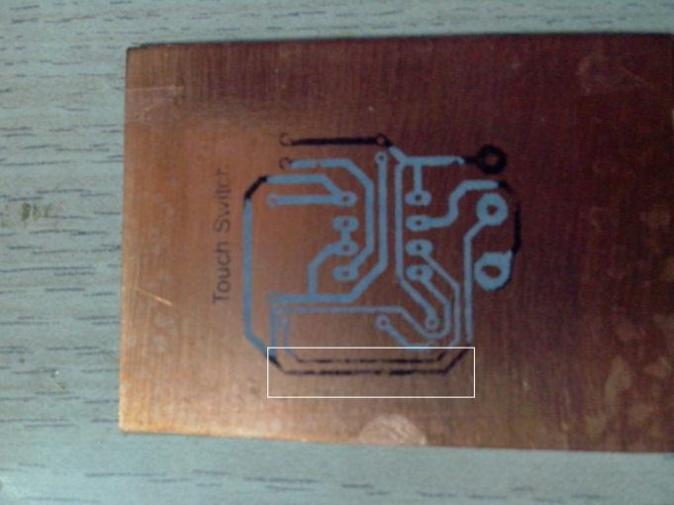
Steps in PCB design
Step 6: Peeling
Place printed plate in Luke warm water (10 min)
Remove the paper
Use black marker to dark lighted track

Slide 48
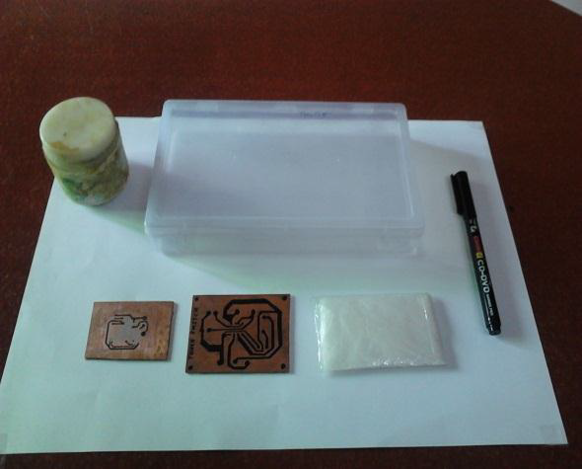
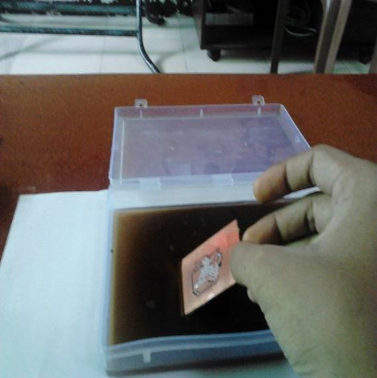
Steps in PCB design
Step 7: Etching
Dissolve 2-3 tea spoon ferric chloride in water
Dip PCB in etching solution for 30 min
FeCl₃ reacts with unmasked Cu and removes unwanted Cu
Cu + FeCl₃ = CuCl₃ + Fe

Slide 49
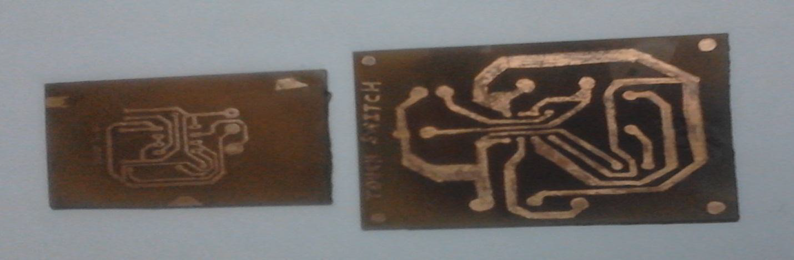
Steps in PCB design
Step 8: Apply thinner ( Final touch)
Few drops of thinner (acetone or nail polish) on pinch of cotton will remove the remaining toner
Rinse carefully and dry with a clean cloth

Slide 50
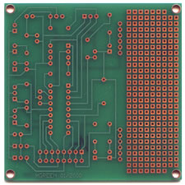
Steps in PCB Design
Step 9: Drill holes and apply Solder Mask
Apply solder mask area to entire board with the exception of solder pads

Slide 51
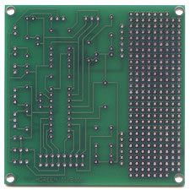
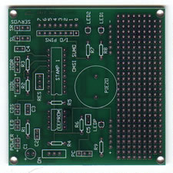
Steps in PCB Design
Step 10. Solder Coat
Step 11: Silkscreen
Apply solder to pads
Apply white letter marking using screen printing process
http://www.youtube.com/watch?v=Q6WJqjVleG0&feature=related

Slide 52
WEBSITES
http://www.advancedcircuits.com
How to download the software (EAGLE Layout editor)
Go to http://www.cadsoftusa.com
Click ‘Freeware’
Click ‘Download’
Find the correct version (Windows/Linux,English)
Also download Manual and Tutorial

Slide 53
References
PCB Design slides by Jakia Afruz
www.wikipedia.org
www.pcbexpress.com
A Practical Guide to high-speed printed circuit board layout

