Slide 1
Everyday Living
“China”
Mary Jane Bungque

Slide 2
Outline
China Life Guide
  Education
  Housing and Family
  Clothing
  Food
  Transportation
  Dating / Marriage
  Festivals
  Banned Networks

Slide 3
Introduction
China is a great country
  Traditional culture
  Street food
  Family relationship
    Respect
  Festivals
    Food
    Clothing
  Social network
    Facebook, Twitter, Youtube, etc.

Slide 4
Education
Primary School
  6 – 12 y/o
Junior Middle School
  12 – 15 y/o
Senior Middle School
  15 – 18 y/o
University or Higher School
  18 – 22 y/o
Notes:
State run system of public education run by the Ministry Education
It is required that all citizen must attend for at least 9 years
Government provides primary education for 6 years
Some province has 5 years of primary school but 4 years of middle school
Majority is 3 years for both middle school and high school

Slide 5
Housing and Family
Housing
  Family size
  Long term responsibility
  State support
  Rural landlords and government
Family Forms
  Marriage is permanent
  Adoption / Purchased
  Son(s)
  Daughter(s)
Notes:
Family and size complexity varied directly with class
Family members are bound, in law and custom, to support their aged or disabled members
The state supports individual if there are no other family members who supports them or no income base
Rural landlords and government has the largest families, poor peasants has the smallest
Couples who produced no sons, or no children at all, adopted or purchased infants outright.
Families with daughters but no sons tried to find men willing to marry their daughters and move into their families, abandoning their original families and sometimes even their original surnames.
Families with daughters but no property to attract a son-in-law were sometimes forced to sell their daughters as concubines or prostitutes.

Slide 6
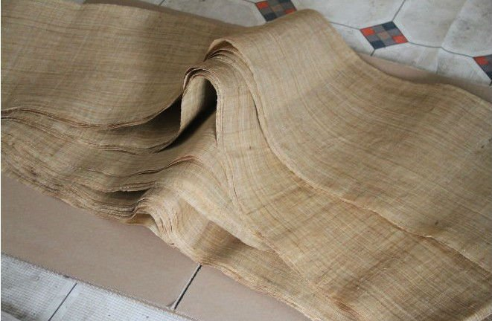
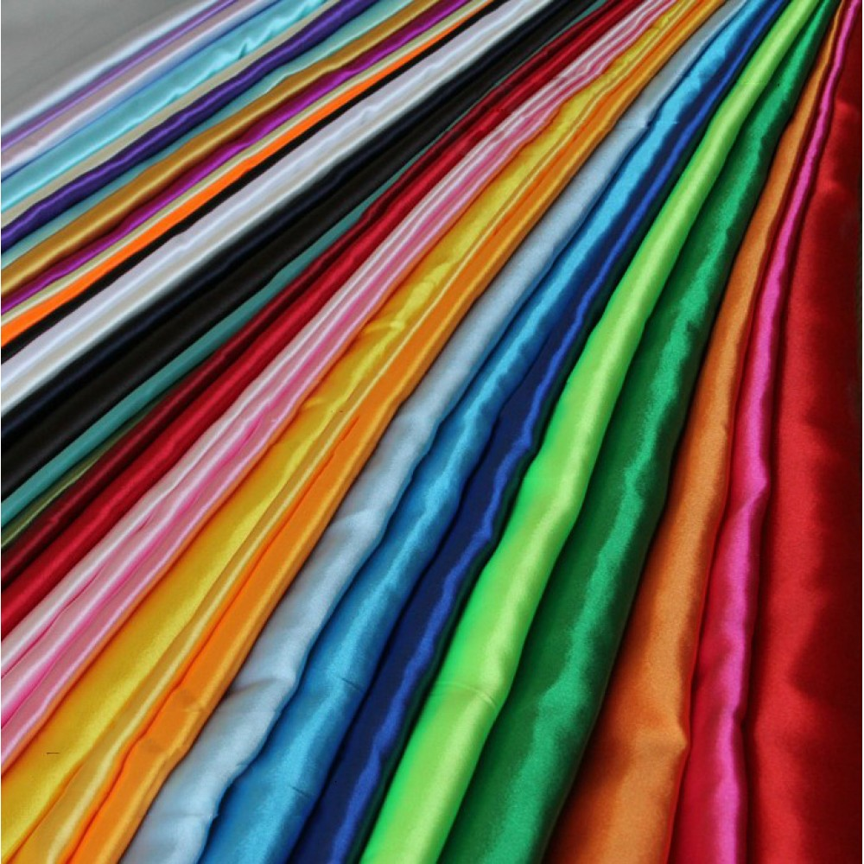
Clothing
Ancient Clothing
  Poor – hemp or ramie
    Blue and black
  Rich – Silk
    All color
  Hair – men/women
  Feet – tiny
Notes:
Men and women’s hair are not allowed to be cut because they got it from their parents so it is disrespectful to cut it
Ancient times, women though that in order to be beautiful they needed little tiny feet about 3 inches, they wrap tight bandages around the feet of little girls about 5 to 6 y/o, bandages were so tight they broke the girls toes and bent them underneath their feet. They had to walk like that, girls spent most of their time crying until it stop hurting

Slide 7



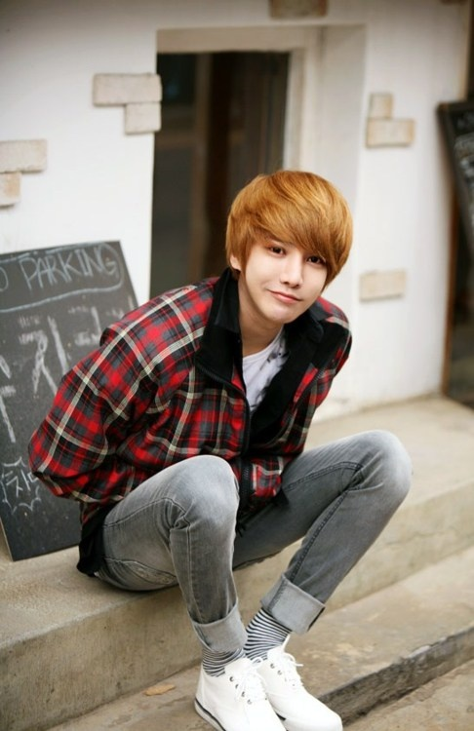
Clothing Cont.
Today’s Clothing Fashion
  Urban styles
  No western styles
  Qipao – Chinese Pinyin
Notes:
Formal attires for business
Children’s wears cartoonish style to make them look cute
China has not yet been influenced by western style
Qipao – Chinese pinyin means mandarin gown, used and made mainly by upper class women

Slide 8
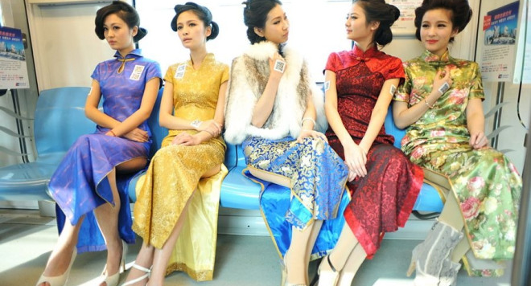
Clothing Cont.

Slide 9
Chinese Food
Eight main regional cuisines
  Anhui
  Cantonese
  Fujian
  Hunan
  Jiangsu
  Shandong
  Sichuan
  Zhejiang
Famous Chinese food
  Beijing Roast Duck
  Boiled sliced Chicken
  Chinese Style Steamed Fish

Slide 10
Transportation
Railway
  Trains / MRTs / LRTs
Motors
  Personal car / motorcycles
  Buses
  Taxi
Planes
Ships
  Boats / Jets

Slide 11
Dating and Marriage
Dating
  “I” pronounce as “Eye”
    WO AI NI
Marriage
  Pre-arrangement before marriage
  Important
  Primitive
  Maternal marriage
  Monogamy

Slide 12
Festivals
Spring Festivals
  Chinese New Year
  Chinese Lunar Year
  The Lantern Festival
  Qingming Festival-Tomb Sweeping Day
  Dragon Boat Festival-Duanwu Jie
  Qixi Festival - Qixi Jie
  Mid-Autumn Festival (Chinese Moon Festival)
  Double Nineth Festival - Elder Day
  Dong Zhi Festival - Winter Solstice Festival
  Ethnic Group Festivals
Notes:
First day of the first lunar month and ends on 15th of the first lunar month
Chinese New Year is the longest and most important festivity in the Lunar Calendar

Slide 13

Banned networks
2,700 websites are blocked
  Mainland china excluding Hong Kong and Macau
    Facebook
    Twitter
    Youtube
    Picasa
    Etc.
Notes:
Policy of internet censorship

Slide 14
References
http://www.chinatraveldiscovery.com/china-life/
http://www.travelchinaguide.com/intro/cuisine_drink/cuisine/eight_cuisines.htm

