Slide 1
Data Synchronizer Performance
In the Presence of
Parameter Variability
Samuel Dunham
Advisor : Dr. George Engel
Southern Illinois University Edwardsville
Department of Electrical and Computer Engineering
IC Design Research Laboratory
Edwardsville, IL 62025-1801
Notes:
1

Slide 2
Outline
Introduction
Design of a Simple Data Flip-Flop Used as a Synchronizer
Design of a Specialized Synchronizer Cell
Formal Sensitivity Analysis and Parameter Variability
Comparison of Analysis With Simulation
Summary, Conclusions, and Future Work

Slide 3
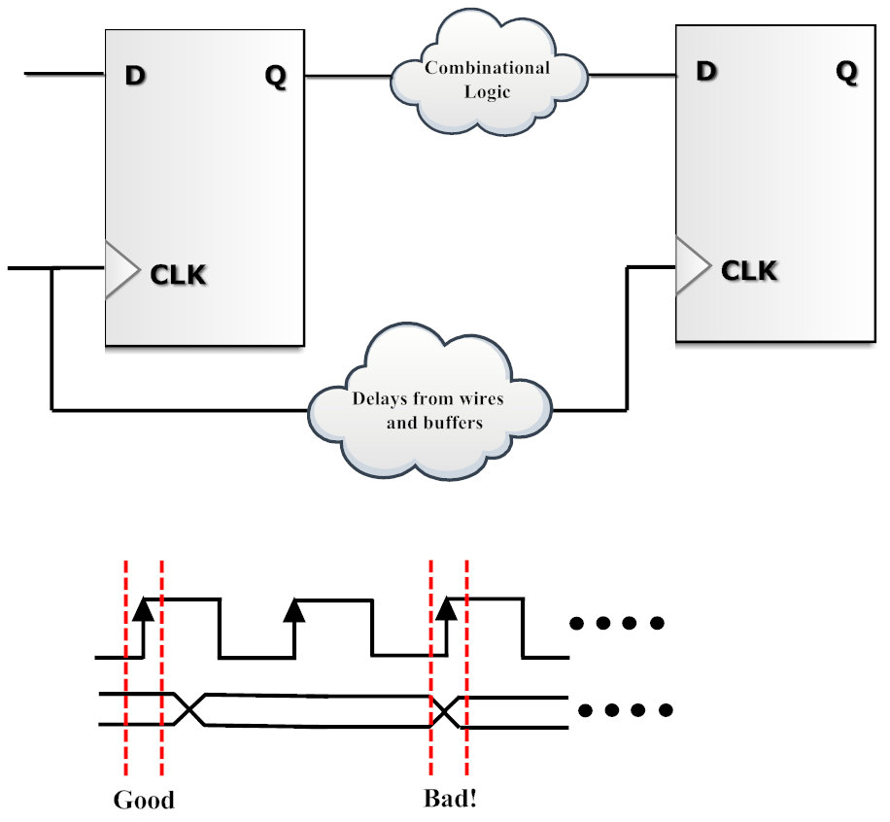
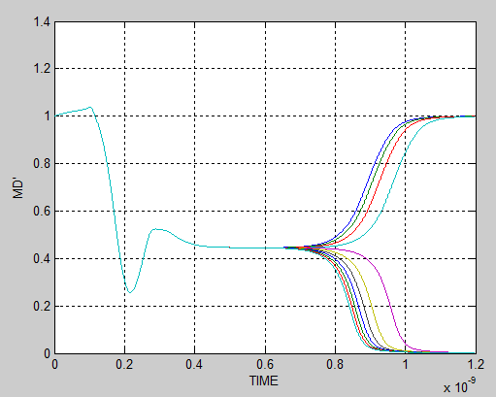
Metastability in Synchronous Digital Systems
3
Notes:
3

Slide 4

Metastability Hazards
  Uncertainty in transition timing
  Uncertainty in logic level
  Data-skew uncertainty
Mean Time Between Failure (MTBF)
4
Notes:
4
Add MTBF equation

Slide 5
Need for a Public Domain Synchronizer
Metastability is not well-understood by many practicing design engineers and their managers
Metastability related failures are likely to increase as transistor feature size shrinks and process variability increases. Modern designs may possess tens of thousands of synchronizers.
As greater emphasis is placed on semiconductor reliability, design engineers will be required to produce better estimates of MTBF rates.
Having a concrete circuit will make it easier for engineers to understand the pitfalls they are likely to encounter when trying to estimate metastability-related MTBF rates.
5
Notes:
5

Slide 6
Thesis Objectives
Design, layout, and characterize a standard flip-flop cell for use as a synchronizer.
Design, layout, and characterize a specialized synchronizer cell.
Perform a sensitivity analysis to predict how performance changes when supply voltage, threshold voltage, and temperature change.
Compare predicted performance to that obtained through simulation.
6
Notes:
6

Slide 7
Significance of Work
Determining the parameters which characterize the performance of synchronizer at a single operating point can take several minutes ore hours to determine through simulation.
If these parameters are made on silicon, it may take hours or even days to determine the performance parameters at a single operating point.
In this talk I will demonstrate, using the results of a formal sensitivity analysis, how the parameters obtained, for example at nominal temperature and supply, can be used to accurately predict synchronizer performance at elevated temperature or supply voltage.
7
Notes:
7

Slide 8
FreePDK45
Purposely non-manufacturable 45 nm “process”
Predictive HSPICE models from ASU
PDK (Process Design Kit) from NCSU for Cadence IC6 toolset
Used by researchers to explore device performance and design flows in deep sub-micron processes
Three threshold voltages available
VTL → Low threshold → High-speed
VTG → Normal threshold → General-purpose
VTH → High threshold → Low-power
8
Notes:
8

Slide 9



Device Characterization
Devices parameters must be characterized for use in the development of sensitivity equations
there are three operating regions of interest :
  Strong Inversion
  Moderate Inversion
  Weak Inversion
We begin with the short channel effect modified square law equation :
where
9
Notes:
9
Unbold stuff out, use only for significant

Slide 10


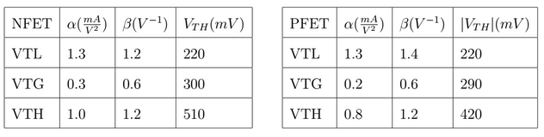
Device Characterization (continued)
We will use the weak inversion equation to set an upperbound in the sensitivity analysis later
If high field effects are negligible then the simple square law can be used
Three types of devices available in this process and the parameters extracted:
  VTL
  VTG
  VTH
10
Notes:
10

Slide 11
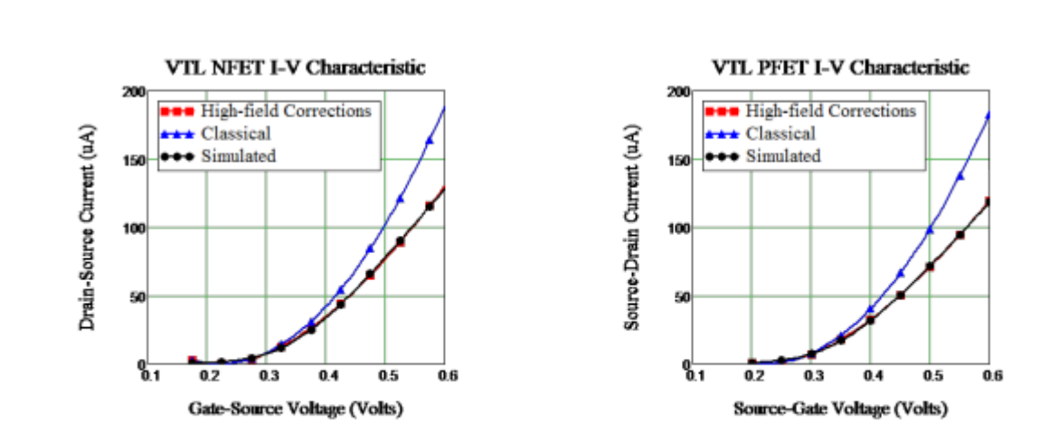
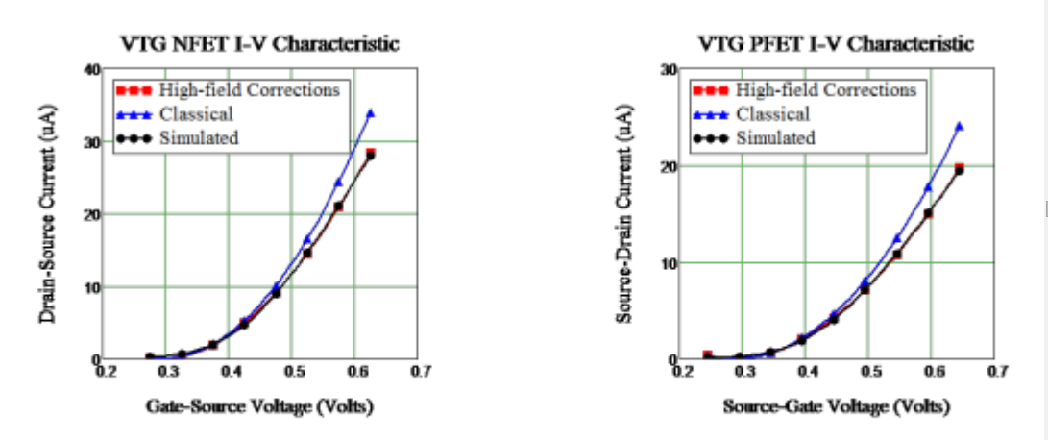
Device Characterization (continued)
11
Notes:
11

Slide 12
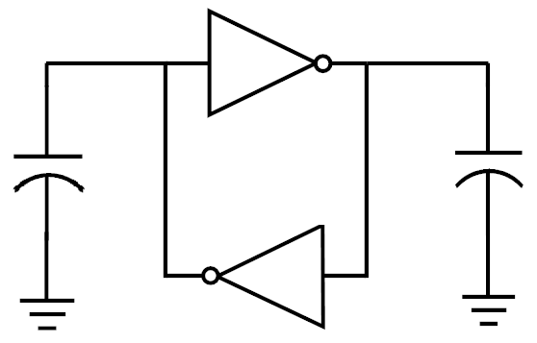

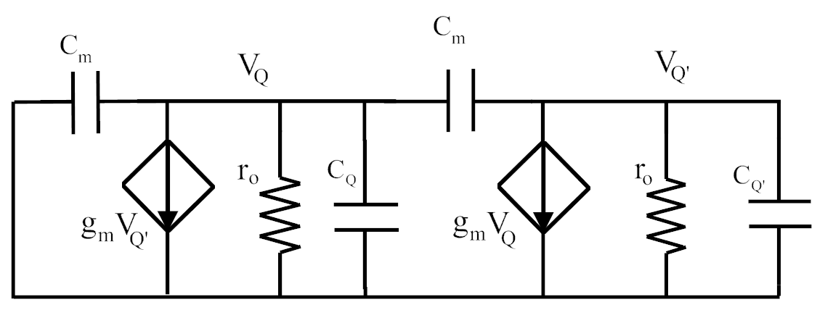
Analysis of a Metastable Latch
12
Notes:
12

Slide 13
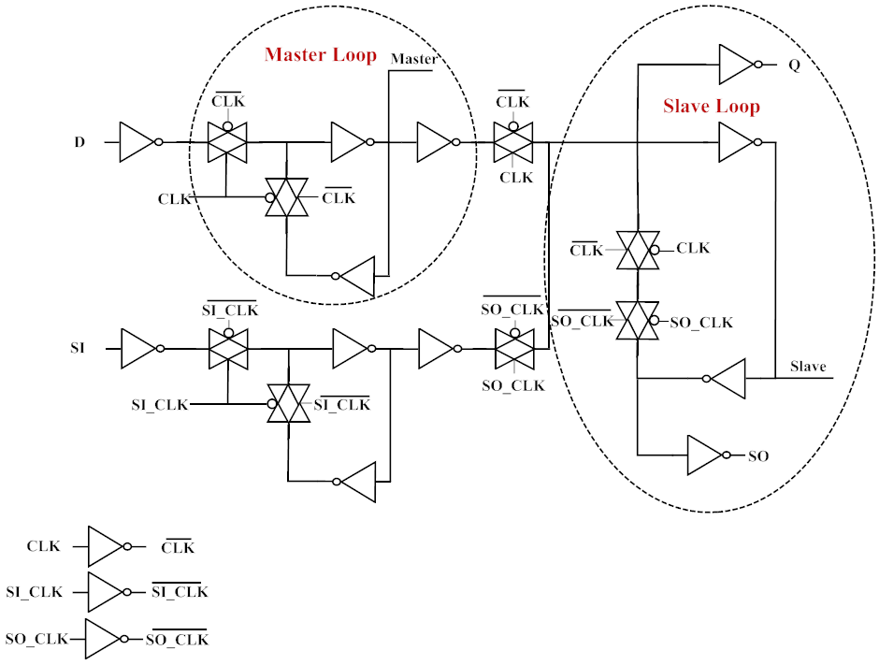
A Data Flip-Flop with Scan Chain
Courtesy of Ian Jones
13
Notes:
13

Slide 14


Gain-Bandwidth Product and τ
Gain-Bandwidth Product and τ are inversely proportional
This relation is used to size the devices in the regenerative loops
Through use of a small signal analysis, a near-optimum size for loop devices can be easily determined. This method gives engineers a good method to design a high-quality synchronizer.
14
Notes:
14

Slide 15
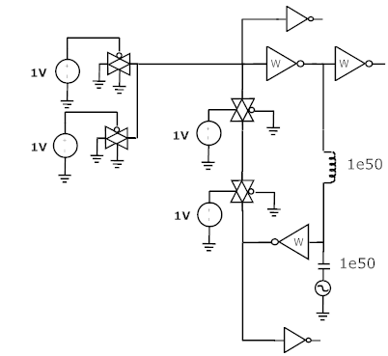
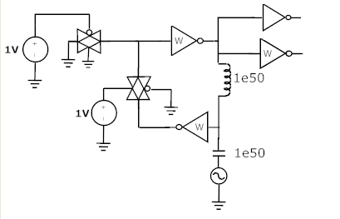
AC Analysis Used to Size FETs in Master/Slave Loops
Master Slave
15
Notes:
15

Slide 16
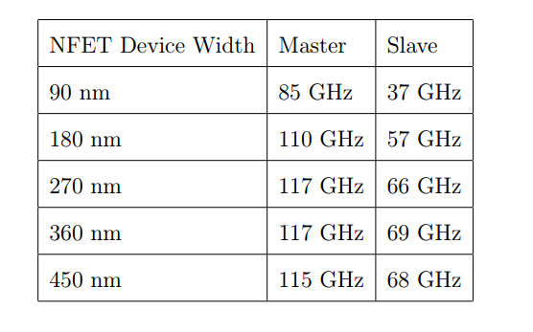
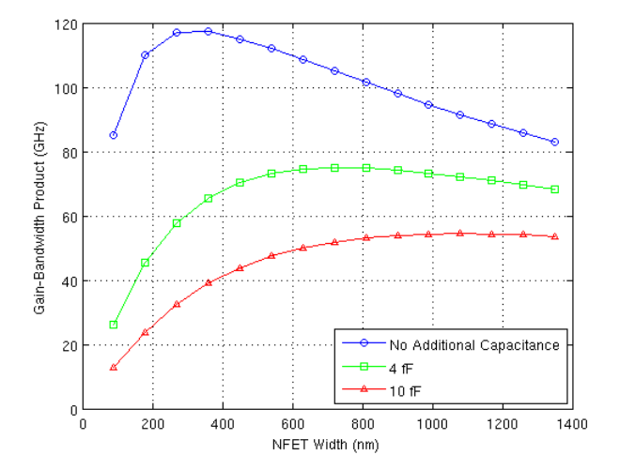
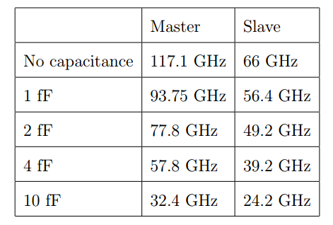
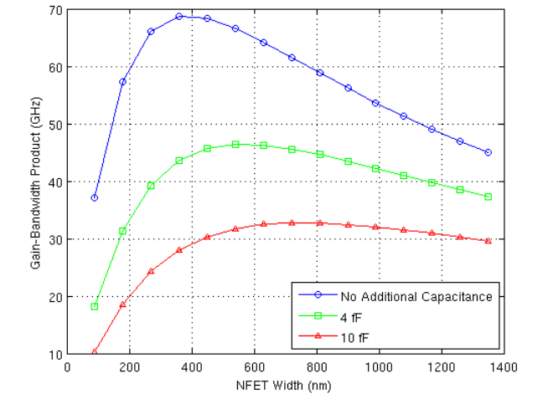
GBW as a function of Device width
Master Loop
Slave Loop
16
Notes:
16

Slide 17
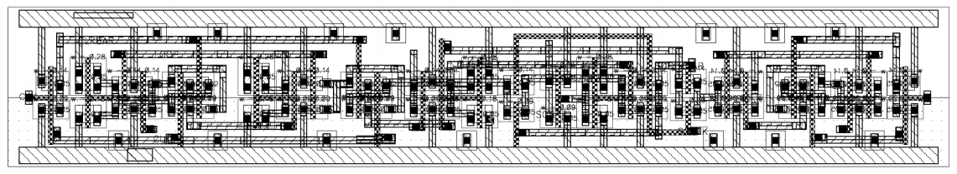
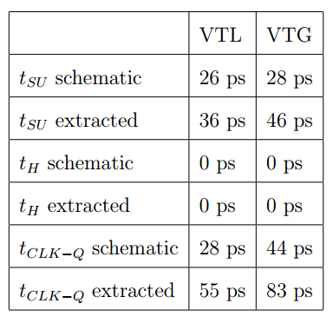
Physical Layout and Design Performance
Area 1.63 μm x 9.6 μm or 15.65 μm²
17
Notes:
17

Slide 18
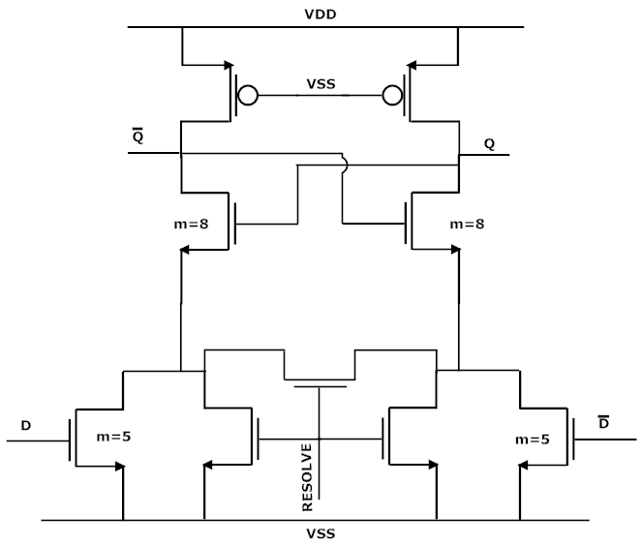
Design of a Specialized Synchronizer
In order to show that the analytical methods presented are robust and transcend topology, a radically different synchronizer cell was chosen to develop results for comparison
A design based upon a pseudo-NMOS latch and a patent held by Oracle® was chosen
The flip-flop was designed specifically to be used as a synchronizer circuit. It has less capacitance on the critical nodes and a reduced sensitivity to V_{m}
18
Notes:
18

Slide 19
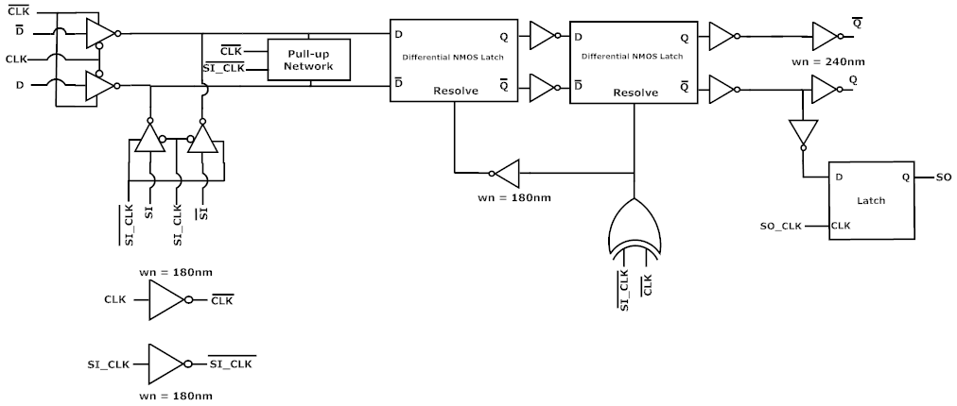
A Specialized Synchronizer Cell
Patent held by Oracle
19
Notes:
19

Slide 20


Introduction to Formal Sensitivity Analysis
Designers need a method that accurately predicts variations in outputs based upon input parameters
The sensitivity of a function is formally defined as
Once the sensitivity factor is known, the relative change of a function based upon a given parameter can be computed as
20
Notes:
20

Slide 21



Sensitivity Equations
First, the circuit function τ must be defined
For the strongly inverted with FET this computes to
For the weakly inverted FET this computes to
21
Notes:
21

Slide 22


Sensitivity Equations (continued)
For a strongly inverted FET the equations can be simplified based upon high field effects :
  if (low field) then
  if (high field) then
With a defined circuit function we will now explore sensitivity to the following:
  Supply voltage (VDD)
  Threshold voltage
  Temperature
22
Notes:
22

Slide 23



Sensitivity Equations for Supply Voltage
For the supply voltage, we compute sensitivity of τ to V_{m} using the numerator denominator analysis to get
If high field affects are negligible
Under the assumption that V_{m} is ½ of the supply voltage
For weak inversion, using the same methods :
23
Notes:
23
Edit

Slide 24


Sensitivity Equations for Threshold Voltage
We start under the assumption of strong inversion and that V_{m} is half of the supply voltage and get the following result
If the device is weakly inverted
24
Notes:
24

Slide 25



Sensitivity Equations for Temperature
Temperature variation is a bit more complicated as it depends on the following factors
  Mobility
  Threshold voltage
k₁ and k₂ are fitting parameters found to be -2.5 and -0.2 mV/C
The equation for a strongly inverted FET is
The equation for a weakly inverted FET is
25
Notes:
25
Put k1 and k2 values from thesis in here, not range. Omit chain rule stuff.

Slide 26
PVT Tolerant Synchronizer Design
From the equations developed through formal sensitivity analysis the following recommendations can be made for a PVT variation tolerant design:
  Use the largest supply voltage possible
  Use the lowest threshold devices available in the regenerative loop
  Use minimum length FETs in the loops since high-field effects reduce sensitivity
  Use transistor widths no wider than necessary since wider devices can force the FETs out of strong inversion
  Choose a synchronizer topology with metastable voltages that are insensitive to supply voltage changes.
26
Notes:
26

Slide 27



Prediction of τ from a Known Value
Through the sensitivity equations developed, it is possible to estimate values of τ in the presence of PVT variation. The sensitivity equation can predict the change.
Using this equation, we can predict the new value of τ
This can easily be programmed as a recurrence equation
27
Notes:
27

Slide 28
MetaACE: A Tool for the Study of Synchronizer Performance (Courtesy of Blendics)
The first commercial product able to simulate synchronizer failure events due to metastability
Able to predict circuit behavior across variations of process parameters, supply voltages, and operating temperatures
Allows a designer to identify circuits that may exhibit synchronizer failures and give an estimate of mean-time between-failures (MTBF)
This tool will be used to compare results developed from formal sensitivity analysis
28
Notes:
28

Slide 29
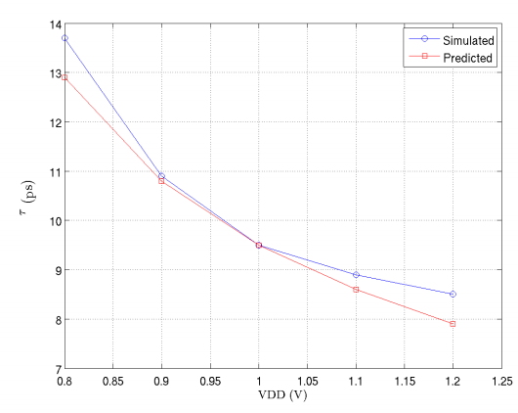
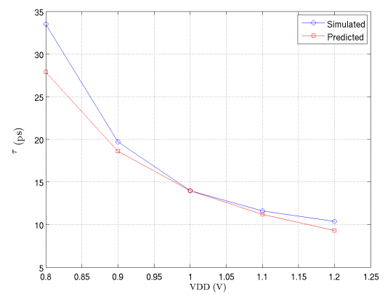
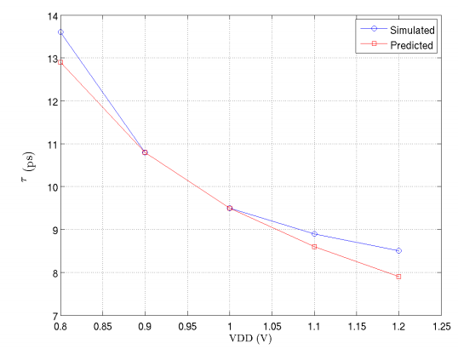
Sensitivity of τ to Supply Voltage (Simple Data Flip-Flop)
VTL VTG VTG/VTL
Master loop devices
Correlation Coefficients
  VTL : R² = 0.986, RMS error = 0.5 ps
  VTG : R² = 0.986, RMS error = 2.6 ps
  VTG/VTL : R² = 0.986, RMS error = 0.5 ps
29
Notes:
29

Slide 30
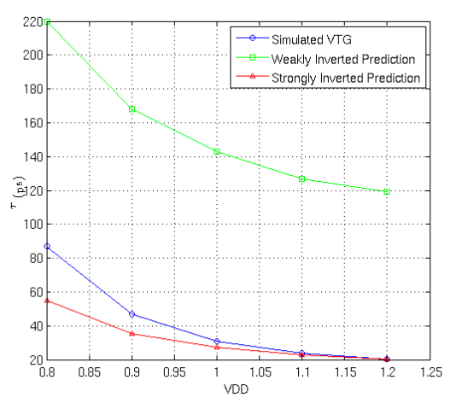
Sensitivity of τ to Threshold Voltage (Simple Data Flip-Flop)
Analysis uses VTL devices and predicts τ for VTG devices
Results diverge at low supplies due to moderate inversion
Weak and Strong inversion predictions provide bounds
                - Strong Inversion Curve
                R² = 0.998
                RMS error = 15 ps
                - Weak Inversion Curve
                R² = 0.989
                RMS error = 114 ps
30
Notes:
30

Slide 31
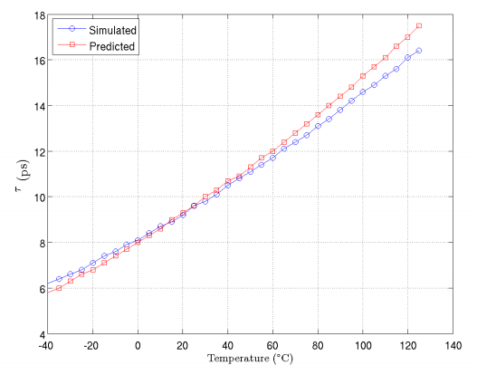
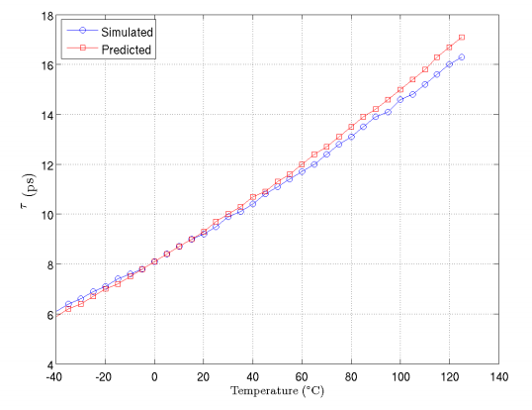
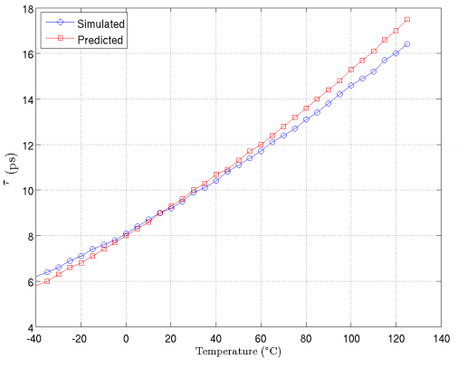
Sensitivity of τ to Temperature (Simple Data Flip-Flop)
VTL VTG VTG/VTL
Values are simulated and predicted over the automotive temperature range : -40 ºC to 125 ºC
Correlation coefficients
  VTL : R² = 0.996, RMS error = 0.5 ps
  VTG : R² = 0.996, RMS error = 0.4 ps
  VTG/VTL : R² = 0.998, RMS error = 0.5 ps
31
Notes:
31

Slide 32


Modifications to the Sensitivity Analysis
The previously developed sensitivity equations make the assumption that V_{m} is precisely half of the supply voltage
This specialized cell has the benefit of having a reduced sensitivity of Vm to the supply voltage, so a modification to the sensitivity factor must be made
Analyzing the circuit, the equation for V_{m} can be found as
Using this result, the new sensitivity factor (neglecting high field effects) is
32
Notes:
32

Slide 33
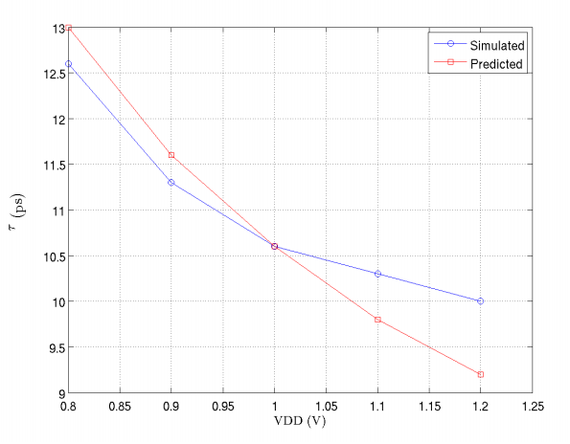
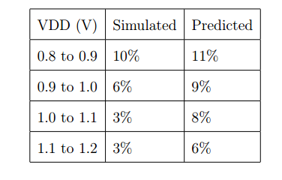
Sensitivity of τ to Supply Voltage (Specialized Cell)
R²= 0.97
RMS error = 0.5 ps
Maximum Error = 8%
33
Notes:
33

Slide 34
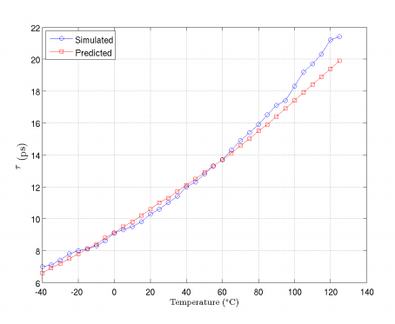
Sensitivity of τ to Temperature (Specialized Cell)
R²= 0.992
RMS error = 0.7 ps
Maximum error = 9%
34
Notes:
34

Slide 35
Summary
A design methodology for producing high quality synchronizer designs was presented. The method uses an AC analysis to optimize the GBW of the cascaded inverters in the critical regenerative loops.
A formal sensitivity analysis was performed to predict how changes in process, supply voltage, and operating temperature affect the performance of a data synchronizer.
The results of the analysis was then used in an iterative manner to predict changes in synchronizer performance over, for example, a wide range of operating temperatures and supply voltages, saving reliability engineers valuable time
The predictions agreed with simulation with startling accuracy!
Recommendations for PVT-tolerant synchronizer designs were presented.
35
Notes:
35

Slide 36
Future Work
There is still plenty of work that can be done
  Simulation at corner cases
  Unify the weak and strong inversion results
  Fix the issues in the extracted version of the specialized synchronizer cell
  Use a manufacturable process and do real world tests
36
Notes:
36

Slide 37
Acknowledgements
NSF Grant # 0924010 “Blended Clocked and Clockless integrated Circuit systems” SIUE
Blendics
Ian Jones at Oracle
Dr. Jerry Cox
Dr. George Engel
Dave Zar
The entire ECE faculty and staff of SIUE
My family and friends for supporting me in my studies and academic pursuits
37
Notes:
37

Slide 38
Questions?
?

Slide 39

Formal Sensitivity Analysis (continued)
If a function is composed of multiple parameters, the total change of can be computed as
It is also possible to show that a function f has a parameter y which in turn depends on a parameter x, the sensitivity to x can be computed as
And if a function is rational, then the sensitivity can be computed as the difference of the sensitivity of the numerator and the sensitivity of the denominator
39
Notes:
39
Pitch maybe

Slide 40
Summary of Results for the Public Synchronizer
Using small-signal analyis to optimize GBW optimization, a decent synchronizer was developed.
Layout showed a factor of two performance decrease in comparison to a simple data flip-flop
Using only basic information from the loop devices, and a value of τ from MetaACE, values at different operating points could be predicted with incredible accuracy
Noticeable deviations occur at low supplies due to entering moderate inversion
Master and Slave loop τ’s differ significantly due to extra capacitance present in the slave loop. This means that the design will never be as good as it could possibly be.
40
Notes:
40

Slide 41
Design of a Simple Flip-Flop as a Synchronizer
The first design in this thesis was suggested Ian Jones of Oracle®
This circuit was chosen as the first circuit for verification of the sensitivity analysis due to its simplicity
This design is general enough that almost every standard cell libraries will have some type of version of this flip-flop
In order to accurately model a circuit one might see in an IC, a scan chain is added to make representative of a real design.
This flip-flop is meant to be considered as the public synchronizer due to its proliferation in standard cell libraries. Designers without access to special synchronizer cells will use a design identical or similar to this one, and thus need a circuit which has pre-defined metastability characteristics
41
Notes:
41

Slide 42
Design Sizing and GBW
The same method to size the previous design is applied to the specialized synchronizer cell
Unlike the previous design,
The patent suggests NFETs in the loop be sized at 8x minimum width, and the analysis used follows
The GBW of the loops in Ian’s circuit is 41% larger than that of the public synchronizer
The Pull-up PFETs are set to minimum size to reduce capacitance on the node
The input devices were sized by steadily increasing the width until no benefit was seen in CLK-Q delay
42
Notes:
42

