Slide 1


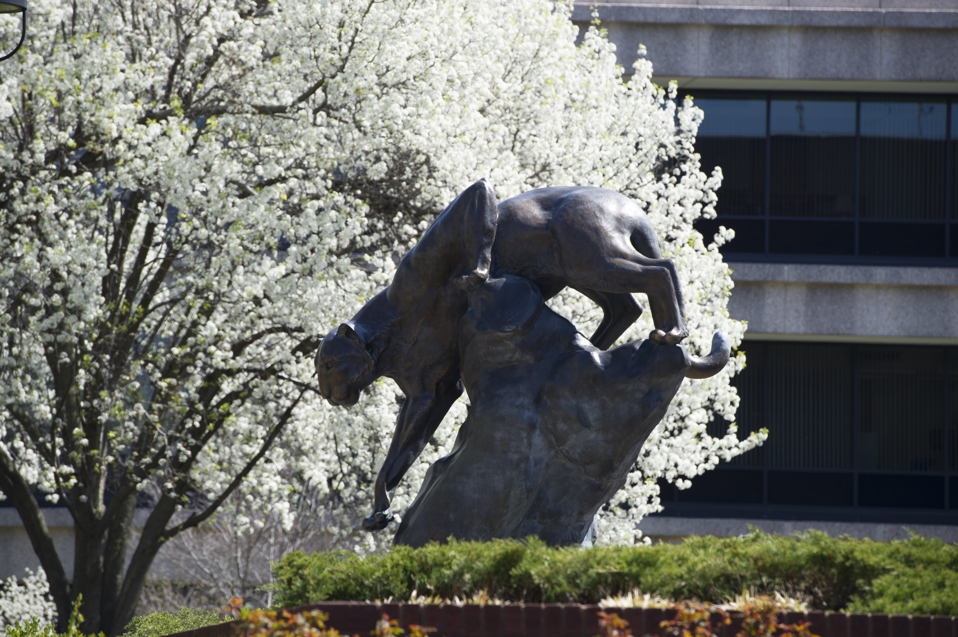

LinkedIn Workshop
Conor Johsnon, MS E.D Career Counselor

Slide 2

LinkedIn

Slide 3
What is LinkedIn
What is LinkedIn?
Online platform where professionals can update information about their careers and network with other professionals or potential employers.
How can LinkedIn help?
Connect with professionals including alumni, fellow academics, industry professionals, and future employers
Promote yourself, your organization, and your professional accomplishments

Slide 4
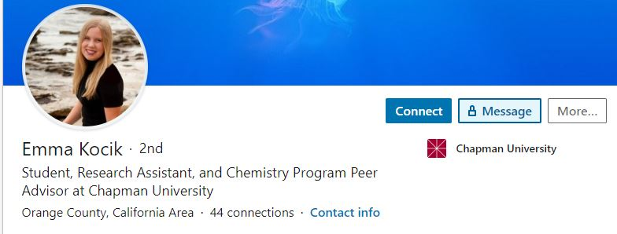
LinkedIn Bio and Headline
PHOTO:
Add a professional looking profile photo. Profiles with pictures are 7X more likely to be searched. Add your city/zip code so recruiters can find you.
HEADLINE:
Stand out with a keyword-rich headline that describes how you want to be known on LinkedIn.
URL:
Customize your URL & put on your resume & email signature
https://blogs.chapman.edu/scst/2020/06/02/linkedin-profile-tips-for-stem-students/

Slide 5
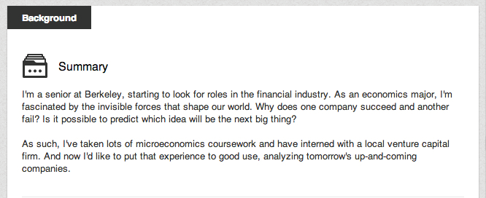
Summary
Use the summary to tell a clear, human story about who you are today — your career arc, values, and what you enjoy contributing
Highlight the experience, strengths, and interests you want people to notice first, keeping the tone warm and forward‑looking
Add some personality here, not too long!

Slide 6
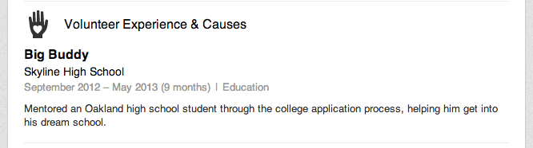
Experience
Summarize your most meaningful professional roles with a focus on impact, leadership, and the results you helped create
Include volunteer or community experience that demonstrates your values, skills, and continued engagement beyond traditional employment

Slide 7
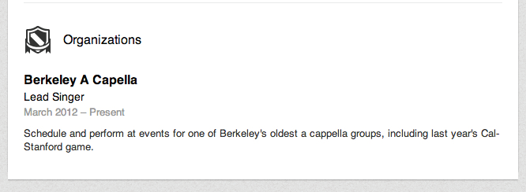
Organization
Be sure to describe what you did with each organization and if you had a leadership role
This is where you can list SUAA

Slide 8
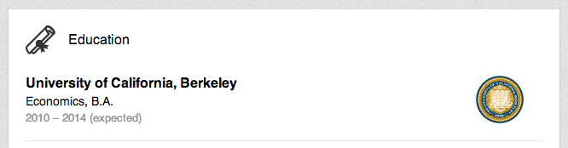
Education
Starting with college, list all the education experiences you’ve had – including summer programs and study abroad opportunities.

Slide 9
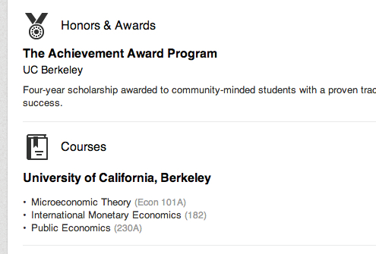
Honors/Awards
Showcase meaningful recognitions from your career or community that reflect excellence, leadership, or long‑term contribution
Include awards with context (why it mattered, who granted it, and the impact it represents) to reinforce your professional reputation

Slide 10
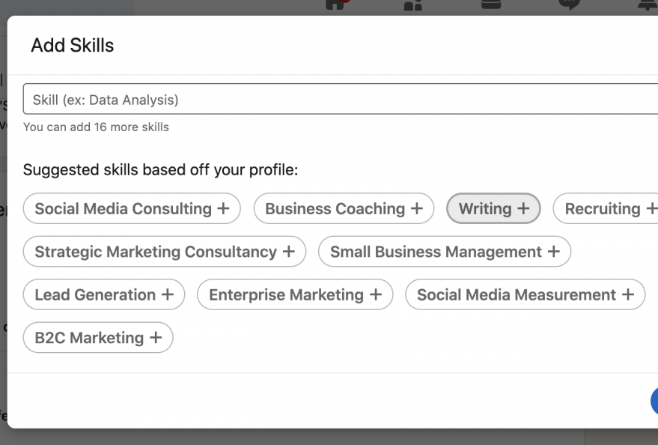
Skills
Focus on skills that reflect your strongest expertise today — especially those you still enjoy using or want to be sought out for
Prioritize abilities demonstrated through real experience (leadership, technical, interpersonal) rather than long lists of outdated or rarely used skills
5-10 skills

Slide 11
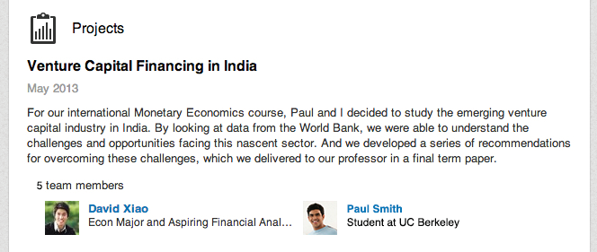
Projects
Highlight major career achievements or legacy projects that demonstrate long-term impact
Choose projects that reinforce the expertise or reputation you want to be known for today
Include cross-functional, community, or post‑retirement initiatives that reflect ongoing contribution

Slide 12

Posting on LinkedIn
Post content related to your career/organization
High quality & relevant industry conversation starters
Post upcoming events and deadlines
Repost organizational events
Comment!​

Slide 13

Final Tips!
Add a background photo​
Add connections in your field ​
Add at least 30 skills​
Follow influencers in your field ​
Keep active

Slide 14
Questions?
Conor Johnson
conojoh@siue.edu
siue.edu/cdc

