Slide 1

Cougar Cupboard Volunteer Training
Lealia Williams

Slide 2
Welcome
This is the volunteer training for the Cougar Cupboard. Everyone who volunteers in the cupboard must take this course prior to their first shift. Thanks for volunteering at the Cougar Cupboard!

Slide 3
Introduction
What is the Cougar Cupboard?
The Cougar Cupboard is run entirely on donations, and is open to active students, faculty and staff. The university wants the campus community and students to be entirely focused on achieving academic achievement, not on finding food or other essential hygienic items.
Location: The Cougar Cupboard is located in the Lower Level of the MUC in Room 0012.
Cougar Cupboard Website:
Email: cougarcupboard@siue.edu
Instagram: @siuecougarcupboard

Slide 4
Cougar Cupboard Expectations
Treat staff and fellow students with respect.
Service is on a first-come, first-served basis.
Saving spots in line is not allowed.
Available stock depends on donations.
Take only what you need.

Slide 5
Cougar Cupboard Expectations continued
Refrain from derogatory language and cursing.
Do not engage in verbal or physical aggression of any kind.
No alcohol or drugs should ever be brought onto or used on the premises.
Follow requests of staff members
Be kind to one another.
Respect the specific rules of activities and areas (food pantry, fresh food giveaways, clothing etc.)

Slide 6
Cougar Cupboard Expectations Continued
Please bring water only in bottles with closed tops. If water is spilled, it must be cleaned up immediately.
While volunteering at the Cupboard please refrain from eating. We ask that you eat before or after your shift.
Do not invite friends to the Cupboard unless they are volunteering or shopping.

Slide 7
What will you be doing at the Cougar Cupboard
When you arrive to your shift- Scan the QR code at the front desk to clock into your shift
During your time volunteering your job will include:
Letting clients into the cupboard and checking them out once they have finished shopping
Restocking items on the shelves, ensuring enough for each hour the cupboard is open (Some items may be requested that are not in stock for the day if supplies are running low)
Tasks such as writing the month and year on the top of the food can products, going to the storage room to grab low in stock items, or bundling mass products into a smaller kit
IMPORTANT!
If your shift ends when the cupboard closes, lock the door (automatic when shut) and turn the lights off before leaving the cupboard.

Slide 8
NOTE
Note: If a volunteer comes to work smelling of marijuana or alcohol, it can pose a safety concern and be a hygiene issue, especially when working around food. The volunteer will be asked to leave.
As far as the law- SIUE has policy stating no marijuana use on campus so it is at the discretion of the Cougar Cupboard director to not allow one to work if they feel they are under the influence of alcohol or marijuana.

Slide 9
Cupboard Hours for the Fall 2024
Hours available to Shop:
Monday 11:00am-2:00 pm
Tuesday CLOSED
Wednesday 11:00am-2:00 pm
Thursday 3:00 pm-6:00 pm
Friday 11:00 am- 2:00 pm
Hours available to Volunteer:
Monday 11:00 am-2:00 pm
Tuesday CLOSED
Wednesday 11:00 am - 2:00 pm
Thursday 3:00 pm- 6:00 pm
Friday 11:00 am- 2:00 pm

Slide 10
Instructions
We do not accept non-perisable food ( cheese, eggs, fresh fruit, vegetables, homemade baked goods, refrigerated milk, and expired or opened food.
We accept unopened nonperiashiable goods for example ( rice, canned goods, pasta sauce, pasta, beans, applesauce, toothpaste, peanut butter, trash bags, detergent pods).
Four clients can shop at one time.
Marketing photos (please take pictures of items that are donated)
Please contact the Cougar Cupboard or Lealia if you are not able to make your shift ( please let me know at least an hour before your shift). Call 618-650-2020.
If you miss more than 1 shift and/or are late without communication, you will be at risk of not being able to volunteer at the Cougar Cupboard.

Slide 11
Confidentiality: A Quick Overview
Confidentiality is super important to the program and to clients in order to create dignified and safe space for clients in need. Some of what you should NOT be doing include
1. Talk about who you see shopping in the cupboard.
2. Share any personal information
3. Review files
4. Make copies of data or personal information
5. Remove confidential information
6. Identify a client outside the cupboard
If you oversee any of these happening, please inform the supervisor immediately! If you have any questions regarding the confidentiality agreement or what it means before signing it, email cougarcupboard@siue.edu

Slide 12
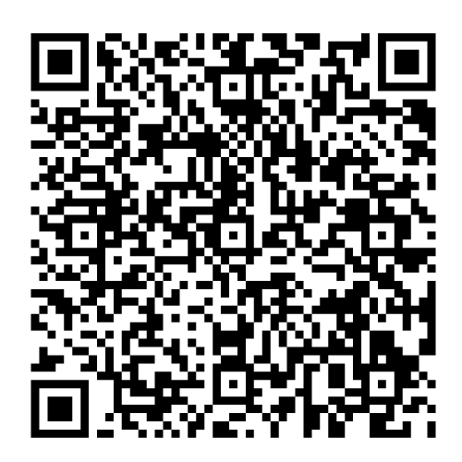
Confidentiality Agreement
Before working in the Cougar Cupboard, you must sign the confidentiality agreement. This agreement can be found here:
If you would prefer a printout copy, please email cougarcupboard@siue.edu

Slide 13
Student requirements:
1. Communicate with us 24 hours before any event for which you are going to be absent or late.
2. Please be on time and do not leave early (unless agreed upon with the Site Leader prior to arrival to the site).
3. Do not violate any university conduct policies or agency site policies.

Slide 14
Attendance Agreement Policy
Important: The Community Engagement Team has the right to refuse access to the service experiences it sponsors.*
Below outlines the Community Engagement Attendance Agreement Policy. If a student has violated these policies twice within either the Spring or Fall semester (both occurrences falling within one semester) the Supervisor reserves the right to block any future attempts by the student to volunteer for Cougar Cupboard shifts, as it will have been determined it is a detriment to the program. When the semester’s restart January 1st and/or August 1st the student may again start to engage in volunteer opportunities in the Cupboard once again.
You are allowed 1 no call/no show before being banned from volunteering. If you know you will be unable to make it to your shift, please contact us 24 hours beforehand.

Slide 15
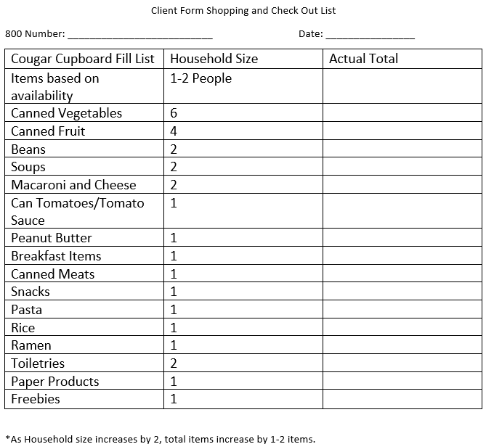
Client Form Shopping & Check Out List
Here is the form that the client will use for shopping.

Slide 16
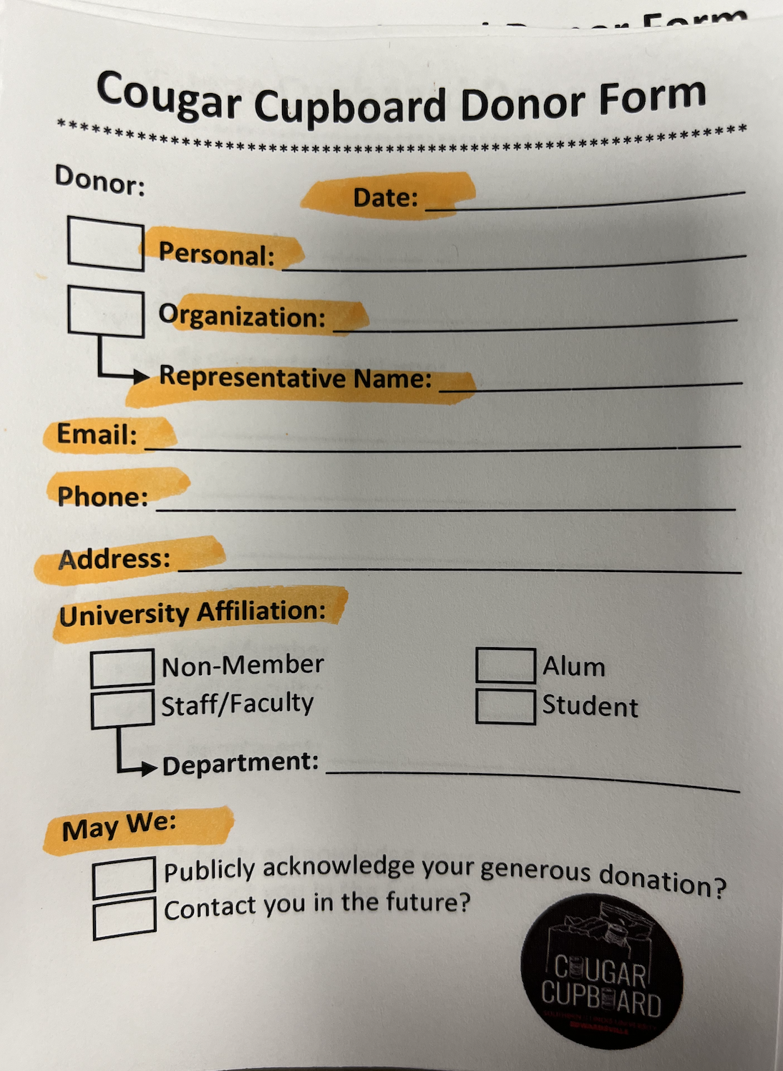
Cougar Cupboard Donor Form
Here is the form to fill out when someone brings a donation. Take a picture of the donated items and ask if you can take a picture of the donor with their items.

Slide 17
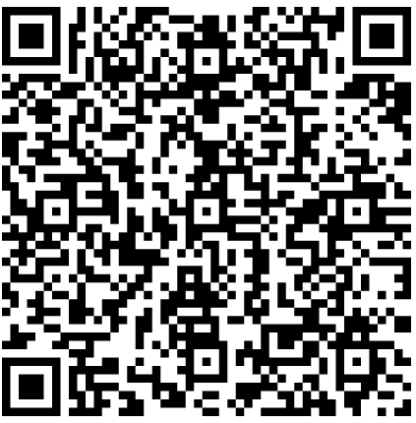
Quiz
Link is here

Slide 18
Wrap Up
Thanks for completing the training if you have any questions about the Cougar Cupboard, please email me : leawill@siue.edu

Slide 19
Next Steps to Volunteer
1.Sign your confidentiality agreement
2. Sign up for volunteer shifts through Sign Up Genius here
3. Read your monthly emails! Also watch for additional emails for special volunteer opportunities (food drives, large donations, etc.)
4. Show up to your shift on time and ask for the day's assignment

Slide 20
Congratulations! You completed Volunteer Training !

