Slide 1
SOUTHERN ILLINOIS UNIVERSITY EDWARDSVILLE · OFFICE OF THE PROVOST
CourseDog
Introductory Training
Reviewing curriculum proposals — for chairs and deans
Transitioning from CurricUNET to CourseDog
Target go-live: September 8, 2026

Slide 2





TODAY’S SESSION
What we’ll cover
Why CourseDog
For approvers
What’s changing — and what stays the same
How to review, vote, and route proposals
Getting started
Best Practices
Logging in and finding your way around
How to make curriculum management work for you
Approval routing
Help & practice
How proposals move through SIUE governance
Where to get support and practice safely
SIUE · CourseDog Approvers Training
1

Slide 3
WHY COURSEDOG
The how changes, not the what
CourseDog replaces CurricUNET as SIUE’s system of record for curriculum proposals, approvals, catalog, and program tracking. Our governance does not change — the same approvals, committees, and standards still apply.
Stays the same
What changes
What you gain
Approval steps & committees
Academic standards & policy
Your role in the process
The system you log into
Paper/PDF forms → online proposals
Where you go to act on items
Real-time status at a glance
No re-keying — SIS integration
One searchable proposal archive
SIUE · CourseDog Approvers Training
2

Slide 4
TRANSITION
Where we are, and what’s ahead
May 15, 2026
Summer 2026
Sept 8, 2026
Ongoing
CurricUNET stops accepting new proposals
Data migrated · pilot with Pharmacy & Forensic Sciences MS
Go-live — CourseDog becomes the system of record
Office hours, sandbox practice, and reinforcement
Proposals already in CurricUNET are preserved and administratively transferred into CourseDog for continued review.
SIUE · CourseDog Approvers Training
3

Slide 5
SAME IDEA, NEW NAME
From CurricUNET to CourseDog
You used to say… | In CourseDog it’s…
Launch a proposal | + New Proposal
Originator | Created By / Proposer
Form (90A, 91A, …) | Proposal type (New Course, Edit Program… Form names are still there!)
Your approval queue | “Vote Required”
Approval step / approver | Workflow step / approver
Routing sheet | Workflow
SIUE · CourseDog Approvers Training
4

Slide 6
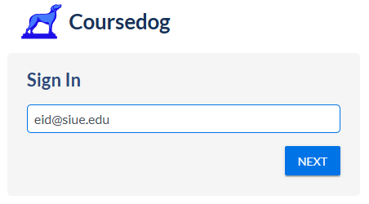
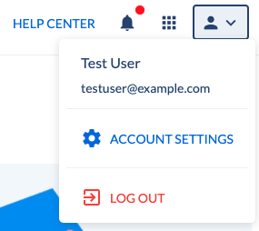
GETTING STARTED
Logging in
Logging in
Go to app.coursedog.com (Chrome recommended) – Please do not practice here!
You’re redirected to SIUE single sign-on
Sign in with your SIUE e-ID and password
Account Settings
User-specific Default Views
Email Notification Preferences
  Daily Digest - recommended
  Immediate
SIUE · CourseDog Approvers Training
5

Slide 7
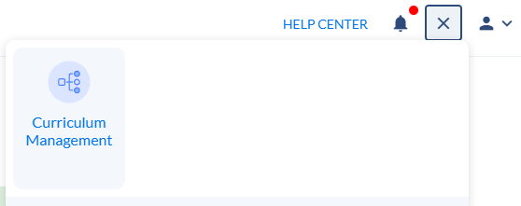
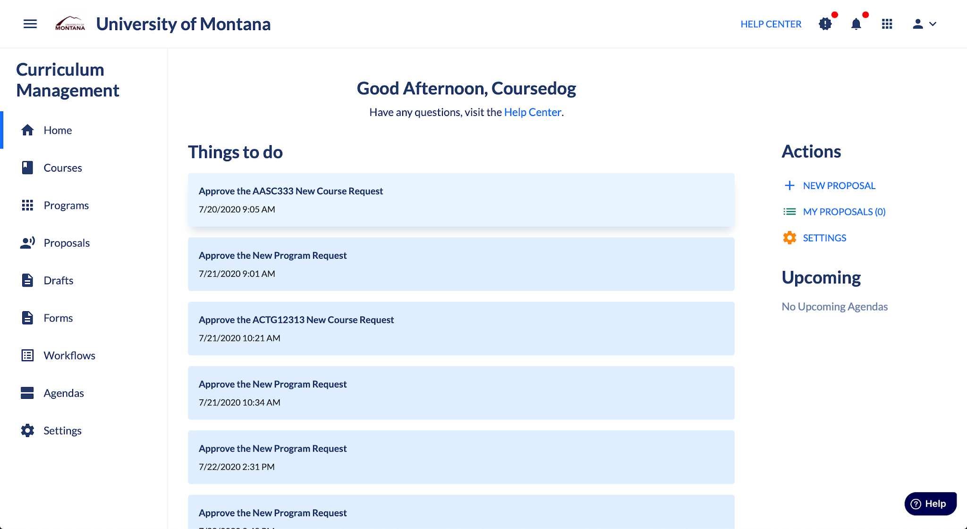
GETTING STARTED
Finding your way
Product Launcher
If you’re brought to the Product Tiles landing page, select “Curriculum Management”.
Otherwise, click the Product Launchpad dot grid in the top right and navigate to Curriculum Management.
More products to come!
Homepage & Menu
User-specific Default Views
Email Notification Preferences
  Daily Digest - recommended
  Immediate
SIUE · CourseDog Approvers Training
6

Slide 8
For approvers
Evaluate proposals, record a decision, and keep curriculum moving

Slide 9
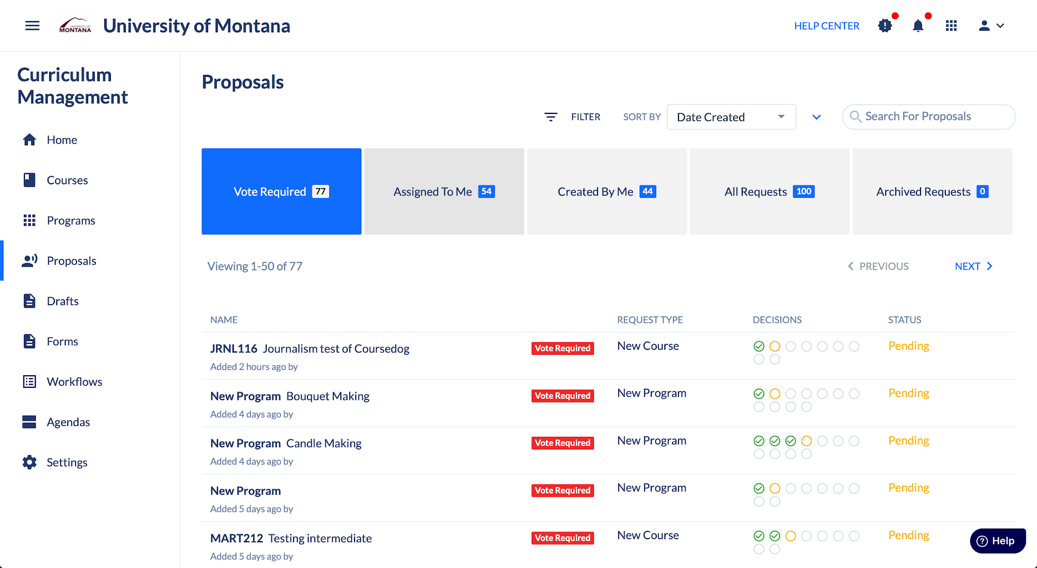
FOR APPROVERS
Your dashboard: where to act
Viewing Proposals
The Proposals Dashboard will show you the proposals that are most important:
Vote Required: proposals are at your workflow step & awaiting votes
Assigned to Me: proposals are in-flight, but not at your workflow step yet
Created by Me: proposals that you have submitted
All Requests & Archived Requests: all proposals in Coursedog
You can filter & customize your dashboard views further:
Apply filters based on the proposal type, status, etc.
Customize the columns in the dashboard to see critical information at a glance
Save Views to reuse later, or to make your personal Default View in your Account Settings
Dashboard Views
SIUE · CourseDog Approvers Training
7

Slide 10
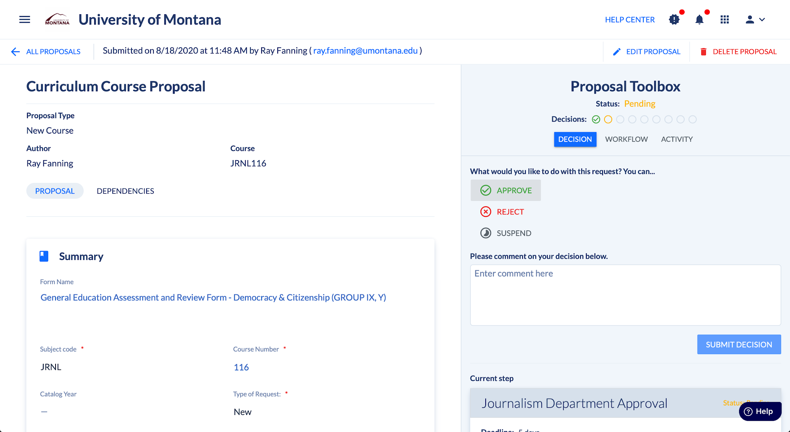
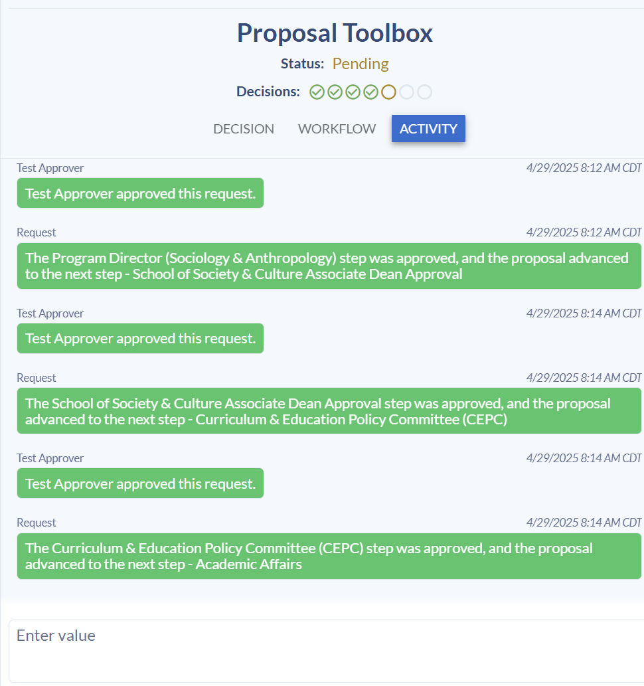
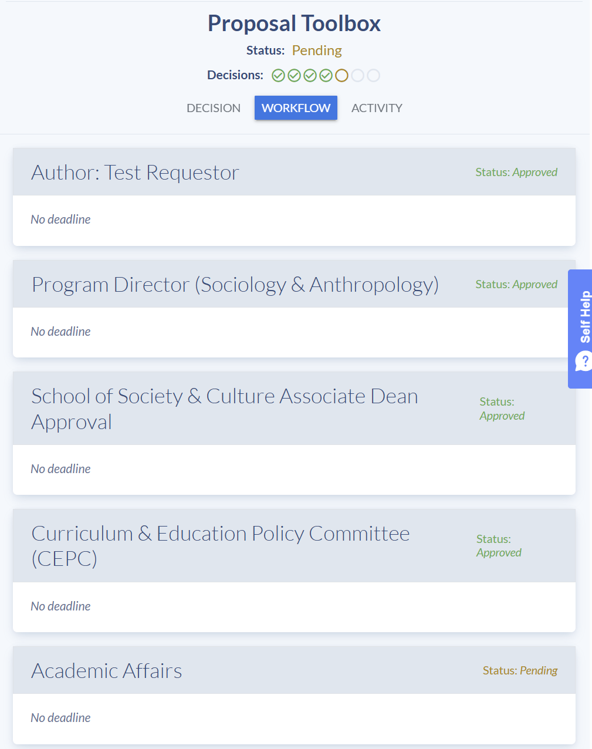
FOR APPROVERS
Review, then decide
Review
Open from Vote Required → Proposal Toolbox appears
Read the rationale and attachments
Take Action
  Approve/Reject and add a comment
  Route back to an earlier step for fixable issues
  Download a PDF for committee records
When viewing a Proposal, you can review & take action as needed:
Review the proposal information on the left
Make decisions on the proposal - Approve, Reject, Route Back, or make other custom decisions. Include comments with your vote
Review the proposal’s workflow path
View the proposal’s Activity Log, and make non-voting comments for others to see.
Proposal Toolbox
SIUE · CourseDog Introductory Training
8

Slide 11
GOVERNANCE
How approval routing works
CourseDog mirrors SIUE’s existing approval path as automated workflow steps. A graduate program change (Form 91A) routes:
Department Chair
→
School Curriculum Committee
→
Dean’s Office
→
Provost — initial review
→
1
2
3
4
Graduate Programs Committee
→
Graduate Council
→
Provost — Chancellor approval
→
SIU System / IBHE (as applicable)
5
6
7
8
You have 2 weeks to review items in your queue before they auto-advance!
SIUE · CourseDog Approvers Training
9

Slide 12
Best Practices
✓ WHAT TO LOOK FOR IN A PROPOSAL Before approving, confirm the proposal includes: Clear justification — a rationale that explains the need for change and its curricular impact Defined learning objectives — measurable, and aligned with the course level and program outcomes Consistency across the form — prerequisites, credit hours, and course numbers match throughout Letter of support from affected units — required whenever the proposal impacts another department's courses, prerequisites, or curriculum In addition, confirm course proposals include: Complete, accurate syllabus — matches the proposed course/catalog description, credit hours, and format Accurate catalog description — reflects the course as it will actually be taught
Check your queue on a schedule
Know your deadline – 2 week auto-advance
Assign a designee before you need one
Review & Take Action – your feedback matters
Bring questions to us before go-live on September 8
Questions? Pat Sears · psears@siue.edu | Ma Zenia Agustin · zagusti@siue.edu

Slide 13
SUPPORT
Getting help and resources
Your SIUE contacts
Self-service resources
CourseDog Support Knowledge Base
Curriculum End User Guide (ideal pre-reading)
Short product demo videos
Pat Sears
Registrar — rollout, workflow, access & roles
psears@siue.edu · 618-650-3243
Ma Zenia Agustin
Curriculum forms — proposal content & form questions
zagusti@siue.edu · 618-650-2357
Practice in the sandbox
Access the sandbox at https://staging.coursedog.com/#/cm/home
Use this to practice preparing and modifying
SIUE · CourseDog Approvers Training
11

Slide 14
SOUTHERN ILLINOIS UNIVERSITY EDWARDSVILLE · OFFICE OF THE PROVOST
CourseDog
Submitters Training
Launching curriculum proposals — for proposers
Transitioning from CurricUNET to CourseDog
Target go-live: September 8, 2026

Slide 15
TODAY’S SESSION
What we’ll cover
Why CourseDog
Approval routing
What’s changing — and what stays the same
How proposals move through SIUE governance
Getting started
Best Practices
Logging in and finding your way around
How to make curriculum management work for you
For submitters
Help & practice
How to review, vote, and route proposals
Where to get support and practice safely
SIUE · CourseDog Approvers Training
1

Slide 16
WHY COURSEDOG
The how changes, not the what
CourseDog replaces CurricUNET as SIUE’s system of record for curriculum proposals, approvals, catalog, and program tracking. Our governance does not change — the same approvals, committees, and standards still apply.
Stays the same
What changes
What you gain
Approval steps & committees
Academic standards & policy
Your role in the process
The system you log into
Paper/PDF forms → online proposals
Where you go to act on items
Real-time status at a glance
No re-keying — SIS integration
One searchable proposal archive
SIUE · CourseDog Approvers Training
2

Slide 17
SAME IDEA, NEW NAME
From CurricUNET to CourseDog
You used to say… | In CourseDog it’s…
Launch a proposal | + New Proposal
Originator | Created By / Proposer
Form (90A, 91A, …) | Proposal type (New Course, Edit Program… Form names are still there!)
Your approval queue | “Vote Required”
Approval step / approver | Workflow step / approver
Routing sheet | Workflow
SIUE · CourseDog Submitters Training
3

Slide 18
GETTING STARTED
Logging in
Logging in
Go to app.coursedog.com (Chrome recommended) – Please do not practice here!
You’re redirected to SIUE single sign-on
Sign in with your SIUE e-ID and password
Account Settings
User-specific Default Views
Email Notification Preferences
  Daily Digest - recommended
  Immediate
SIUE · CourseDog Submitters Training
4

Slide 19
GETTING STARTED
Finding your way
Product Launcher
If you’re brought to the Product Tiles landing page, select “Curriculum Management”.
Otherwise, click the Product Launchpad dot grid in the top right and navigate to Curriculum Management.
More products to come!
Homepage & Menu
User-specific Default Views
Email Notification Preferences
  Daily Digest - recommended
  Immediate
SIUE · CourseDog Submitters Training
5

Slide 20

For submitters

Slide 21
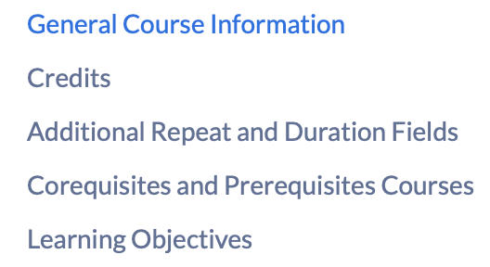
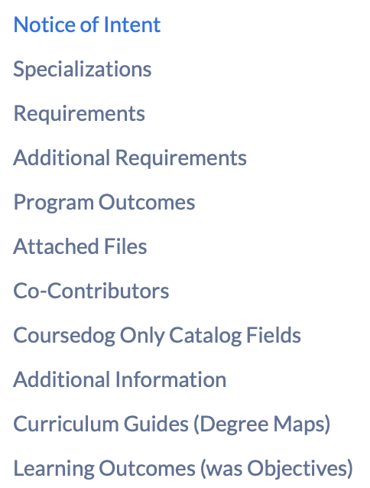
FOR PROPOSERS
Getting Ready
For Course Proposals:
General Course Information
Syllabus, Rationale, etc.
Co/Pre-Requisites
Co-Contributor
Course Description
Learning Objectives
For Program Proposals:
General Program Information
Letters of Support
RME
Co-Contributor
Course Description (and/or Changes)
Degree Map
Learning Outcomes
SIUE · CourseDog Submitters Training
7

Slide 22
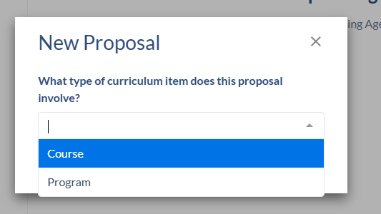
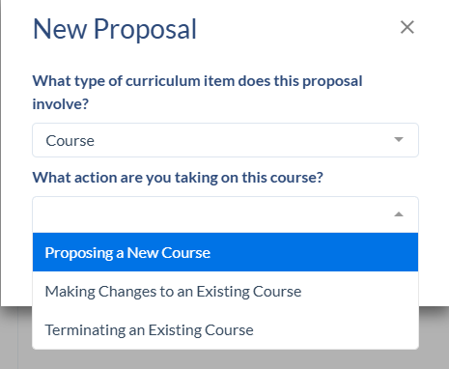
FOR PROPOSERS
Launching a proposal
Start it
Click + New Proposal, or open a course/program and choose Propose Changes.
Fill it out
Complete required fields, write a clear rationale, and attach a syllabus. Work auto-saves to Drafts.
Submit & track
Submit from the Actions toolbar, then watch progress in the Workflow view.
SIUE · CourseDog Submitters Training
7

Slide 23
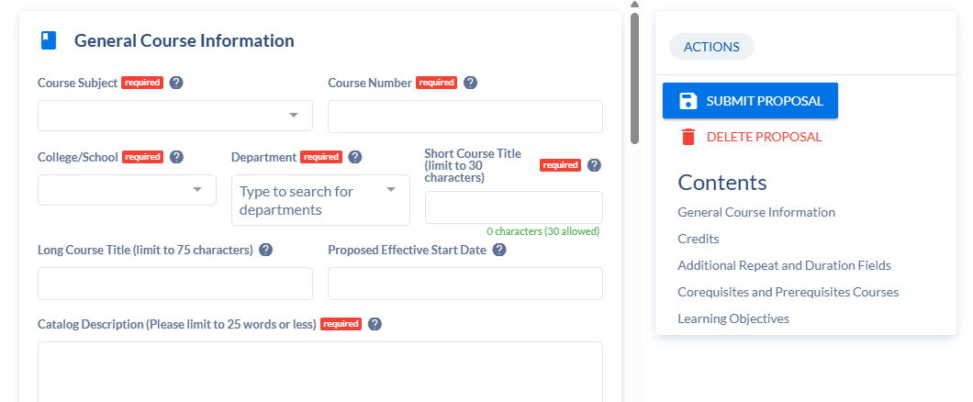
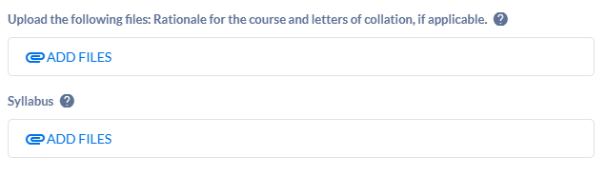
FOR PROPOSERS
Proposal Completion
SIUE · CourseDog Submitters Training
8

Slide 24
FOR PROPOSERS
SIUE forms → CourseDog proposals
Course changes
SIUE form | CourseDog proposal
90A | New Course
90B | Discontinue Course
90C | Change Course
90CEZ | Still on Kuali for now
Program changes
SIUE form | CourseDog proposal
91A | Edit Program
91AEZ | Still on Kuali for now
RME | Must be included as an attachment when relevant
91B | Edit / Discontinue (partial)
91C | Program proposal (moratorium)
92B | Discontinue Program
92A | New Program
IMPORTANTLY: You do not need to know which form you need – it will auto-populate based on what you submit
SIUE · CourseDog Submitters Training
9

Slide 25
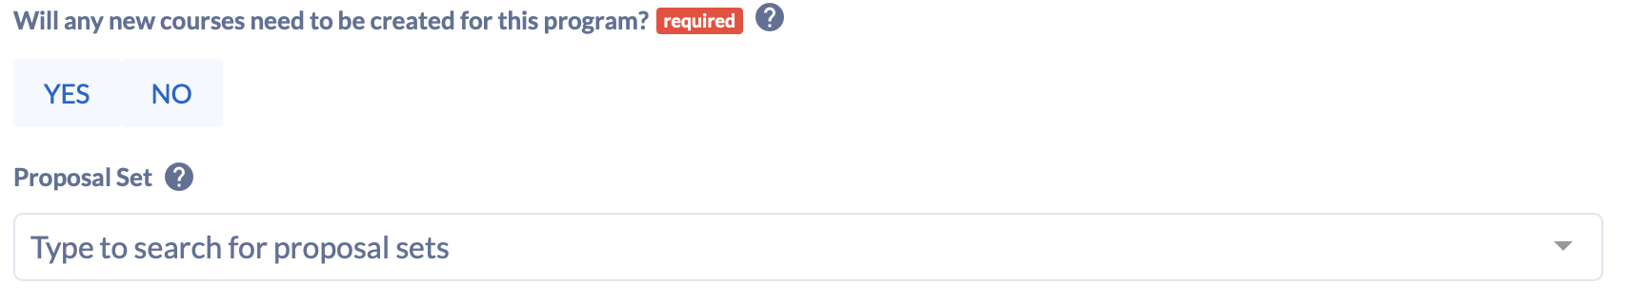
FOR PROPOSERS
Proposal Sets (Bundles)
When making program changes, you can submit all proposals together and link them through Proposal Sets
Recommended: Draft all individual course proposals then initiate program proposal and link them using Proposal Set prompt
Proposal Sets will move through routing together
SIUE · CourseDog Submitters Training
9

Slide 26
Coursedog Demo

Slide 27
GOVERNANCE
How approval routing works
CourseDog mirrors SIUE’s existing approval path as automated workflow steps. A graduate program change (Form 91A) routes:
Department Chair
→
School Curriculum Committee
→
Dean’s Office
→
Provost — initial review
→
1
2
3
4
Graduate Programs Committee
→
Graduate Council
→
Provost — Chancellor approval
→
SIU System / IBHE (as applicable)
5
6
7
8
Each stage has 2 weeks to review items before they auto-advance!
SIUE · CourseDog Approvers Training
10

Slide 28
Best Practices
✓ WHAT A COMPLETE PROPOSAL NEEDS Before you submit, make sure you have: Clear justification — a rationale that explains the need for change and its curricular impact Defined learning objectives — measurable, and aligned with the course level and program outcomes Consistency across the form — prerequisites, credit hours, and course numbers match throughout Letter of support from affected units — required whenever the proposal impacts another department's courses, prerequisites, or curriculum In addition, confirm course proposals include: Complete, accurate syllabus — matches the proposed course/catalog description, credit hours, and format Accurate catalog description — reflects the course as it will actually be taught
Get all your info together, then start a new proposal
Assign a co-contributor
Incomplete proposals cause delays
Track your status
Submit bundles (program + courses)
Questions? Pat Sears · psears@siue.edu | Ma Zenia Agustin · zagusti@siue.edu

Slide 29
SUPPORT
Getting help and resources
Your SIUE contacts
Self-service resources
CourseDog Support Knowledge Base
Curriculum End User Guide (ideal pre-reading)
Short product demo videos
Pat Sears
Registrar — rollout, workflow, access & roles
psears@siue.edu · 618-650-3243
Ma Zenia Agustin
Curriculum forms — proposal content & form questions
zagusti@siue.edu · 618-650-2357
Practice in the sandbox
Access the sandbox at https://staging.coursedog.com/#/cm/home
Use this to practice preparing and modifying
SIUE · CourseDog Approvers Training
11

