Slide 1


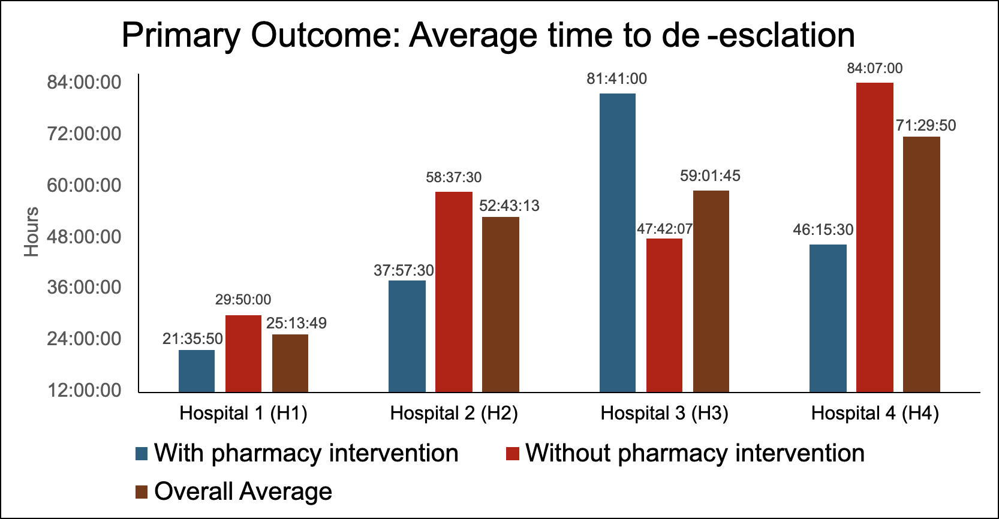
The Impact of the BioFire Blood Culture Identification 2 (BCID2) Panel and Pharmacist-Driven Interventions on Antibiotic De-escalation Across a Health System
Venise Govan, PharmD Candidate ; Jared Sheley, PharmD, BCPS
Background
Results
Conclusions
The timely identification and management of bloodstream infections are critical to improving patient outcomes and promoting antimicrobial stewardship. The BioFire® Blood Culture Identification 2 (BCID2) panel offers rapid organism and resistance gene identification, allowing for earlier optimization of antimicrobial therapy. However, the full clinical value of this technology is best utilized when paired with pharmacist-driven protocols that guide antibiotic de-escalation based on diagnostic results.
Baseline Characteristics
Characteristics |  | Hospital 1 | Hospital 2 | Hospital 3 | Hospital 4
Median age (years) |  | 68 (18-89) | 64 (18-89) | 66 (18-89) | 74 (18-89)
Suspected Infection Source, N (%) | Urinary | 40 (29.6) | 22 (27.8) | 17 (50) | 4 (26.6)
 | Respiratory | 28 (20.7) | 23 (29.1) | 4 (11.7) | 5 (33.3)
 | Skin and soft tissue | 26 (19.3) | 24 (30.4) | 7 (20.6) | 3 (20)
 | Gastrointestinal | 13 (9.6) | 2 (2.5) | 2 (5.8) | 4 (26.6)
 | Other | 28 (20.7) | 8 (10.1) | 4 (11.7) | 3 (30)
Pathogen, N (%) | Gram (+) organisms | 86 (63.7) | 72 (71.2) | 24 (28.6) | 9 (60)
 | Staphylococcus spp. (not aureus) | 40 (29.6) | 21 (20.8) | 8 (9.5) | 2 (13.3)
 | Staphylococcus aureus | 19 (14.1) | 15 (14.8) | 4 (4.8) | 2 (13.3)
 | Methicillin resistance | 26 (30.2) | 14 (13.8) | 2 (2.4) | 0
 | Streptococcus spp. | 8 (5.9) | 11 (10.9) | 4 (4.8) | 3 (30)
 | Enterococcus spp. | 3 (2.2) | 3 (2.9) | 5 (5.9) | 0
 | Micrococcus spp. | 3 (2.2) | 1 (1) | 0 | 1 (0.06)
 | Multiple gram (+) organisms present | 6 (4.4) | 4 (3.9) | 1 (1.2) | 1 (0.06)
 | Other | 7 (5.2) | 3 (2.9) | 3 (3.6) | 1 (0.06)
 | Gram (-) organisms | 47 (34.8) | 29 (28.7) | 20 (23.8) | 6 (40)
 | Pseudomonas aeruginosa | 4 (3.0) | 1 (1) | 1 (1.2) | 1 (0.06)
 | Escherichia Coli | 23 (17.0) | 14 (13.9) | 12 (14.2) | 3 (20)
 | Klebsiella Pneumonia | 4 (3.0) | 5 (4.9) | 1 (1.2) | 2 (13.3)
 | ESBL | 7 (14.9) | 4 (3.9) | 2 (2.4) | 0
 | Yeast | 2 (1.5) | 1 (1) | 1 (1.2) | 0
 | Other | 16 (11.9) | 4 (3.9) | 3 (3.6) | 0
Pharmacist involvement was strongly associated with improved de-escalation timelines, which highlights the critical role of clinical pharmacy services in reducing unnecessary broad-spectrum exposure and maximizing the utilization of the BCID2 panel.
The de-escalation time for H1 showed a 13+ hour difference in comparison to H2, H3, and H4, with a ≥10% increase of pharmacy interventions.
Observed differences between sites indicate an opportunity to refine and standardize pharmacist-led protocols to enhance consistency and maximize the clinical benefit of BCID2.
Objective
To evaluate the impact of implementing BCID2 in conjunction with pharmacist-led interventions across the HSHS health system, with the goal of assessing their combined effect on patient outcomes and stewardship practices in real-world hospital settings.
Discussion
Methods
Limitations:
Smaller institutions usually send more extensive cases to larger institutions, leaving less data to be collected.
Some patients presented with multiple pathogens or multiple suspected infections, which caused increased durations of broad-spectrum therapy.
Next Steps:
Although not directly measured, timely de-escalation may contribute to reduced antimicrobial resistance, shortened lengths of stay, and improved patient outcomes, suggesting areas for future investigation.
Because this analysis includes only four HSHS facilities, expanding data collection to all HSHS sites would provide a more comprehensive assessment of practices across the entire health system.
Study Design
Multi-center, retrospective review from March 1, 2024 – May 31, 2024
Study Population
Adults aged 18-89 hospitalized with positive blood cultures at selected HSHS facilities
Exclusion:
Data Source
Electronic health record reports
Outcomes
Primary- Time to antibiotic de-escalation, defined as the interval between initiation of broad-spectrum antibiotics and the first documented intervention (either order entry or stewardship recommendation) following BCID2 result availability.
Data Analysis
Secondary- Time to targeted therapy, duration of broad-spectrum antibiotic use, and documentation of pharmacist recommendations.
Descriptive statistics
Approved by Southern Illinois Univeristy institutional review board
Inclusion:
Institutions that had not yet implemented the BCID2 panel
Patients that were transferred to another institution during therapy
Patients that transitioned to hospice/comfort measuresduring therapy
Patients who passed away during therapy
References
BIOFIRE® Blood Culture Identification 2 panel. bioMérieux Website. https://www.biomerieux.com/us/en/our-offer/clinical-products/biofire-blood-culture-identification-2-panel.html
Ford BA, Martello JL, Wietholter JP, Piechowski KL. Antibiotic de-escalation on internal medicine services with rounding pharmacists compared to services without. Int J Clin Pharm. 2020;42(2):772-776. doi:10.1007/s11096-020-01029-w
H1
35% pharmacy intervention
Difference in de-escalation hours: 8:15:30
H2
23% pharmacy intervention
Difference in de-escalation hours: 21:20:00
H3
12.5% pharmacy intervention
Difference in de-escalation hours: 34:39:07
H4
20% pharmacy intervention
Difference in de-escalation hours: 38:32:30
Disclosures
Authors of this presentation have the following to disclose concerning possible financial or personal relationships with commercial entities that may have a direct or indirect interest in the subject matter of this presentation:
Venise Govan: Nothing to disclose
Jared Sheley: Nothing to disclose

