Slide 1


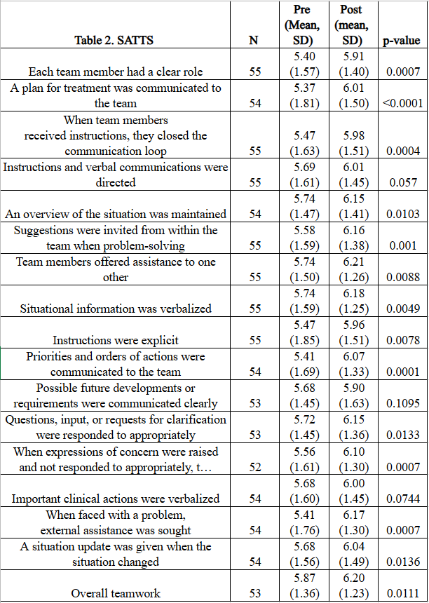
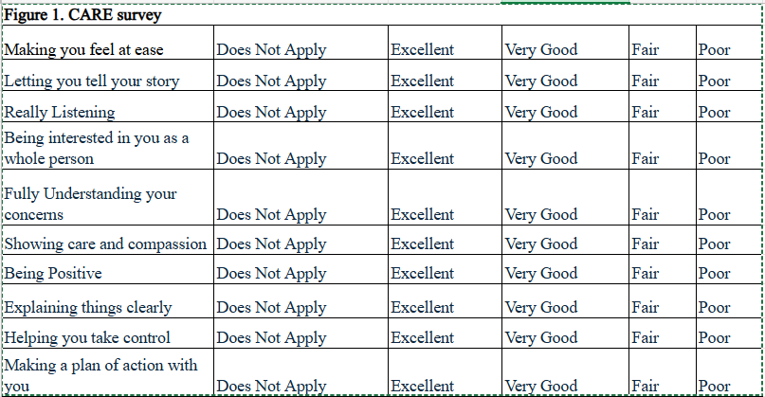
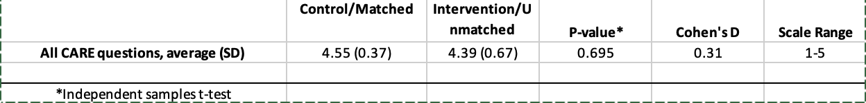
The Importance of Empathy Training in Pharmacy Students
Skyler Moorman, PharmD Candidate
Bryton Pruett, PharmD Candidate
Stephanie Hunziker, PharmD
School of Pharmacy
BACKGROUND
RESULTS
Empathy is a key skill for healthcare professionals, including pharmacists. It involves involving understanding patient emotions, acknowledging concerns, and showing support.
Empathy was once thought to be an innate trait, but research
Empathy training has been linked to better patient outcomes and improved communication between providers and patients.
Improvisation (improv) training has shown potential benefits, including reduced burnout and improved empathy
Studies with medical students and residents show improved empathy scores after improv and empathy training.
Research on improv and empathy training among pharmacy students is limited, highlighting a need for further study in this population.
METHODS
Spring 2025: 59 third-year pharmacy (P3) students took part in an improvisation workshop developed in collaboration with the SIUE Theatre Department.
Students were randomly assigned to either an intervention group or a control group.
The intervention group completed the improvisation workshop before patient simulations, while the control group completed simulations before the workshop.
Scenarios focused on patient communication, problem-solving, and collaborative decision-making.
Students completed pre- and post-surveys assessing teamwork and communication skills.
Surveys used the Self-Assessment Teamwork Tool (SATT) to measure collaborative skills.
Standardized patients evaluated student empathy using the Consultation and Relational Empathy (CARE) measure.
Results were used to compare teamwork, communication, and empathy outcomes between groups.
References
CONCLUSION
1Wilkinson H, Whittington R, Perry L, Eames C. Examining the relationship between burnout and empathy in healthcare professionals: A systematic review. Burn Res. 2017 Sep;6:18-29. doi: 10.1016/j.burn.2017.06.003. PMID: 28868237; PMCID: PMC5534210.
Nembhard IM, David G, Ezzeddine I, Betts D, Radin J. A systematic review of research on empathy in health care. Health Serv Res. 2023 Apr;58(2):250-263. doi: 10.1111/1475-6773.14016. Epub 2022 Jul 15. PMID: 35765156; PMCID: PMC10012244.
Paulus CM, Meinken S. The effectiveness of empathy training in health care: a meta-analysis of training content and methods. Int J Med Educ. 2022 Jan 26;13:1-9. doi: 10.5116/ijme.61d4.4216. PMID: 35092671; PMCID: PMC8995011.
Amjadi MF, Kociubuk J, Hollnagel F, Tsenkova VK, Zelenski AB. Zoom Improv is accessible and enhances medical student empathy. BMC Med E uc. 2024 Sep 27;24(1):1049. doi: 10.1186/s12909-024-06017-6. PMID: 39334240; PMCID: PMC11429412.
5. Wündrich M, Schwartz C, Feige B, Lemper D, Nissen C, Voderholzer U. Empathy training in medical students - a randomized controlled trial. Med Teach. 2017 Oct;39(10):1096-1098. doi: 10.1080/0142159X.2017.1355451. Epub 2017 Jul 27. PMID: 28749198.
6. Finley D, Hunziker S, Hookstra J, Jones G, Botchway A. Enhancing Pharmacy Students’ Team Decision-Making Through Empathy and Medical Improvisation: A Workshop-Based Approach. Submitted for publication January 2026.
7. Roper L, Shulruf B, Jorm C, Currie, J, Gordon C. Validation of the self-assessment teamwork tool (SATT) in a cohort of nursing and medical students. Med Teach 2018; 40(10): 1072-1075.
8. Mercer S, Maxwell M, Heaney D, Watt G. The Consultation and Relational Empathy (CARE) measure: Development and preliminary validation and reliability of an empathy-based consultation process measure. Fam Pract 2024; 21: 699-705.
We recommend continuing this empathy training as part of SIUE’s core curriculum for students
When completing this training we recommend continuing the SATTS survey for students and having the standardized patients complete the CARE survey. This is to ensure that the training is making a difference and provide clarity if any changes are need to be made.
We recommend moving this idea of empathy training into earlier years the program. This is to ensure the introduction of empathy early and allow students to open their mind. This is also to avoid students that may be experiencing burnout as they are moving on through the program.
Completing this with students earlier in the program can allow for more engagement from students and make empathy a key point throughout the coursework.
Overall, our background research and results from SIUE’s first attempt at empathy training show improv and empathy training have benefit in students

