Slide 1


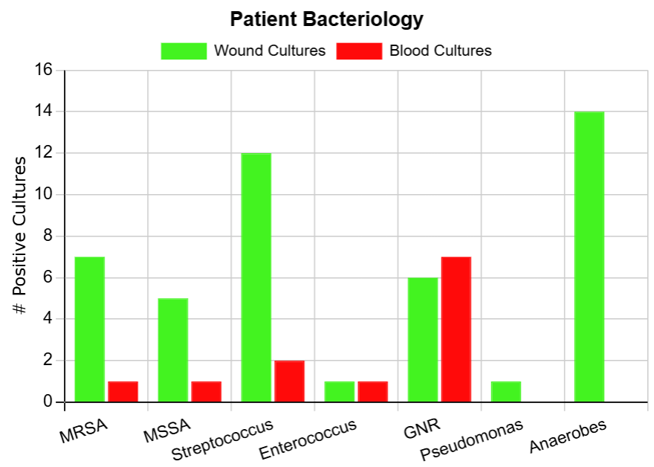
A Retrospective Study Assessing the Spectrum of coverage necessary for diabetic foot infections
Ryan Ward, PharmD. Candidate, Ed Weiler, PharmD., Aakash Patel, PharmD, BCIDP
Background
Results
Conclusions
Antimicrobial stewardship is a key component of therapy as resistance patterns and adverse events rise in the United States
Diabetic foot infections are a common complication of mismanaged diabetes
Initial antibiotic therapy depends on severity and risk factors for resistant bacteria
Of our 77 patients, 49 received inappropriate therapy (63.6%)
The most common reason for inappropriate therapy was unnecessary anaerobic coverage
41 patients received surgery, and 26 patients had amputations
ER providers and Hospitalists ordered the most antibiotics
19 patients were tested with MRSA nares and 4 were positive
Patients received antibiotic therapy for a mean duration of 19 days
Anaerobic coverage is being overprescribed in our patient population
These antibiotics should be reserved for deeper skin infections
The most frequently used order set may be a source of confusion due to poor wording
Possible solutions include adjusting the skin infection order set wording and provider education
Not all patients received MRSA nares testing, further evaluation may be necessary
Total antibiotic duration is appropriate per IWGDF guidelines
Objectives
Assess the appropriateness of antibiotic therapy ordered in patients with diabetic foot infection
Assess rates of Methicillin-Resistant Staphylococcus aureus positivity and total duration of antibiotic therapy provided
Methods
This study was a dual-center retrospective chart review
86 patients were admitted with diabetic foot infection, 77 received antibiotic therapy
Pediatric patients were excluded
Appropriateness of therapy was determined by guideline recommendations
Limitations
Author contact
Limitations include a small patient population for a dual center study, and the lack of A1c data captured
Ryan Ward (ryaward@siue.edu)

