Slide 1


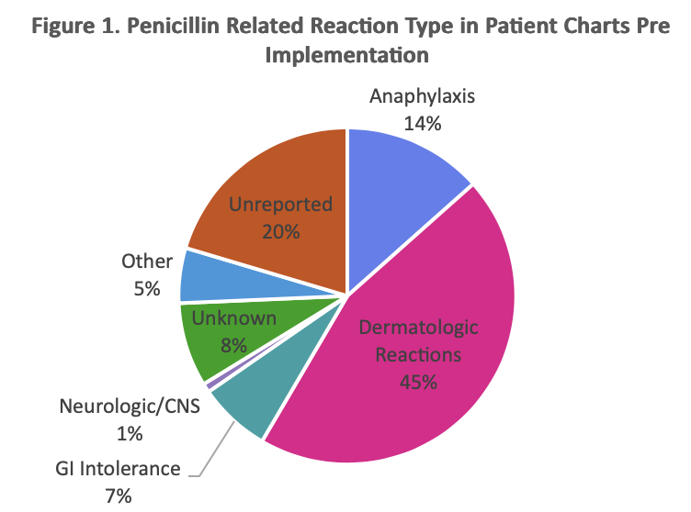
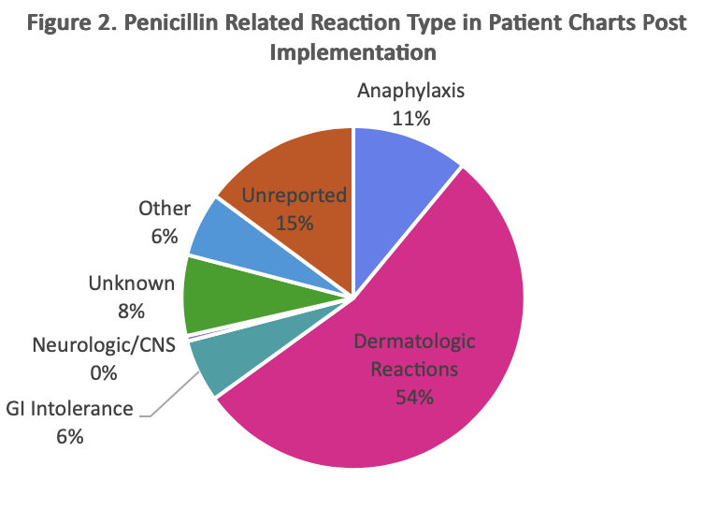
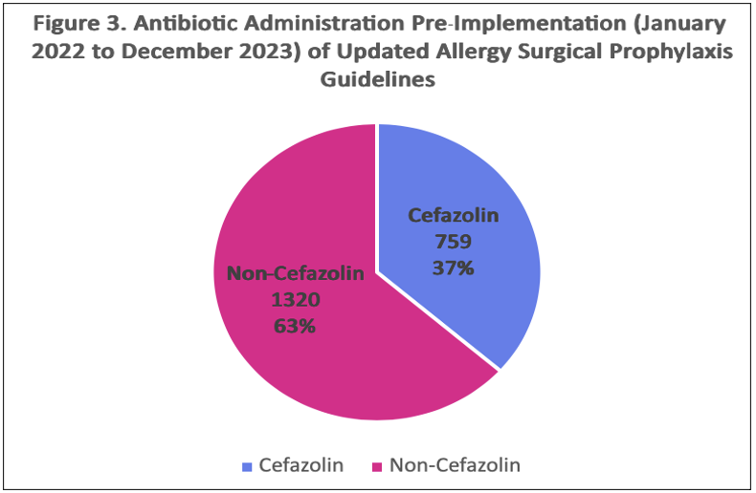
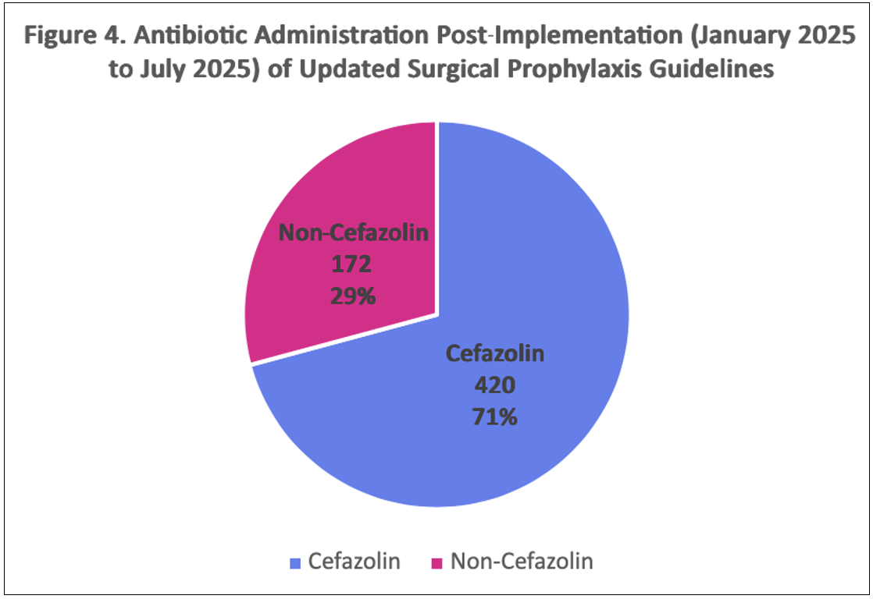
A Retrospective Review of the Impact of Updated Surgical Prophylaxis Guidelines in a Community Hospital Setting on Cefazolin Administration in Patients with Reported Penicillin Allergies
Puja Patel, PharmD Candidate
Michael Geisler, PharmD, BCPS
Background
Results
Conclusions
Surgical site infections (SSIs) account for 20% of all hospital-acquired infections
>$20,000/admission¹
$3.3B/year in the United States¹
~10% of patients report a penicillin allergy²
Guideline Update: 2022 AAAAI Drug Allergy Practice Parameters → most patients with a penicillin allergy, including anaphylaxis, can safely receive cefazolin routinely without prior testing³
Enable cefazolin use without on-site Allergy and Immunology at a community hospital
Reduce SSIs over 3 to 4-fold, improve stewardship, safety, and costs⁴
A total of 2,671 patients from BJC Memorial Hospital were include
Pre-Implementation: 2,079
Post-Implementation: 592
Demographics: Median age 63 years, 83.6% white, 68.3% women
Optimizing the use of cefazolin in penicillin allergic patients resulted in a 1.9-fold (34% absolute) increase in cefazolin use​
340 additional patients per 1,000 receive cefazolin
Zero documented immediate reactions post-implementation
Supports hospital wide cefazolin use in penicillin allergic patients for surgical prophylaxis
Potential SSIs associated healthcare cost savings +$140,000 to $160,000 annually
Purpose
Evaluate the impact of updated drug allergy practice parameters on the use of cefazolin versus second-line antibiotics for surgical prophylaxis in patients with documented penicillin allergies at a community hospital without on-site allergists
Primary outcome:
Pre-Implementation:
37% of patients with a penicillin allergy received cefazolin prior to surgery
Post-Implementation:
71% of patients with a penicillin allergy received cefazolin prior to surgery
NNT: 3
Secondary outcome:
Increase cefazolin use was not associated with an increased rate of immediate or delayed reactions; 0 documented
Methods
Design: Single-center, retrospective chart review
Study period: January 2022 - December 2023 and January 2025 - July 2025
Population: Patients aged 18–89 with a documented penicillin allergy undergoing surgery
Exclusion Criteria: Positive MRSA PCR prior to surgery, contraindication to cefazolin, including severe cutaneous adverse reactions (SCARs)
Primary Outcome:
Rate of cefazolin administration before vs after updated guidelines
Secondary Outcome:
Rate of immediate and delayed adverse reactions post-implementations
References
Shambhu, S, Gordon AS, Liu L, et al. The Burden of Health Care Utilization, Cost, and Mortality Associated with Select Surgical Site Infections. Joint Commission Journal on Quality and Patient Safety. 2024;50(12):857-866. 10.1016/j.jcjq.2024.08.005
CDC. Antibiotic Prescribing and Use: Clinical Features of Penicillin Allergy. Published 2025. https://www.cdc.gov/antibiotic-use/hcp/clinical-signs/?CDC_AAref_Val=https://www.cdc.gov/antibiotic-use/clinicians/Penicillin-Allergy.html
Khan DA, Banerji A, Blumenthal KG, et al. Drug allergy: A 2022 practice parameter update. J Allergy Clin Immunol. 2022;150(6):1333-1393. doi:10.1016/j.jaci.2022.08.028
Norvell MR, Porter M, Ricco MH, et al. Cefazolin vs Second-line Antibiotics for Surgical Site Infection Prevention After Total Joint Arthroplasty Among Patients With a Beta-lactam Allergy Open Forum Infect Dis. 2023;10(6):ofad224. Published 2023 Apr 24. doi:10.1093/ofid/ofad224

