Slide 1

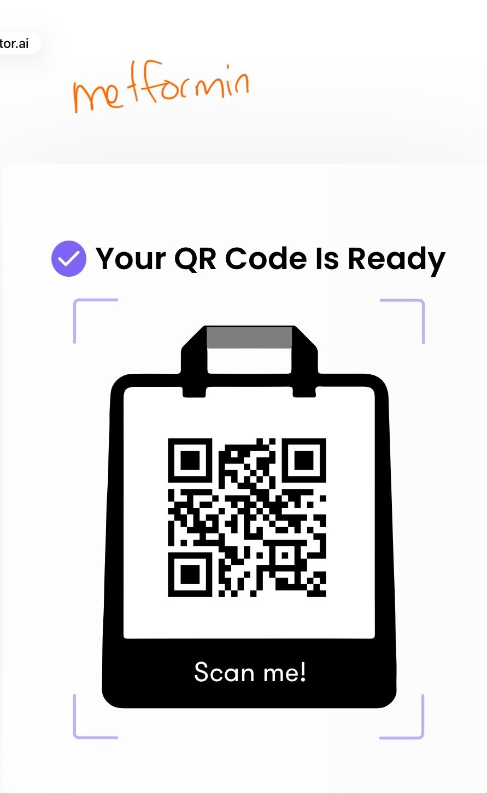
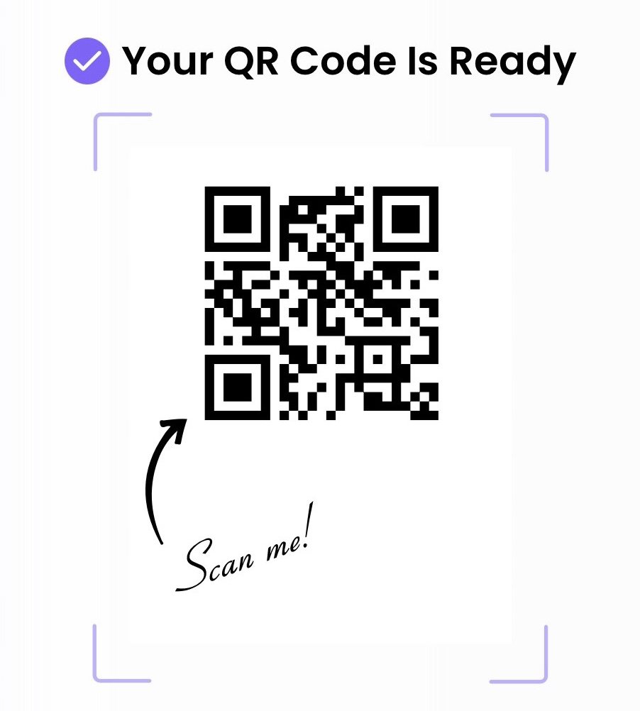
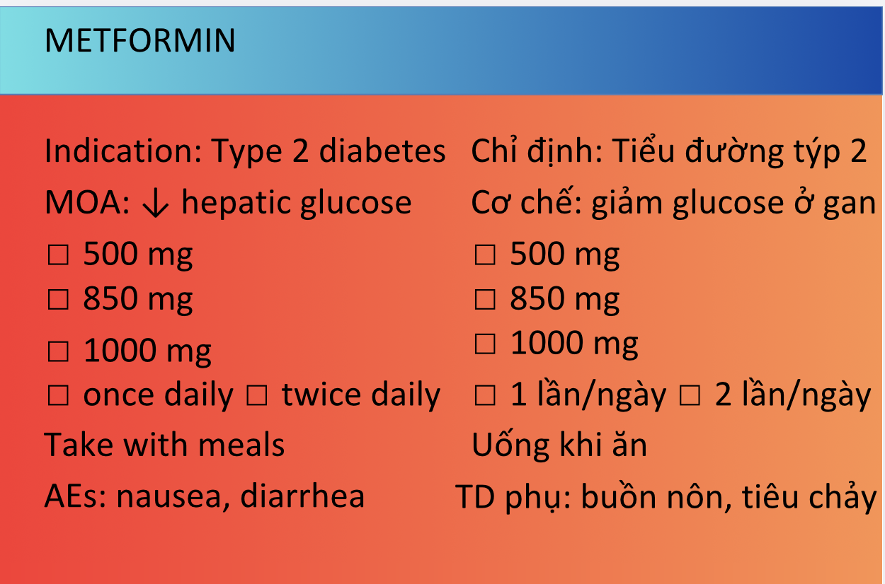
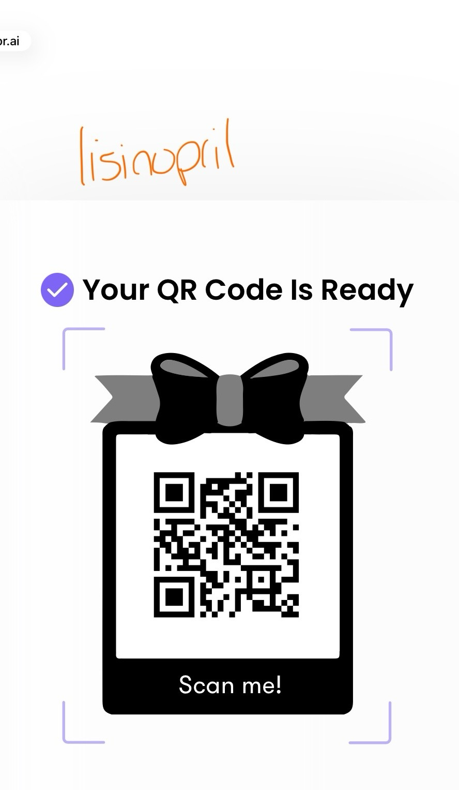
Breaking Barriers: Development of Limited English Proficiency Medication Education
Nataly Nguyen, Pharm.D. Candidate Stephanie Hunziker, PharmD, BCMTMS
School of Pharmacy
BACKGROUND
RESULTS
DISCUSSION
Limited English Proficiency (LEP) affects over 25 million individuals in the U.S¹
LEP is associated with increased medication errors, reduced adherence, and adverse health outcomes²
LEP patients experience significantly higher rates of adverse events (49.1% vs. 29.5%), with many linked to communication barriers³
Medication instructions are often delivered in English at a level exceeding patient health literacy
Existing tools (RxTran, ScriptAbility, interpreters) improve access but do not fully address comprehension or retention
Table 1: Developed medication Tools
LEP patients are more likely to misunderstand medication instructions and experience poorer outcomes³
Existing language access tools are: Primarily text-based, Not designed for low health literacy, or not easily reviewed by patients
Studies show patients misunderstand up to 20% of medication label instructions¹⁰
This intervention: combines written + spoken education, allows repeated access via QR code, and reduces reliance on informal interpreters
Medication | Indication | Key Couseling Points
Metformin | Diabetes | GI effects
Lisinopril | Hypertension | Cough, angioedema
Atorvastatin | Hyperlipidemia | Rhabdomyolysis
OBJECTIVES
Develop a bilingual (English Vietnamese) medication education tool
Improve patient understanding of indication, dosing, and side effects
Address language barriers and health literacy limitations
Support pharmacist counseling and patient-centered care
Figure 1: Intervention Design
CONCLUSION
A bilingual, QR-linked medication education tool was successfully developed
The intervention is scalable, low-cost, easily implementable
Has strong potential to improve medication understanding, enhance adherence, and reduce preventable errors
Supports more equitable, patient-centered pharmacy care
METHODS
Study Design
Practice-based innovation in community pharmacy
Setting
Independent pharmacy in Vietnamese centered area of St. Louis
Medication Selection
Metformin
Lisinopril
Atorvastatin
Intervention
Bilingual index card (English & Vietnamese)
QR-linked Vietnamese video (<1 min)
Content Development
Vietnamese: Thuốc Biệt Dược
Clinical verification: Lexicomp
Reviewed for: accuracy, clarity, cultural appropriateness
Metformin Atorvastatin
lisinopril
NEXT STEPS
Expand to additional medications and OTC products
Pilot test with Vietnamese speaking LEP patients
Collect patient and pharmacist feedback
Evaluate impact on medication understanding, adherence, error reduction
Key Findings
Intervention demonstrated:
Feasibility in community pharmacy workflow
Reproducibility for multiple medications
Addressed both:
Language barriers
Health literacy limitations
Provided a reusable method to reinforce pharmacist counseling
Formal patient outcomes were not collected
References
1.U.S. Census Bureau. People that speak English less than “very well” in the United States.
2.Twersky, S. E., Kossler, C., Chang, J., Hastings, J., & Lee, J. The impact of limited English proficiency on healthcare access and outcomes in the United States: A scoping review. International Journal of Environmental Research and Public Health, 21(1), 123–138.

