Slide 1

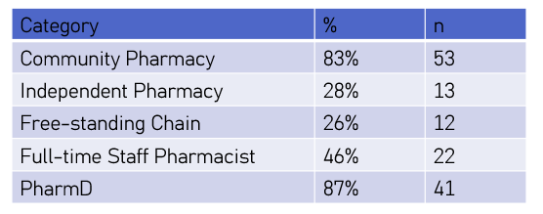
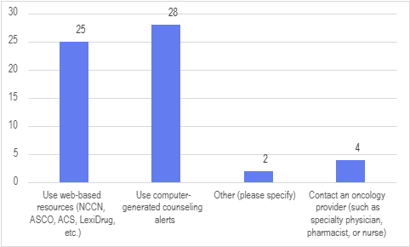
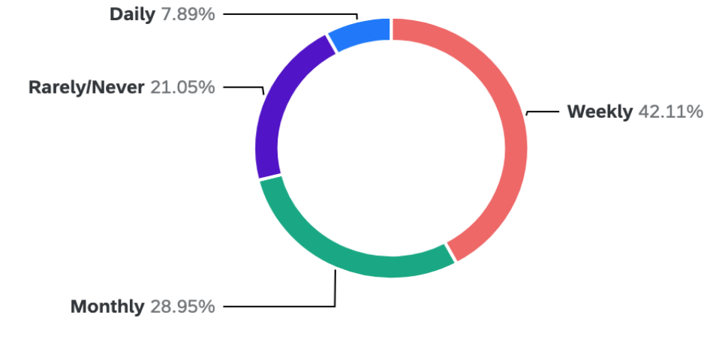
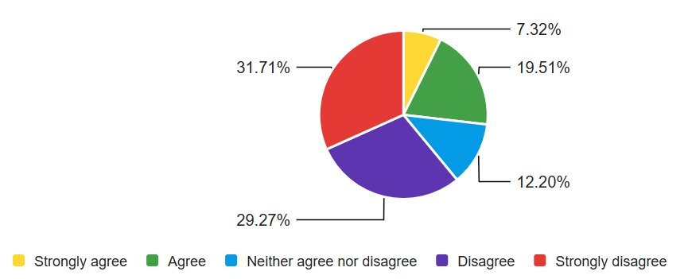
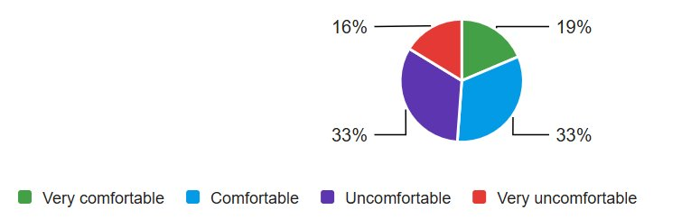
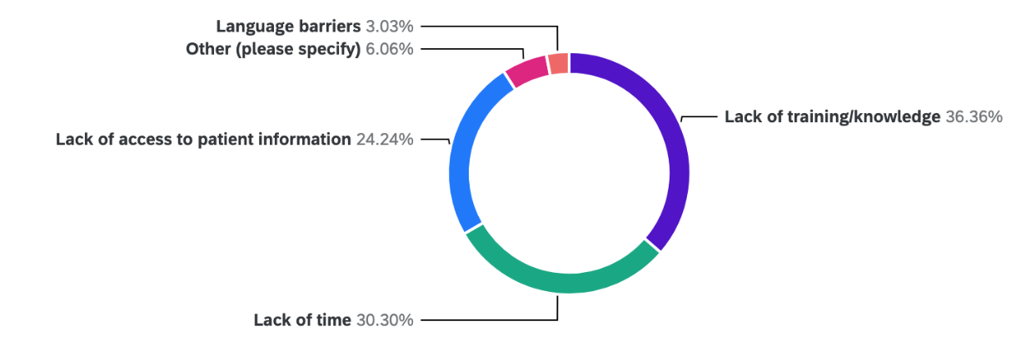
Southern Illinois University Edwardsville School of Pharmacy
Oral anticancer medications are increasingly used in outpatient settings, making community pharmacies a frequent point of contact for patients.
Pharmacists counsel on side effects, identify drug interactions, ensure safe handling, and support adherence.
A 2016 Illinois survey showed gaps in oncology knowledge, counseling confidence, and continuing education (CE) access.
This project reassesses these areas in 2025 and compares results to 2016 to identify changes and ongoing CE needs.
Oral anticancer medications are increasingly used in outpatient settings, making community pharmacies a frequent point of contact for patients.
Pharmacists counsel on side effects, identify drug interactions, ensure safe handling, and support adherence.
A 2016 Illinois survey showed gaps in oncology knowledge, counseling confidence, and continuing education (CE) access.
This project reassesses these areas in 2025 and compares results to 2016 to identify changes and ongoing CE needs.
COMMUNITY PHARMACISTS’ KNOWLEDGE AND COMFORT WITH ONCOLOGY CARE
Natalia Wallman, PharmD Candidate and Keith A. Hecht, PharmD, BCOP
BACKGROUND
Oral anticancer medications are increasingly used in outpatient settings, making community pharmacies a frequent point of contact for patients.
Pharmacists counsel on side effects, identify drug interactions, ensure safe handling, and support adherence.
A 2016 Illinois Pharmacists Association (IPhA) survey showed gaps in oncology knowledge, counseling confidence, and continuing education (CE) access.
RESULTS
Table 1: Participants Demographics
Figure 1: Impact and engagement with oncology patients
Figure 2: Comfort with oncology counseling
Figure 3: Barriers to oncology counseling
RESULTS
Figure 4: Counseling approaches
OBJECTIVE
Evaluate current knowledge, comfort, and CE needs of community pharmacists regarding oral oncology therapies and compare results to 2016 to identify changes and ongoing CE needs.
Figure 5: Continuing Education (CE)
Question: I have completed CE activity/activities on this topic.
METHODS
Design: Cross-sectional survey of pharmacists via Qualtrics.
Population: Community pharmacists, including independent, chain, and other practice settings.
Survey topics:
  Demographics
  Education/training on oral oncology therapies
  Comfort with counseling
  CE participation and needs
  Perceived barriers
  Impact on patient outcomes
Participants:
  Licensed Illinois community pharmacists with B.S. Pharmacy or PharmD
  Students, technicians, non-practicing pharmacists excluded
Analysis: Descriptive statistics; results compared to previous 2016 survey when applicable
This study was approved by the Institutional Review Board (IRB) at SIUE.
CONCLUSIONS
Across both the 2016 and 2025 surveys, community pharmacists continue to report gaps in education and comfort with oral oncology therapies.
Barriers such as limited time, training, and access to patient information persist.
Despite these challenges, most pharmacists believe they have a moderate to significant impact on patient outcomes.
These findings highlight the ongoing need for targeted and accessible oncology-focused CE to strengthen pharmacists’ confidence and improve patient care as the use of oral anticancer therapies continues to grow.

