Slide 1


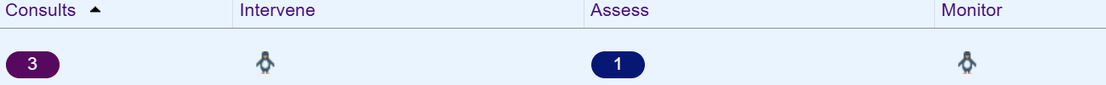
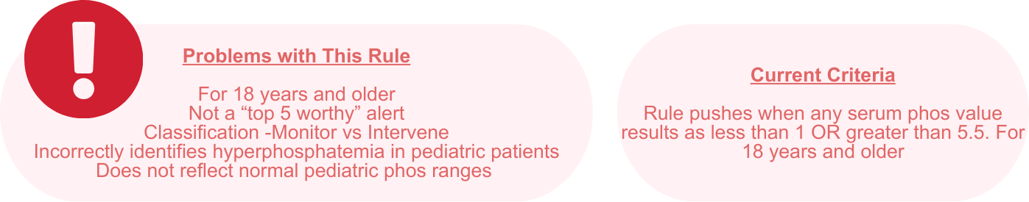
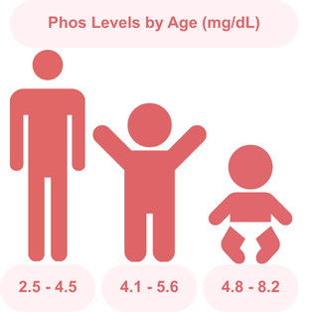
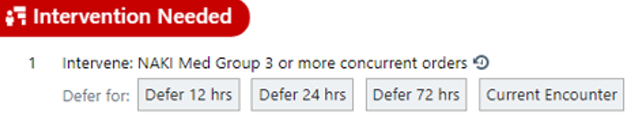
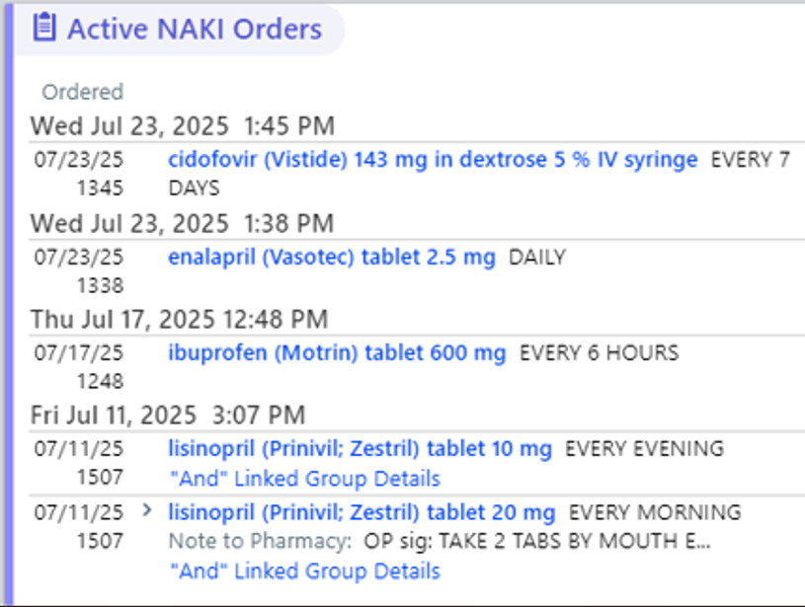
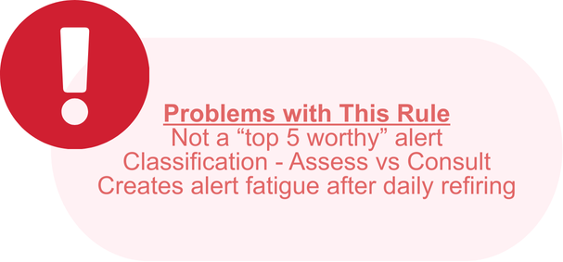
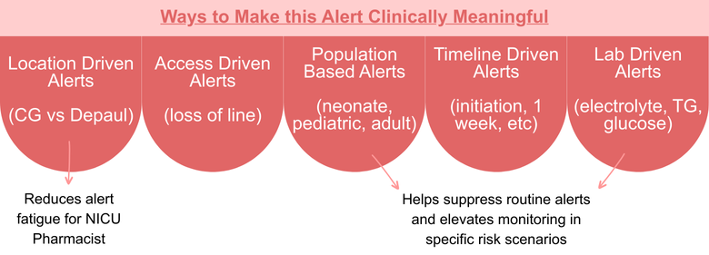
Evaluating and Enhancing Clinical Decision Support for Pediatric Pharmacists: A Quality Assessment of the Kosmas 4 Kids System
Madison Kelley, PharmD Candidate and Kyle Mays, PharmD, BCPPS
Background
Kosmas Alerts on an Epic Patient List
Discussion
The Kosmas 4 Kids program functions as a pharmacy clinical scoring tool, meaning that it systematically evaluates patient-specific data to generate actionable alerts that guide pharmacist interventions. The tool integrates with Epic to apply rule-based logic that identifies when a pharmacist should be alerted. By translating complex clinical scenarios into prioritized alerts, the tool supports pharmacists who float across teams, helping them quickly orientate unfamiliar patients and make timely, informed decisions. The Cosmas program has already been adapted and utilized by adult institutions, but has not been refined to the needs of pediatric patients.
The intent is that the most commonly fired rules are those that result in meaningful clinical pharmacist intervention. While rules geared towards assessing and monitoring pharmacotherapy have their role, consults and interventions help provide more value-based care that can help improve clinical outcomes. Currently, many of the top firing alerts are not things that a clinical pharmacist can act on, like seen in the example of the "Receiving TPN" rule. By refining the criteria of these rules, the Kosmas 4 Kids system can not only alert pharmacists when action needs to be taken, but help pharmacists prioritize which interventions may be more urgent.
Assess: VTE Prophylaxis
Example Logical Expression:
WHEN:Patient.Age >= 13 OR (Patient.Age < 13 AND Count(VTE_RiskFactors) >= 4 AND Count(Bleeding_RiskFactors) = 0 AND Patient.Location IN ("PICU", "Inpatient") AND NOT EXISTS (Active Order for VTE Prophylaxis)
Monitor: Abnormal Phos Level
Clinical Process
Moving Forward
Future pediatric‑specific rules may include weight‑based dosing thresholds, age‑restricted medication use, immunization status, and IV drug compatibility.
Assess: Receiving TPN
References / Disclosure
1. Children’s Hospital of Philadelphia. Laboratory Reference Ranges. Philadelphia (PA): Children’s Hospital of Philadelphia; 2024 Jun [cited 2025 Dec 1]. Available from: https://www.chop.edu/sites/default/files/2024-06/chop-labs-reference-ranges.pdf
2. Raffini L, Thornburg C. Venous thromboembolism in pediatrics. Pediatrics in Review. 2021 Feb;42(2):78‑90. doi:10.1542/pir.2019‑0026.
AI assistance was used to refine the logical expression on this poster.

