Slide 1

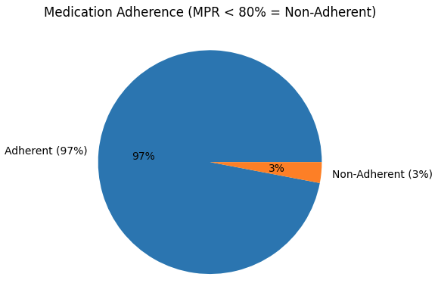
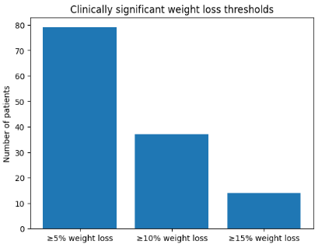
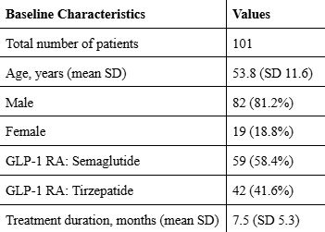
Adherence to GLP-1 Receptor Agonists and Associated Weight Loss in U.S. Veterans
Logan Sink, Pharm D. Candidate
School of
Pharmacy
BACKGROUND
METHODS
FUTURE STUDIES
Type 2 Diabetes Mellitus (T2DM) and obesity are major global public health challenges.
  Strong association between obesity and T2DM development and progression.
  Increasing prevalence of T2DM and obesity
  >40% of adults in the US classified as obese.¹
GLP-1 Receptor agonists (GLP-1 RAs) show benefits in:
  Glycemic control.
  Weight reduction.
  Cardiovascular and renal benefits.²
Retrospective review of patient data from the Marion VA Healthcare system
Inclusion Criteria
  GLP-1 RA therapy for > 60 days
  Baseline weight measured prior to GLP-1 RA therapy
  >1 Follow up weight
Adherence measurement
  Medication Possession Ratio (MPR) obtained from data
  Adherent = MPR > 0.80
Larger population (National VA analysis)
Longer follow-up duration
Agent-specific outcomes
Inclusion of additional variables
  A1c, concomitant medications
RESULTS
CONCLUSION
High refill adherence to GLP-1 RA’s in U.S. Veterans
Small non-adherent cohort
  limited comparison
Clinically significant weight loss observed
REFERENCES
Centers for Disease Control and Prevention. Adult obesity facts. CDC. May 14, 2024
Chandrasekaran P, Weiskirchen R. The Role of Obesity in Type 2 Diabetes Mellitus—An Overview. International Journal of Molecular Sciences. 2024;25(3):1882. doi: 10.3390/ijms25031882
Weiss T, Carr RD, Pal S, Yang L, Sawhney B, Boggs R, Rajpathak S, Iglay K. Real-World Adherence and Discontinuation of Glucagon-Like Peptide-1 Receptor Agonists Therapy in Type 2 Diabetes Mellitus Patients in the United States. Patient Prefer Adherence. 2020;14:2337-2345. doi:10.2147/PPA.S27767
Clinical trials of GLP-1 RAs show significant weight loss.²
Real-world studies show declining adherence over time.³
Limited data in the U.S. Veteran population.
Total of 101 patients from the data met the inclusion criteria.
  98 patients labeled adherent
  3 patients labeled non-adherent
Mean MPR from patient data was 1.16
Mean weight loss 24.7 pounds
  >5% weight loss (79)
  >10% weight loss (37)
  >15% weight loss (14)
OBJECTIVE
Study Objective:
  Evaluation of adherence to GLP-1 RAs in veterans.
  Assessment of how adherence correlates to weight loss.

