Slide 1




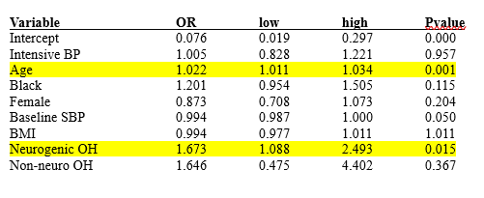
Relationship of Orthostatic Hypotension and Hospital Readmission Among Patients Treated for Hypertension
School of
Pharmacy
Logan Gray, Pharm. D. Candidate, Mark Ruscin, Pharm. D.
BACKGROUND
OUTCOME
DISCUSSION
Hospital readmissions among Medicare recipients are a significant clinical and economic burden.
Orthostatic hypotension (OH) is a common finding among older patients; however, the relationship of OH to 30-day readmissions is unclear.
This study aimed to determine if OH (neurogenic vs. non-neurogenic) are independent predictors of 30-day readmissions.
The primary endpoint was a composite of 30-day hospital readmissions or ER visits, as we were not able to separate out hospital and ER visit data.
NOH often is a failure of the autonomic nervous system’s baroreflex, unlike non-neurogenic OH, which often stems from reversible factors like dehydration.
For pharmacists and providers, the presence of OH creates a complex issue: increasing antihypertensive doses to meet SBP goals may precipitate OH, leading to syncopal events or falls.
Limitations: The retrospective nature of the data; SPRINT excluded patients with diabetes; excluding patients treated with B-blockers limits external validity.
RESULTS
Of the 4050 patients, 308 (7.6%) were identified as having OH.
Within the OH group, 156 patients were classified as neurogenic and 152 as non-neurogenic.
Primary outcome: Neurogenic OH was a significant independent predictor of 30-day returns.
Patients with nOH experienced a 67.3% increased risk of readmission or ER visit compared to those without OH (OR 1.673; 95% CI 1.088-2.493; p=0.015).
Older age was also associated with a statistically significant higher risk of admission (OR 1.022; p=0.001)
METHODS
We utilized an anonymous dataset of 4050 patients aged 55-89 who participated in the SPRINT HTN trial.
Patients treated with β-blockers were excluded.
OH Subtypes: A sit-to-stand ratio was calculated: Δ in HR / Δ in SBP
Neurogenic OH (nOH): Ratio < 0.5
Non-neurogenic OH: Ratio ≥ 0.5
A Poisson regression model was used to evaluate the relationship between predictor variables and readmissions.
CONCLUSION
The ΔHR/ΔSBP ratio is a simple tool to help identify subtypes of OH.
Neurogenic OH carries a 67.3% increased risk of 30-day return, suggesting it may have utility in screening models and hospital discharge protocols.
Pharmacists and healthcare providers should evaluate older antihypertensive patients at discharge to identify patients experiencing OH/nOH.
Fanciulli, A., Kerer, K., Leys, F., Seppi, K., Kaufmann, H., Norcliffe-Kaufmann, L. and Wenning, G.K. (2020), Validation of the Neurogenic Orthostatic Hypotension Ratio with Active Standing. Ann Neurol, 88: 643-645. https://doi.org/10.1002/ana.25834

