Slide 1


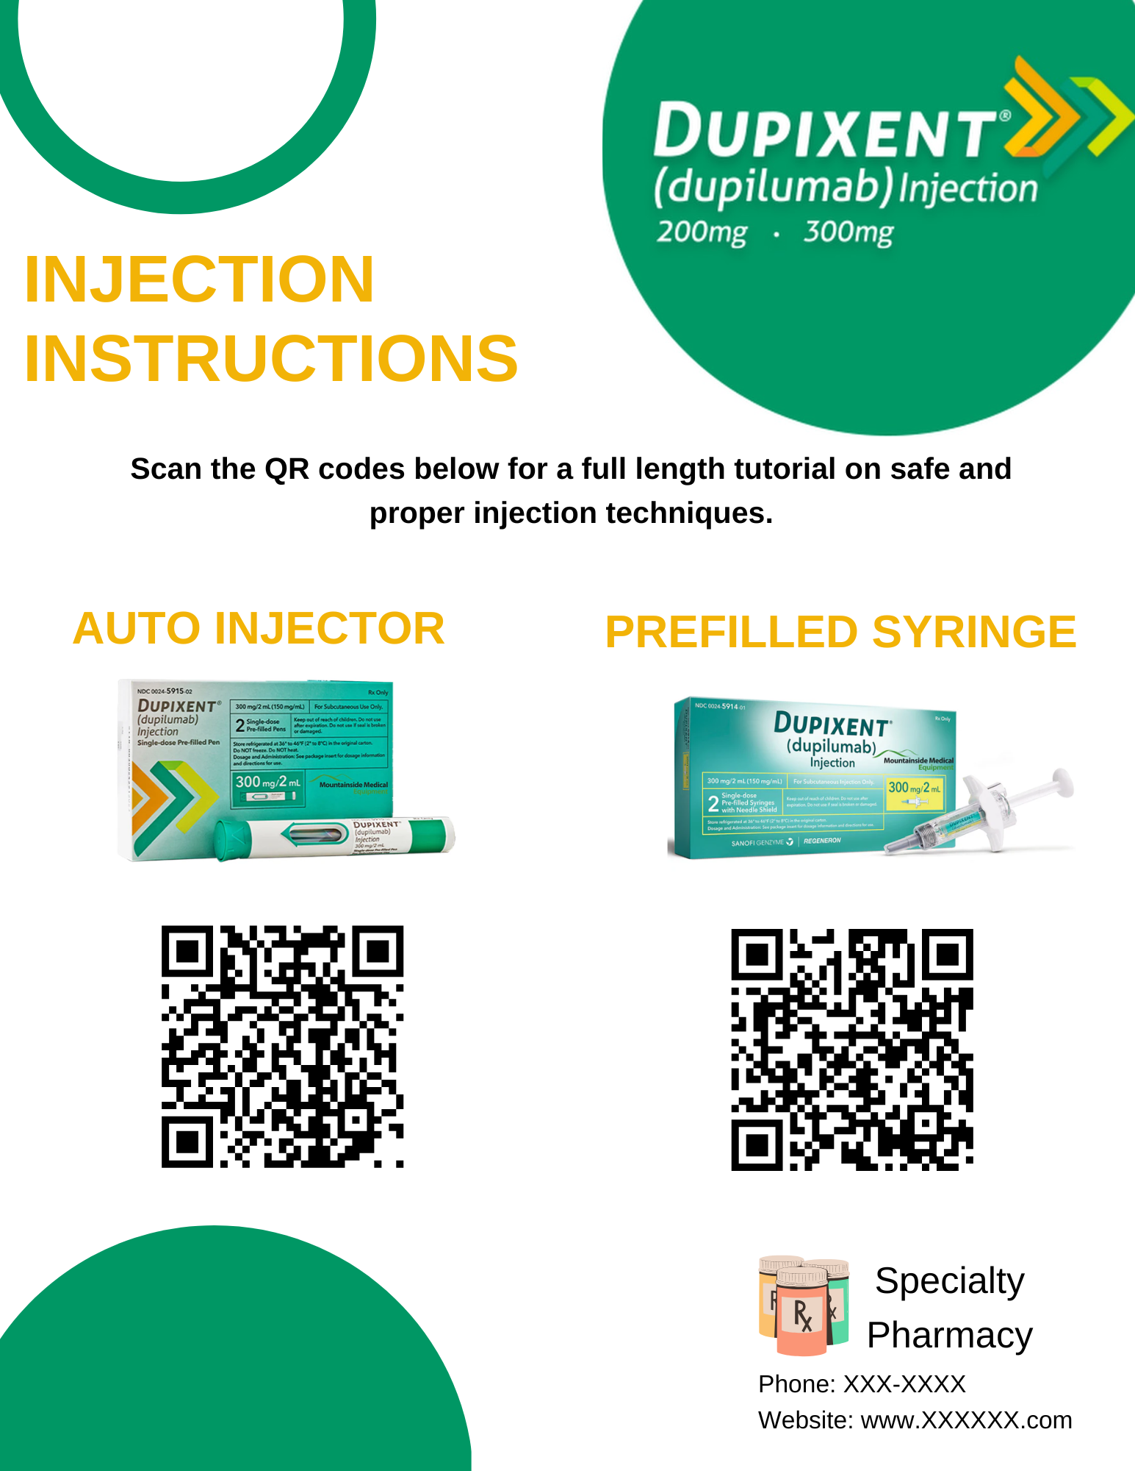
Impact of QR Codes on Modern Patient Education
Kathryn Countryman, Pharm. D. Candidate, Kelsey Edwards, Pharm. D. Candidate
Hannah Admire, Pharm. D.
Background
Implementation
Sample Handout
Discussion
Only 17% of healthcare QR code usage is utilized for educational tools and resources.¹ QR codes have the potential to provide the detailed education and training needed to help patients have successful and safe home medication use, especially for medications such as biologics that require subcutaneous or intravenous injection. Biologics target disease states that previously had no available therapies, exponentially expanding patient populations within specialty pharmacy services.
100 first time Dupixent users will be provided a handout with a QR code that will directly link to the manufacturer's instructional videos².
Compare retrospectively to previous first time Dupixent users.
Patient adherence, number of QR code scans, and phone call volume will be measured over a 12-week period.
Using QR codes for direct access to instructional videos allows for patients to have optimized patient care. Correct administration technique of biologic medications is crucial to their efficacy, and therefore adherence.
Decreasing administration questions allows for the pharmacist to focus on therapeutic concerns, clinical questions, and other pharmacy duties.
QR codes are a low-cost technology that can boost patient satisfaction and adherence, and buffer against pharmacist burnout.
Objectives
Analysis
References
Provide patients with direct access to manufacturer instructional videos to simplify administration of injectable medications for first time users. Outcomes are patient adherence, patient satisfaction, and pharmacist satisfaction.
Patient adherence will be measured by number of completed refills needed to provide sufficient medication for the 12-week period.
A successful decrease of phone call administration questions will be defined as a >50% reduction in phone calls related to injection technique.
The number of QR code scans will be monitored to ensure use of the technology.
Joshi, P., & Sawant, S. (2024). The Impact and Potential of Quick Response (QR) Codes in Healthcare: A Comprehensive Review. Proceedings of the Human Factors and Ergonomics Society Annual Meeting, 68(1), 1153-1158. https://doi.org/10.1177/10711813241278266
DUPIXENT Prescribing Information: https://www.dupixenthcp.com/

