Slide 1

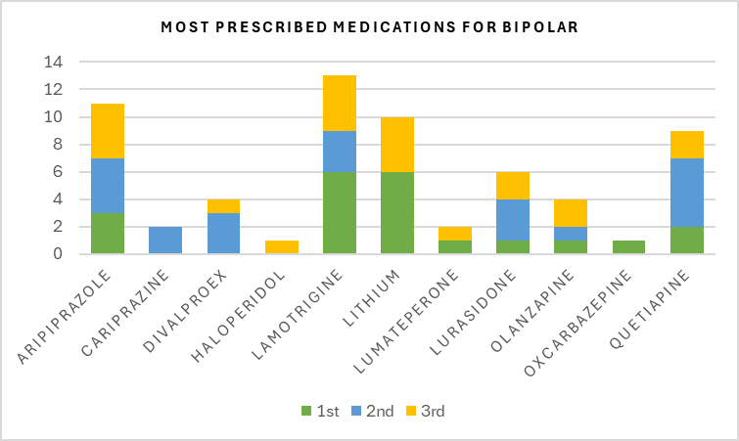
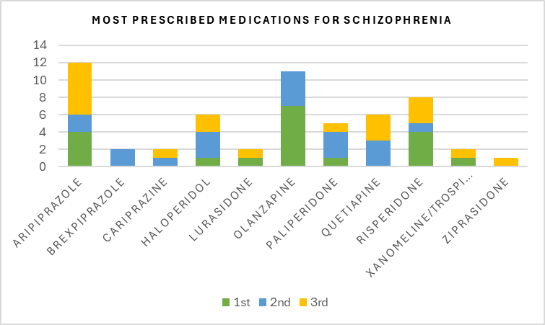
Bipolar and schizophrenia guideline usage for medication decision-making in psychiatric prescribers
Katelyn Booten, PharmD Candidate
Dr. Kelly Gable, PharmD, BCPP, FAAPP
School of
Pharmacy
BACKGROUND
RESULTS
DISCUSSION
The APA guidelines for BD and SCZ were last updated in 2005 and 2020, respectively.
Antipsychotics and mood stabilizers are the two classes used for treatment.
The purpose of the research is to explore prescriber preferences, understand the differences between guideline recommendations and the medications used by the prescribers, and if prescribing patterns tend to fall on recent research, newer medications, or are guideline based.
A total of 21 prescribers responded, with most, 11, prescribing for 5 years or less.
The approximate percentage of patients they see who are diagnosed with BD or SCZ - five reported less than 25%, ten reported between 25%-50%, four reported between 50%-75%, and two reported more than 75% of their time.
Most respondents selected treatment guidelines as the most influential factor when it came to prescribing medication.
APA guidelines were selected 20 times for BD and 19 times for SCZ of the 21 prescribers.
Since APA BD guideline is outdated, prescribers should turn to 2023 CANMAT, 2025 NICE, and the 2023 VA/DoD guidelines and treat patient specific symptoms with certain medications.
Most of the SCZ guidelines recommend medication based on their side effect profile, with aripiprazole being the first option. Aripiprazole was the most prescribed in total here, with a majority listing it third, but olanzapine was listed the most as first.
LIMITATIONS
METHODS
Lack of access to participants, small sample size, not listing research articles or studies to stay updated.
A survey was created for psychiatric prescribers to fill out.
Questions asked about guideline usage and opinions and their most common medications.
An email was sent out to a psychiatric prescriber organizations with a link to the survey and a brief description explaining the purpose.
It was an optional survey that was open for four months.
CONCLUSION
Prescribers listed 2002 APA BD guideline the most despite listing aripiprazole and quetiapine as common medications, they are not found within the APA guideline.
Aripiprazole was the most prescribed for SCZ, so it appears side effects are a major concern when prescribing antipsychotics.

