Slide 1

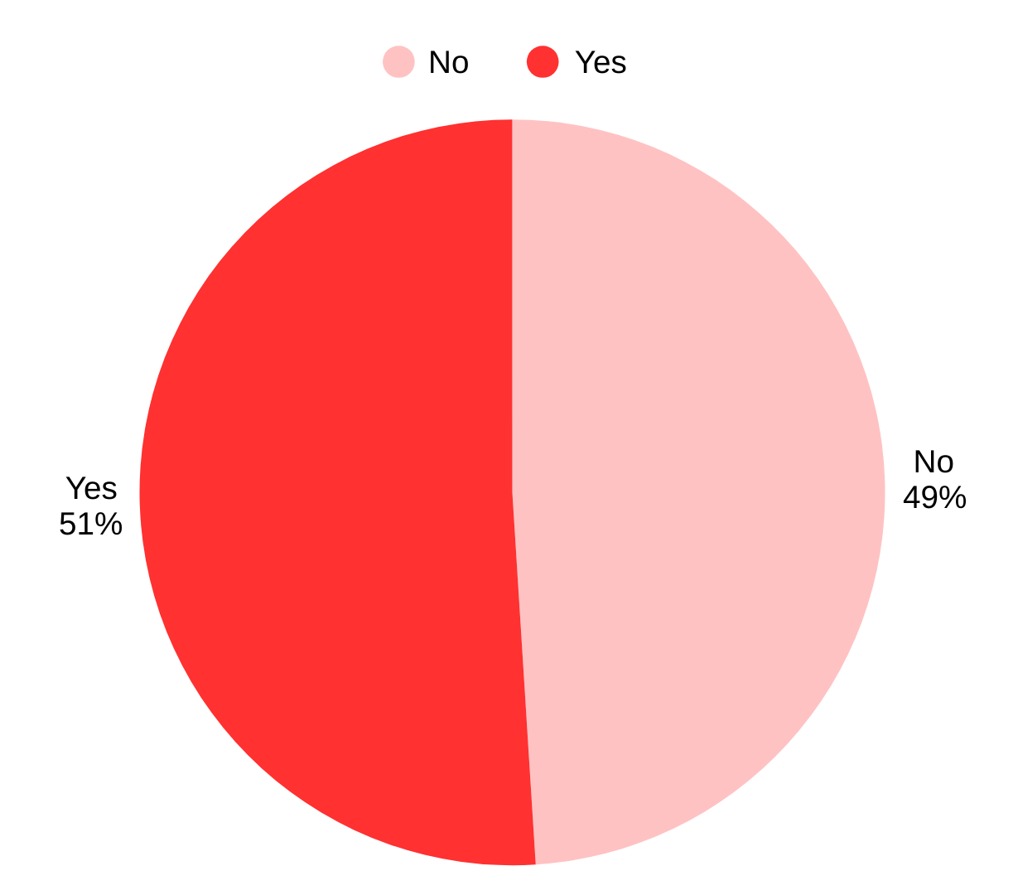
Drug Utilization Evaluation for Group A Streptococcal Pharyngitis Treatments
Jillian Barber, Pharm.D Candidate, Guadalupe Lopez-Vergara, Pharm.D Candidate
Miranda Wilhelm, Pharm.D
School of
Pharmacy
BACKGROUND
RESULTS
Adherence to Treatment Guidelines
Group A Streptococcal (GAS) pharyngitis is one of the most common reasons for outpatient visits, affecting nearly 5.2 million people each year.
Rates of infection with GAS have increased in adults aged 18-64 years old since 2014. ¹
Previous studies have shown inconsistent prescribing patterns for GAS pharyngitis, largely nonadherent to treatment guidelines. ^{2,3}
Inappropriate antibiotic prescribing can lead to patient harm and antibiotic resistance. ⁴
Primary Endpoint:
Adherence to 2024 CDC GAS Pharyngitis Treatment Guidelines. Reported as Yes or No.
Secondary Endpoints:
Appropriate medication strength, frequency, and/or duration.
Documented allergy to the preferred therapy.
If the prescription was filled at the SIUE Health Services Pharmacy.
Reported as Yes or No.
Results | N (%)
Total patients reviewed | 63 (100%)
Primary Objectives
Guideline adherence
Appropriate therapy: Amoxicillin 500 mg PO BID for 10 days | 29 (46%)
Patients with penicillin allergy: Azithromycin 250 mg PO 2 tabs day 1, then 1 tab days 2-5 | 3 (5%)
 | 32 (51%)
Inappropriate treatment regimen
Incorrect dose, correct frequency and duration: Amoxicillin 875 mg PO BID for 10 days | 29 (46%)
Incorrect frequency, correct dose and duration: Amoxicillin 500 mg PO TID for 10 days | 1 (1.5%)
Incorrect dose and duration due to concomitant infection: Amoxicillin/clavulanate 875/125 mg PO BID for 7 days | 1 (1.5%)
 | 31 (49%)
Secondary Objective
Prescription filled at SIUE Health Service Pharmacy | 54 (85%)
CONCLUSIONS
METHODS
Single-center, retrospective chart review via electronic health records at SIUE Health Services Clinic.
IRB Approval was obtained.
Recommended dosing from the 2024 CDC GAS Pharyngitis Treatment Guidelines.
Inclusion criteria:
Patients that tested positive for GAS pharyngitis from January 1, 2024 – December 31, 2024.
Exclusion criteria:
Less than 18 years old and above the age of 89 years old.
Secondary infections of GAS pharyngitis within the preset date of chart review.
Nearly half of prescribed therapy did not follow the treatment guidelines properly.
Highlights the importance of antimicrobial stewardship and the potential role of pharmacists to improve this initiative.
DISCLOSURES
There are no conflicts of interest to disclose.
REFERENCES
1.Group A strep disease surveillance and trends. Centers for Disease Control and Prevention. July 8, 2024. Accessed June 8, 2025. https://www.cdc.gov/group-a-strep/php/surveillance/index.html.
2. Roberts RM, Hicks LA, Bartoces M. Variation in US Outpatient Antibiotic Prescribing Quality Measures According to Health Plan and Geography. The American Journal of Managed Care. 2016;22.
3. Linder JA, Chan JC, Bates DW. Evaluation and Treatment of Pharyngitis in Primary Care Practice: The Difference Between Guidelines Is Largely Academic. Arch Intern Med. 2006;166(13):1374–1379. doi:10.1001/archinte.166.13.1374.
4. Haynes MA, Temkit M, Kushner I, Hindman DE. Appropriateness of Use of Streptococcal Pharyngitis Testing and Associated Antibiotic Prescribing in the Urgent Care Setting. Clinical Pediatrics. 2024;63(12):1691-1697. doi:10.1177/00099228241237908.

