Slide 1

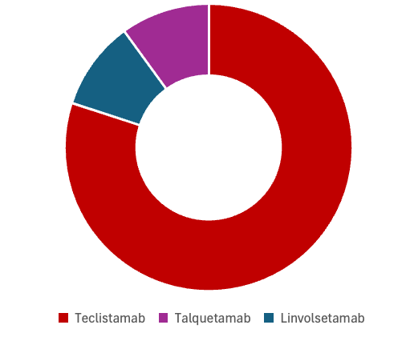
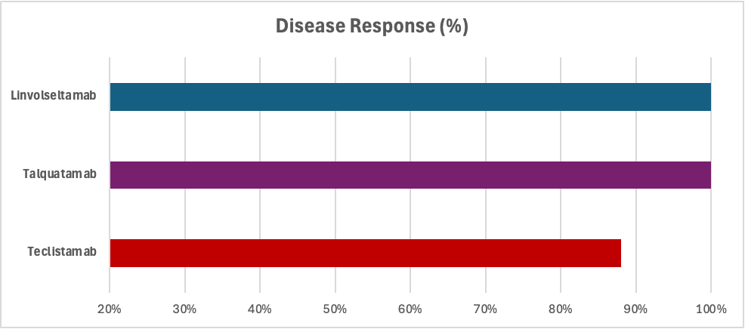
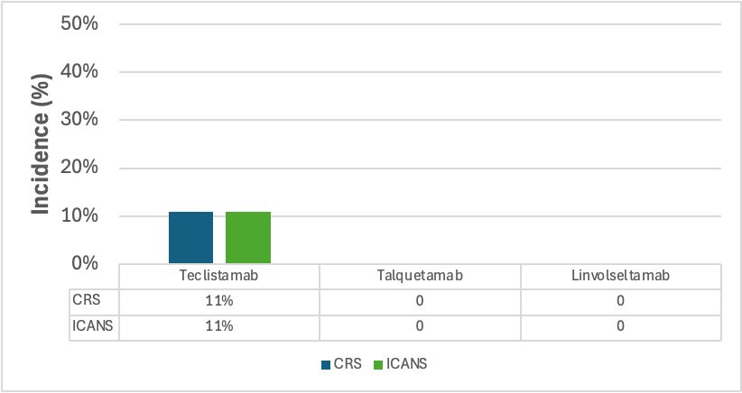
Evaluation of Bispecific T-cell Engagers in Multiple Myeloma Patients at a Community Teaching Hospital
Jarret Morgan, PharmD Candidate and Keith Hecht, PharmD, BCOP
School of Pharmacy
BACKGROUND
RESULTS
Currently FDA-approved bispecific T-cell engagers (BiTEs) for the treatment of relapsed or refractory (R/R) multiple myeloma (MM) includes teclistamab, talquetamab, elranatamab, and linvoseltamab
These agents have shown meaningful efficacy in clinical trials, though carry risks of cytokine release syndrome (CRS) and immune effector cell-associated neurotoxicity syndrome (ICANS)
The objective of this study is to generate real-world evidence assessing the efficacy and safety outcomes of BiTEs in the treatment of R/R MM at a community teaching hospital
Figure 1: Eligible Patients in Study (N = 10)
Table 1: Baseline Characteristics at BiTE Agent Initiation
 | Average (Range) |  | N (%)
Age in Years |  | Received Transplant
Teclistamab | 79 (58-89+) | Teclistamab | 3 (38%)
Talquetamab | 80 (N/A) | Talquetamab | 1 (100%)
Linvoseltamab | 37 (N/A) | Linvoseltamab | 1 (100%)
Serum Creatinine |  | Male
Teclistamab | 1.64 (0.82-2.81) | Teclistamab | 5 (63%)
Talquetamab | 1.76 (N/A) | Talquetamab | 1 (100%)
Linvoseltamab | 0.93 (N/A) | Linvoseltamab | 1 (100%)
Serum Albumin
Teclistamab | 3.7 (3.2-4.2)
Talquetamab | 3.8 (N/A)
Linvoseltamab | 4.4 (N/A)
1
1
8
METHODS
This project was granted IRB approval from St. Luke's and Southern Illinois University Edwardsville
Data was collected as a retrospective chart review using the institution’s electronic health record, Cerner
Inclusion Criteria: ≥ 18 years diagnosed with MM, progression/measurable disease at screening, received a BiTE therapy at St. Luke's Center for Cancer Care or St. Luke's hospital, and ≥ 1 disease assessment following the initiation of BiTE therapy
Primary Objective: Describe the efficacy of BiTEs in the treatment of MM
Secondary Objectives: Describe safety through incidence and severity of treatment-related adverse effects, specifically regarding CRS and ICANS
Figure 3: Percentage of Patients Achieving a Disease Response
Figure 3: Incidence of Treatment-Related Adverse Events
CONCLUSION
Observed disease response rates exceeded those previously reported in clinical trials for the agents assessed in this retrospective review out of St. Lukes Hospital
Incidence of both ICANS and CRS were substantially lower than rates previously reported in clinical trials
Longer treatment duration and higher utilization of teclistamab may be attributable to its comparatively greater incidence of adverse events
88%
100%
100%
100%
88%
100%
*100% of CRS events were grade 2 **100% of ICANS events were grade 1

