Slide 1

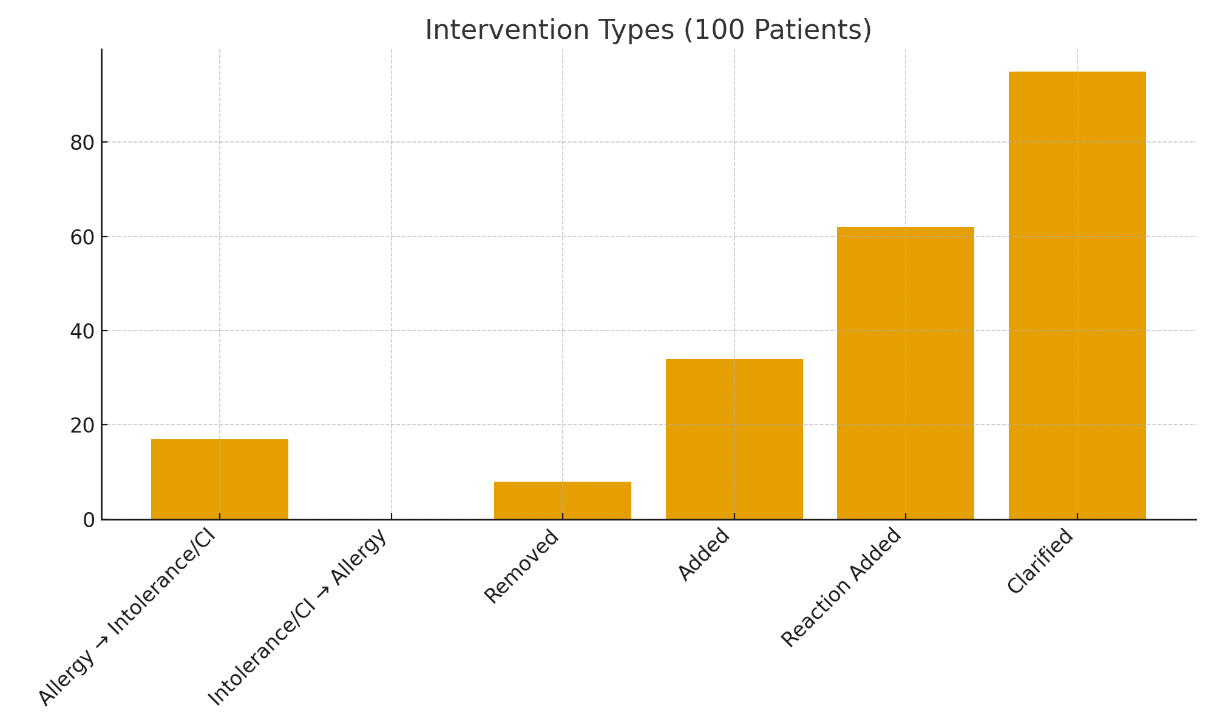
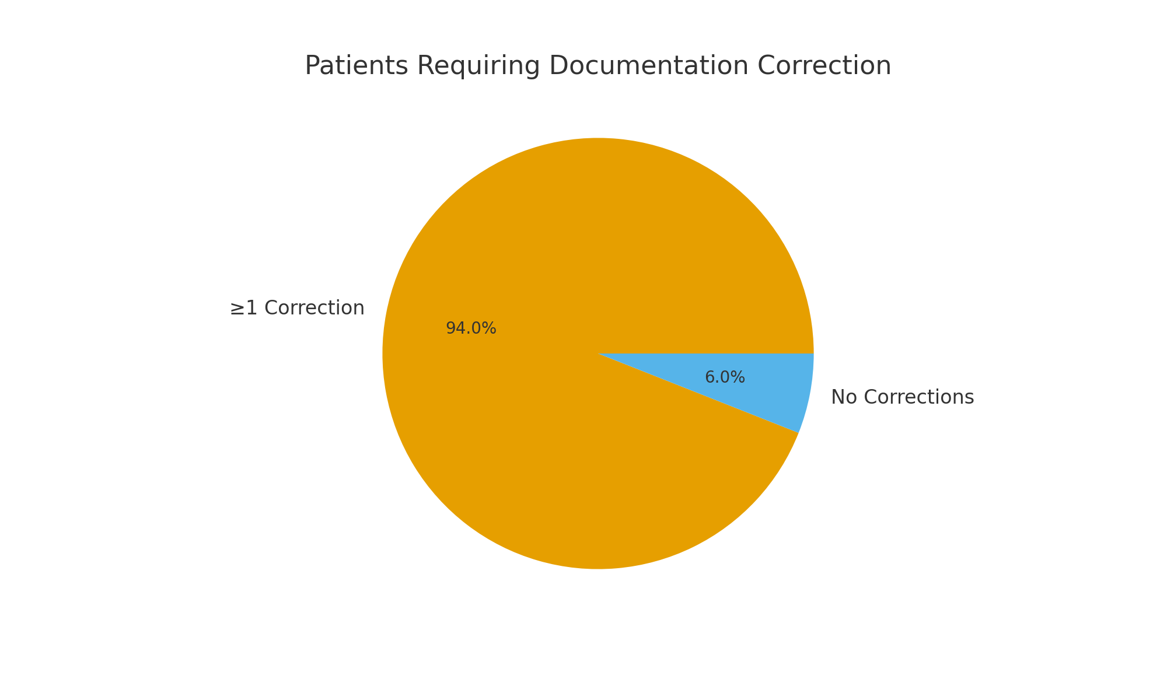
Optimizing Beta-Lactam Allergy Documentation: A Pharmacy-Driven, Patient-Centered Approach
Noah Scott PharmD Candidate, Jack Livingston PharmD Candidate, Deidre Schipper, PharmD, BCPS
School of
Pharmacy
BACKGROUND
RESULTS
FUTURE PLANS
Beta-lactam antibiotics are among the most prescribed antimicrobials, yet up to 10% of patients report a penicillin allergy. Over 90% of these reported allergies are inaccurate, outdated, or non–IgE mediated
Mislabeling penicillin allergies leads to: use of broader-spectrum, less effective, or more toxic alternatives; increased risk of antimicrobial resistance; higher rates of C. difficile infection; longer hospital stays; and higher costs
EHR allergy documentation is frequently incomplete, lacking reaction descriptions or incorrectly classifying adverse effects as allergies
Pharmacist-led allergy clarification is a proven strategy that improves antimicrobial stewardship (AMS) outcomes by restoring access to optimal beta-lactam therapy
Figure 1: Interventions Types
Figure 2: Patients Requiring Correction
Develop a standardized beta-lactam allergy clarification toolkit
Implement EHR prompts requiring reaction details before saving an allergy
Train nursing staff to perform initial allergy interviews
Evaluate outcomes such as:
  beta-lactam utilization before/after clarification
  Cost impact
  C. difficile rates
  Length of stay
CONCLUSION
METHODS
100 patients with a documented beta-lactam allergy were interviewed
94% required at least one correction to their EHR allergy profile, while 6% required no correction to their profiles
Pharmacists completed 217 total reaction interventions
Most common changes were reaction clarifications (95) and newly added reactions (62)
17 allergies were downgraded to intolerance or contraindication
8 beta-lactam allergies were removed entirely
No cases required upgrading from intolerance to allergy
Pharmacist-led allergy clarification significantly improves the accuracy and clinical usefulness of beta-lactam allergy documentation
Nearly all patients reviewed had errors or omissions requiring correction, highlighting the need for routine verification
Improved allergy accuracy directly supports antimicrobial stewardship by:
  expanding use of first-line beta-lactams
  reducing unnecessary broad-spectrum therapy
  lowering risk of resistance
  lowering risk of C. difficile infection
  enhancing patient safety and therapeutic outcomes
This structured clarification model is feasible, effective, and scalable across inpatient settings
Prospective, pharmacy-driven clarification project conducted over five weeks at Sarah Bush Lincoln Health Center
Inclusion Criteria: Hospitalized adults ≥18 years old & documented beta-lactam allergy in EHR
Exclusion Criteria: Admitted to behavioral health or labor & delivery
Process: Daily Cerner EHR report identified eligible patients, pharmacist conducted structured interviews with patients or caregivers, EHR allergy documentation was immediately updated when warranted
Interview questions assessed: Reaction type, Timing, Severity, Outcome
Intervention Types: Allergy → intolerance/ contraindication, intolerance/contraindication → allergy, reaction added, reaction clarified, beta-lactam allergy removed, beta-lactam allergy added
EXCEPTIONAL OUTCOMES
LESSONS LEARNED
217 validated interventions improved EHR accuracy
94% correction rate revealed major documentation gaps
Multiple allergy downgrades increased access to optimal antibiotics
Reaction detail enhanced provider decision-making and AMS efficiency
Most “allergies” represent side effects, childhood reactions, or vague histories
Nursing and pharmacy staff benefit from standardized interview prompts
Real-time documentation correction prevents downstream antimicrobial misuse
Many patients believed they were “allergic” based solely on family history or outdated childhood events

