Slide 1

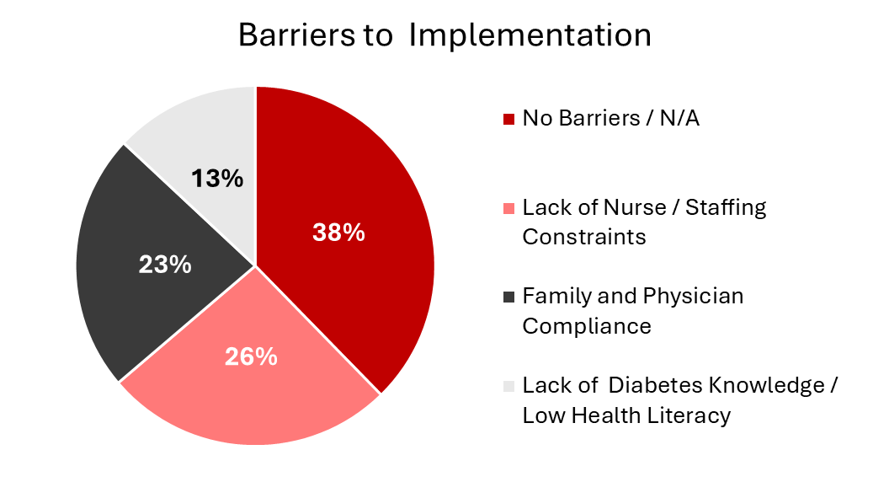
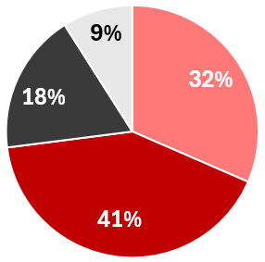
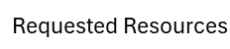

School of
Pharmacy
PharmD, CDCES
Evaluation of the Illinois Care of Students with Diabetes Act Implementation Within Illinois Schools
Haley N. Pruden, PharmD Candidate and Jessica L. Kerr, PharmD, CDCES
PharmD, CDCES
PharmD, CDCES
BACKGROUND
PURPOSE
CONCLUSION
Diabetes requires constant, careful management to prevent life-threatening complications.
The Illinois Care of Students with Diabetes Act (CSDA) requires schools to provide certain protections for students with diabetes at school, however, does not provide additional resources or specific guidance for its implementation.
Research on how the CDSA is being implemented (in reality) and barriers preventing its implementation (in realistic practice) is needed.
Evaluate how Illinois schools implement the Illinois Care of Students with Diabetes Act in practice, identify barriers to implementation of the act, so that they may be addressed and resolved, and identify resources and tools that may be provided to aid schools in the implementation of the act.
Over 40% of the responding Illinois schools did not report experiencing barriers to implementation of the Illinois Care of Students with Diabetes Act. Many schools expressed that the act does not apply to them because they currently do not have any enrolled students with diabetes. Multiple schools stated they were unaware of the act altogether.
Schools reporting barriers cited insufficient staffing, compliance and communication concerns from outside entities, and lack of in-depth knowledge on the awareness and management of diabetes.
Most commonly requested resources were increased staffing and funding for school healthcare staff and in-depth diabetes education and training for school staff members and students.
101 completed survey responses
20% of schools covered K- 12th grade, 32% of schools covered only up to 8th grade, and 8% of schools covered above 8th grade only.
76% of schools were public schools
74% of schools reported having a nurse on staff
  88% of which were employed at the school full-time
METHODS
SIUE IRB approval obtained
Descriptive qualitative study
Survey sent to one administrator for each school in Illinois serving any grades pre-kindergarten through 12th grade
Recruited via email address provided by a Freedom of Information Act request to the Illinois State Board of Education
5,034 total schools contacted. 3,979 public schools, 1,039 private or charter schools, 16 “other state funded” schools
Survey created and administered via Qualtrics XM
Responses collected anonymously
Survey open for 3 weeks
Reminder email sent at 1.5 weeks
Questions covered school demographics, staff training practices, implementation procedures, perceived barriers, and needed resources
NEXT STEPS
# of Enrolled Students With Diabetes 2024-2025 School Year
0 | 30%
1-3 | 55%
4-6 | 8%
7-10 | 2%
≥ 11 | 5%
Provide guidance to Illinois schools on processes and resources for creating or obtaining and utilizing Diabetes Medical Management Plans
Collect and provide education and resources on diabetes management for school staff.
Source and create tools to facilitate communication and collaboration between schools, physicians, and students with diabetes and their support team.
Staff Diabetes Education Training Mode of Delivery
Synchronous Virtual | 30%
Live | 27%
On-Demand | 37%
Alternative Modes | 13%
Live and On-Demand | 27%
References
1. Centers for Disease Control and Prevention. National Diabetes Statistics Report. May 15, 2024. Accessed June 8, 2025. Available from: https://www.cdc.gov/diabetes/php/data-research/index.html
2. American Diabetes Association [Internet]. Common Terms. diabetes.org. Accessed June 8, 2025. Available from: https://diabetes.org/about-diabetes/common-terms
3. American Diabetes Association [Internet]. Illinois. diabetes.org. Accessed on July 15, 2025. Available from: https://diabetes.org/advocacy/safe-at-school-state-laws/IL
4. Care of Students with Diabetes Act [Internet], ILCS 105/145. 2010 (IL). Accessed April 30, 2025. Available from: https://ilga.gov/legislation/ilcs/Articles?ActID=3284&ChapAct=105%C2%A0ILCS%C2%A0145/&ChapterID=17&ChapterName=SCHOOLS&ActName=Care%20of%20Students%20with%20Diabetes%20Act.
5. Illinois State Board of Education. Directory of Educational Entities, [email addresses released in response to Freedom of Information Act request, reference F000490-072425] [Internet]. 2025. Received July 25, 2025. Available from: email from Illinois State Board of Education Records Center.

