Slide 1



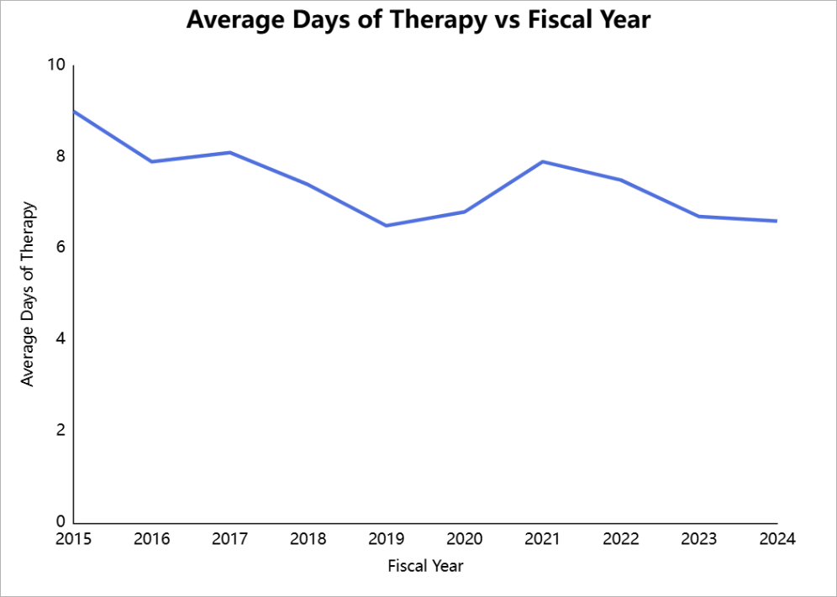
School of Pharmacy
Impact of a 7-Day Automatic Antibiotic Stop Policy at Hannibal Regional Hospital
Ethan Rucker, PharmD Candidate
Charity Sturgeon, PharmD
BACKGROUND
RESULTS
CONCLUSION
According to the World Health Organization, antimicrobial resistance is considered to be “one of the top global public health and development threats,” and the misuse/overuse of antimicrobials is the main driver in the development of drug-resistant pathogens
Antimicrobial stewardship is defined as “the effort to measure and improve how antibiotics are prescribed by clinicians and used by patients”
At Hannibal Regional Hospital, antibiotic stewardship policies were implemented on December 21, 2015 that put an automatic stop at 7 days of therapy on inpatient antibiotic orders with appropriate indications
The automatic stop was automatically removed if the prescriber selected indications that require >7 days of antibiotic therapy (bacteremia, Clostridium difficile, endocarditis, meningitis, osteomyelitis, prosthetic joint infections, and septic shock)
This reduced unnecessary antibiotic exposure, potentially limited the emergence of antimicrobial resistance, and encouraged timely provider reassessment of therapy
In July of 2025, Hannibal Regional Hospital began utilizing Epic, which does not have the same 7-day automatic stop on antibiotic orders
The objective of this study was to examine the impact this 7-day automatic stop policy had on antibiotic utilization at Hannibal Regional Hospital
27,554 patients received antibiotics over the study period
201,191 total days of therapy were recorded
Average: 7.44 days of therapy per patient
After implementation of the automatic stop policy, a sustained reduction in antibiotic utilization was observed
Total DOT decreased from 1,567 in FY2015 to a low of 1,375 in FY2020
Average days of therapy per patient decreased from 9.0 days to 6.8 days over the same time period
Average DOT per patient decreased from 9.0 to 6.6 days over the total duration of data collection
From FY2021–2024:
  Total DOT and number of patients treated increased
  Despite increased inpatient census, average days of therapy remained stable between 6–8 days
  Average DOT per patient remained consistently lower than baseline (FY2015) throughout the study period
Overall, the data demonstrates a downward trend in days of therapy after implementation of the policy:
The implementation of a 7-day automatic stop policy was associated with a meaningful reduction in antibiotic utilization at Hannibal Regional Hospital
Average days of therapy per patient decreased from 9.0 days in fiscal year 2015 to a range of 6–8 days following implementation and remained consistently below baseline despite increased patient volume
These trends indicate a sustained improvement in antimicrobial stewardship following the introduction of the automatic stop policy
Limitations include the use of fiscal year data rather than patient-specific data, lack of evaluation of clinical outcomes, and the utilization of a single-center
Overall, automated stewardship interventions such as antibiotic stop policies can reduce unnecessary antibiotic exposure and may improve patient care when implemented within electronic health record systems
 | FY15 AVG | FY16 AVG | FY17 AVG | FY18 AVG | FY19 AVG | FY20 AVG | FY21 AVG | FY22 AVG | FY23 AVG | FY24 AVG
Days of Therapy (DOT) | 1567 | 1518 | 1609 | 1552 | 1438 | 1375 | 2059 | 1993 | 1946 | 2089
Patients Treated | 176 | 190 | 199 | 209 | 219 | 202 | 257 | 264 | 290 | 315
Average DOT/Patient | 9.0 | 7.9 | 8.1 | 7.4 | 6.5 | 6.8 | 7.9 | 7.5 | 6.7 | 6.6
REFERENCES
METHODS
Antimicrobial resistance. World Health Organization. November 21, 2023. Accessed November 10, 2025. https://www.who.int/news-room/fact-sheets/detail/antimicrobial-resistance.
Core Elements of Antibiotic Stewardship. Centers for Disease Control and Prevention. Accessed November 14, 2025. https://www.cdc.gov/antibiotic-use/hcp/core-elements/index.html.
Olney K.B., & Burgess D.S. (2023). Antimicrobial regimen selection. DiPiro J.T., & Yee G.C., & Haines S.T., & Nolin T.D., & Ellingrod V.L., & Posey L(Eds.), DiPiro’s Pharmacotherapy: A Pathophysiologic Approach, 12th Edition. McGraw Hill. https://accesspharmacy.mhmedical.com/content.aspx?bookid=3097&sectionid=264605923
Metlay, J. P., Waterer, G. W., Long, A. C., Anzueto, A., Brozek, J., Crothers, K., Cooley, L. A., Dean, N. C., Fine, M. J., Flanders, S. A., Griffin, M. R., Metersky, M. L., Musher, D. M., Restrepo, M. I., & Whitney, C. G. (2019). Diagnosis and Treatment of Adults with Community-acquired Pneumonia. An Official Clinical Practice Guideline of the American Thoracic Society and Infectious Diseases Society of America. American journal of respiratory and critical care medicine, 200(7), e45–e67. https://doi.org/10.1164/rccm.201908-1581ST
Dennis L. Stevens, Alan L. Bisno, Henry F. Chambers, E. Patchen Dellinger, Ellie J. C. Goldstein, Sherwood L. Gorbach, Jan V. Hirschmann, Sheldon L. Kaplan, Jose G. Montoya, James C. Wade, Practice Guidelines for the Diagnosis and Management of Skin and Soft Tissue Infections: 2014 Update by the Infectious Diseases Society of America, Clinical Infectious Diseases, Volume 59, Issue 2, 15 July 2014, Pages e10–e52, https://doi.org/10.1093/cid/ciu296
Aaron Oliver, Andrea Quinn, Amanda Ries, Erin Weslander, Katarzyna Malkowicz, P-1727. Impact of Four-Day Automatic-Stop Orders on the Duration of Antibiotic Treatment, Open Forum Infectious Diseases, Volume 12, Issue Supplement_1, February 2025, ofae631.1891, https://doi.org/10.1093/ofid/ofae631.1891
Adu-Gyamfi A, Hamilton K, Cressman L, Lautenbach E, Dutcher L. Impact of Removal of Automatic 7-Day Stop Orders for Inpatient Antimicrobials. Infection Control & Hospital Epidemiology. 2020;41(S1):s264-s265. doi:10.1017/ice.2020.831
Single-center, retrospective observational study evaluating antibiotic utilization at Hannibal Regional Hospital
Study period included fiscal years 2015–2024
After the 7-day automatic stop policy was implemented on December 21, 2015, data was obtained from the hospital’s electronic health record system as well as antimicrobial stewardship records
Fiscal year 2015 served as the baseline that represented antibiotic use prior to policy implementation, while fiscal years 2016–2024 reflected antibiotic usage after implementation
Data evaluated included: days of therapy (DOT), patients treated, and average days of therapy per patient
Days of therapy was defined as the total number of days that a patient received an antibiotic regardless of dose or frequency
Average days of therapy per patient was calculated by dividing total DOT by the number of patients who received antibiotic therapy during each fiscal year
These values were compared to assess trends before and after implementation of the automatic stop policy
Primary outcome: change in average days of therapy following implementation to determine whether the policy was successful

