Slide 1

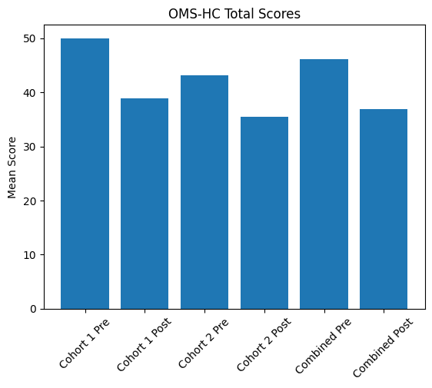
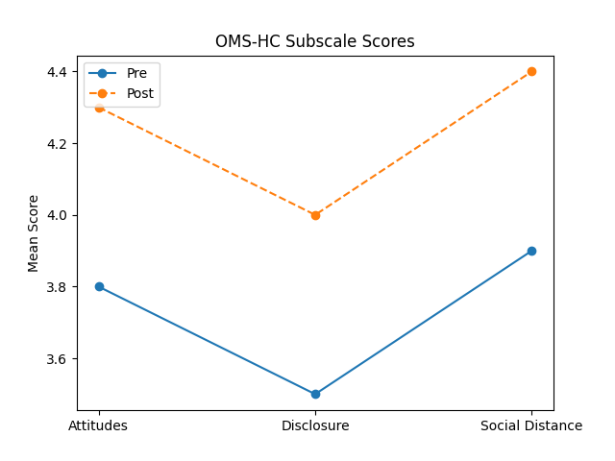
Stigma in Mental Health: Evaluating Educational Interventions for Pharmacy Students
Dan Botnar, Pharm D. Candidate; Kelly Gable, Pharm D., BCPP
School of
Pharmacy
BACKGROUND
RESULTS
STATISTICAL ANALYSIS
Stigma toward mental health conditions influences how healthcare providers perceive and interact with patients.¹
Pharmacy students often have limited exposure to structured stigma-reduction training.²
Borderline personality disorder (BPD), anxiety disorders, and attention-deficit/hyperactivity disorder (ADHD) each carry distinct forms of stigma that can affect communication, empathy, and treatment decisions.¹
Condition-specific workshops have been shown to improve students’ understanding of these biases using scoring guides like the Opening Minds Stigma Scale for Health Care Providers (OMS-HC).³
OMS-HC responses were numerically coded and reverse-scored according to published guidelines; total and subscale scores (Attitudes, Disclosure, Social Distance) were calculated
Descriptive statistics were calculated and reported as mean (SD) for all outcomes
Pre–post changes within each cohort and the combined sample were analyzed using paired-samples t-tests
Effect sizes (Cohen’s d) were calculated to assess magnitude of change, with statistical significance set at p < .05
Group | n | Pre Mean (SD) | Post Mean (SD) | t | p-value | Cohen’s d
Cohort 1 | 7 | 50.00 (5.54) | 38.86 (5.01) | 8.46 | < .001 | 2.01
Cohort 2 | 9 | 43.11 (5.62) | 35.44 (14.88) | 1.70 | .127 | 0.62
Combined | 16 | 46.13 (6.45) | 36.94 (11.45) | 3.58 | .003 | 0.96
FUTURE PLANS
Adapt workshops for other healthcare disciplines.
Assess long-term impact on stigma reduction.
METHODS
CONCLUSION
Third-year pharmacy students participated in three brief workshops for BPD, ADHD, and anxiety disorders.
The OMS-HC-20 was completed before and after the workshops to measure changes in stigma.
Results demonstrated reductions in mental health stigma across all OMS-HC subscales and the total score.
Supports integrating targeted stigma-reduction training into pharmacy curricula
M = mean; SD = standard deviation; 95% CI = 95% confidence interval around the mean. Higher scores indicate lower stigma after reverse scoring. p-values derived from paired-samples t-tests. Cohen’s d reflects effect size.
Corrigan, P. W., Druss, B., & Perlick, D. (2014). The impact of mental illness stigma on seeking and participating in mental health care. Psychological Science in the Public Interest, 15(2), 37–70. https://doi.org/10.1177/1529100614531398
Dopheide, J. A., Werremeyer, A. B., Haight, R. J., Gutierrez, C. A., & Williams, A. M. (2017). Curriculum in psychiatry and neurology for pharmacy programs. American Journal of Pharmaceutical Education, 81(9), 6165. https://doi.org/10.5688/ajpe6165
Kassam, A., Papish, A., Leese, M., & Thornicroft, G. (2012). The Opening Minds Stigma-Scale for Health Care Providers (OMS-HC). BMC Psychiatry, 12, 62. https://doi.org/10.1186/1471-244X-12-62
Notes:
Corrigan, P. W., Druss, B., & Perlick, D. (2014). The impact of mental illness stigma on seeking and participating in mental health care. Psychological Science in the Public Interest, 15(2), 37–70. https://doi.org/10.1177/1529100614531398
Dopheide, J. A., Werremeyer, A. B., Haight, R. J., Gutierrez, C. A., & Williams, A. M. (2017). Curriculum in psychiatry and neurology for pharmacy programs. American Journal of Pharmaceutical Education, 81(9), 6165. https://doi.org/10.5688/ajpe6165
Kassam, A., Papish, A., Leese, M., & Thornicroft, G. (2012). The Opening Minds Stigma-Scale for Health Care Providers (OMS-HC). BMC Psychiatry, 12, 62. https://doi.org/10.1186/1471-244X-12-62

