Slide 1

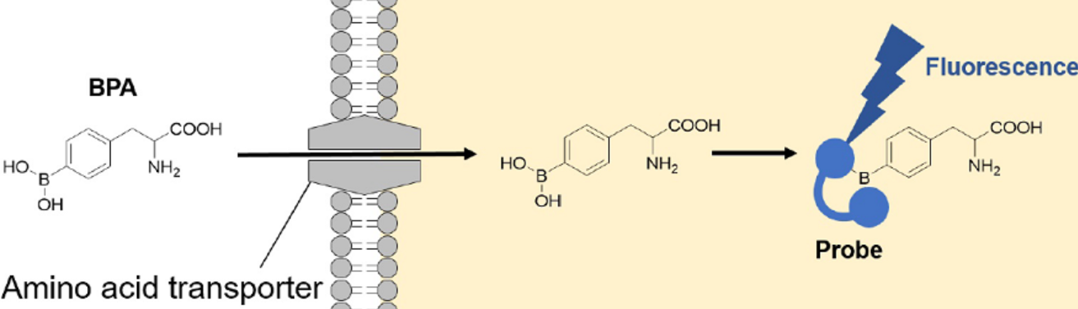
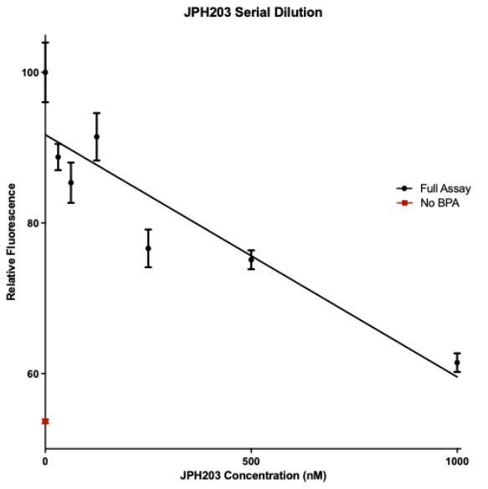
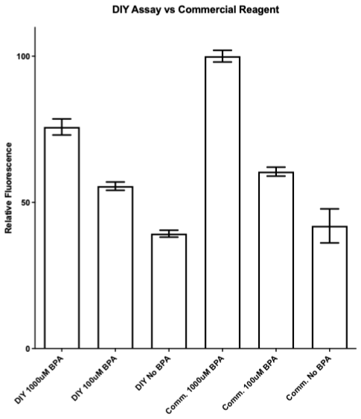
A Low-Cost Fluorescence-Based DIY Assay for Screening LAT1 Inhibitors
Corrine Pierce, PharmD Candidate
Mentor: Dr. Joseph Schober
School of
Pharmacy
BACKGROUND
COST BREAKDOWN
The DIY method costs < $0.01 per test versus $4.48 per test for the commercial kit, a >3,000-fold cost reduction.
L-type amino acid transporter 1 (LAT1) is an amino acid transporter overexpressed in several cancers, making it a promising target for drug development.
Existing fluorescence-based LAT1 activity assays rely on a single proprietary, expensive commercial kit, limiting access to high-throughput drug screening.
To address this, we developed a DIY fluorescence-based p-Boronophenylalanine (BPA) uptake assay using an easily accessible detection reagent.
This approach aimed to replicate the commercial assay’s function at a fraction of the cost, allowing broader access in research settings for early drug screening.
CONCLUSION
RESULTS
This project demonstrates a feasible, ultra-low-cost DIY assay for assessing LAT1 inhibitor activity.
By reducing assay cost and dependence on proprietary reagents, this approach may broaden access to cancer drug screening tools and accelerate discovery of new targeted therapies.
METHODS
Preliminary testing evaluated detection reagent concentration and exposure time to establish consistent signal conditions.
A fluorescence-based assay was then performed to measure LAT1-mediated uptake of (BPA). A549 cancer cells were treated with BPA ± the LAT1 inhibitor JPH-203, and fluorescence was measured using either the DIY detection reagent or the leading commercial probe under identical conditions.
Cost per test was estimated based on reagent quantities and unit pricing for each assay.
FUTURE PLANS
Investigate the inclusion of a secondary tracer dye to normalize for cell number and improve data consistency.
Evaluate the assay in additional cancer cell lines.
Figure 1A. Fluorescence assay performed using cells treated with the LAT1 inhibitor JPH-203 at varying concentrations.
Figure 1B. Assay performed using BPA concentrations of 0, 100, and 1000 µM with either the DIY detection reagent or the commercial probe solution.

