Slide 1
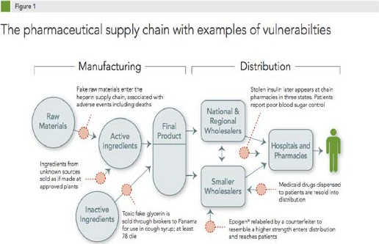
Implementing Tracelink into A Rural Hospital Pharmacy
Caleb Geary, PharmD Candidate | Jill Kellerman, RPh, Pharmacy Director
Pinckneyville Community Hospital, Pinckneyville, IL
BACKGROUND & INTRO
The Drug Supply Chain Security Act (DSCSA), enacted in 2013, requires the end-to-end tracking and tracing of medications across the drug supply chain to improve safety and prevent counterfeit drug distribution.
Compliance Deadlines: Extended due to COVID-19. For dispensers with 25 or fewer full-time employees, the deadline is November 27, 2026.
Setting: Pinckneyville Community Hospital, a federally designated critical access hospital.
Solution: The hospital partnered with Tracelink, a third-party platform designed to facilitate compliance via secure data exchange.
Risks of Non-Compliance: Severe penalties including fines up to $500,000, criminal violations, or loss of dispensing license.
OBJECTIVE
To identify barriers to implementation.
To train pharmacy staff at Pinckneyville Community Hospital to utilize Tracelink's track-and-trace technology effectively.
METHODS
A student pharmacist was designated as the primary Tracelink trainer and led the implementation efforts.
Preparation: Reviewed DSCSA requirements, completed Tracelink's online video and written training modules, and assessed baseline staff familiarity.
Infrastructure Verification: Verified required tools (workstation, computer, scanning tool) were present before workflow integration.
Staff Training: Conducted individualized staff training sessions focused on:
  Receiving medication orders
  Barcode scanning procedures
  Error resolution (e.g., "product no order data" and "order data no product")
Problem Solving: Identified incomplete partner data for returning medications and engaged the Tracelink representative for resolution.
ANTICIPATED OUTCOMES
Regulatory Compliance: Guarantee no disruptions to the supply chain while meeting DSCSA track-and-trace regulations.
Interoperability: Strengthen seamless data exchange with trading partners (e.g., Cardinal Health).
Staff Confidence: Improve operational confidence and reduce receiving and reconciliation errors.
BARRIERS IDENTIFIED
Workflow Inefficiencies: Barcode scanning and data verification introduce additional steps, increasing technician workload.
Resource Constraints: Limited staffing and competing operational priorities in a critical access setting.
Technical Vulnerabilities: Reliance on systems introduces risks related to downtime and internet reliability.
Training Gaps: Potential for inconsistent utilization without a standardized onboarding process for future employees.
DISCUSSION & CONCLUSION
Implementing Tracelink in a rural critical access hospital is feasible and successfully supports regulatory compliance without compromising patient care.
Key Facilitators: Alignment with existing trading partners and utilizing vendor-provided training resources.
Implementation Strategy: The involvement of a student pharmacist proved highly valuable to lead system familiarization and mitigate workflow challenges.
Sustainability: Long-term success requires formalizing standard operating procedures and establishing continuous training mechanisms.
References
U.S. Food and Drug Administration. Title II of the Drug Quality and Security Act (Drug Supply Chain Security Act). Accessed April 24, 2026. https://www.fda.gov/drugs/drug-supply-chain-security-act-dscsa/title-ii-drug-quality-and-security-act
Viebeck E. Senate inches toward passing drug bill. The Hill. November 2013. Accessed April 24, 2026. https://thehill.com/blogs/floor-action/senate/190254-senate-inches-toward-passing-drug-bill/
U.S. Food and Drug Administration. Waivers and exemptions beyond the stabilization period. Accessed April 24, 2026. https://www.fda.gov/drugs/drug-supply-chain-security-act-dscsa/waivers-and-exemptions-beyond-stabilization-period
TraceLink Inc. TraceLink digital supply network for life sciences. Accessed April 24, 2026. https://www.tracelink.com/
Accreditation Commission for Health Care (ACHC). DSCSA: Safeguarding the drug supply chain. Accessed April 24, 2026. https://achc.org/dscsa-safeguarding-the-drug-supply-chain/

