Slide 1

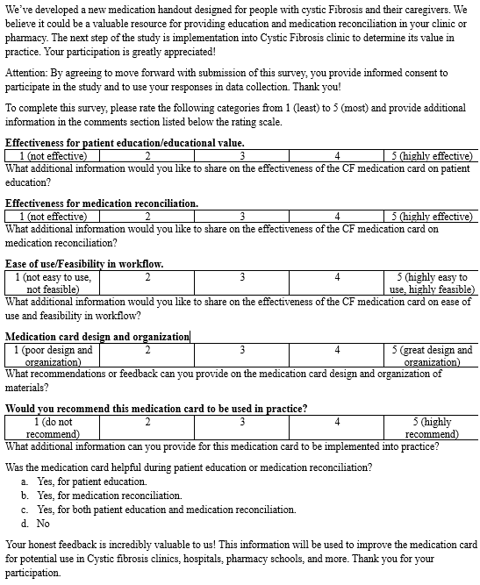
Implementation of a Medication Card for
Cystic Fibrosis Education
Anna Flath, PharmD Candidate and Lisa Lubsch, PharmD, BCPPS, AE-C, FPPA
School of Pharmacy
Background
Results
Cystic Fibrosis (CF) is a genetic disorder that affects the CFTR function leading to the production of thick mucus, pancreatic insufficiency, and respiratory symptoms
Medication nonadherence occurs in around 50% of patients with CF
Longer hospital stays, frequent hospitalizations, IV antibiotic requirements, and a decline in lung function
Most common in the adolescent population
Email sent to 34 participants → 21 responses received, 11 participants did not proceed past the initial statement and were not included in analysis
10 responses included data for analysis (Question 1 included 10 participants and question 2 through 5 included 8 participants
88% responded helpful for both patient education and medication reconciliation
Feedback: remove CFTR modulator dosing, helpful images, add MVW tablet/capsule images, helpful in pediatric setting and in clinic that do not use the same EMR, add Hypersal 3.5% or NaCl 3%, create a poster version, laminated copies, improve simplicity, improve image quality, add the order of inhaled therapies, remove boxes around drug names
Methods
Conclusion
Study Period: 1/30/26 to 3/4/26
Implementation Steps:
IRB approval
Emailed participants study information, survey link, IRB approval, research participant notification, and IRB recruitment document
Obtained consent during the survey
Participants implemented the medication card then completed the survey rating scale and questions (see Figure 1)
Collect results and analyze data
Figure 1) Medication card information, consent for participation statement, rating scale and questions for feedback.
Aspects included the educational value, effectiveness in medication reconciliation, feasibility in workflow, medication card design/organization, and recommendation for use in practice.
Positive effect on patient care to improve patients’ knowledge of CF medications
Aided patients, parents, and clinicians by providing images for recognition.
Potential future use in clinical practice
Other studies are needed to measure the direct impact on patients and their knowledge of CF medication to prove increased adherence rates and assess the effect on nonadherence
References
Cystic Fibrosis Foundation. About Cystic Fibrosis. Cystic Fibrosis Foundation website. https://www.cff.org/intro-cf/about-cystic-fibrosis. Accessed October 19, 2025.
Eakin MN, etc. The impact of medication adherence on lung health outcomes in cystic fibrosis. Curr Opin Pulm Med. 2013;19(6):687-691. doi:10.1097/MCP.0b013e3283659f45. Available at: https://www.ncbi.nlm.nih.gov/pmc/articles/PMC5450651/. Accessed October 29, 2025.
Quittner AL,etc. Pulmonary medication adherence and health-care use in cystic fibrosis. CHEST. 2014;146(1):142-151. doi:10.1378/chest.13-1926. Accessed October 29, 2025.

