Slide 1

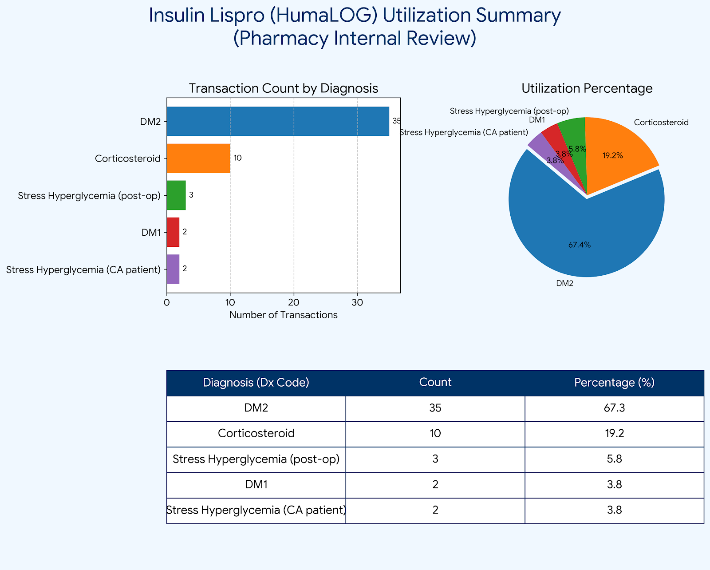
The Hidden Challenge: Evaluating Insulin Lispro use in non-diabetic patients in an inpatient rehabilitation setting
Abigail Spann , PharmD Candidate; Misty Farr , PharmD, MHA
School of
Pharmacy
BACKGROUND
METHODS
Discussion
Prevalence of SIH: Stress-induced hyperglycemia (SIH) is a frequent clinical finding, occurring in up to 30–40% of all hospitalized patients.
Pathophysiologic Drivers: The condition is primarily driven by the body’s response to acute physiologic stress—such as major surgery or severe illness—and the common clinical use of corticosteroids.
Clinical Consequences: In the inpatient rehabilitation setting, poor glycemic control is not a benign finding. It is directly linked to several suboptimal patient outcomes.
The Insulin Balance: While insulin lispro is the gold standard for the rapid correction of acute hyperglycemia, its application in non-diabetic patients requires caution.
IRB approval
Study Design: Retrospective, single-center chart review at a 40-bed Inpatient Rehabilitation Facility.
Timeline: Data collect November 2025 through February 14, 2026. During the 90-day study period, 52 patients met the criteria for receiving insulin therapy
Population: Adult patients receiving insulin therapy; excluded those with a prior diagnosis of Type 1 or 2 DM to isolate stress and steroid-induced cases.
Data Points: Analyzed point-of-care glucose logs, corticosteroid dosing, and incidence of hypoglycemia (BG <70 mg/dL).
The Gap: While T2DM drives most insulin use, nearly 10% of cases were pure stress-induced hyperglycemia (SIH) in non-diabetics.
Steroid Impact: Steroids caused 20% of cases; high-dose prednisone led to significant late-afternoon glucose "escapes."
Safety: A 7.7% nocturnal hypoglycemia rate suggests standard sliding scales are too aggressive for non-diabetic patients with fluctuating intake.
Clinical Stakes: Glycemic control is vital for physical therapy; uncontrolled sugars compromise wound healing and bone integrity.
RESULTS
FUTURE PLANS
Standardized IRF Protocols: Develop a pharmacist-led "Transition of Care" glycemic review for all new admissions to identify non-diabetic patients at risk for SIH.
Staff Education: Launch a nursing education initiative focusing on the coordination of insulin lispro administration with actual nutritional intake ("No Tray, No Lispro").
Objective
References
To evaluate the use of insulin lispro in managing hyperglycemia among non-diabetic patients in an inpatient rehabilitation setting, including associated benefits, risks, and underlying etiologies.
American Diabetes Association. (2026). Standards of Medical Care in Diabetes—2026. Diabetes Care.
Moghissi, E. S., et al. (2009). Consensus statement on inpatient glycemic control. Endocrine Practice.
Umpierrez, G. E., et al. (2012). Management of Hyperglycemia in Hospitalized Patients in Non-Critical Care Settings. Journal of Clinical Endocrinology & Metabolism.
Illinois Pharmacy Practice Act. (225 ILCS 85). Section 44: Disclosure of pharmacy retail price and clinical care standards (2026 Update).

