Slide 1
What You Need to Know about Application Submission and Assignment
Yujing Liu, Ph.D.
Deputy Director
Division of Receipt and Referral (DRR)
Notes:
Hi, I'm Yujing Liu and I'm the Deputy Director of the division of receipt and referral at the Center for Scientific Review or C-S-R. Today, I'm going to talk about the E-submission and the application receipt and assignment processes.

Slide 2
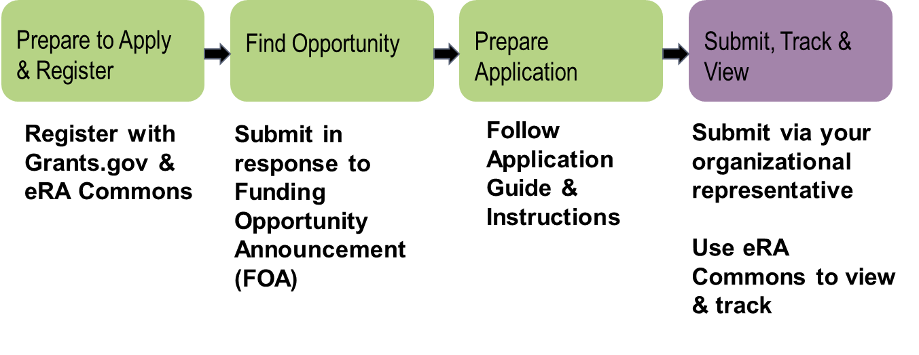
Application Process (Overview)
Notes:
The submission process can be broken down into four main activities. First institutions need to go out and register with grants.gov in the eRA Commons. Second applicants need to find a funding opportunity announcement since all of our applications are submitted to funding opportunity announcements. Third you need to look at the instructions in the funding opportunity announcement and application guide and follow them to prepare your application. And finally when the application is ready to go you submit the application through grants.gov. Your authorized organizational representative AOR is responsible for submission for you but you're also responsible for tracking the application through the submission process all the way to eRA Commons making sure once it gets there that it looks like you expected it to look.

Slide 3
DRR Is at the End of the Grants.gov Pipeline
Incoming applications for all of NIH + other HHS Agencies
Remaining applications distributed among Center for Scientific Review (CSR) IRGs
Problems? Policy Compliance?

Slide 4
What Does DRR Do?
Determines if application is
On time
Formatted correctly
Complete
Compliant with NIH policy
Makes Institute Assignment for funding consideration
Makes Study Section Assignment for review
Notes:
DRR is responsible for screening and returning late applications. We also perform a number of other policy checks, some of which are listed here. However, administrative review and compliance checking is a shared responsibility among all NIH staff including Scientific Review Officers, Program Officials and Grants Management Staff. If we find problems, we’ll let you know. DRR also assigns applications to an NIH institute for funding consideration and to a study section for the review. (pause) Let me step back a moment to talk about how you can get more information about which institute and study section might be right for your application.

Slide 5
Find a Funding Opportunity (FOA)
https://grants.nih.gov/funding/searchguide/index.html
Notes:
Since all applications must be submitted to an FOA published in the NIH Guides to Grants and Contracts, you can use keywords to search appropriate FOAs. Also, you can use the Organization option to narrow your FOA search to a specific Institute. Once you find an FOA, you need to access the application package and then follow all the instructions in the FOA and the application guide when you prepare your application. (pause)

Slide 6
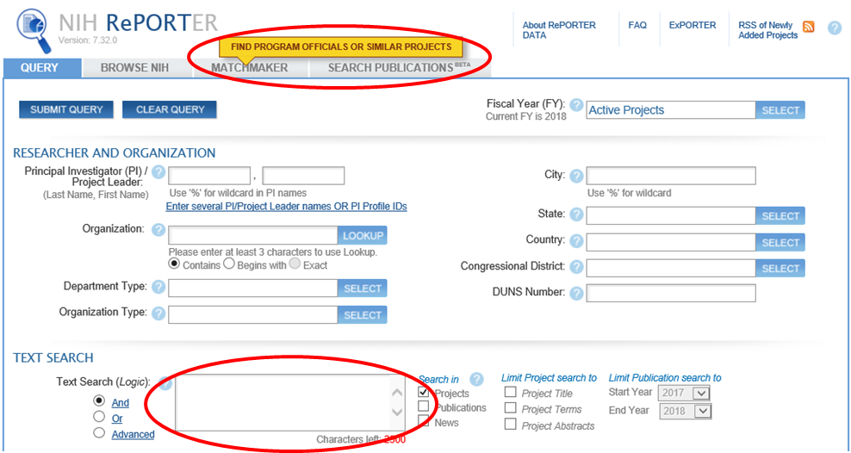
Help Your Application Get to the Right Institute
http://projectreporter.nih.gov/reporter.cfm
Notes:
I'd like to give you some advice about how you can get more information on identifying an institute that might be interested in your research. If you're experienced investigator you probably have a good idea on which institute you want. But if you're new investigator or experienced investigator moving into a different field you might need a little advice. (pause) One resource you can use is the NIH Reporter, which is a database of funded NIH Grant applications. (Pause) Once you get to this page, you can search the database in one of two very easy ways. One is to use the text search box highlighted by the lower red circle, where you can insert the search keywords for your science. The other way is to click on the upper tab called Matchmaker. It is a very nice tool, where you can paste in your abstract or specific aims, and it will be compared to the database of NIH-funded Grants. Matchmaker will then give you information like this.

Slide 7
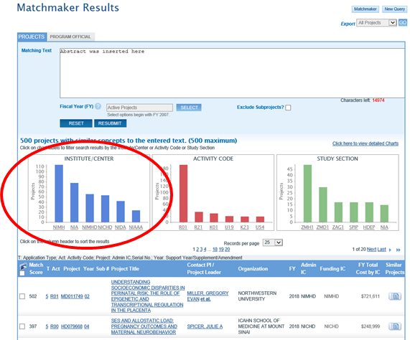
How to Find an Institute, Step 2
Copy abstract/Aims
Matchmaker Search returns:
List of Institutes
List of funded grants
Link to Program Officials
Notes:
One piece of information I think is most interesting here is the left hand blue histogram. It will tell you which institute has been funding for science similar to yours. This information may be very helpful if you want to suggest that your application be assigned to a specific institute.

Slide 8
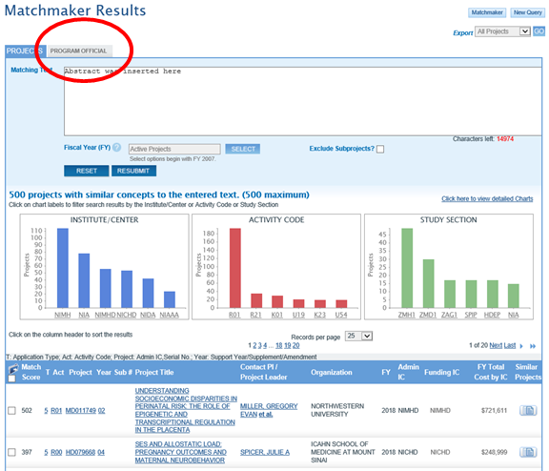
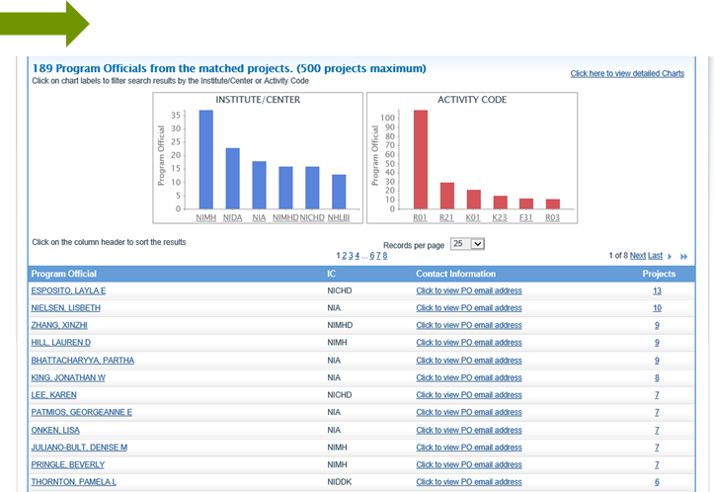
Find Program Officer to Discuss
Notes:
If you click on the program official Tab in the red circle, you can find the contact information for the program officials who manage similar applications. These individuals can help you better understand how well your research might fit in their Institutes and provide additional guidance.

Slide 9
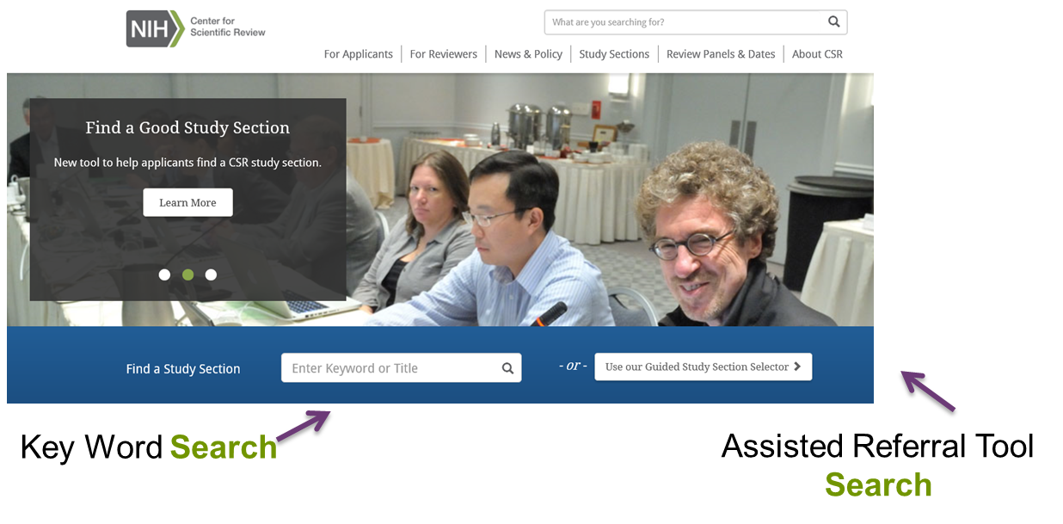
Help Your Application Get to the Right Study Section
http://www.csr.nih.gov
Notes:
(pause)
Now, I'd like to talk about study section assignment with a caveat that some study sections can't be requested because we have some preset agreements – usually related to specific Requests for Applications or special reviews -- where certain applications must be reviewed in specific review groups or special emphasis panels. However, most applications assigned to CSR are reviewed in our regular standing study sections. If you go to the CSR website, you have several options for searching for study sections. One is to do a keyword search, so if you're studying angiogenesis for example, you can put the keyword directly into that box and you will get a series of study sections that might be appropriate for your science. Another way to search for a study section, is to use our Assistant Referral Tools or A-R-T by clicking the box on the right.

Slide 10
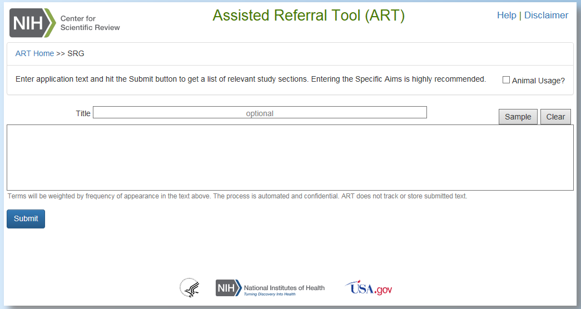
Assisted Referral Tool
Notes:
This will lead you to the tool where you can paste in your application title and abstract or specific aims in the boxes. By submitting this information, the search results will provide you with a list of possible study sections for you to consider.

Slide 11
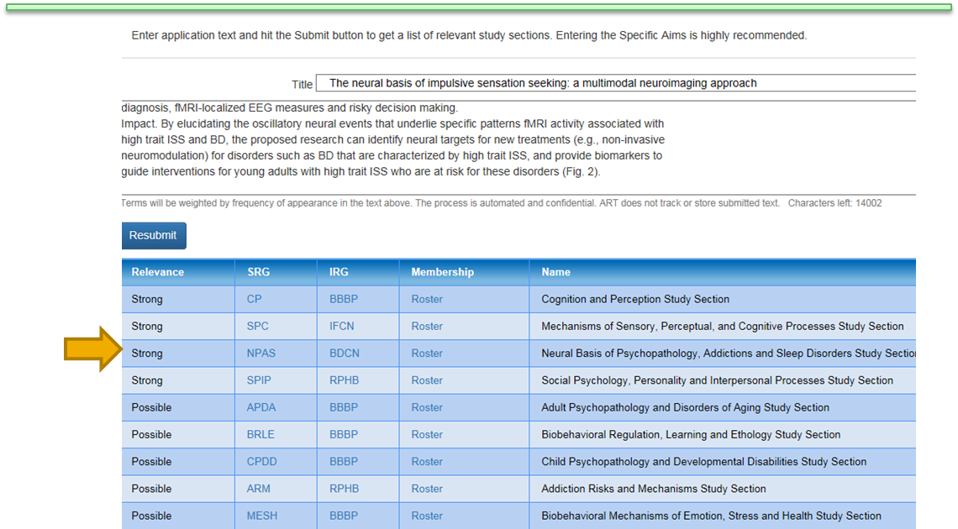
Example of ART Recommended Study Section/IRG

Slide 12
How to Find a Study Section, Browse
https://public.csr.nih.gov/StudySections
Notes:
Alternatively, you can just browse CSR’s website and examine the clusters of study sections called integrated review groups or I-R-Gs and you can look at the individual study sections in the IRGs and get more information about them.

Slide 13
Assignment Request Form (ARF)
The ARF replaces many functions of the cover letter.
Use it to:
Make assignment requests
Identify potential conflicts of interest
List areas of expertise needed to evaluate the application
Never suggest specific reviewers
Notes:
So you've done your research and made a decision about which Institute you'd like to request and which study section you prefer to review your application. How do you convey that information to the NIH? Previously we asked applicants to use a cover letter to make these requests if they wanted to. Now we have a new assignment request form that is part of the application. In addition to use this form to request assignments, you can also let us know about any conflicts you have with potential reviewers and tell us about expertise needed to review your application.

Slide 14
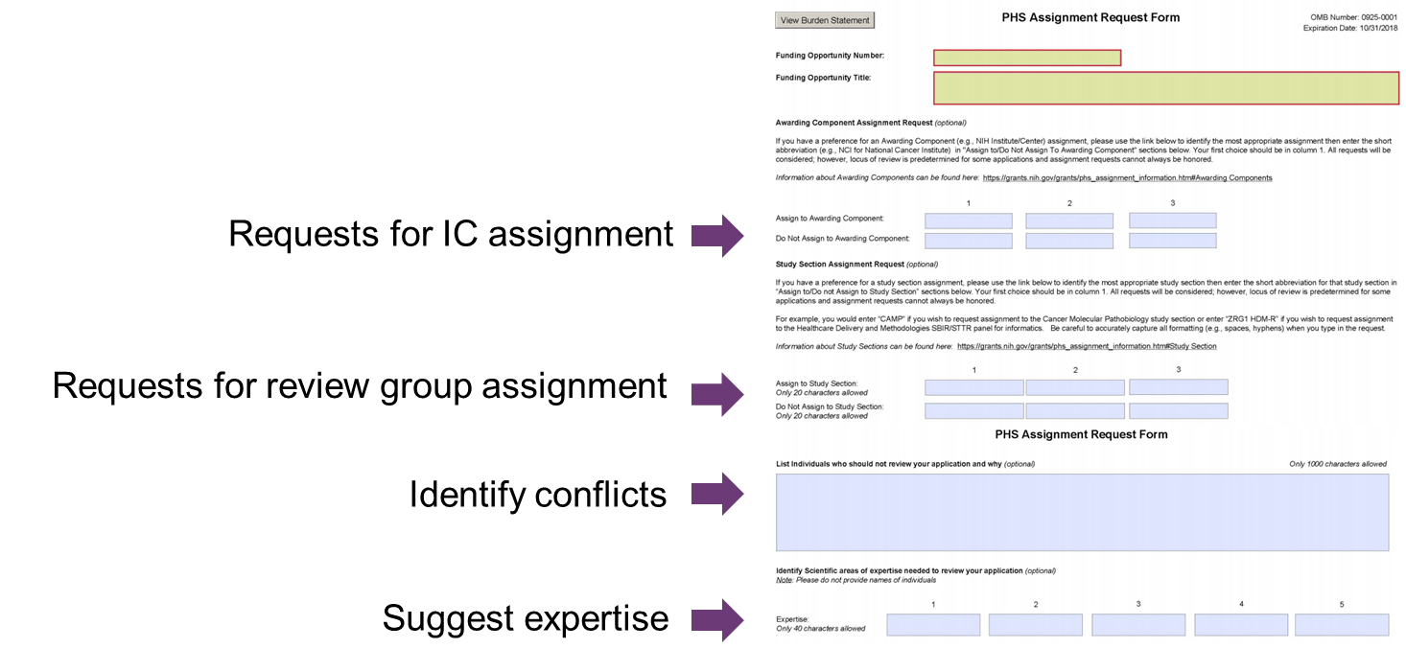
Assignment Request Form (ARF)
Notes:
(pause)
This is what the form looks like and you may use “please assign me to” and “please don't assign me to” requests for institute and study section assignments. There is also a text box to put in information about conflict or expertise needed. It is important to note that this form is optional and you don’t have to request institute or study section assignments. We are always happy to make these assignments for you based on our deep understanding of the areas covered by the NIH Institutes and our review groups.

Slide 15
Cover Letter
You can use a cover letter to:
Explain why your application is late
Provide notice of plans to submit a video
Identify your project as generating large-scale genomic data
Provide pre-approvals ($500k, conference grants)
You should NOT use a cover letter to:
Make assignment requests (use the ARF!)
Suggest specific reviewers (never do this!)
Notes:
Cover letters are still used for a few things. For example, definitely explain to us if you are submitting your application late. This is the place you would also explain to us if you are generating a genome-wide data. This is also the place that you would tell us if you plan to submit a video. So there's a number of things that still belong in the cover letter attachment. However, you should not use a cover letter to make assignment requests or suggest reviewers.

Slide 16
Keep Track of Your Application
AORs submit applications
PD/PIs responsible for accuracy of submission
Do not wait for e-mails; proactively check eRA Commons
If you cannot see your application in eRA Commons, neither can we!
Remember
It is your career and your livelihood on the line
Do not make any assumptions!
Notes:
Some important reminders: The Signing Official in your grants office is responsible for submitting your application on time, but you are responsible for the content. Do not sit back and wait for e-mails. Proactively check your eRA Commons account. If you cannot see your application in Commons, neither can we, and if we can’t see it we can’t review it. Start the submission process early – days early rather than hours early – so that you have plenty of time to view your application after it is compiled on Commons. Sometimes things don’t look the same in Commons as it did on your computer. Take the time to look at the application the way your reviewers will see it. Sometimes applicants forget to include necessary attachments such as letters of support. Give yourself plenty of time to submit a corrected copy if necessary. We cannot accept missing pieces or corrected pages after the deadline.

Slide 17
How NOT to Submit a Late Application
START EARLY!
Application must be accepted TWICE: Grants.gov and NIH
Check eRA Commons for your submitted application
(e-mails are sent but can be caught in SPAM filters)
High volume at deadlines slows processing/validation time
On time application = submitted error-free by 5 PM local time on due date
Errors cause rejection – Warnings are error-free and accepted
No error correction window that extends deadline
Notes:
One very important policy is the NIH’s late application policy. Submitting to the NIH is not like buying a book from a major on-line retailer where 30 seconds after you click the “buy” button, the book is successfully downloaded to your e-reader. NIH applications must be accepted twice. Grants.gov serves as a general portal for electronic applications submitted to various federal agencies. When you receive a tracking number starting with the capital letters G-R-A-N-T this just means it has been accepted by Grants.gov. At that point, NIH retrieves your application and performs numerous validations, all of which must be successfully passed in order for your application to be accepted by the NIH. E-mails are sent at various points during this process but e-mails are not 100% reliable, so you should always be checking the status of your application in eRA Commons. High volumes around submission deadlines can slow validation/processing times by an hour or more. If your application does not pass the validations, it will be rejected with an “error” message. You need time to fix that error and start the submission process all over again. To be on time, your error-free application must be submitted by 5 PM LOCAL TIME on the due date. There is no error correction window that extends the deadline. Applications submitted after the deadline, including those to correct errors, are late and will not be sent forward to review unless they can be accommodated under the NIH late policy.

Slide 18
A Window to Your Application: eRA Commons
eRA Commons is an online interface where a grant applicant can:
Check submitted grant application for errors and warnings and view final image
Track review assignment, view review outcomes (score, summary statements), find contact info
Update Personal Profile to ensure Early Stage Investigator eligibility is in place
Submit pre-award information (just in time)
View Notice of Award and other key documents
And much more!
https://commons.era.nih.gov/commons/
Notes:
One more very important reminder: eRA commons is THE place to make sure your application shows up and it looks right. You can access any error or warning messages on eRA Commons. You can track your application through the system. It takes about 2 weeks for the application to make it through the full receipt and referral process and you can watch it as it goes. You will see the Institute assignment, you will see the SRO assignment and you will see contact information for people in case you have any questions. You'll find everything on the status page for your application in eRA Commons. Plus there's much more you can do there so it's definitely a website that you should become familiar with and use often. Finally thank you for your time and best of luck with your application submission.

