Slide 1


POWER vs WELLBEING
Module 3
Silvana De Lima

Slide 2
Material
Understanding Power and how to use it for good.
  Youtube - Adam Grant on How Humility Builds Stronger Teams & professionals.
  Article: Emotional Intelligence has 12 Elements. Which Do You Need to work On? – Harvard Article by Daniel Goleman and Richard E. Boyatzis - read
Importance of Wellbeing in a changing world
  Back up slides
  Ways to help with Mental Health and Wellbeing.
  Tips on apps and websites to help with wellbeing.
Is power and wellbeing compatible?
  Article: Perspectives on power relations in human health and well-being by Ingrid Larsson and Henrika Jormfeldt.
  Questions and brief discussion.
Networking enables a powerful career
  Article: The Power of Networking.
  Virtual panel with Nuseed CIO – Reetal Pai -15 min

Slide 3
Power: what questions do you have about it??
How can I gain power and keep it?
How can I ensure that I won’t abuse power myself when I have it?
Is it predetermined by personality or wealth? Is it a special “trait”?
Is it understood differently by gender, culture, class?
Is authority same as power?
Is power “dirty”?
Definition by professors Julie Battilana and Tiziana Casciaro (book Power for All):
“Power is energy for everyone to harness to make our lives, work and society better.”
List 3 people you believe are powerful and why – 5 min.
Share thoughts – 10 min.
Notes:
Power fascinates and repulses us
We fear losing our minds or our principles.
Examples of good power:
3rd grader convincing her classmates to participate in a fundraising campaign to benefit a non-profit org that cares for kids with disabilities.
Manager persuading the corporate office to give his team the resources needed to do a better work in better conditions.

Slide 4
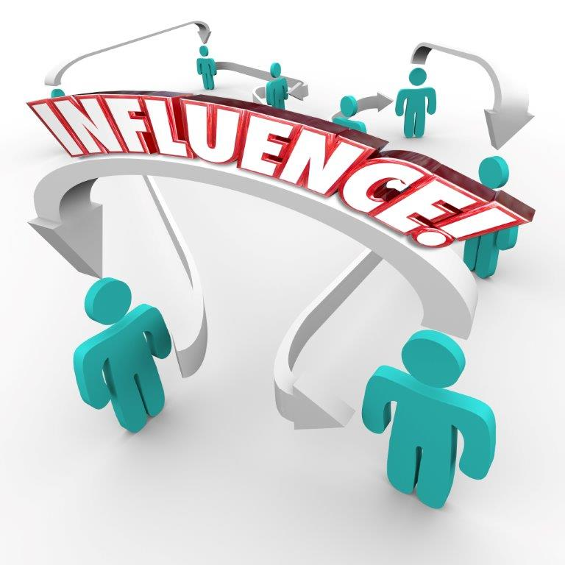
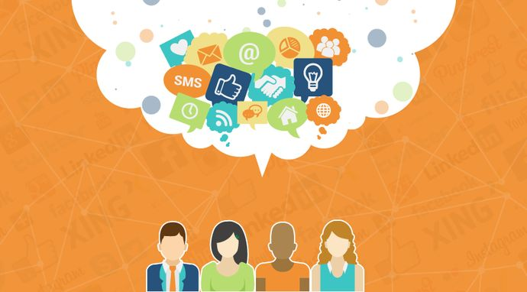

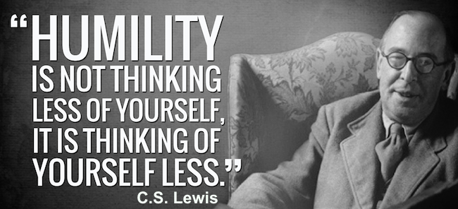

Power exists in the context of a relationship…
You have resources the other values and vice-versa;
The alternatives you and the other have wanted by one another.
“TRAITS” NEEDED TO BE DEMONSTRATED:
Story telling
Inspiration
Trustworthy
Influence one another’s behavior
https://www.youtube.com/shorts/p1onIL74sNE

Slide 5
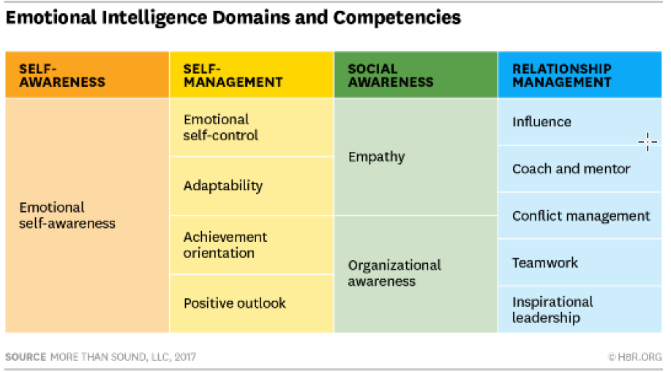


Do you understand how E.I. can enable you to build “power”?
“Emotionally intelligent people are able to self-manage their behaviors and navigate challenges with the best outcome in mind for themselves and their relationships, despite emotions that may be at play.”
Poll: questions about the understanding of EI.
Notes:
Example of how emotional intelligence is misunderstood.
Esther is a well-liked manager of a small team. Kind and respectful, she is sensitive to the needs of
others. She is a problem solver; she tends to see setbacks as opportunities. She’s always engaged and
is a source of calm to her colleagues.
They are defining emotional
intelligence much too narrowly. Because they’re focusing only on Esther’s sociability, sensitivity, and
likability, they’re missing critical elements of emotional intelligence that could make her a stronger,
more effective leader.
Esther might lack: the ability to deliver difficult feedback to employees, the courage to ruffle feathers
and drive change, the creativity to think outside the box.
Esther is clearly strong: empathy, positive outlook, and self-control. But they also include crucial
abilities such as achievement, influence, conflict management, teamwork and inspirational
leadership.

Slide 6

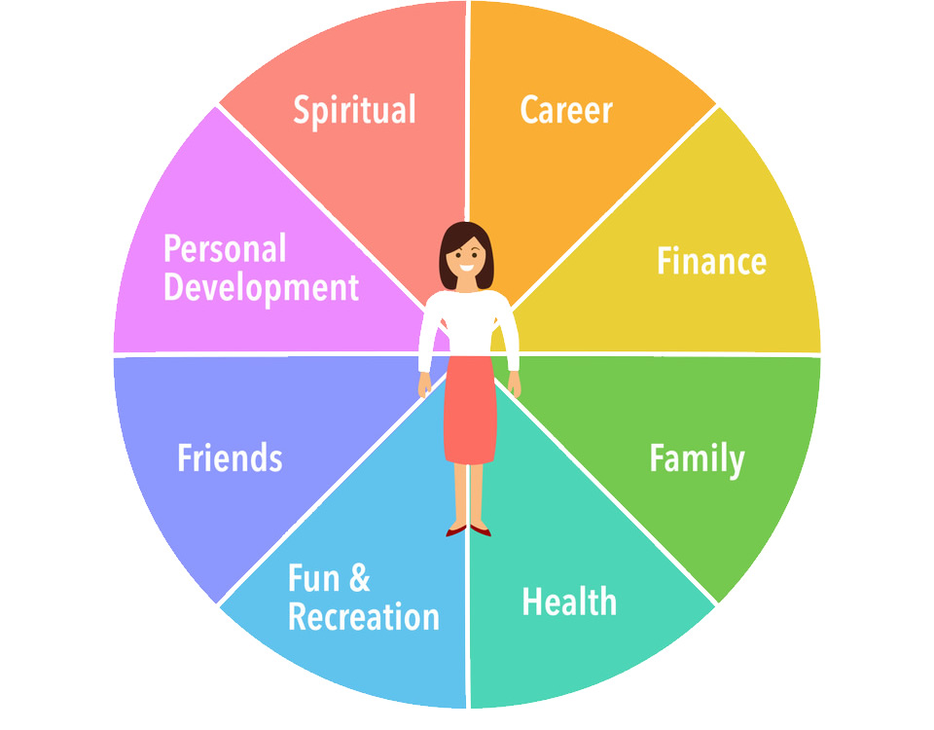
Effective Power and leadership needs Wellbeing & Mental health care
RELATIONSHIPS
E.I.
Constant Changes & Uncertainties
Higher Cost of Living
Crisis hitting minority groups
Mental health includes our emotional, psychological, and social well-being. It affects how we think, feel, and act. It also helps determine how we handle stress, relate to others, and make choices.
Generational shift: focus on QoL
MENTAL HEALTH
WELLNESS
Notes:
lus, there is no escaping the reality that modern society is a source of immense stress for employees. Living in a rapidly changing world filled with uncertainty takes a toll on all of us and, as the cost of living crisis continues, more employees are likely to experience difficulties that impact their mental health – with the crisis hitting women and ethnic minority groups harder. According to research by the Living Wage Foundation, more than three quarters of low-paid workers feel that this is the worst financial period they have ever faced. In the same study more than half (56 per cent) of those surveyed said they had to use food banks, 42 per cent said they were regularly skipping meals for financial reasons, and 32 per cent said they could not heat their homes.
Lastly, corporations must not underestimate the impact of new ways of working on mental health. While there are many positives to remote and hybrid working – ONS data shows that in February 2022 more than three quarters of those who worked from home in some capacity said that being able to work from home gave them an improved work-life balance – it doesn’t come without its challenges. Many employees have found the blurring of professional and personal boundaries difficult, feeling the pressure to be ‘always on’ and finding it tricky to ‘switch off’.

Slide 7
Perspectives on power relations in human health and well-being by Ingrid Larsson and Henrika Jormfeldt.
Analysing the article…
CALL TO ACTION
In the article, how is the coach showing power and leadership with the team?
How is the relationship between the researcher and the participant showing the concept seen in slide 4?
What is the result of empowerment applying the proper way?
Influence
Inspirational leadership
Exchange resources
Conflict Management
Ability to “tell the story”
Be trustworthy
Achievement
Strength/ Resilience
Emotional
Psychological Physical
Social Wellbeing
Power:
Energy to harness to make our lives, work and society better.
Positivity, Self control, Self Awareness, Confidence, Stress management, build relationship.
Notes:
female Swedish national football coaches describe how they carefully manage interpersonal relationships with respect to the well-being of their players as they face social and organizational pressure to win competitions.

Slide 8
Panel interview – Networking enables a powerful career
LEARNING AND GROW
INCREASED VISIBILITY
ACCESS NEW OPPORTUNITIES
SUPPORT AND ENCOURAGEMENT
Reetal Pai – CIO for Nuseed – 20 min
  Introduction – 2min
  Background – 3min
  Questions related to the topic – 10 min
Notes:
1. Access to New Opportunities: The more people you know, the more opportunities you'll have access to. Whether it's a job opening, a new client, or a speaking engagement, having a strong network can help you find and capitalize on opportunities that you might not have discovered otherwise.
2. Learning and Growth: Networking is a great way to learn from others in your industry. By connecting with people who have different experiences and perspectives, you can gain valuable insights that can help you grow both personally and professionally.
3. Support and Encouragement: Building a network of supportive and encouraging peers can be incredibly beneficial, especially during challenging times. Having people you can turn to for advice, feedback, or just a listening ear can make all the difference when you're facing a difficult decision or a setback.
4. Increased Visibility: By networking regularly, you can increase your visibility within your industry and establish yourself as a thought leader or expert in your field. This can lead to new opportunities, partnerships, and collaborations down the road.
So how do you start building your network? Here are a few tips:
1. Attend industry events and conferences: This is a great way to meet people in your field and start making connections. Be sure to bring business cards and follow up with new contacts after the event.
2. Join professional organizations: Joining a professional organization in your industry can help you connect with like-minded individuals and stay up-to-date on industry news and trends.
3. Reach out to people on LinkedIn: LinkedIn is a powerful tool for networking. Use it to connect with people in your field, send personalized messages, and build relationships over time.
4. Offer to help others: Networking isn't just about what others can do for you – it's also about what you can do for them. Look for ways to help others in your network, whether it's by offering advice, making an introduction, or sharing your expertise.

Slide 9
Back up

Slide 10
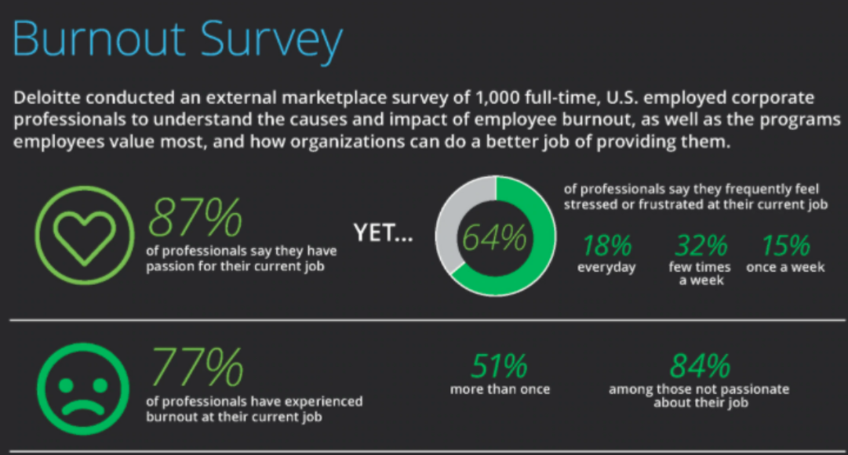
One significant impediment to health and well-being that most of us experience is stress. When stress affects us, it bleeds into every aspect of our lives, including our relationships and personal lives.
“94% of American workers report experiencing “extreme stress” at their jobs. Each year, this work-related stress results in about $190 billion in healthcare costs.”
“Both physical and mental health impact well-being. When people feel mentally fit and balanced, they’re more resilient. Being better equipped to cope with life’s difficulties and bounce back from difficult events improves overall well-being.”

Slide 11
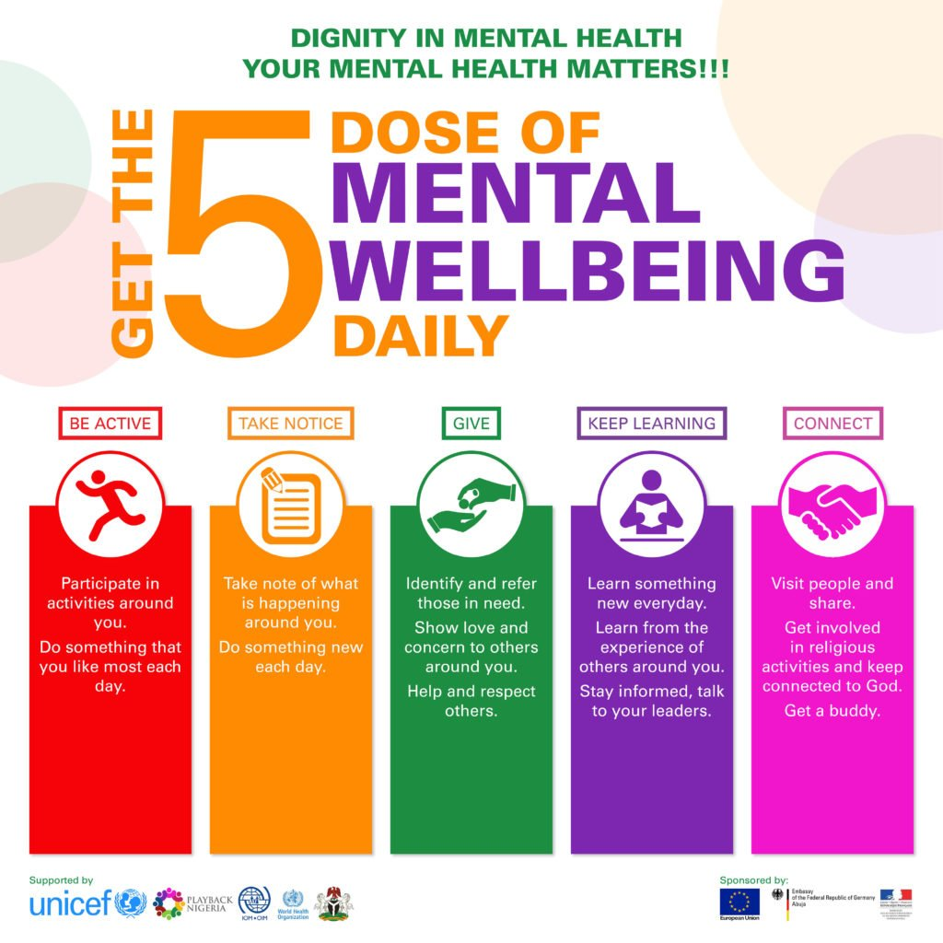

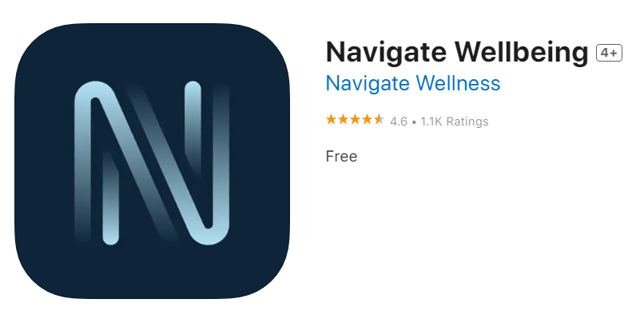
Tools to help with mental health and wellbeing
If you want to incorporate more mindfulness into your daily life, we recommend using one of the many available apps on the market. You can also practice breathing exercises, walking meditation, yoga, or other practices that help root you in daily life.

