Slide 1
You will not be able to turn on your microphone until we open the session up to questions/discussion.
Please keep your webcam turned off until we have opened the session up to questions/discussion. If you choose to
speak during this time, we’d like to see you!
To control your microphone and webcam, use the two buttons on the far left of the Zoom toolbar:
Click the Chat button in the Zoom toolbar to chat with the hosts and other participants:
Notes:
To get started, let’s go over the features of this meeting.
All participants are muted by default and only the hosts/panelists can unmute themselves. Your webcams are turned off by default and we ask that you keep your webcam turned off until the conclusion of the presentation at which point we will open it up for questions and/or discussion.
When we open the meeting up to discussion, go ahead and turn on your webcam and unmute yourself to begin speaking. There may be others who are attempting to ask questions at the same time so please be courteous and take turns. If you are not currently speaking, please mute your microphone.
You can also use the chat feature to chat with the hosts and other participants. Click the Chat button in you Zoom toolbar to open that window.
With that, let’s get started!

Slide 2
Improving the Climate for SIUE’s Women Faculty: Steps for Interrupting Bias and Fostering Inclusion
Southern Illinois University Edwardsville
Diversity Day 2020 October 15, 2020

Slide 3
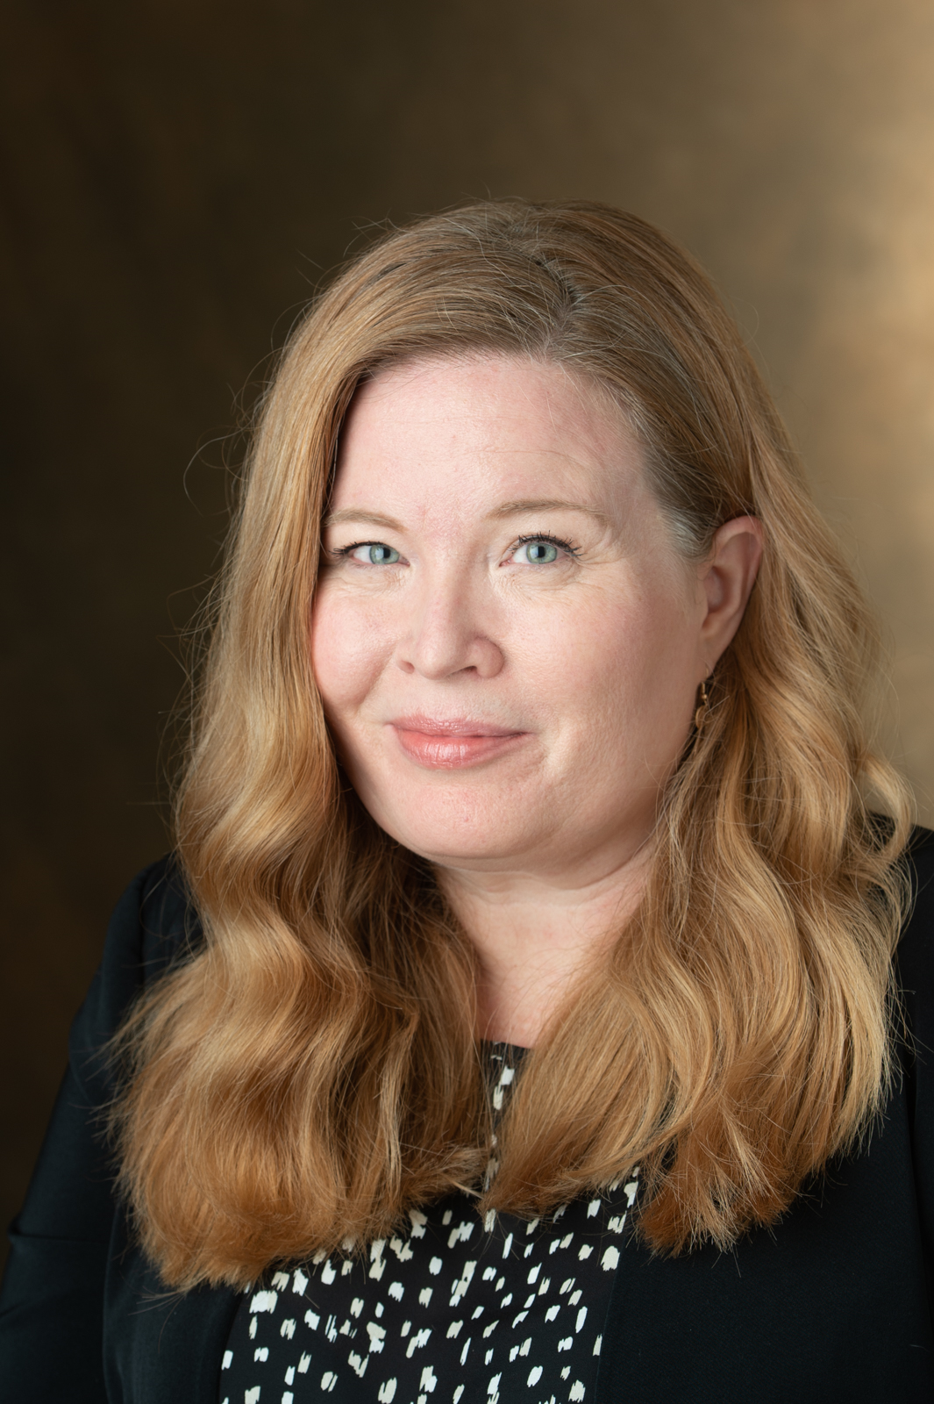
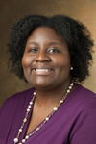
Introductions
Jamie Ball, J.D. Director of Equal Opportunity, Access & Title IX Coordination
Jessica Harris, PhD Assistant Provost and Associate Professor of History
Leah O’Brien, PhD
Distinguished Professor and Chair of Chemistry
Sandra Weissinger, PhD
Associate Professor of Sociology

Slide 4
Overview

Slide 5
Why Does Diversity Matter?
Notes:
Graphic: https://ndcstore.org/products/we-can-do-it-diverse-rosie-the-riveter-beach-blanket
*changing demographics
*Increases innovation
*improved outcomes for students

Slide 6
Why is it important to advocate for equity?
Notes:
*Focus on outcomes…
*address systemic barriers
*institutional accountability

Slide 7
How does SIUE support these goals?
SIUE Strategic Plan
Goal #4: Recruit, support and retain high quality, accomplished, student-centered and diverse employees who continually strive for excellence in achieving University goals
SIUE Diversity and Inclusion Strategic Plan
Goal #2: Increase and Retain the number of faculty, staff, and administrators from underrepresented groups
Goal #4: Develop and maintain a campus climate that acknowledges, embraces, and celebrates diversity and inclusion as a core value of the SIUE community.
NSF ADVANCE (TIME: Toward an Inclusive Model of Excellence)
SIUE’s TIME focuses on strategic initiatives and activities to improve the recruitment, retention and promotion of STEM women, particularly women from underrepresented groups

Slide 8
STEM Problems
Notes:
Photo: https://www.stemschool.com/articles/how-stem-is-actively-solving-real-world-problems

Slide 9
In what ways does discrimination exist within STEM disciplines?
Gender bias and discrimination affects:​
Professional hiring​
Salary
Mentoring​
Credit for collaborative work
Tenure
Promotion​
Respect​
And many other areas ​
Notes:
Graphic: https://www.technologydecisions.com.au/content/it-management/article/50-of-women-in-stem-face-discrimination-419028958

Slide 10
Notes:
Graph: https://www.gbtribune.com/news/trending-topics/if-you-have-a-daughter-good-at-science-and-math-this-new-report-is-worrisome/

Slide 11
Notes:
Source: https://www.awis.org/creating-equitable-stem-workplaces-by-addressing-unconscious-bias/

Slide 12
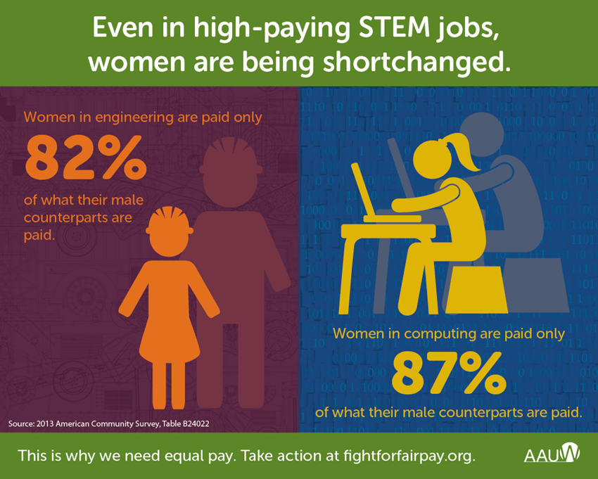
Notes:
Source: https://ww3.aauw.org/2015/04/14/women-shortchanged-in-stem/

Slide 13
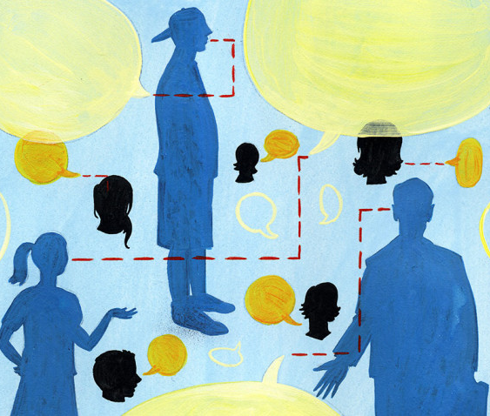
Women receive less credit for their work than men in collaborative projects
Notes:
Image: https://hbr.org/2017/11/research-men-get-credit-for-voicing-ideas-but-not-problems-women-dont-get-credit-for-either

Slide 14
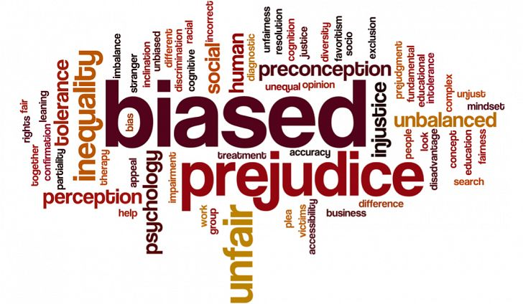
Most faculty believe that they are fair and unbiased…
Numerous well-designed studies in leading peer-reviewed journals show that gender bias is widespread and persistent, despite decades of programs designed to mitigate the problems

Slide 15
Gender Bias and Department Climate
Women faculty in science and engineering who were planning to quit their jobs intended to do so most often because of their department’s climate​
Difficulties that women in science face are compounded by the differences in how men and women perceive equity and respect in the work environment, with men often being unaware of the concerns and challenges that women experience
Callister R. 2006. The impact of gender and department climate on job satisfaction and intentions to quit for faculty in science and engineering fields. J Technol Transf 31:367–375. https://doi.org/10.1007/s10961-006-7208-y.​
Funk C, Parker K. 2018. Women and men in STEM often at odds over workplace equity. Pew Research Center, Washington, DC.

Slide 16
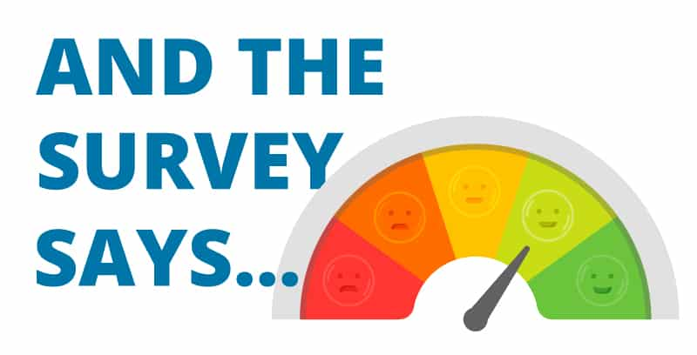
Notes:
Image: http://blog.imec.org/common-themes-from-employee-engagement-pulse-surveys-to-guide-leaders-as-employees-return-to-work

Slide 17
SIUE Climate Survey Data
A spring 2020 climate survey of all SIUE faculty (n = 321, 48.4% response rate) revealed significant gender disparities in perception of climate. For example:
in the School of Engineering 64% of male faculty and 50% of women faculty agreed that their department creates a healthy climate for all faculty
in the College of Arts and Sciences 81% of male faculty and 55% of women faculty agreed that their department creates a healthy climate for women of color
in the School of Education, Health and Human Behavior 100% of male faculty and 50% of female faculty agreed that their department creates a healthy climate for international women.
1-2pm CST Join Meeting ID: 977 0126 5019
Passcode: 509437
What Faculty Say About SIUE’s Climate
Matt Feldmann, PhD, Tom Withee, MS, Susan Morgan, PhD, P.E.

Slide 18
Diversity and Inclusion
We can hire a wide range of diverse employees, but if they don't feel included and equal, they aren't going to contribute their diverse ideas and experiences equally.
Mentors
Cluster hires
Department climate
Etc.
Diversity makes us stronger, through Personal, Professional, and Program Growth.
https://www2.deloitte.com/content/dam/Deloitte/us/Documents/about-deloitte/us-inclus-millennial-influence-120215.pdf

Slide 19
National Science Foundation: ADVANCE
Fortunately, several studies provide evidence that programs designed to raise conscious awareness of gender bias can improve equity.

Slide 20
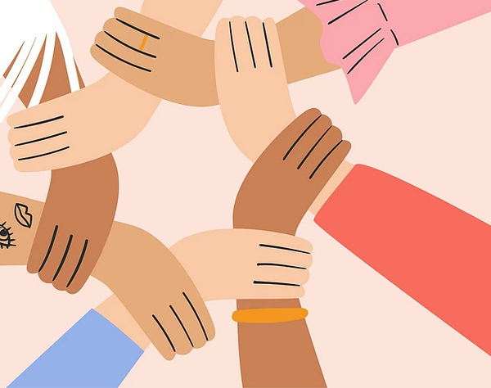
Being an Advocate & Ally

Slide 21
Assessing Bias
Take an implicit bias test in private.
Harvard Implicit Bias Test
We all have personal biases – many are unconscious, yet the contribute to inequalities.
Tips adapted from Roger Green (2014).

Slide 22
Recognizing Bias
Well-intentioned faculty may not recognize unconscious bias and its impact on committee discussions and outcomes.
It is important to recognize common forms of unconscious bias and resistance – making a plan to effectively respond.
Faculty Diversity: Removing Barriers is an excellent resource, providing several tactics for handling resistance.
Tips adapted from Roger Green (2014).

Slide 23
Listen & Create Space
Though women are seen as talking more than men (Spender, 1980), this is not true.
Men often interrupt women when they are speaking – when compared to men interrupting other men.
Listen to women when they speak. Do so without being distracted. Encourage others to do the same.
Tips adapted from Roger Green (2014).

Slide 24
Climate Matters!
The workplace climate matters. A toxic or bullying climate can push individuals to leave.
Climate includes formal policies and informal actions. These can easily disadvantage minoritized populations.
Ways to improve climate?
Support minoritized individuals.
Make sure their voices are heard.
Provide access to leadership roles.
See the work of Fred Piercy et al. (2005).
Tips adapted from Roger Green (2014).

Slide 25
Recognition & Support
Gender impacts the ways in which we communicate with and about women. Gender also has a substantial impact in the way we support, value, and recognize the research and accomplishments of our female colleagues.
Talk with women faculty about their research and attend their research presentations.
Seek opportunities for research collaboration with your female colleagues.
Provide mentorship and professional development opportunities.
Nominate and support women for awards, prizes, invited lectures, and leadership positions at the local, national, and international levels.
2020 Nobel Prize in Chemistry awarded to
Dr. Emmanuelle Charpentier and Dr. Jennifer Doudna
Notes:
As seen in Tip #10, gender impacts the ways in which we communicate with and about women. Gender also has a
substantial impact in the way we support, value, and recognize the research and accomplishments of our female
colleagues. Men are less likely to ask women faculty about their research activities than they are to ask men
faculty, women are less likely to receive effective mentorship, and women are less likely than men to be
nominated for awards, prizes, and leadership positions. As our eleventh tip, we encourage men to recognize,
support, and value the research and professional contributions of their female colleagues. Talk with women faculty
about their research, and attend their research presentations. Seek opportunities for research collaboration with
your female colleagues. Provide mentorship and professional development opportunities. Nominate and support
women for awards, prizes, invited lectures, and leadership positions at the local, national, and international levels.
Publicly recognize and promote the achievements and excellence of your female colleagues.
Photo: Emmanuelle Charpentier and Jennifer Doudna https://www.cbsnews.com/news/nobel-prize-emmanuelle-charpentier-jennifer-doudna-chemistry-crispr-gene-editing-tool/

Slide 26
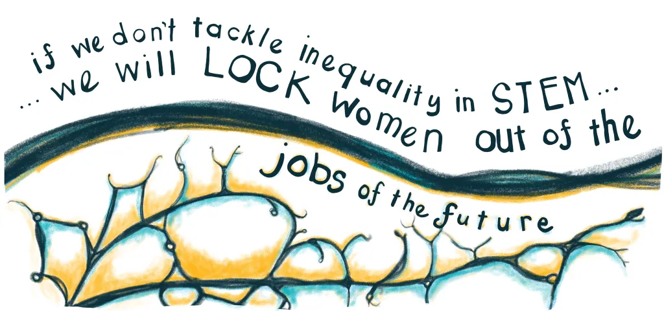
Notes:
Graphic: https://futurescot.com/calls-for-action-to-challenge-discrimination-against-women-is-stem/

Slide 27
Get involved!
SIUE.edu/TIME

Slide 28
Questions and Discussion

