Slide 1
2015 Service Awards

Slide 2
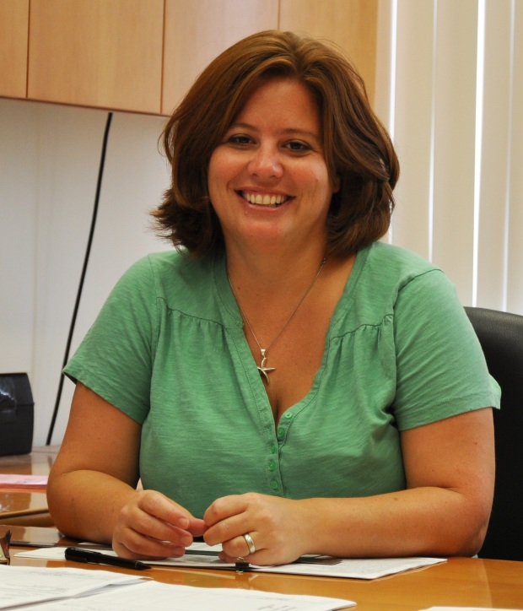
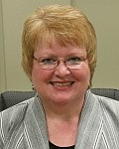
Employees of the Month
May 2014
April 2014
Robbin Butler
Physics
School of Dental Medicine
Anne Moore
School of Education

Slide 3
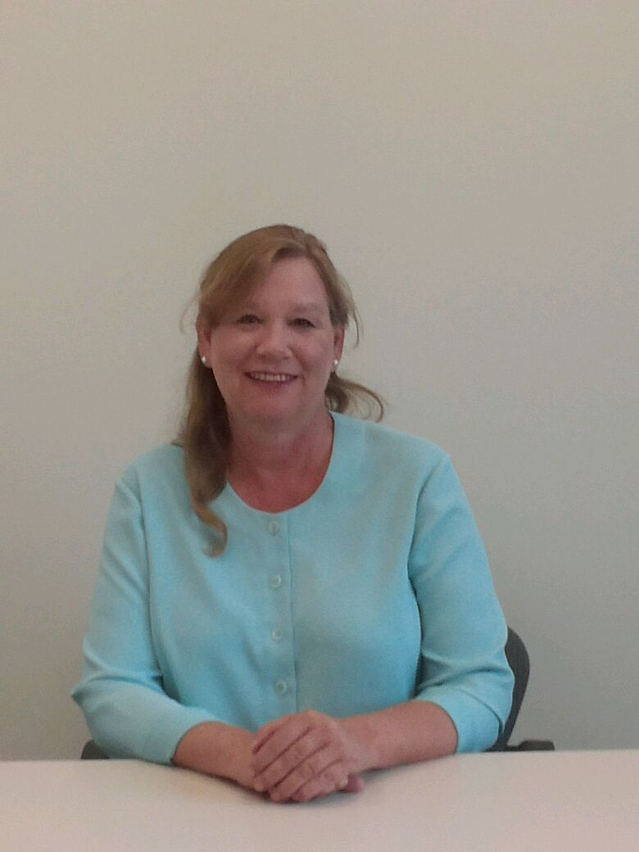
Employees of the Month
June 2014
July 2014
Jeanette Parmenter
Office of Human Resources
No Recipient

Slide 4
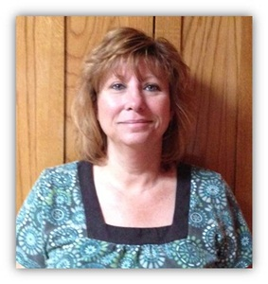
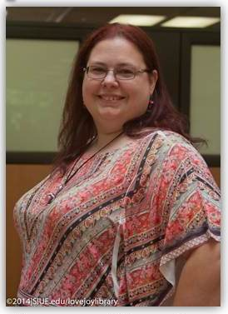
Employees of the Month
August 2014
September 2014
Starla Nixon
Purchasing
Anne Hunter
Library & Information Services Administration

Slide 5
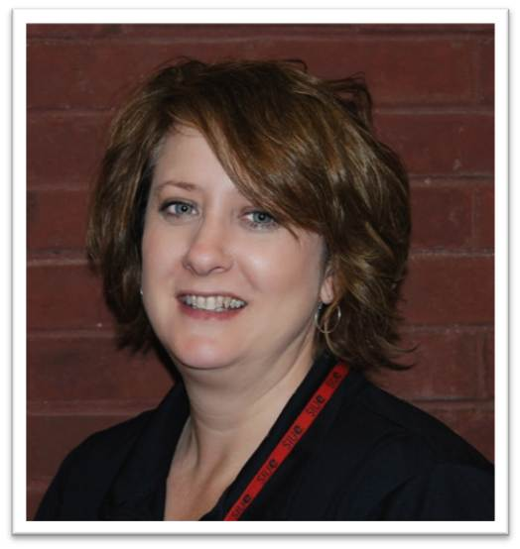
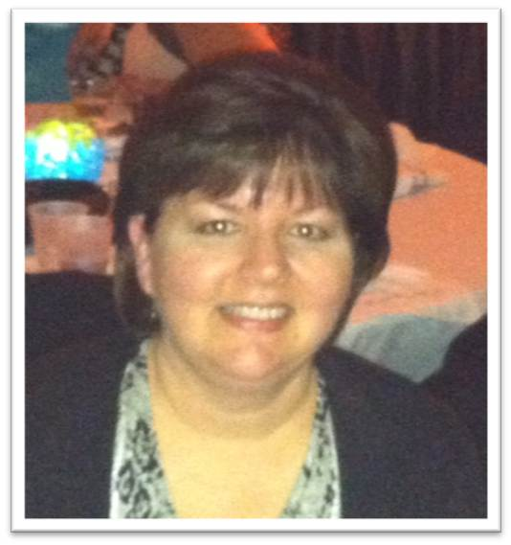
Employees of the Month
October 2014
November 2014
Sheryl Lauth
Information Technology Services
Linda Miller
Educational Leadership

Slide 6
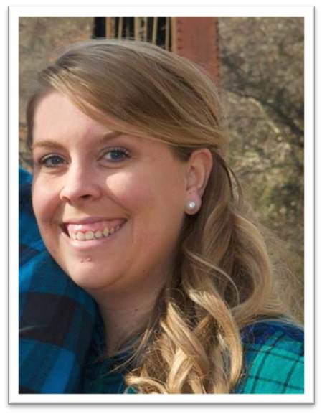
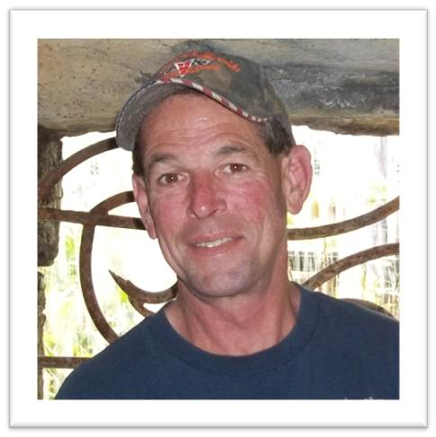
Employees of the Month
December 2014
January 2015
Jackie Warren
University Housing
David Kries
Facilities Management

Slide 7
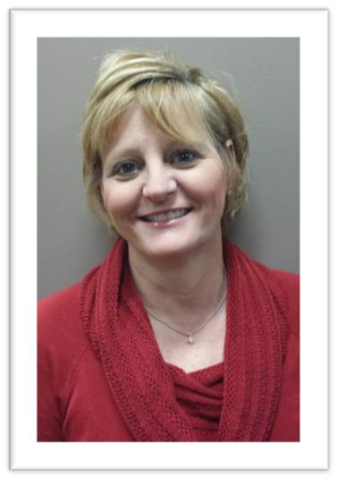
Employees of the Month
February 2015
Beth Weeks
School of Education

Slide 8
Chancellor Julie Furst-Bowe’s
2015 Service Awards
Address

Slide 9
10 Year
Service Award
Honorees

Slide 10
Group 1 10 Year Honorees
Becky Cooper
Dr. Mike Crider
Christina Crosby-Gilmore
Vicki Dagget
Kathleen Feigl
Dr. Connie Frey-Spurlock
Gretchen Fricke
Beth Giese
Dr. Shelly Goebl-Parker
Gina Grace

Slide 11
Group 2 10 Year Honorees
Deborah Hard
Dr. Susan Hume
Terri Rae Huneidi
Tamika Johnson
Dr. Mary Kaemmerer
Jessica Kohl
Dr. David Koonce
Dr. Yun Lu
Kris Magee
Marsha Maine

Slide 12
Group 3 10 Year Honorees
Beth Martens
Angela Marvin
Laura McCann
Kelly Meyers
Donna Montgomery
Dr. Linda Morice
Daniel Murphy
Bill Porzukowiak
Shelley Price-Williams
Fahmida Rabbi

Slide 13
Group 4 10 Year Honorees
Pam Seger
Dr. Douglas Simms
Jill Thirion
Rebecca Walsh
Marci Webb
Michelle Welter
Dr. Christine Winter
Dr. Bill Wuller
Tracy Zeigler

Slide 14
15 Year
Service Award
Honorees

Slide 15
Group 1 15 Year Honorees
Jim Benhoff
Jo Ellen Caia
Rebecca Dabbs MacLean
John Davenport
Kim Durr
Dr. Kay Gaehle
Yvonne Jeffries
Virginia Keel
Dr. Martha Latorre
Brian Lotz
Dr. Frank Lyerla

Slide 16
Group 2 15 Year Honorees
Elizabeth Mayfield
Dr. Stephanie McAndrews
Ellen Meisenheimer
Avonjana Moore Thomas
Melissa Ocepek
Dr. Laurie Puchner
Diane Schilling
Sheila Sorrell
Karen Stovall
Brent Vaughn
Dr. Kathy Wanstreet
Tonica Wright

Slide 17
20 Year Honorees

Slide 18
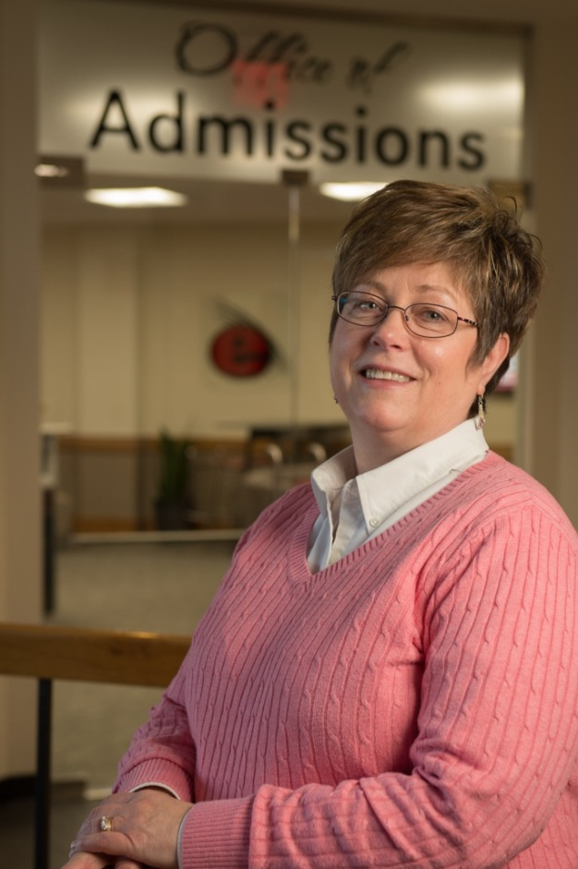
Lori Anderson 20 Years of Service
Office of Admissions

Slide 19
Kathleen Appleby 20 Years of Service
University Services to East St. Louis
Psychology Department

Slide 20
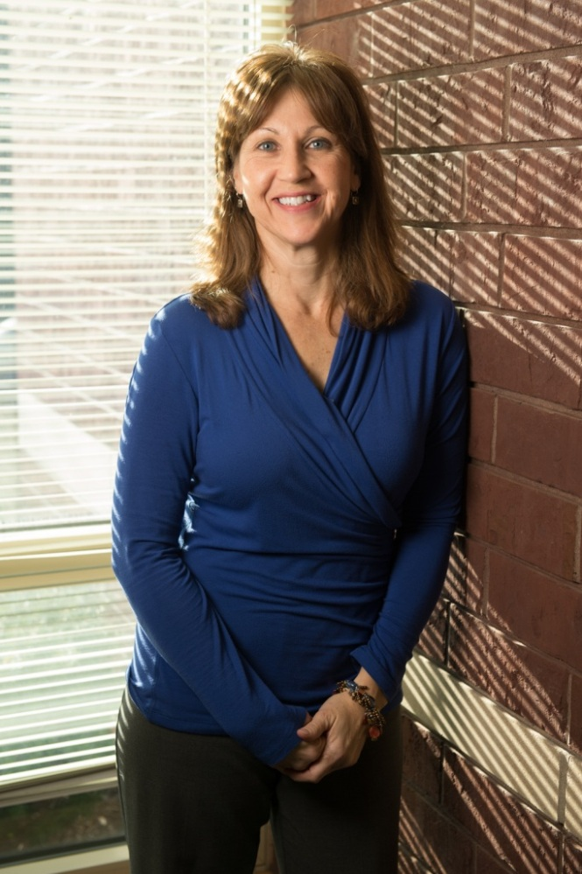
Karen Ash 20 Years of Service
University Housing

Slide 21
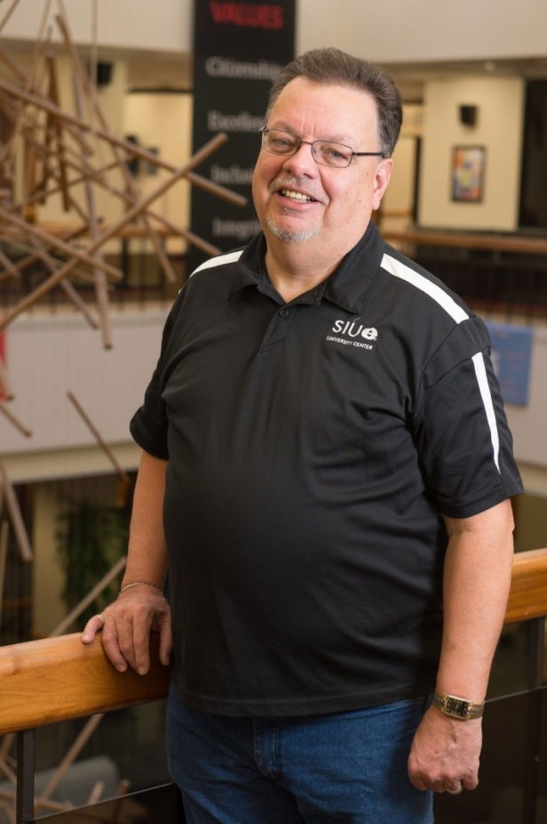
Todd Bartholomew 20 Years of Service
Morris University Center Administration

Slide 22
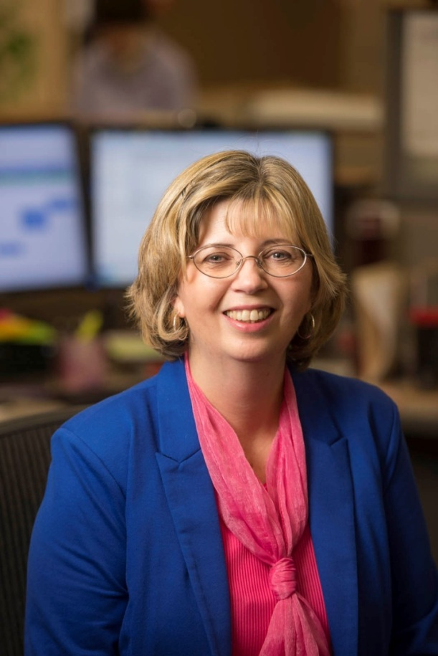
Debbie Brueggemann 20 Years of Service
School of Business

Slide 23
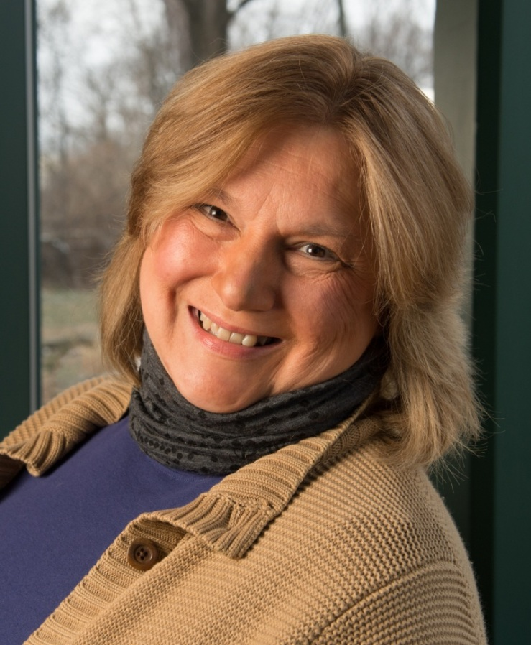
Emma Christensen 20 Years of Service
University Advancement Services & Foundation Operations

Slide 24
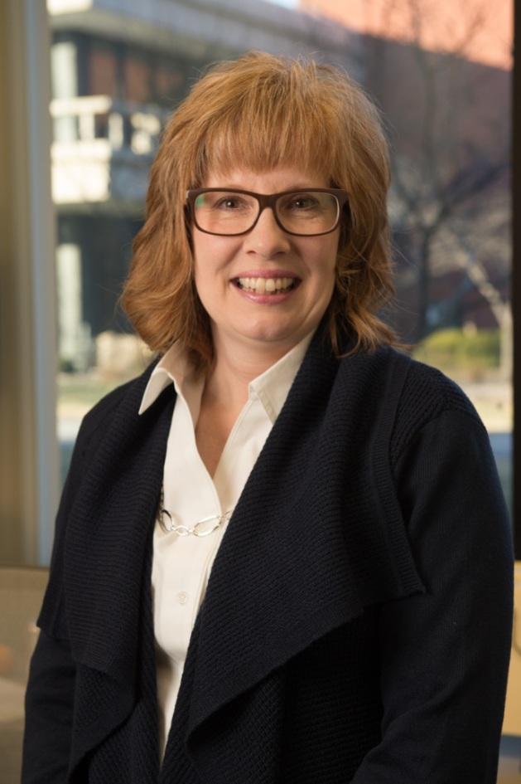
Cindy Cobetto 20 Years of Service
Educational Outreach

Slide 25
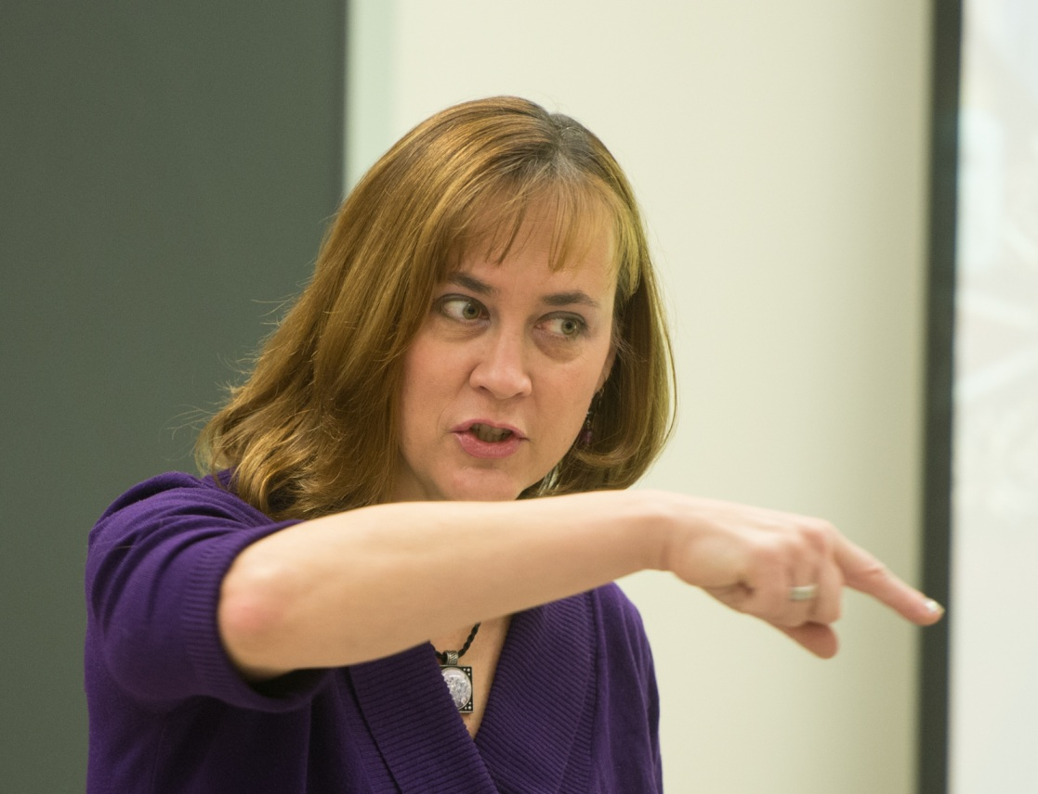
Dr. Catherine Daus 20 Years of Service
Psychology

Slide 26
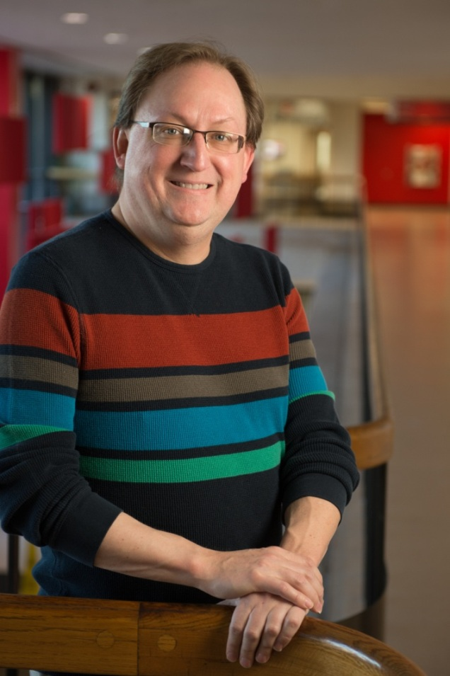
Phillip Eibeck 20 Years of Service
Student Financial
Aid

Slide 27
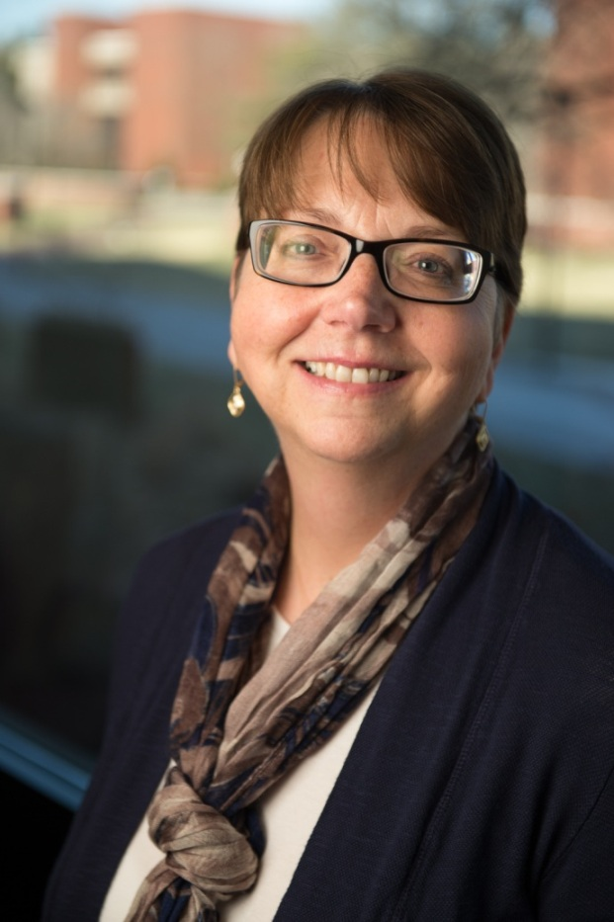
Cathy Foland 20 Years of Service
Office of the Bursar

Slide 28
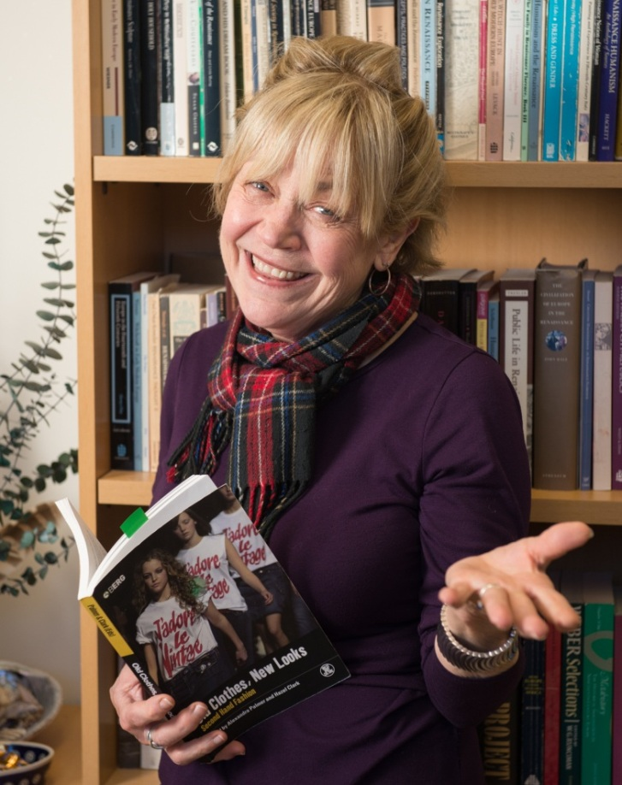
Dr. Carole Frick 20 Years of Service
Historical Studies

Slide 29
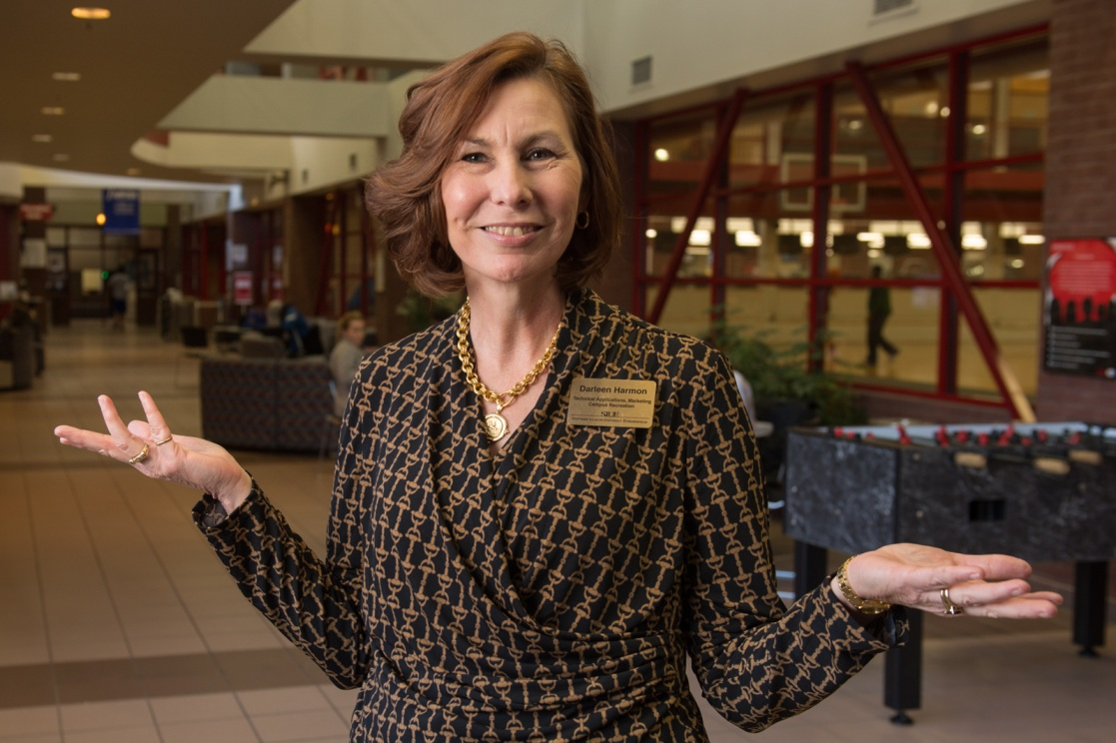
Darleen Harmon 20 Years of Service
Campus Recreation

Slide 30
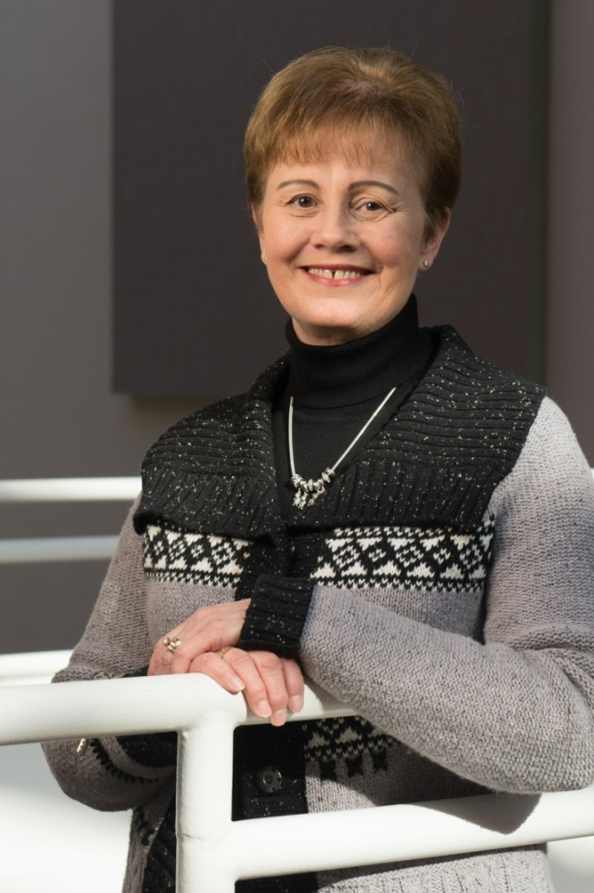
Dr. Kathy Ketchum 20 Years of Service
Primary Care/Health Systems Nursing

Slide 31
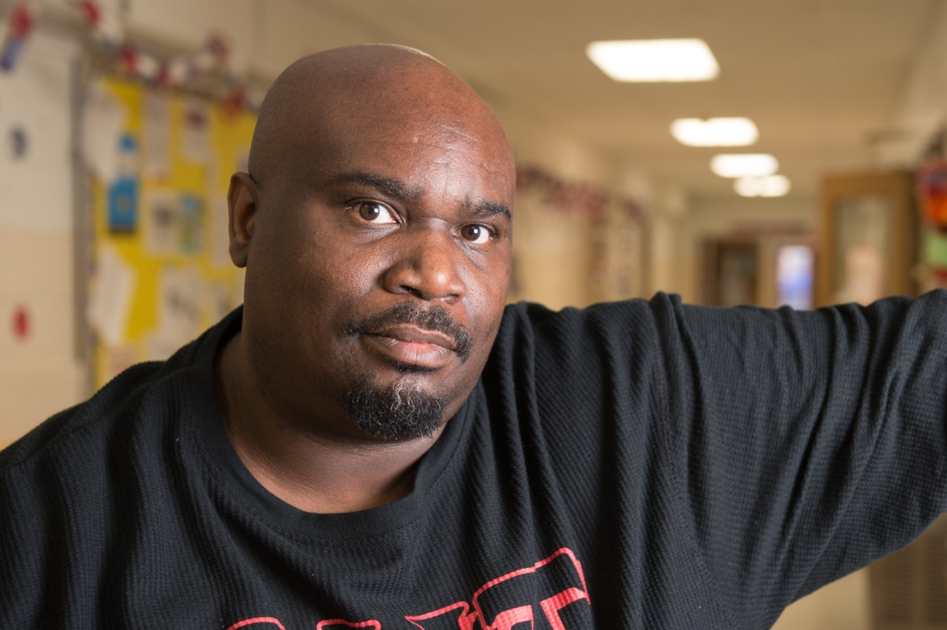
Charles King 20 Years of Service
University Services to East St. Louis

Slide 32
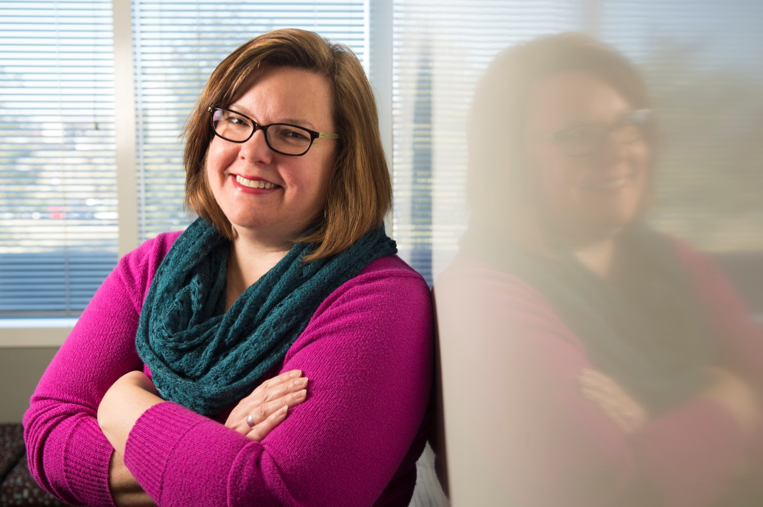
Heather Kniffel 20 Years of Service
University Marketing & Communications

Slide 33
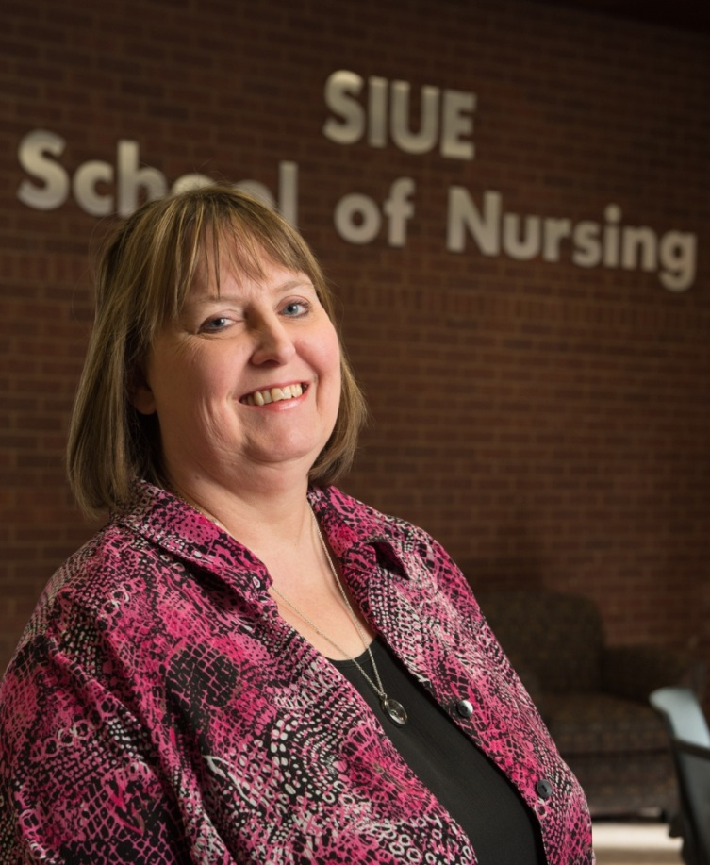
Patricia Koehne 20 Years of Service
School of
Nursing

Slide 34
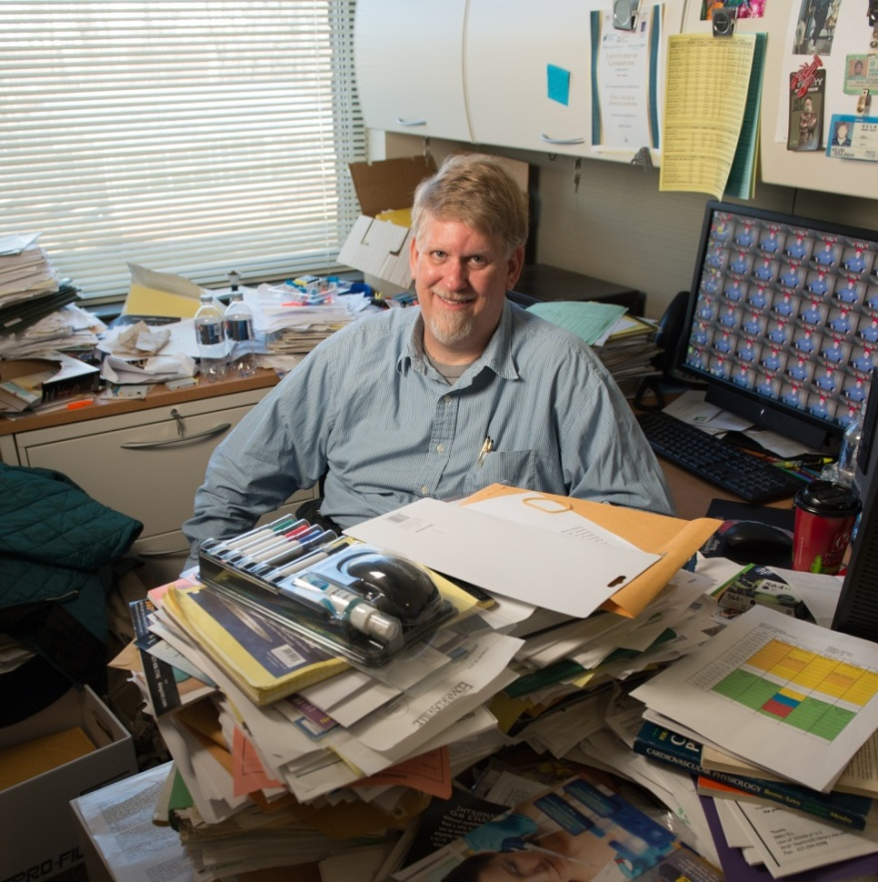
Dr. Kevin Krajniak 20 Years of Service
Biological Sciences

Slide 35
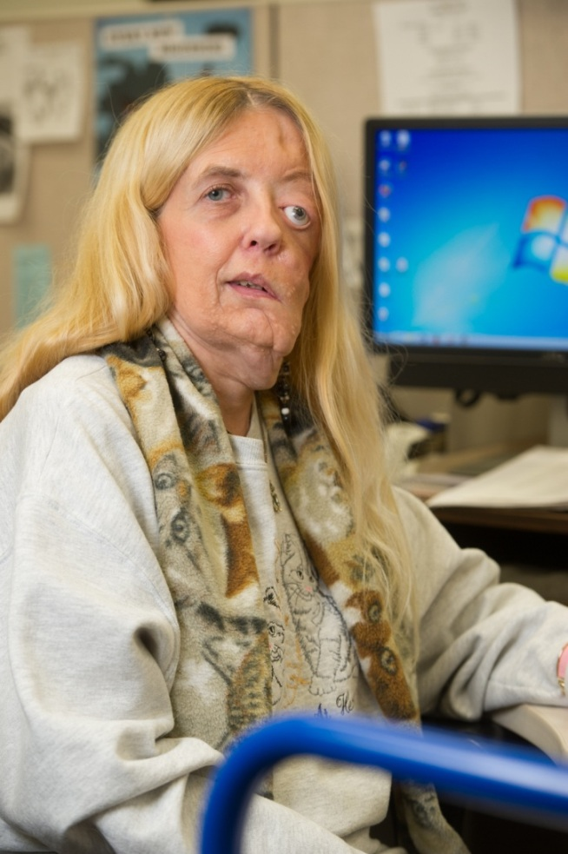
Rita Lesemann 20 Years of Service
Lovejoy Library

Slide 36
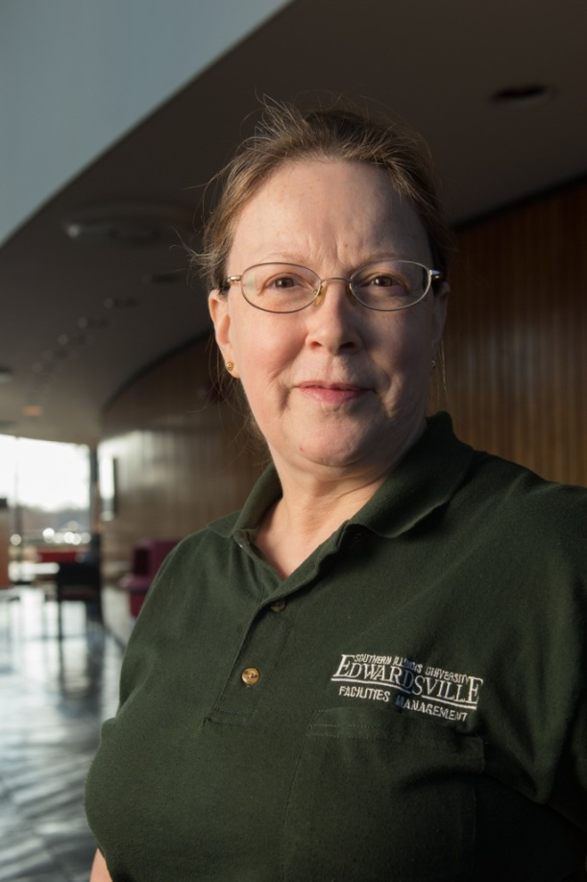
Brenda Mackel 20 Years of Service
Facilities Management

Slide 37
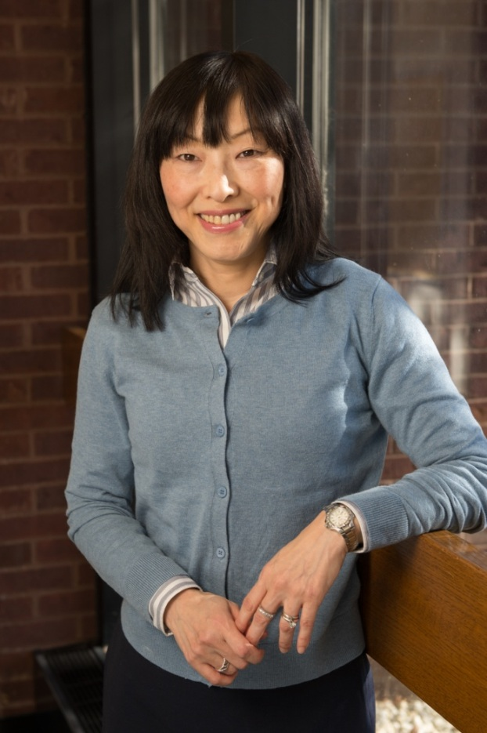
Yukiko May 20 Years of Service
Mathematics & Statistics

Slide 38
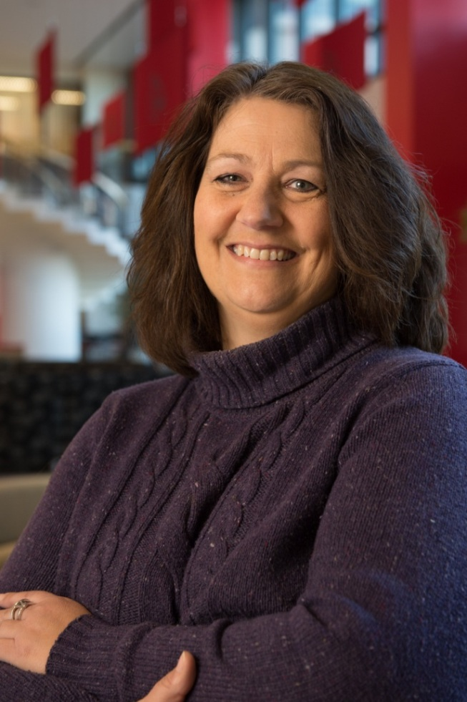
Cheryl Meikamp 20 Years of Service
Office of the
Bursar

Slide 39
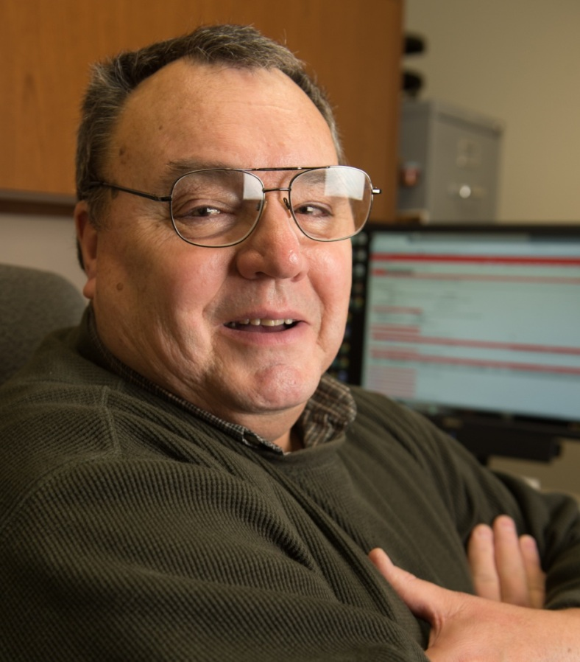
Terry Meredith 20 Years of Service
Information Technology Services

Slide 40
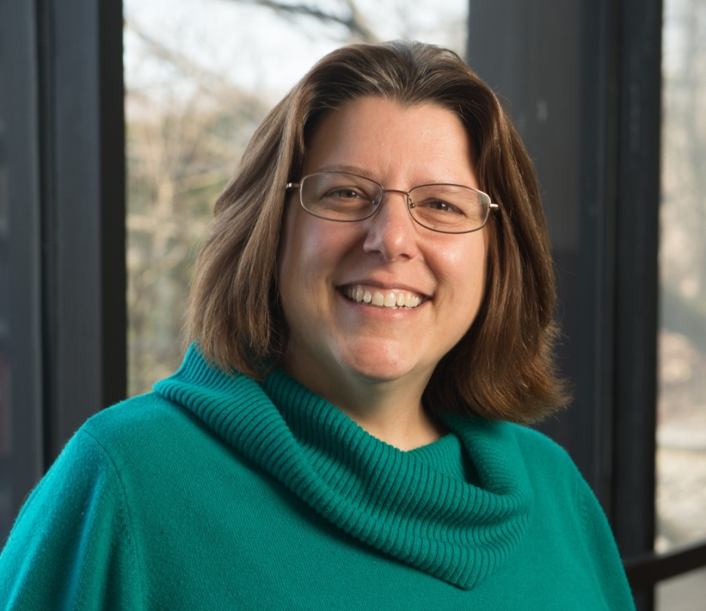
Laura Million 20 Years of Service
Information Technology Services

Slide 41
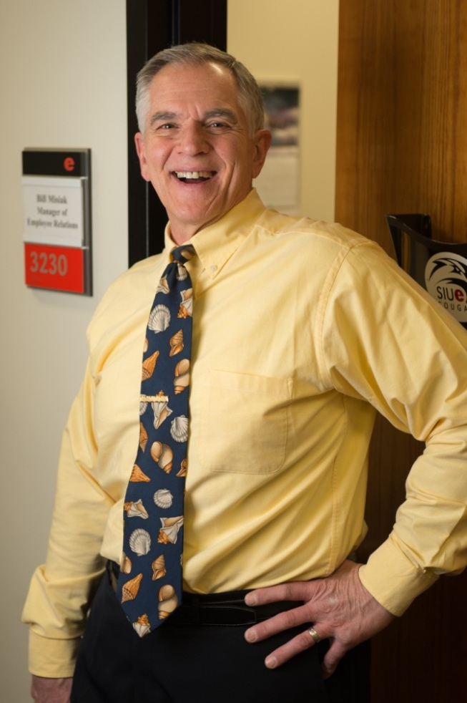
Bill Misiak 20 Years of Service
Office of Human Resources

Slide 42
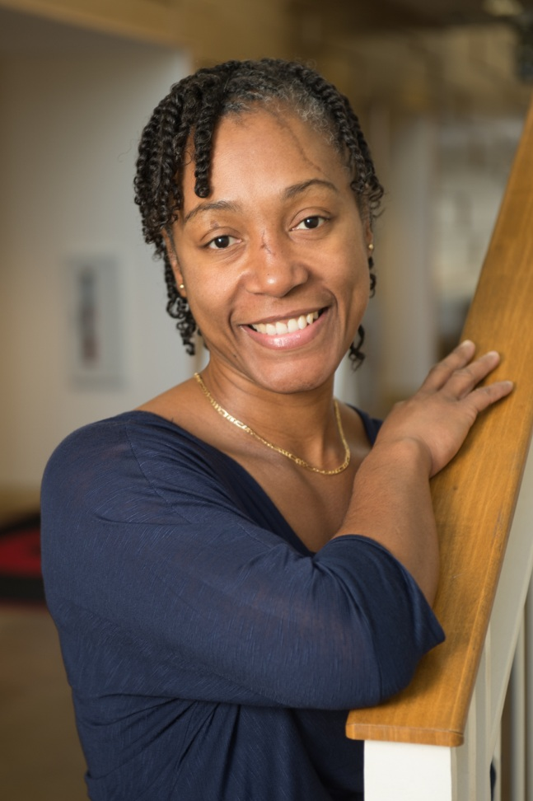
Almetta Mosby 20 Years of Service
Health Services

Slide 43
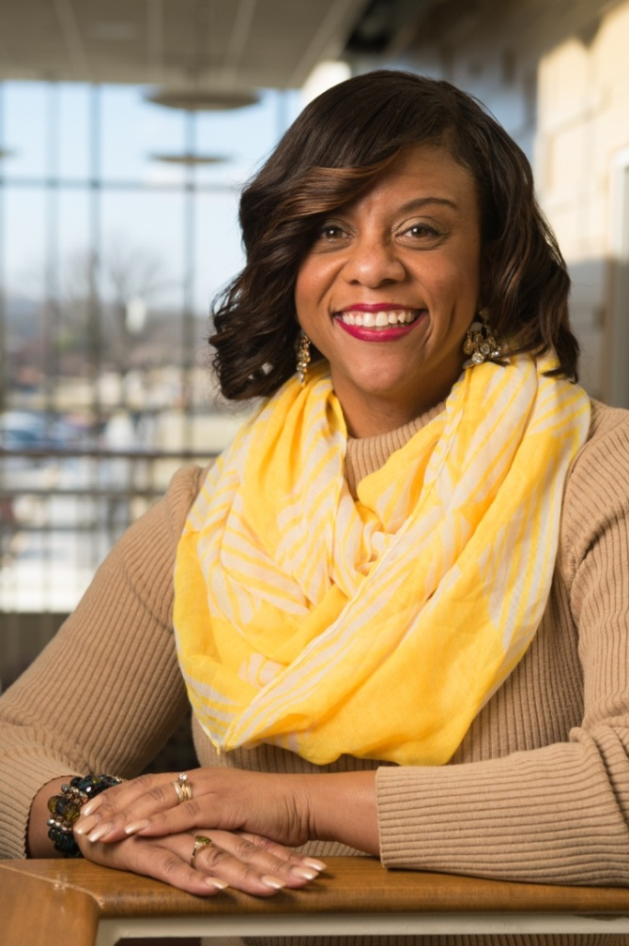
Danita Mumphard 20 Years of Service
Academic Advising

Slide 44
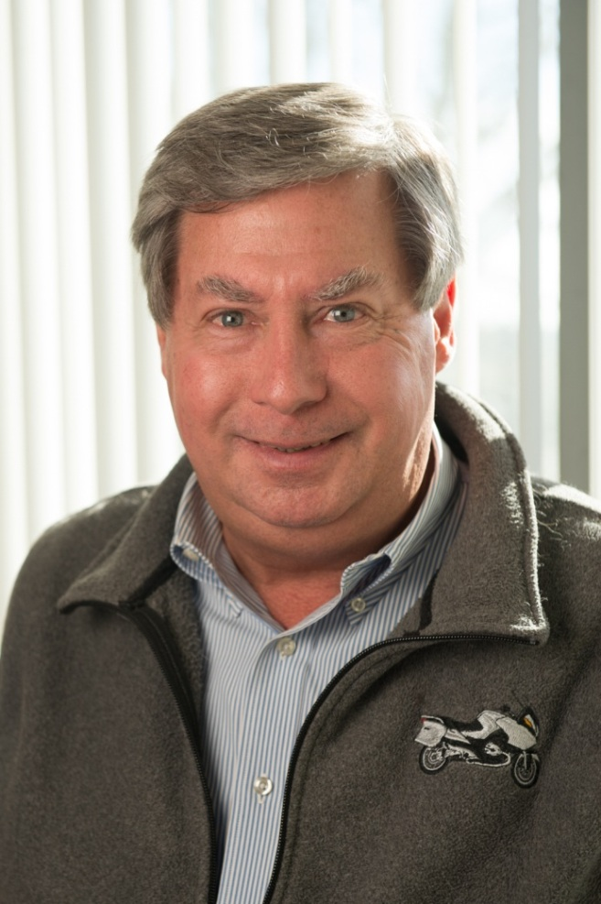
Kenn Neher 20 Years of Service
Vice Chancellor for Administration

Slide 45
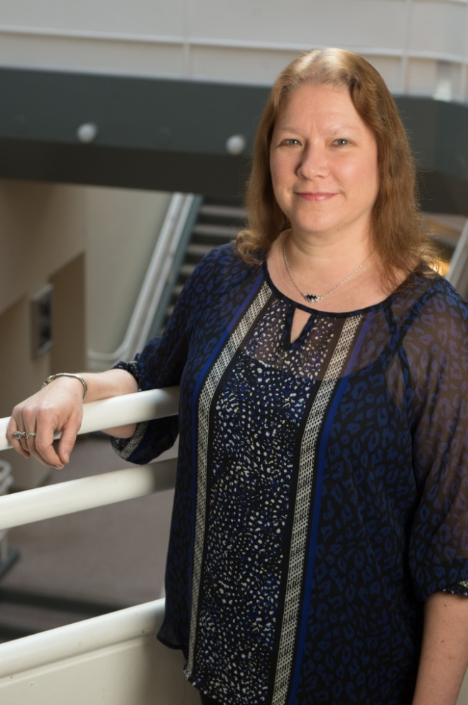
Nancy Newman 20 Years of Service
School of
Nursing

Slide 46
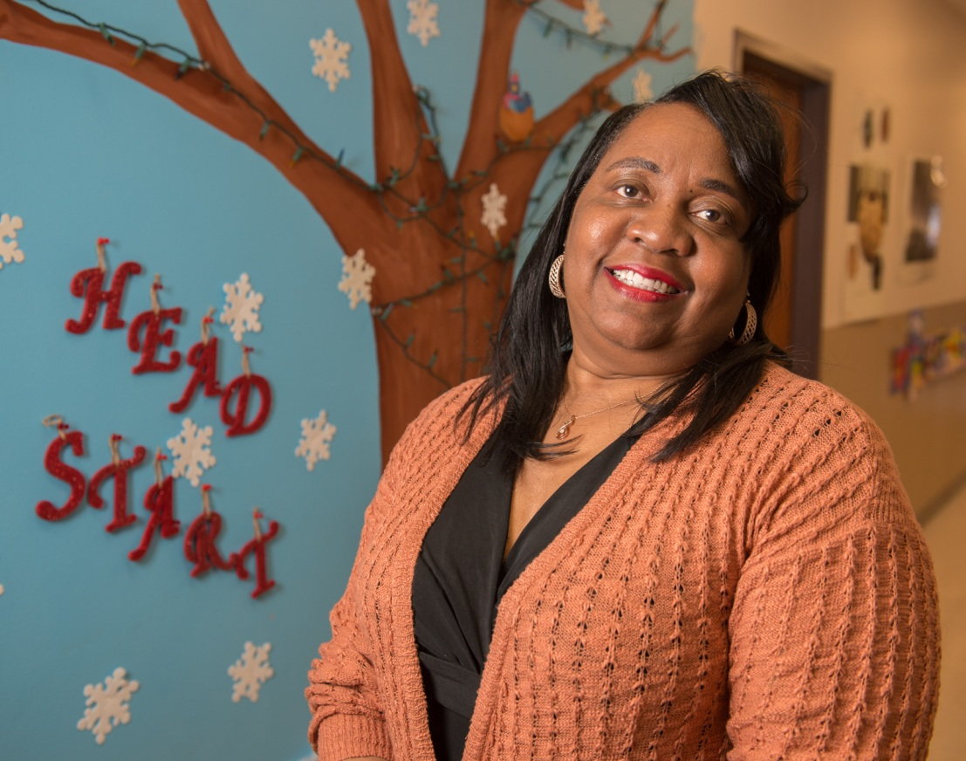
Alicia Parker 20 Years of Service
University Services to East St. Louis

Slide 47
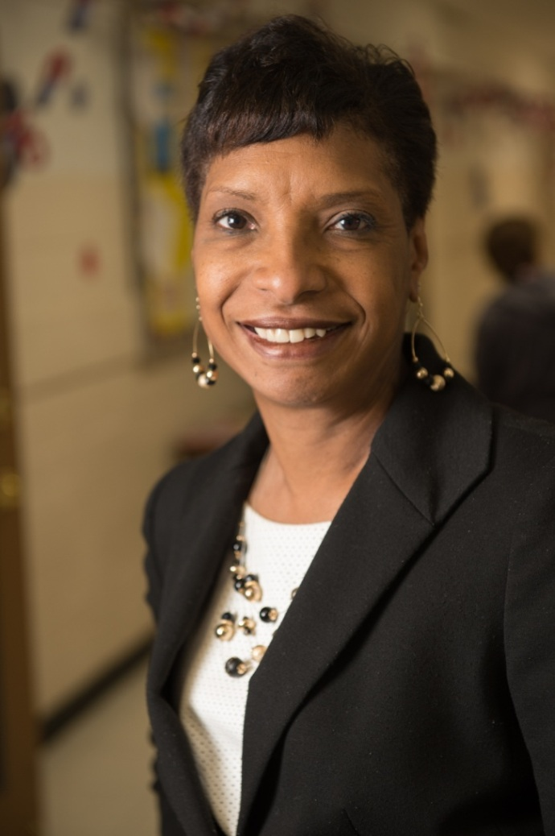
Elva Ross 20 Years of Service
University Services to East St. Louis

Slide 48
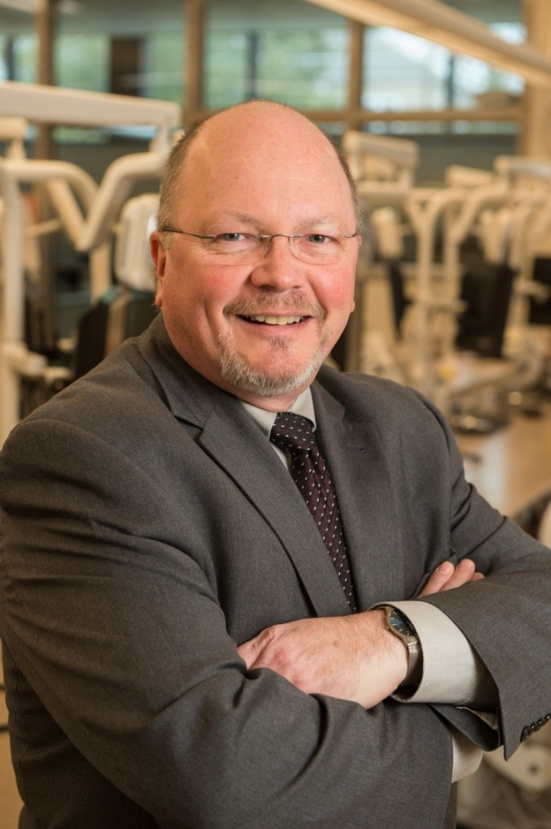
Dr. Bruce Rotter 20 Years of Service
School of Dental Medicine

Slide 49
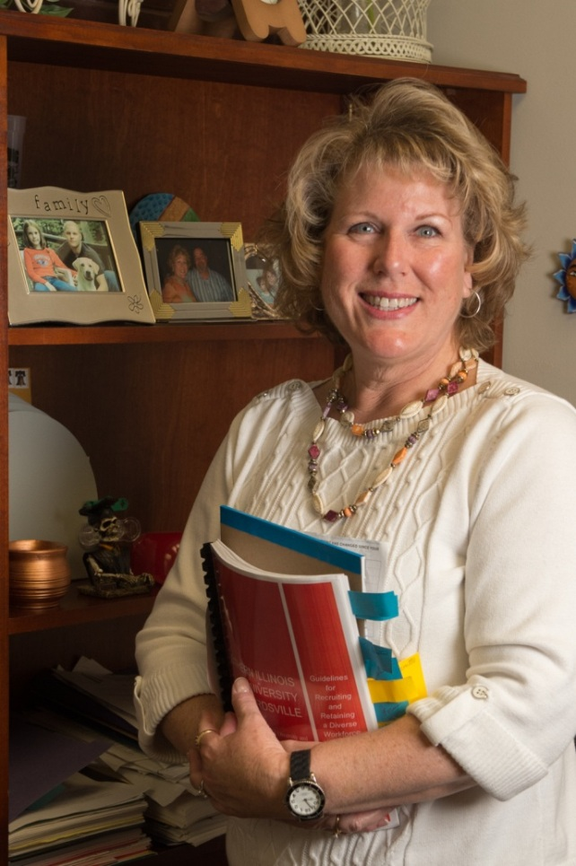
Laura Scaturro 20 Years of Service
Lovejoy Library

Slide 50
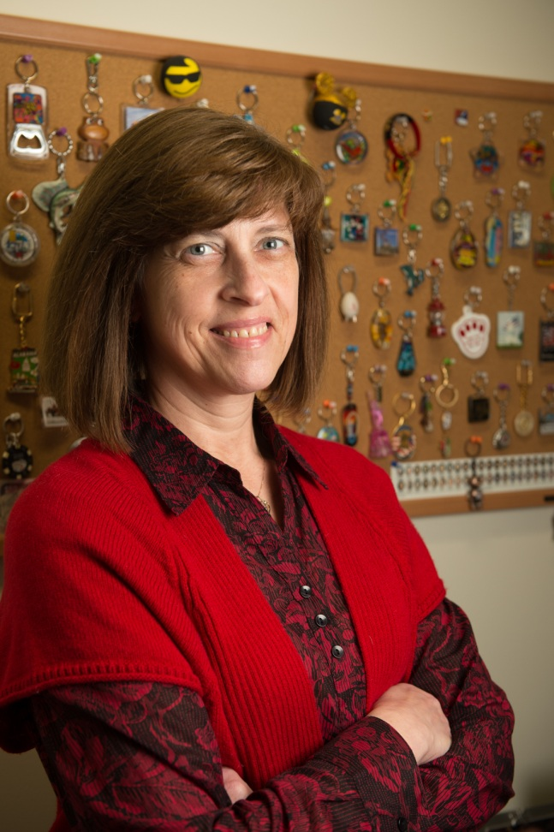
Jill Schaefer 20 Years of Service
Information Technology Services

Slide 51
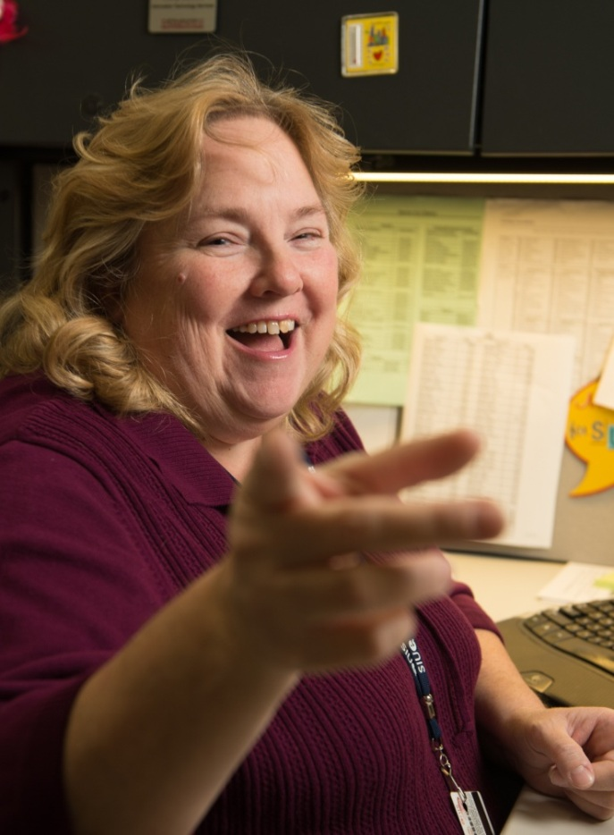
Holly Schott 20 Years of Service
Information Technology Services

Slide 52
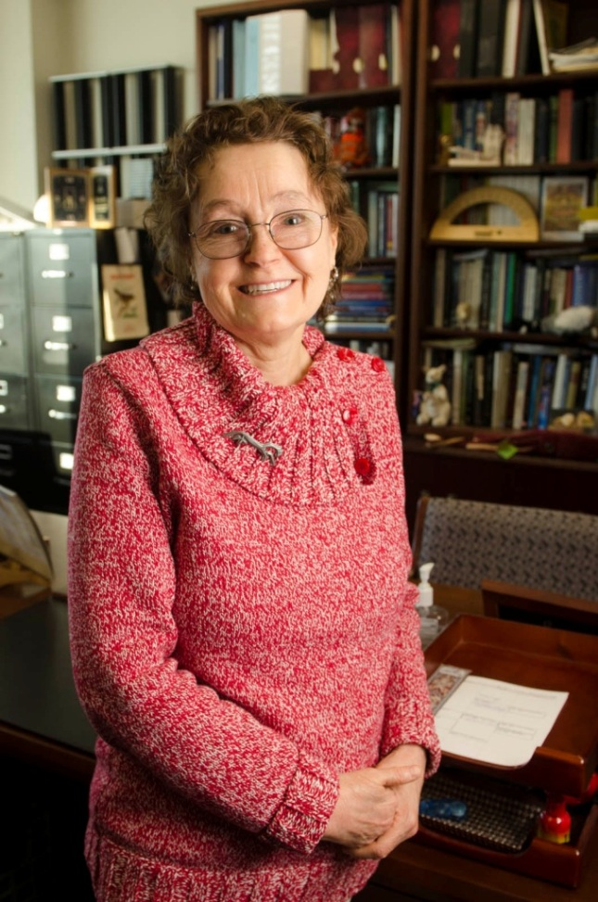
Dr. Wendy Shaw 20 Years of Service
College of Arts & Sciences

Slide 53
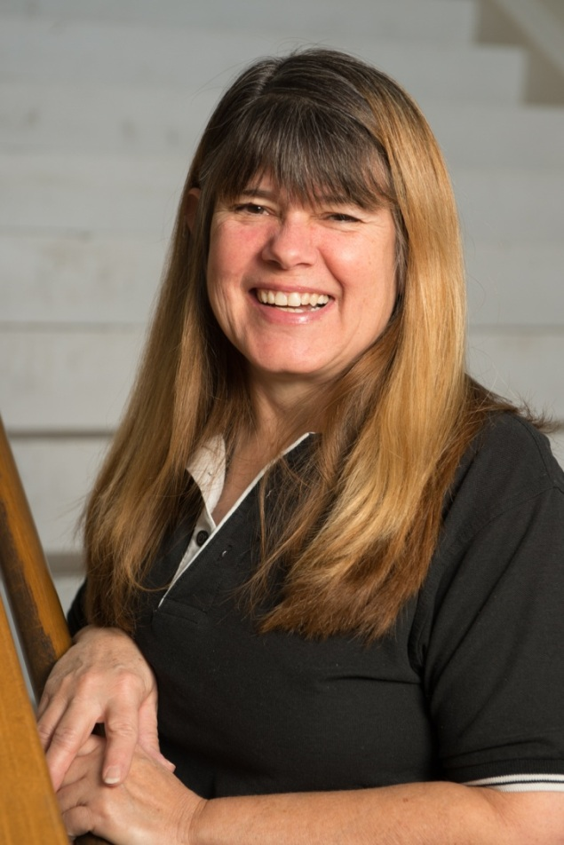
Dawn Snyder 20 Years of Service
Morris University Center Administration

Slide 54
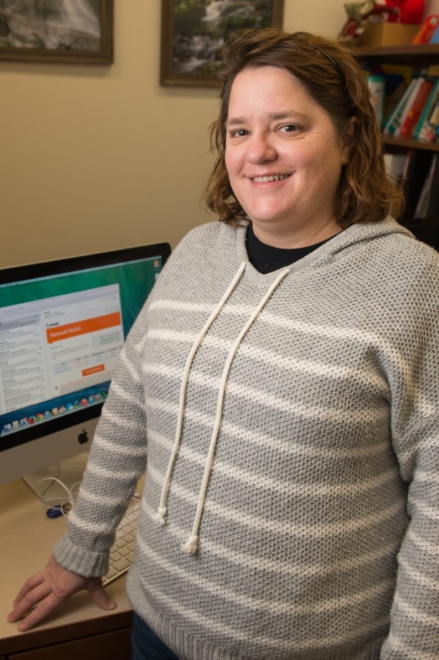
Patty Take 20 Years of Service
Information Technology Services

Slide 55
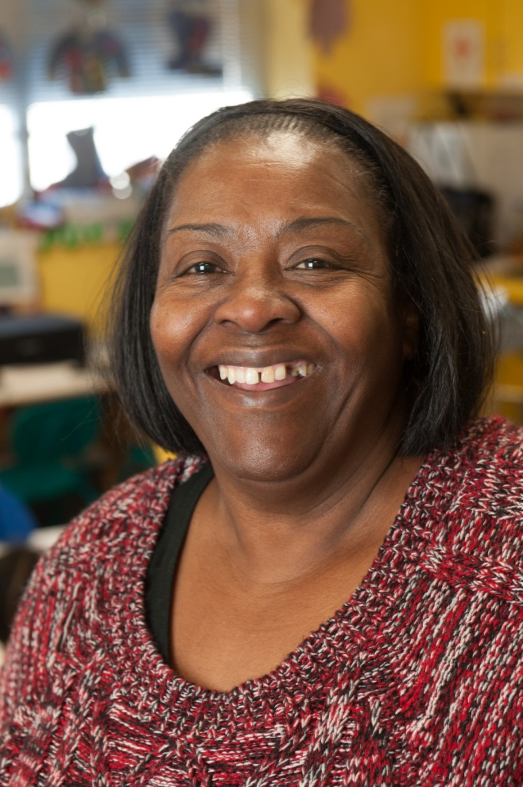
Janice Triplett 20 Years of Service
University Services to East St. Louis

Slide 56
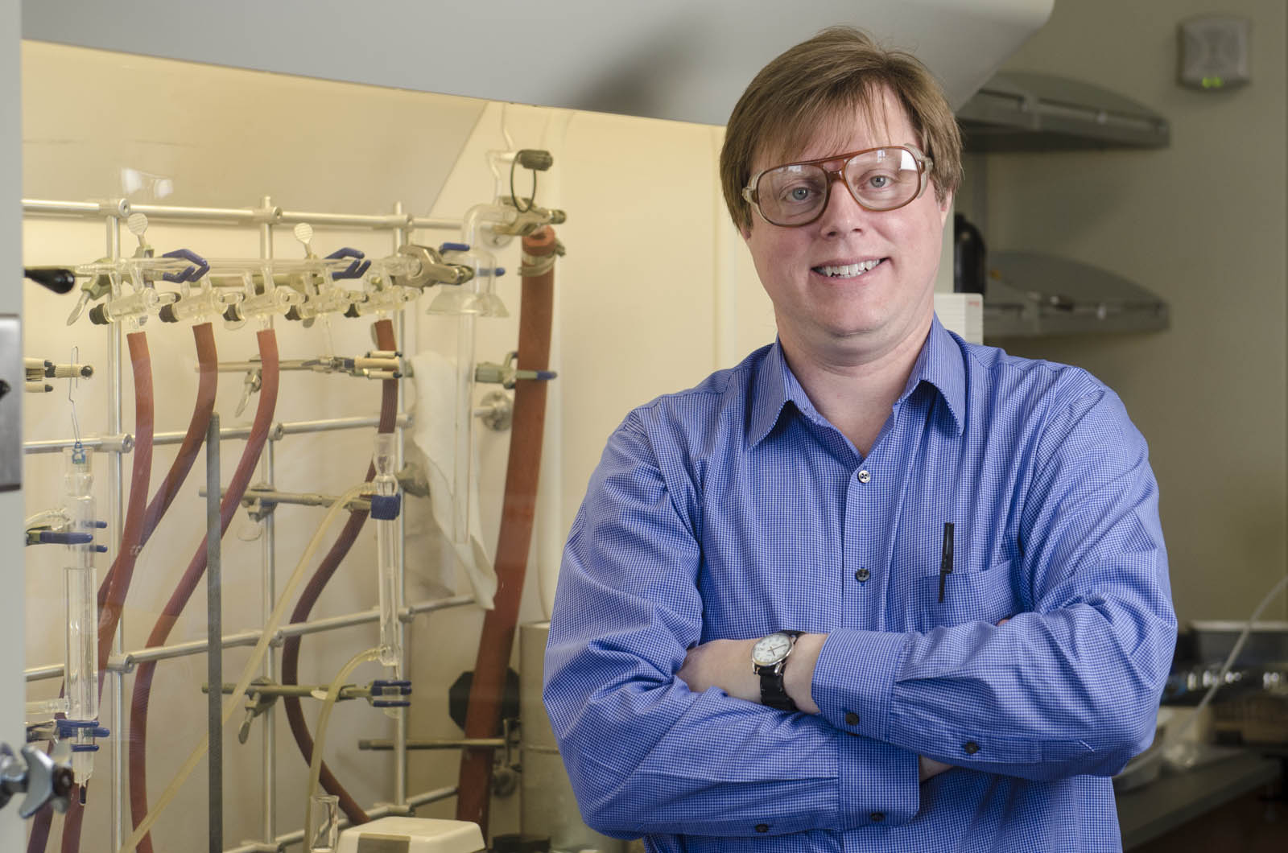
Dr. Eric Voss 20 Years of Service
Chemistry

Slide 57
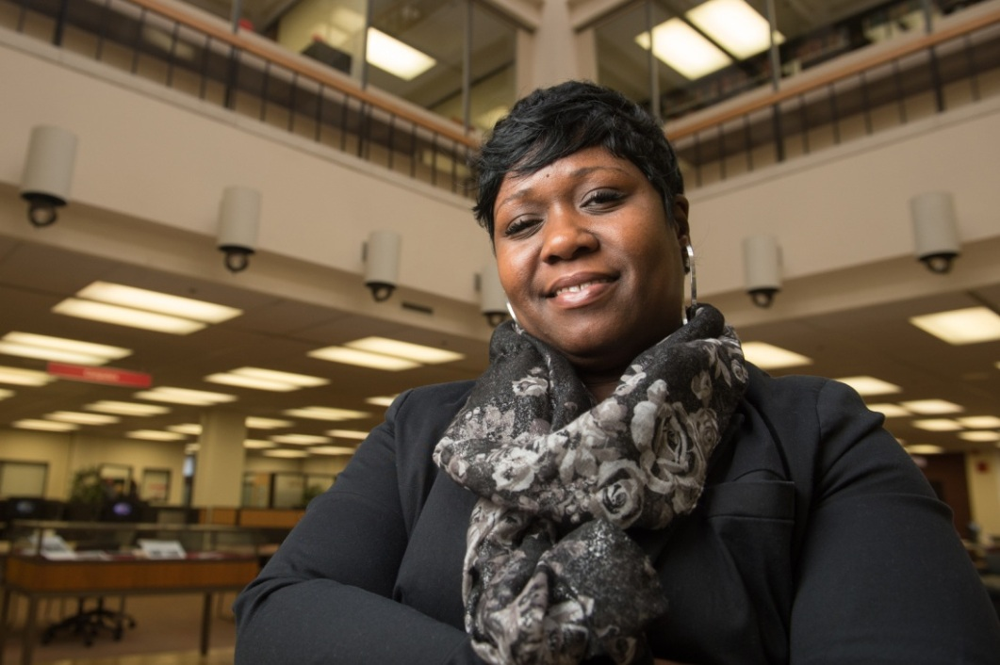
LaShonda Walker 20 Years of Service
Information Technology Services

Slide 58
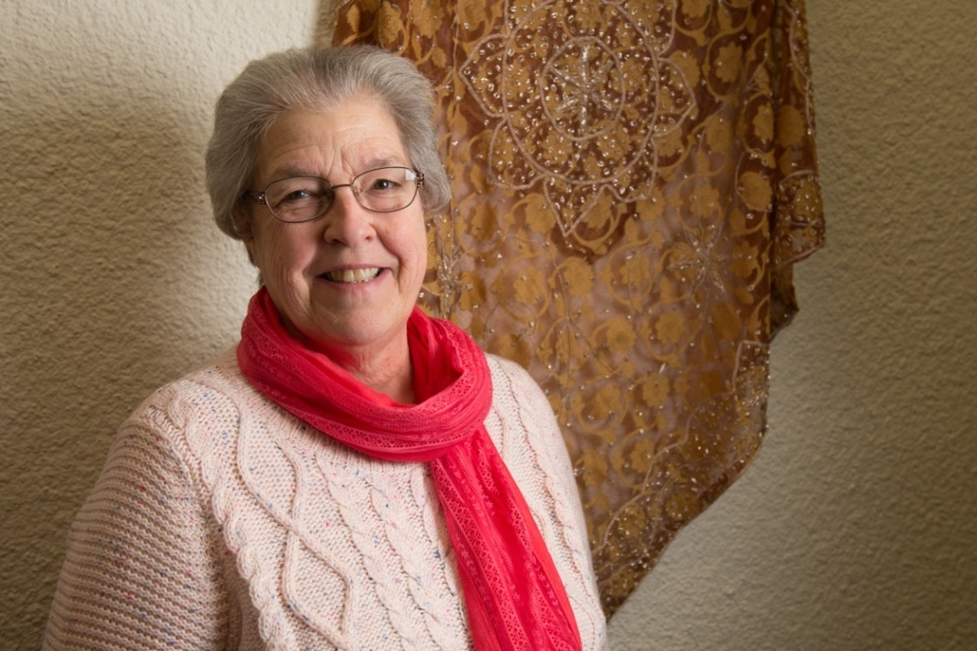
Judy Zimmerman 20 Years of Service
Social Work

Slide 59
25 Year Honorees

Slide 60
Dr. Laura Bernaix 25 Years of Service
School
Of
Nursing

Slide 61
Dr. Belinda Carstens-Wickham 25 Years of Service
Foreign Languages & Literature

Slide 62
Dr. Emmanuel Eneyo 25 Years of Service
Mechanical &
Industrial Engineering

Slide 63
Eric Hess 25 Years of Service
Intercollegiate Athletics

Slide 64
Willa Johnson 25 Years of Service
University Services to East St. Louis

Slide 65
Loretta Jones 25 Years of Service
University Services to East St. Louis

Slide 66
Nanette Markovitch 25 Years of Service
Morris University Center Administration

Slide 67
Linda Marvin 25 Years of Service
Construction

Slide 68
Jodi Olson 25 Years of Service
Office of the Registrar

Slide 69
Linda Skelton 25 Years of Service
Office of Research
&
Projects

Slide 70
Pat Wellen 25 Years of Service
School of Education

Slide 71
Jill Yates 25 Years of Service
Information Technology Services

Slide 72
Denise York 25 Years of Service
Admissions

Slide 73
Tony Zillen 25 Years of Service
Facilities Management

Slide 74
30 Year Honorees

Slide 75
Therese Dickman 30 Years of Service
Lovejoy Library

Slide 76
Tamara Foiles 30 Years of Service
School of Dental Medicine

Slide 77
Carla Micheletto 30 Years of Service
Psychology

Slide 78
Lisa Scheldt 30 Years of Service
School of Dental Medicine

Slide 79
45 Year Honoree

Slide 80
Dr. Timothy Patrick 45 Years of Service
Chemistry

Slide 81
Congratulations to all
Honorees!

