Slide 1
2014 Service Awards

Slide 2
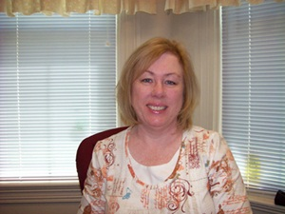
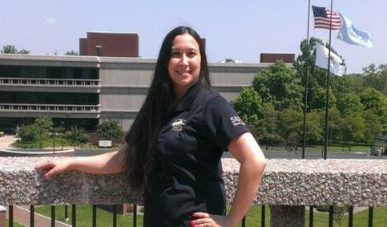
Employees of the Month
June 2013
May 2013
Sherie Gottlob
School of Dental Medicine
Summer Murphy
Office of Human
Resources

Slide 3
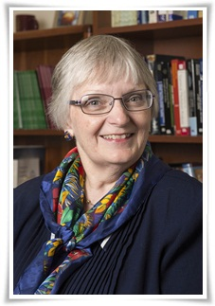
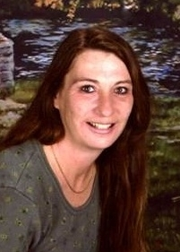
Employees of the Month
July 2013
August 2013
Jennifer Barnhart
Illinois Educational Research Council
Crystal Connoyer
Facilities Management

Slide 4
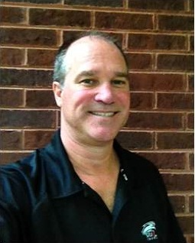
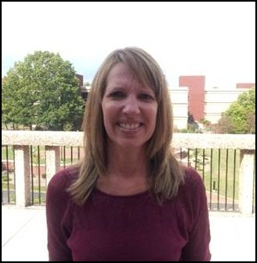
Employees of the Month
September 2013
October 2013
John Renken
Facilities Management
Alarice Houston
Academic Advising

Slide 5
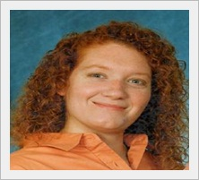
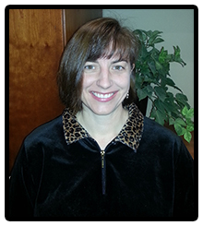
Employees of the Month
November 2013
December 2013
Dana Dain
School of Pharmacy
Kelly Thompson-Hess
Student Financial Aid

Slide 6
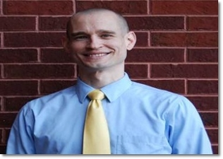
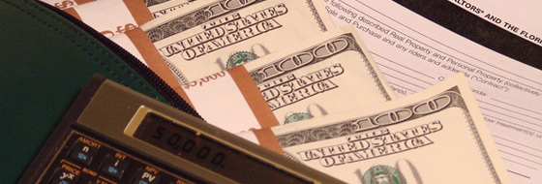
Employees of the Month
January 2014
February 2014
Jeff Price
Academic Computing
Janet Crouch
Office of the Bursar

Slide 7
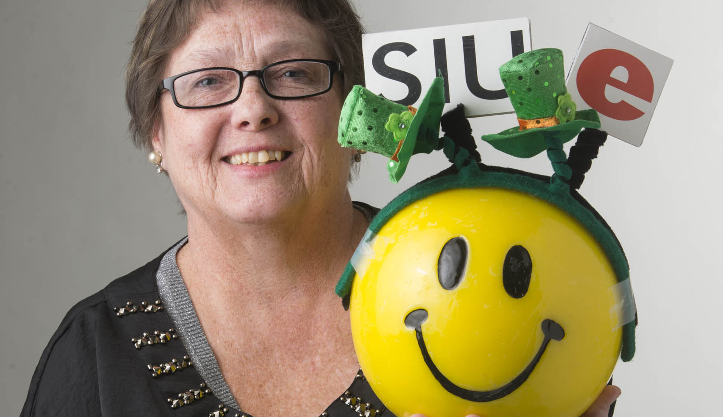
Employees of the Month
March 2014
Jennettie Lierman
Marketing and Communications

Slide 8
Chancellor Julie Furst-Bowe’s
2014 Service Awards
Address

Slide 9
10 Year
Service Award
Honorees

Slide 10
Group 1 10 Year Honorees
Dr. Alicia Alexander
Amanda Armon
Karen Bassimer
Keith Becherer
Mary Billops
Paula Birke
Phillip Brown
Carl Bryan
Todd Burrell
Dr. Riza Demirer

Slide 11
Group 2 10 Year Honorees
Dr. P. Dirks-Linhorst
Leasa Ferry
Dylan Gither
Dean Gireesh Gupchup
Frank Hanes
Dr. Elza Ibroscheva
Anne Kates
Christopher Knetzer
Katherine Ledford
Dr. Mark Luer

Slide 12
Group 3 10 Year Honorees
Edward Matecki
Gail Munneke
Dr. Sally Perry
Sherry Pomatto
Reginald Randolph
Trisha Simmons
Frances Tompkins
Diana Ward
Ned Zini

Slide 13
15 Year
Service Award
Honorees

Slide 14
Group 1 15 Year Honorees
Patrick Bruder
Wendy Bunker
Tracey Burris
Sue Cavaletti
Diane Chappel
Kade Cole
Veronica Corradini
Conrad Crook
Xanthe Emerick

Slide 15
Group 2 15 Year Honorees
Sandra Goodman
Dr. Gary Hicks
Danny Keeton
Patricia Koertge
Joji Mafla
Trisha McCulloch
Christy McDougal
Josephine Morris
Dr. Gerald O'Brien

Slide 16
Group 3 15 Year Honorees
Angela Pulliam
Rene Smith
Sherry Smith
Beth Winet
Julie Wojtal
Traci Woolfolk
Kara Wright

Slide 17
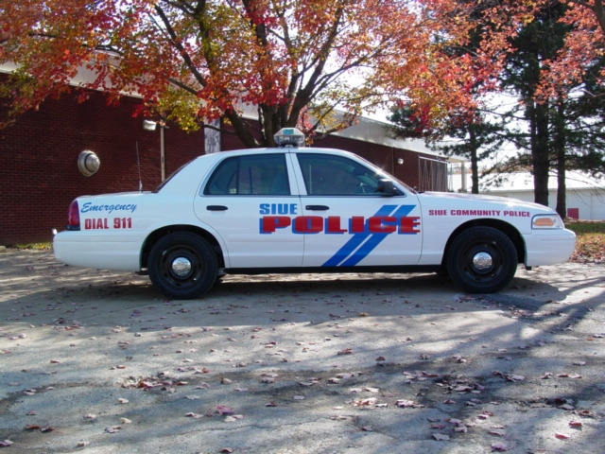
Jill Beck 20 Years of Service
Police Services

Slide 18
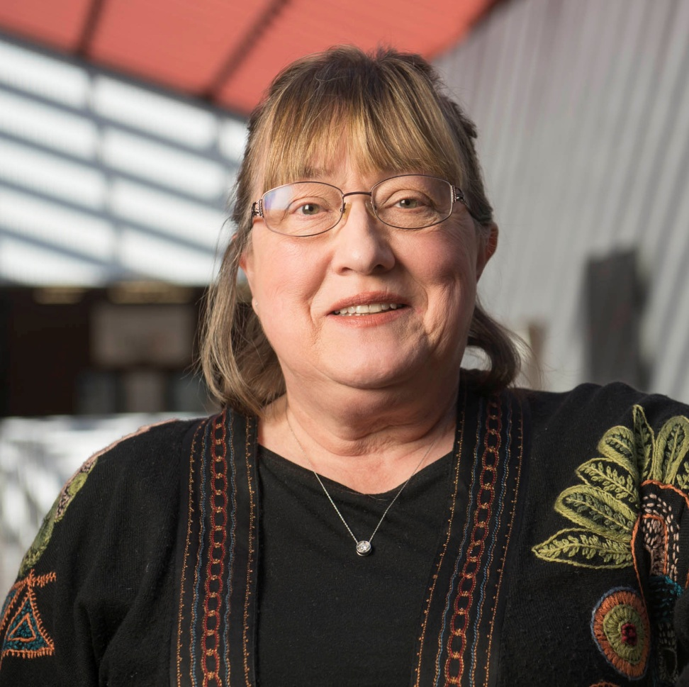
Dr. Virginia Behrhorst 20 Years of Service
Family Health/Community Health Nursing
Psychology Department

Slide 19

Lollie Cotten 20 Years of Service
University Services to East Saint Louis

Slide 20
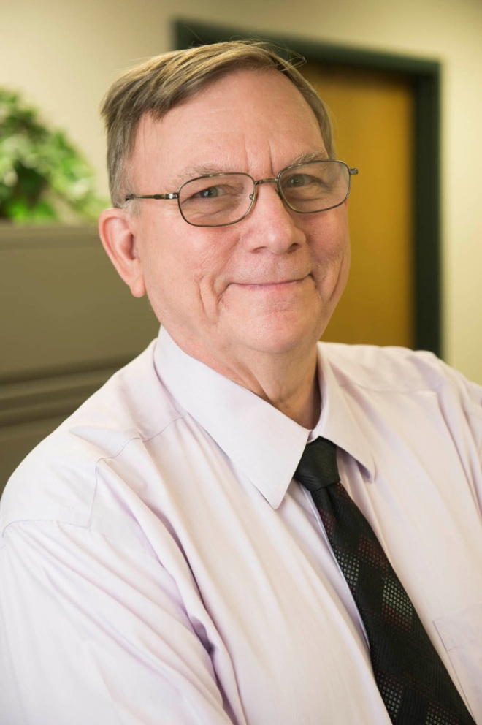
William Dusenbery 20 Years of Service
University Services to East Saint Louis

Slide 21
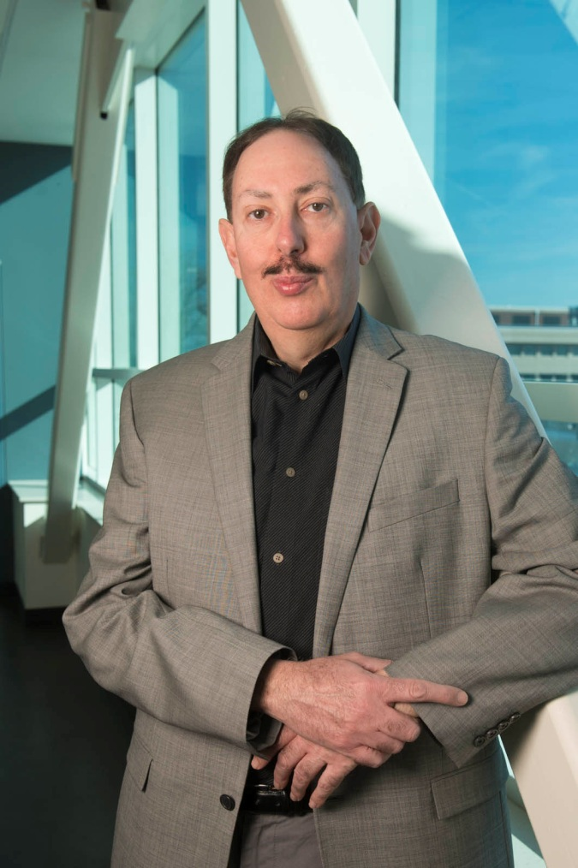
Dr. George Engel 20 Years of Service
Electrical and Computer Engineering

Slide 22
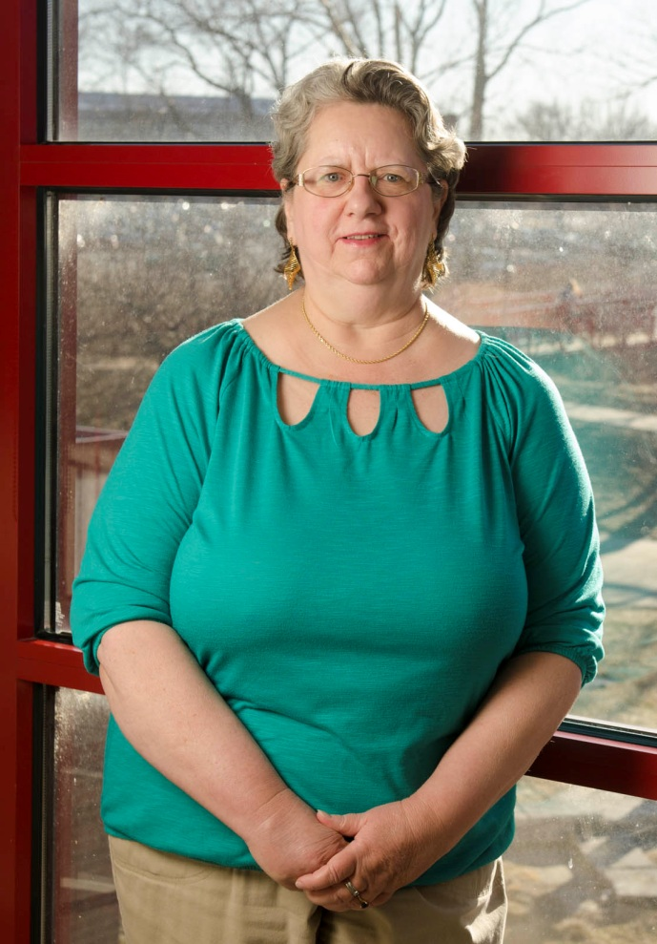
Diana Gould 20 Years of Service
Campus Recreation

Slide 23
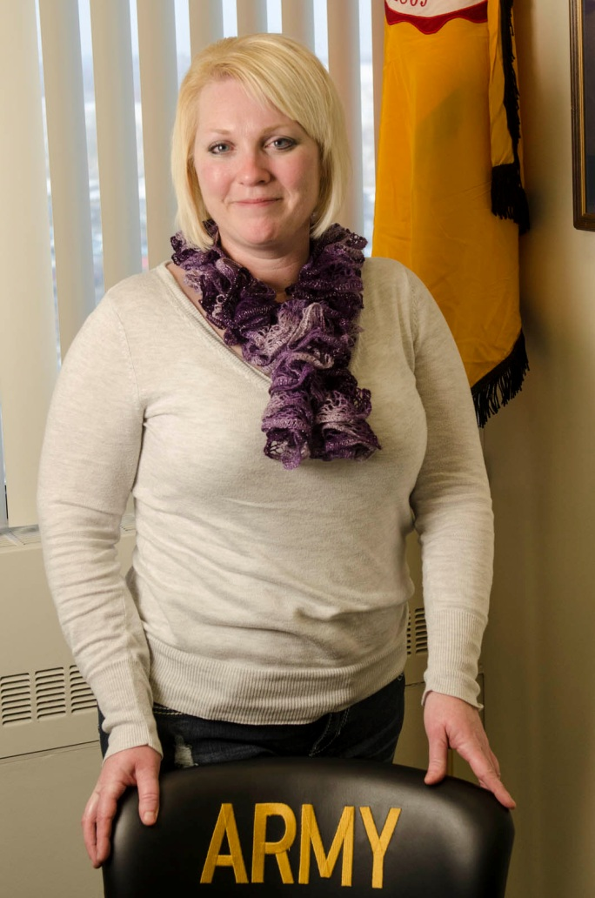
Catherine Harmon 20 Years of Service
Reserve Officers’ Training Corps

Slide 24
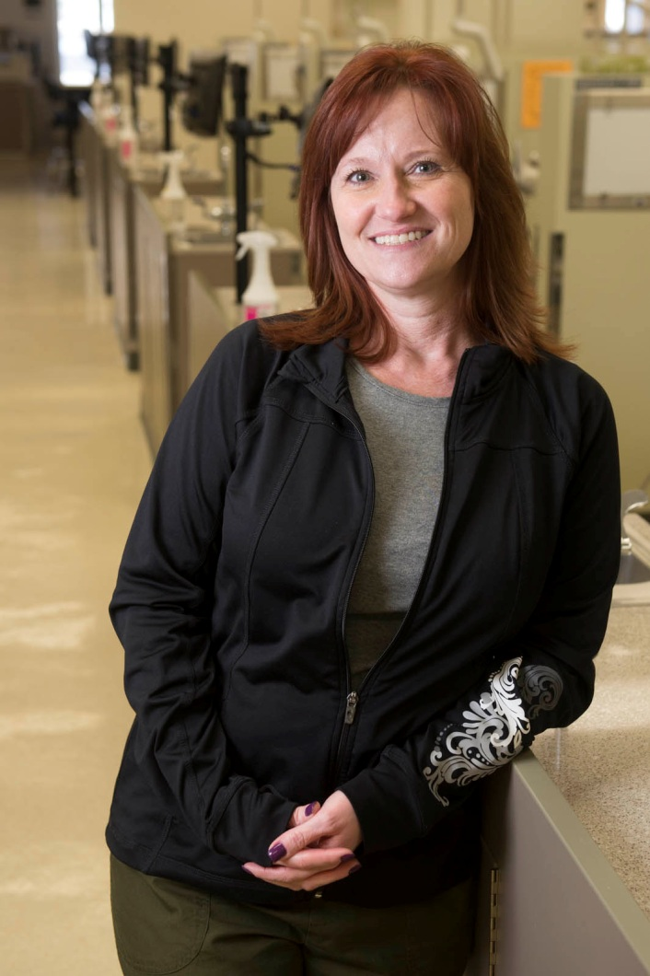
Carla Haydon 20 Years of Service
School of Dental Medicine

Slide 25
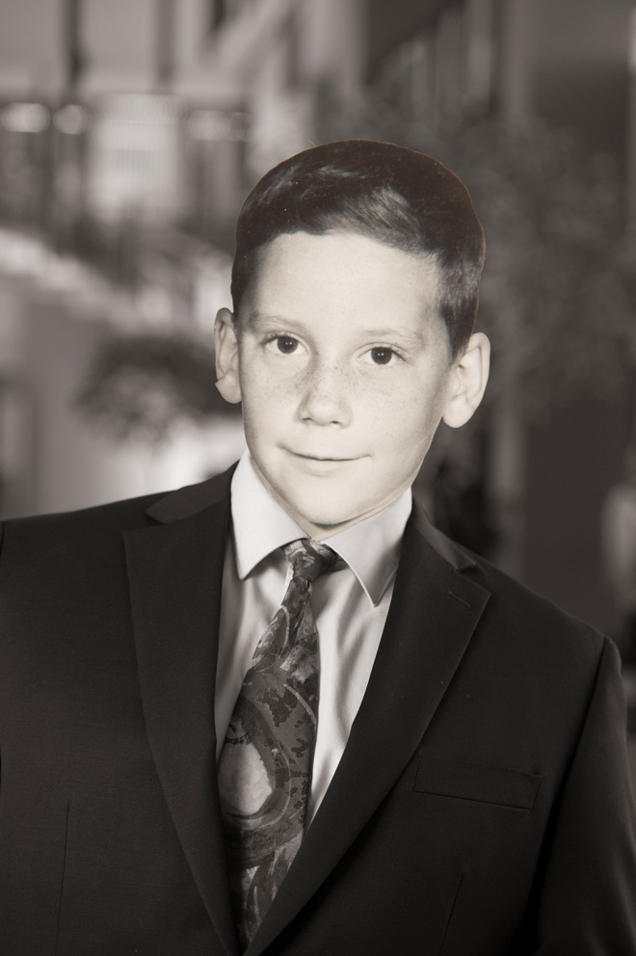
David Heth 20 Years of Service
Financial Affairs

Slide 26
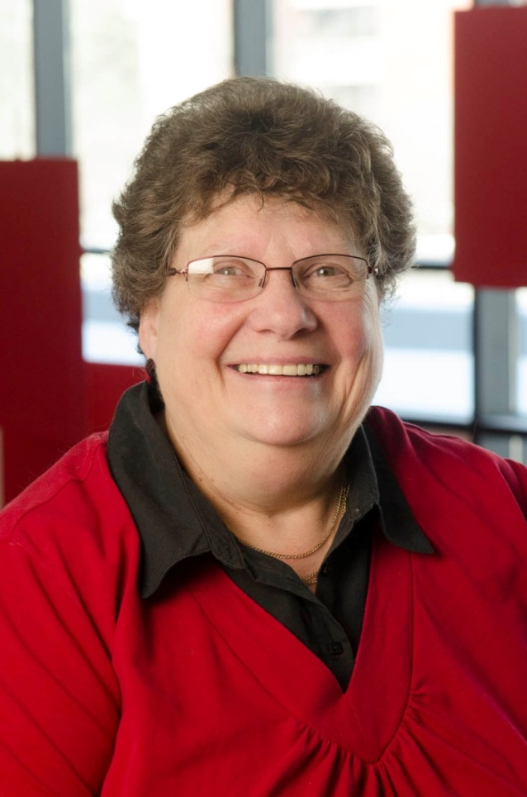
Mary Jenkins 20 Years of Service
Student Financial Aid

Slide 27
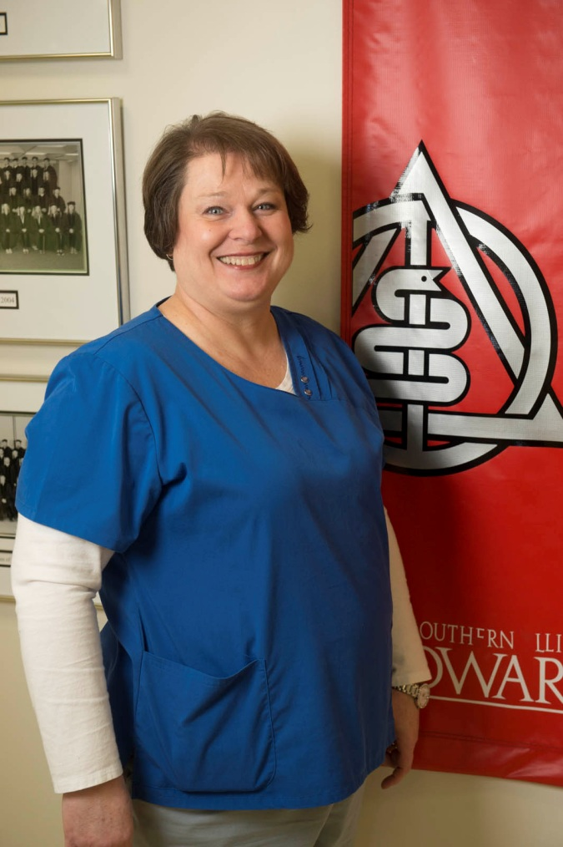
Beth Johnson 20 Years of Service
School of Dental Medicine

Slide 28
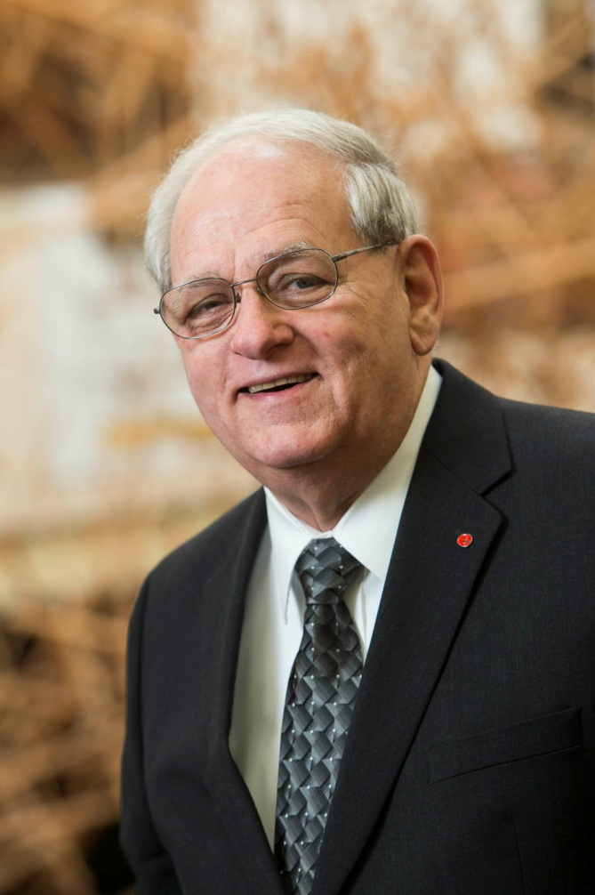
James McDermott 20 Years of Service
Morris University Center Administration

Slide 29
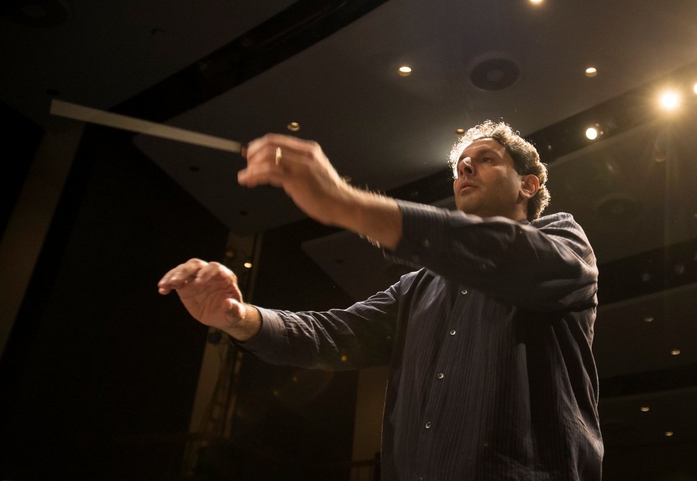
Dr. Michael Mishra 20 Years of Service
Music

Slide 30
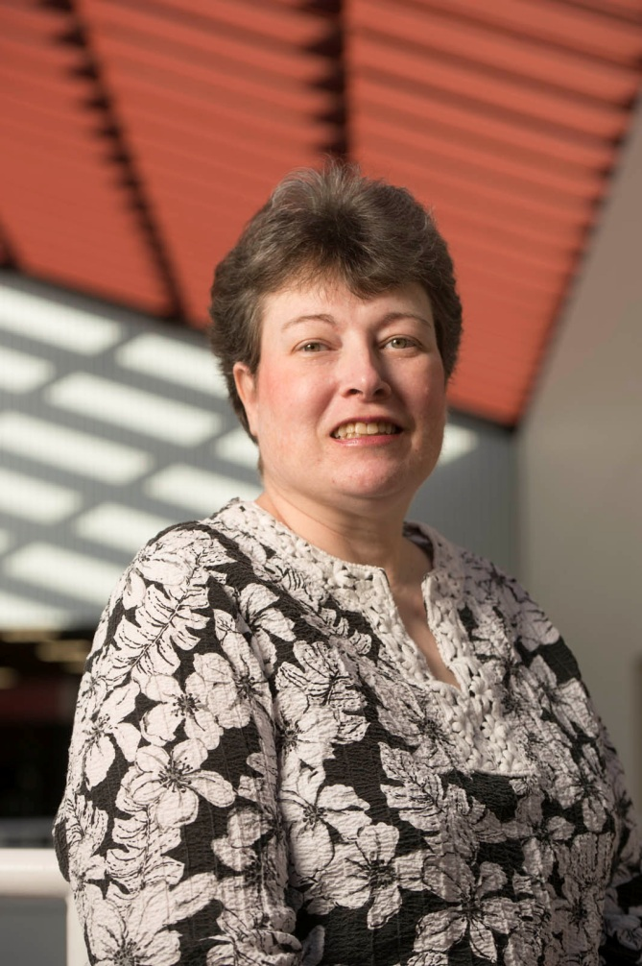
Annette Musenbrock 20 Years of Service
School of Nursing

Slide 31
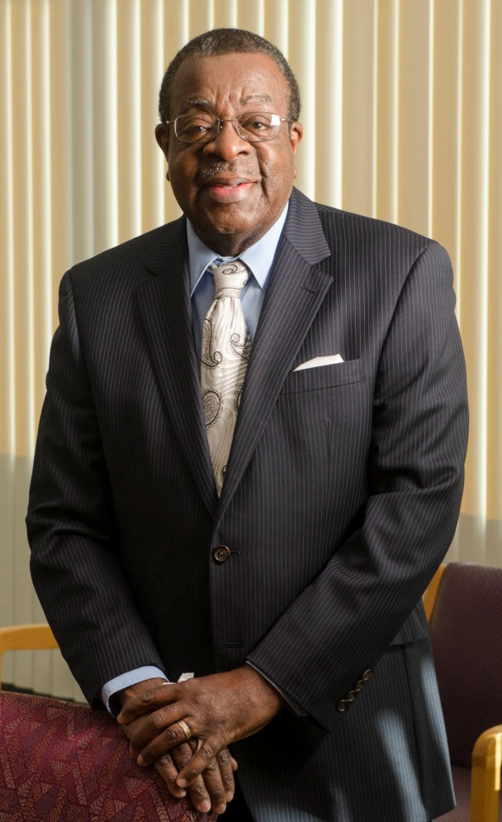
Paul Pitts 20 Years of Service
Office of Institutional Compliance

Slide 32
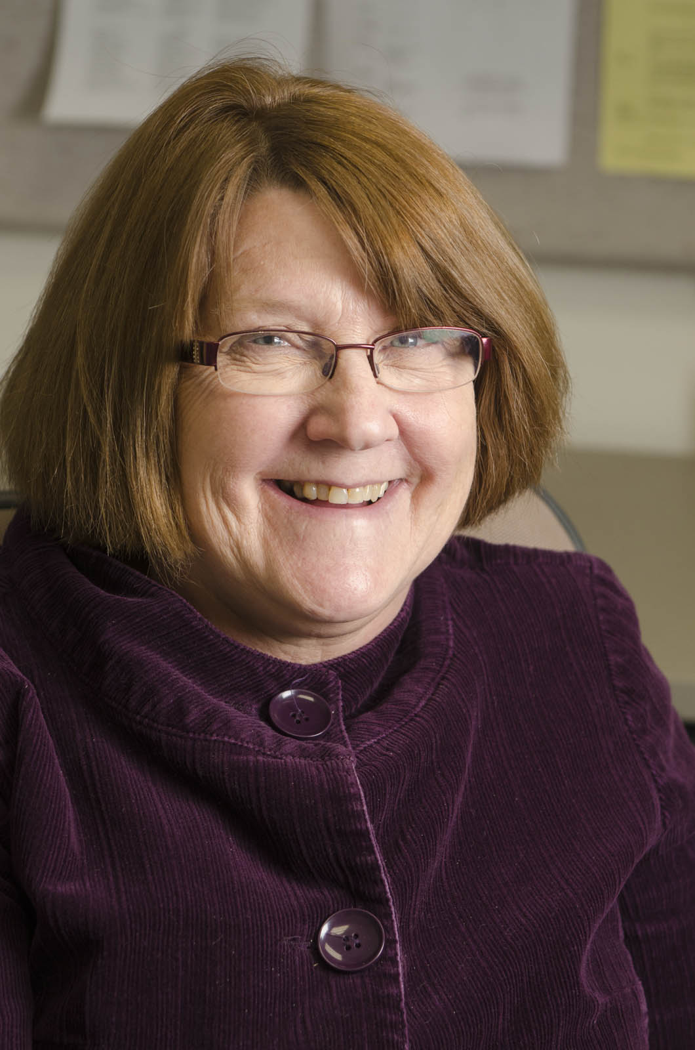
Bonnie Sanderson 20 Years of Service
Academic Advising

Slide 33
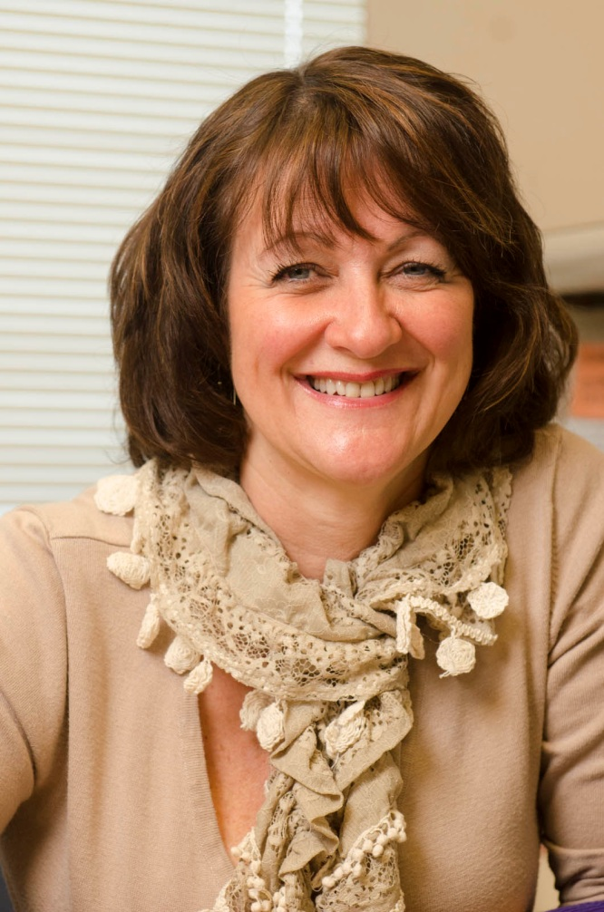
Dr. Cathy Santanello 20 Years of Service
School of Pharmacy

Slide 34
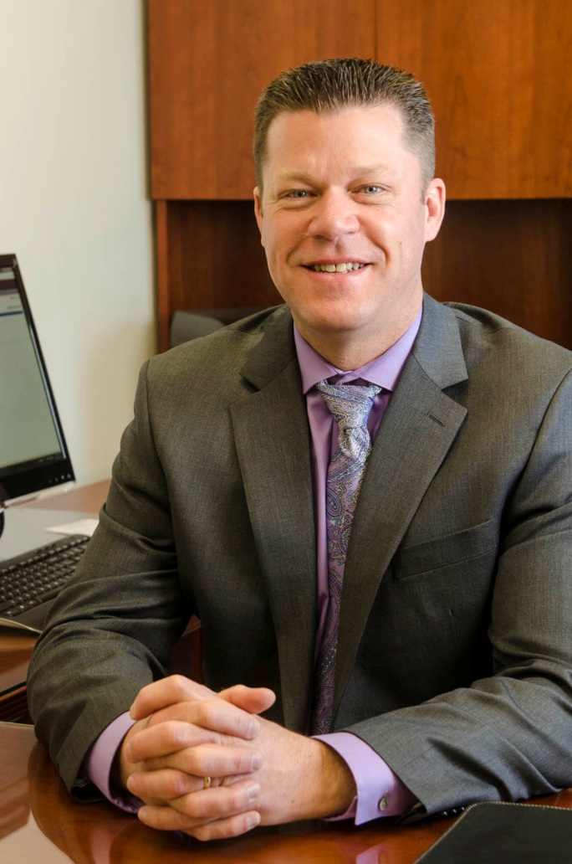
Kevin Schmoll 20 Years of Service
Police Services

Slide 35
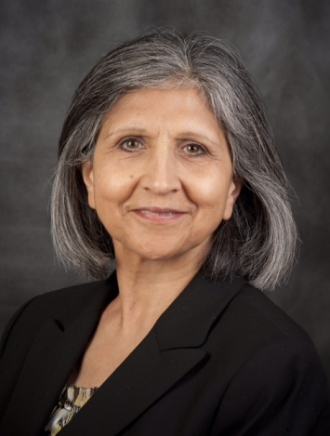
Dr. Nahid Shabestary 20 Years of Service
Chemistry

Slide 36
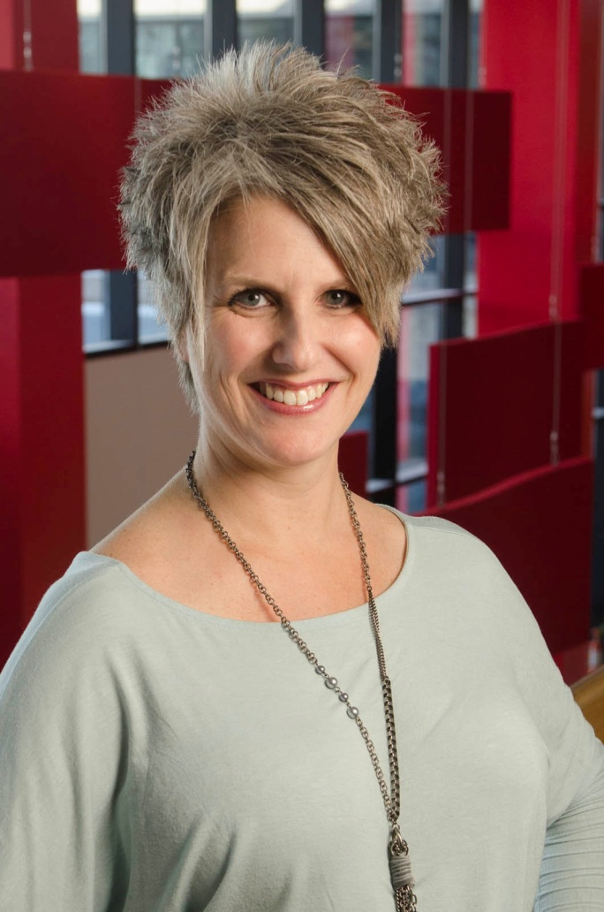
Kara Shustrin 20 Years of Service
Student Affairs

Slide 37
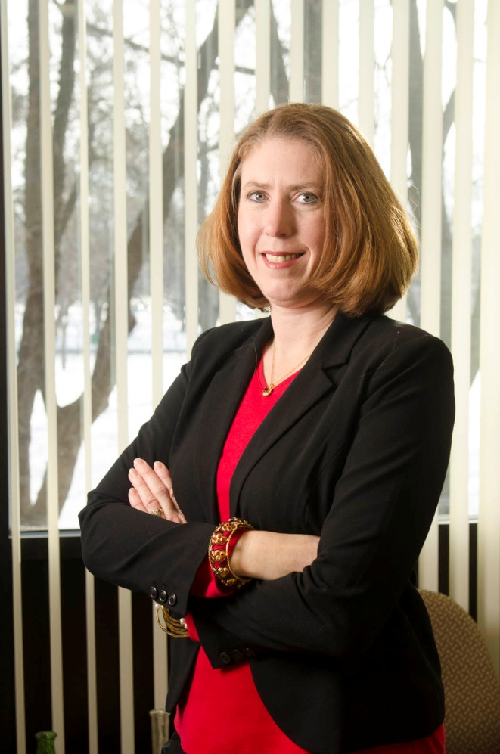
Dawn Sparks 20 Years of Service
Bursar

Slide 38
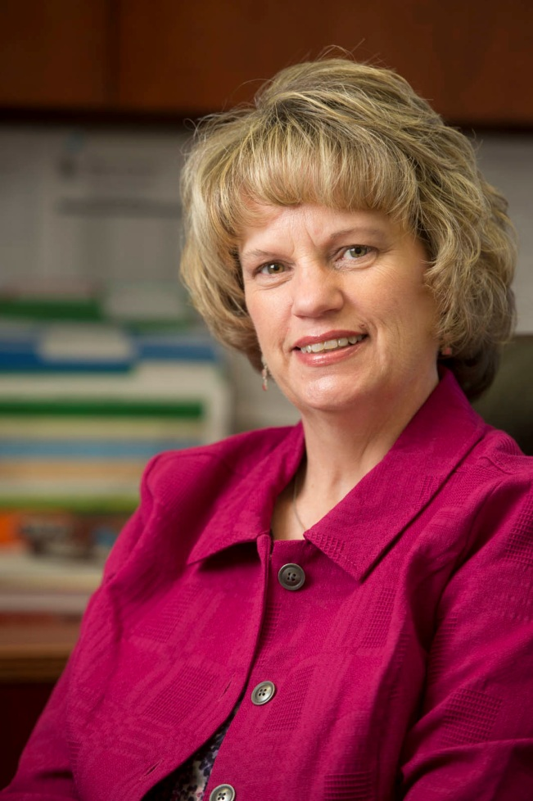
Angela White 20 Years of Service
School of Education

Slide 39
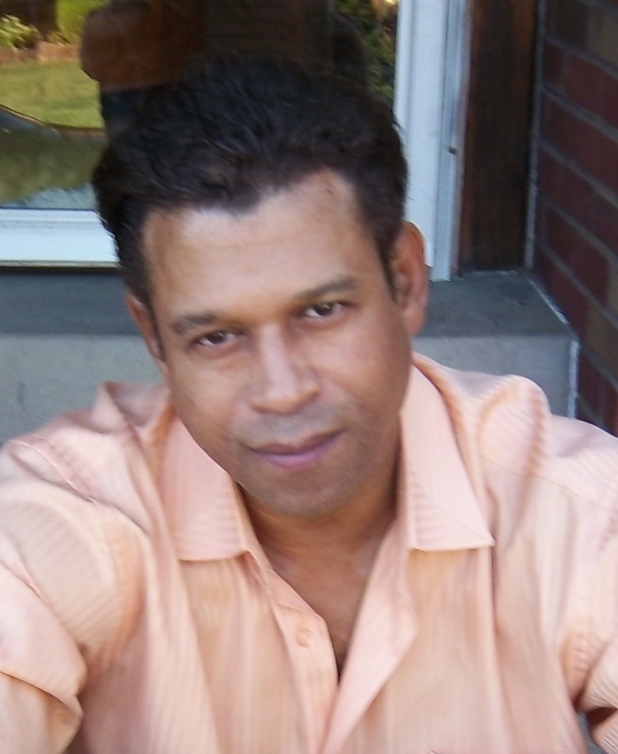
Earl Wilkes 20 Years of Service
University Services to East Saint Louis

Slide 40
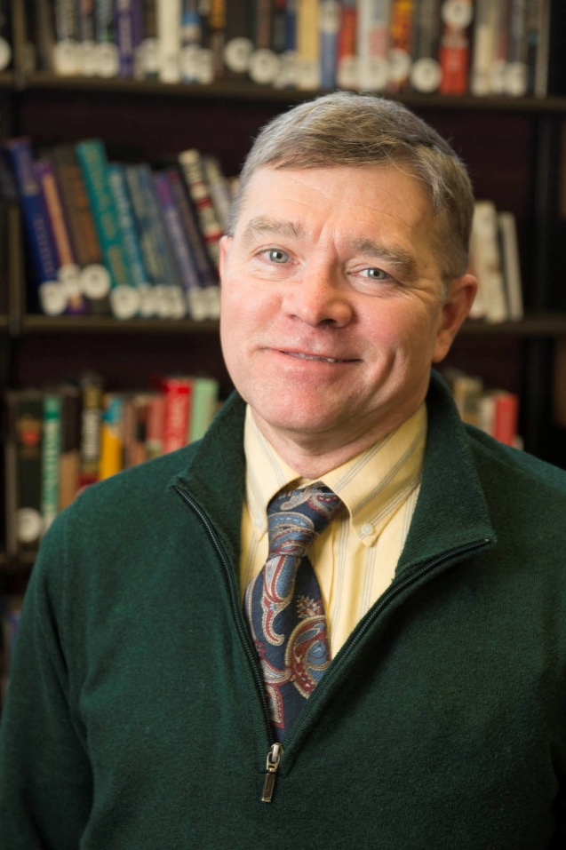
Paul Anthony 25 Years of Service
Lovejoy Library

Slide 41
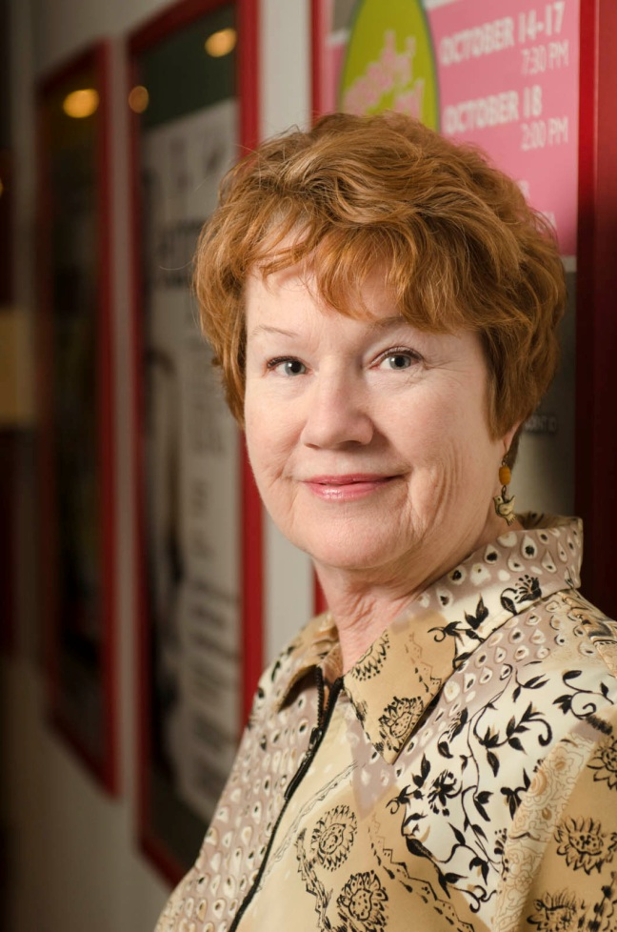
Debra Brown-Thompson 25 Years of Service
Theater and Dance

Slide 42
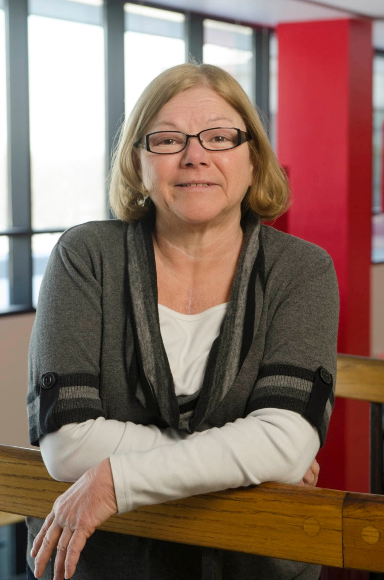
Gail Erb 25 Years of Service
Student Financial Aid

Slide 43
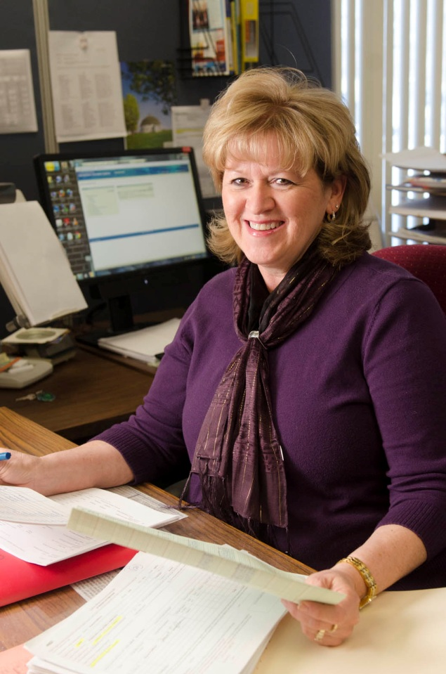
Sharon Giffhorn 25 Years of Service
Purchasing

Slide 44
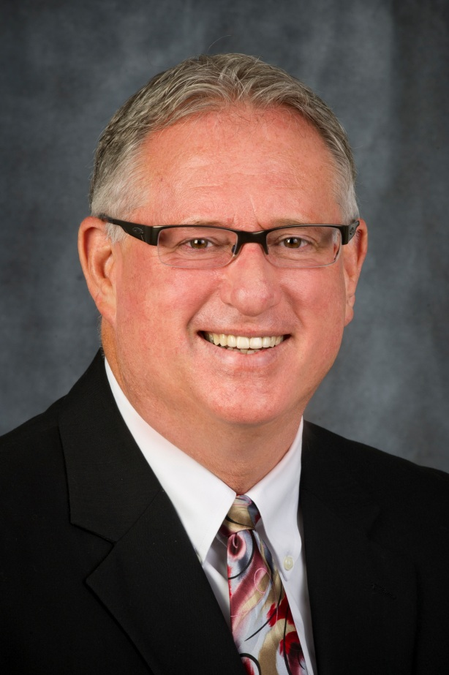
Dr. Bradley Hewitt 25 Years of Service
Intercollegiate Athletics

Slide 45
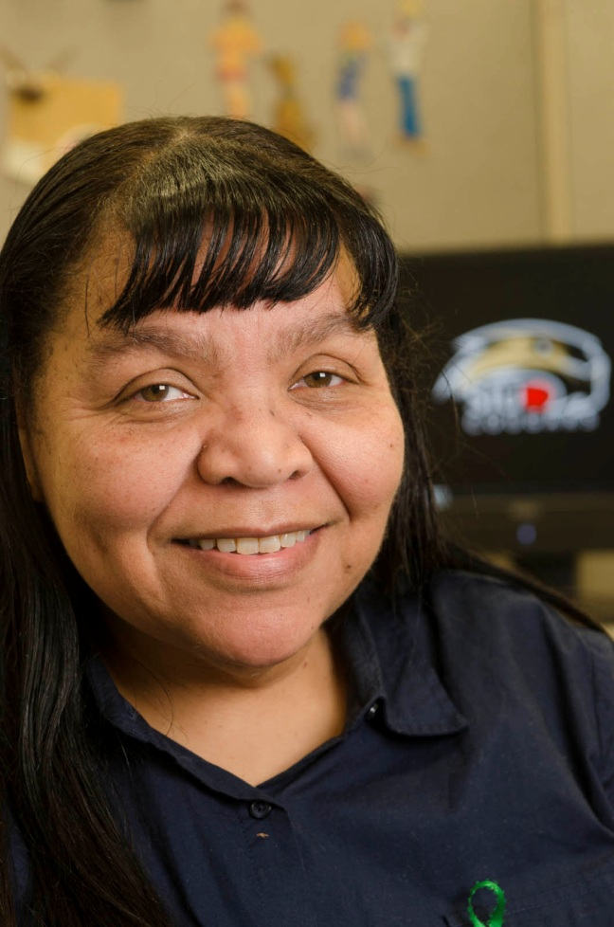
Naomi Jacobs 25 Years of Service
Administrative Accounting

Slide 46

Linda Jaworski-Moiles 25 Years of Service
English Language and Literature

Slide 47
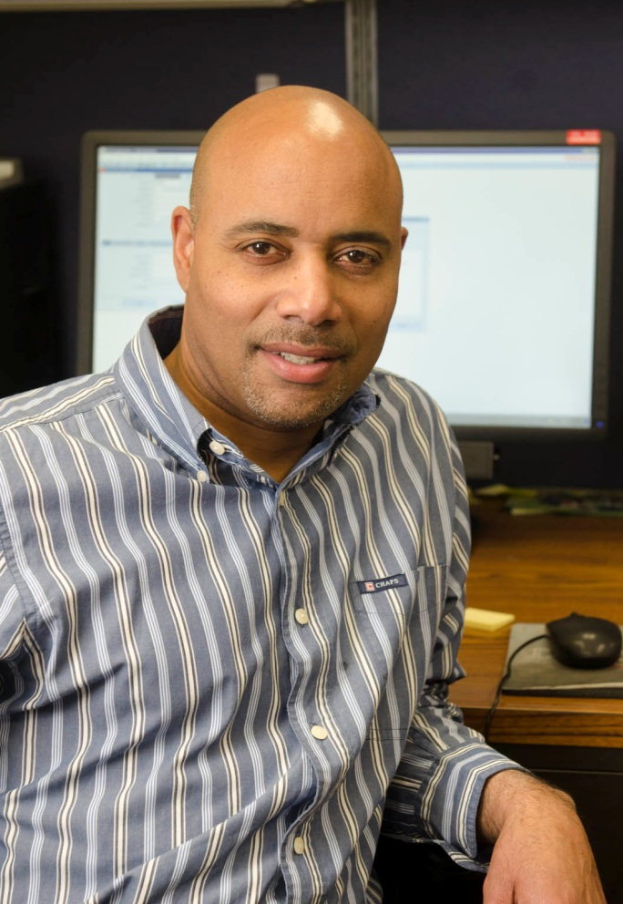
Craig McIntosh 25 Years of Service
Purchasing

Slide 48
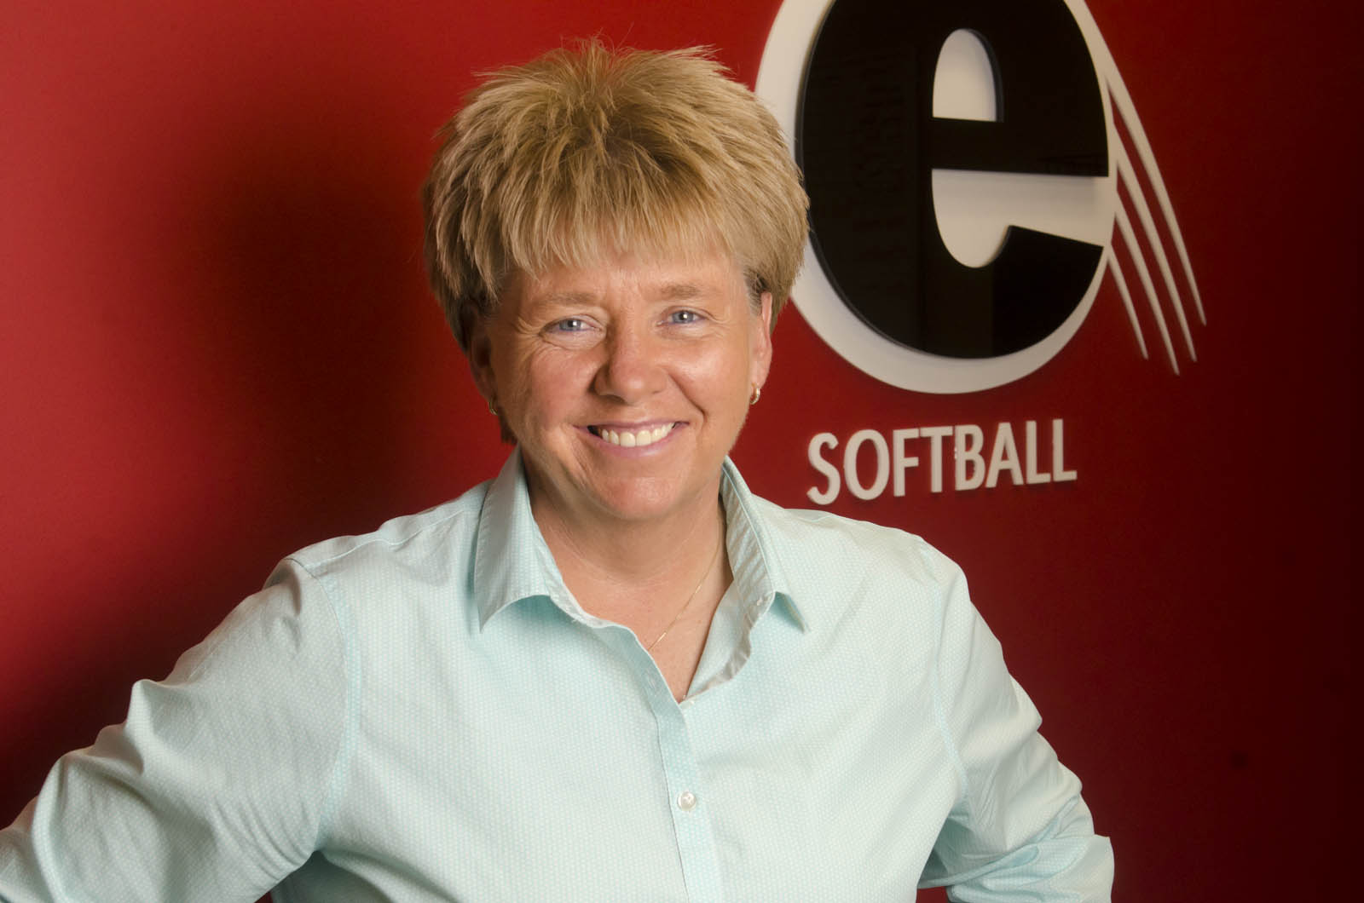
Sandra Montgomery 25 Years of Service
Intercollegiate Athletics

Slide 49
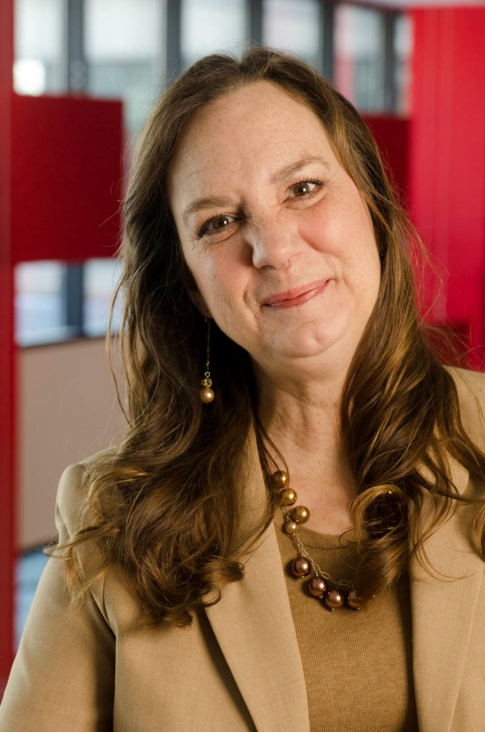
Sally Mullen 25 Years of Service
Student Financial Aid

Slide 50
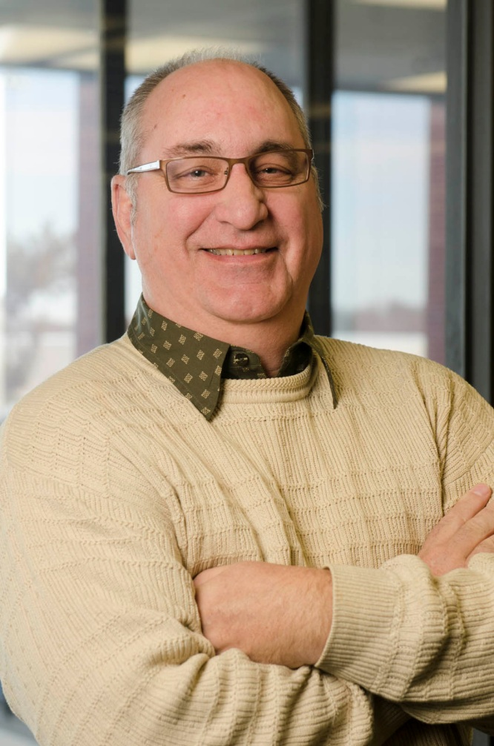
Dr. Wayne Nelson 25 Years of Service
Information Technology Services

Slide 51
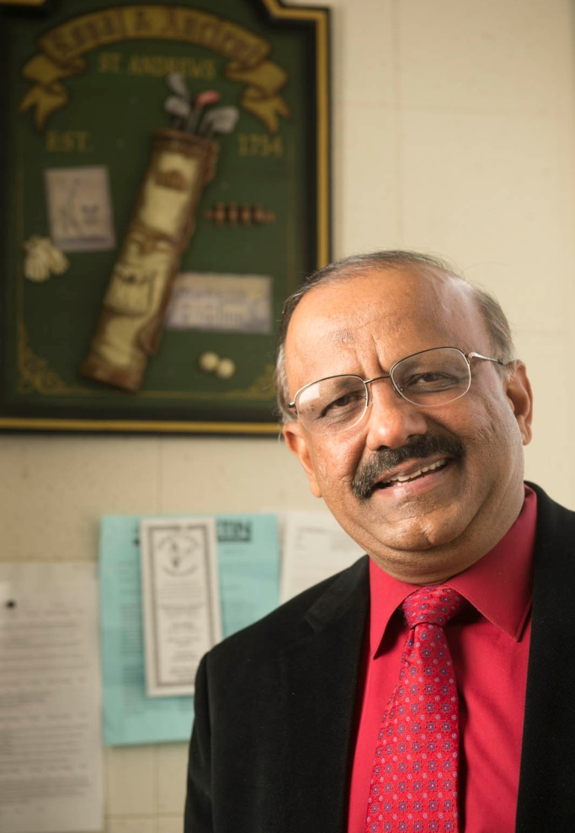
Dr. T.K. Parthasarathy 25 Years of Service
Special Education and Communication Disorders

Slide 52
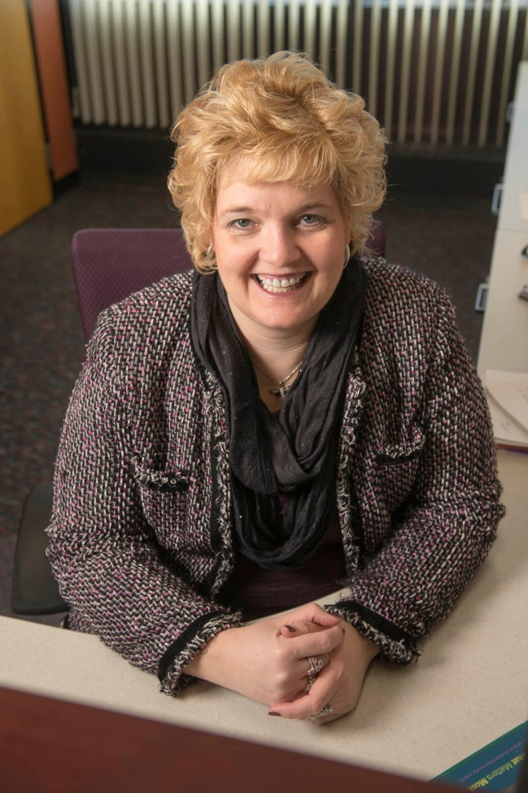
Mary Kay Rehkemper 25 Years of Service
Vice Chancellor of Administration Office

Slide 53
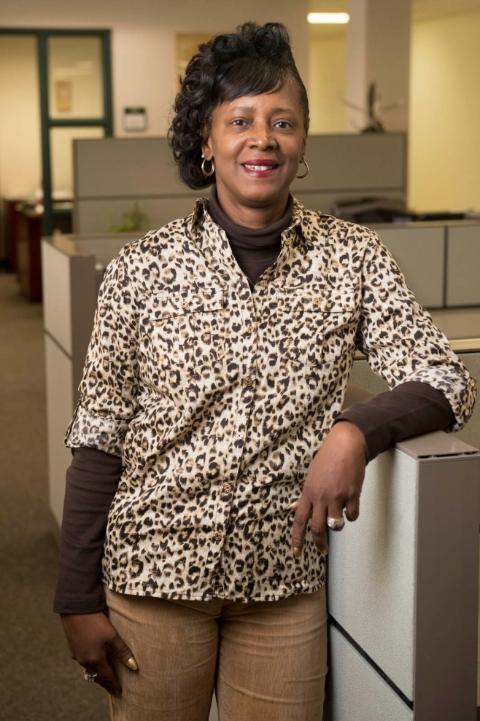
Ann Robinson 25 Years of Service
University Services to East Saint Louis

Slide 54
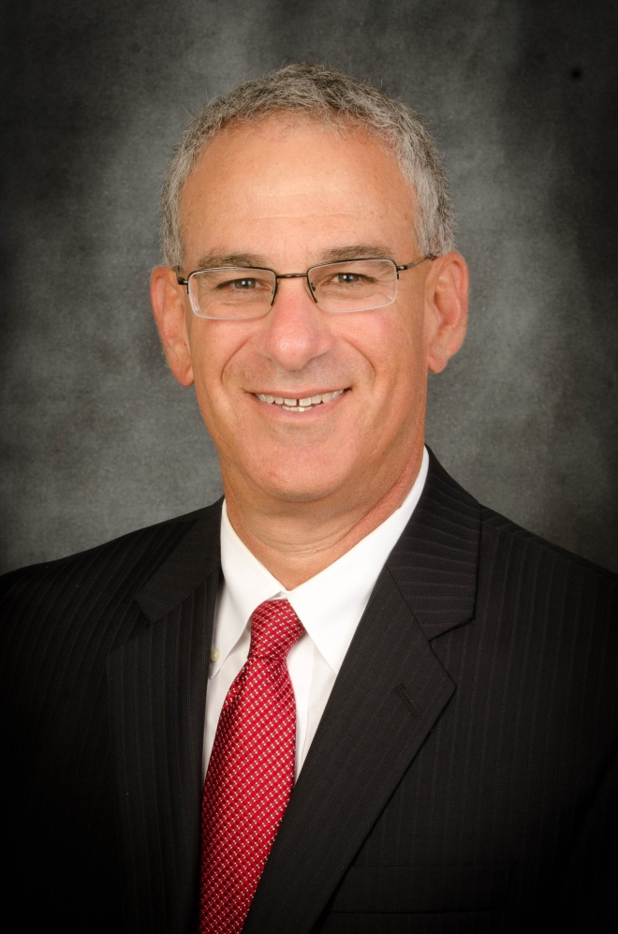
Michael Shultz 25 Years of Service
Housing

Slide 55
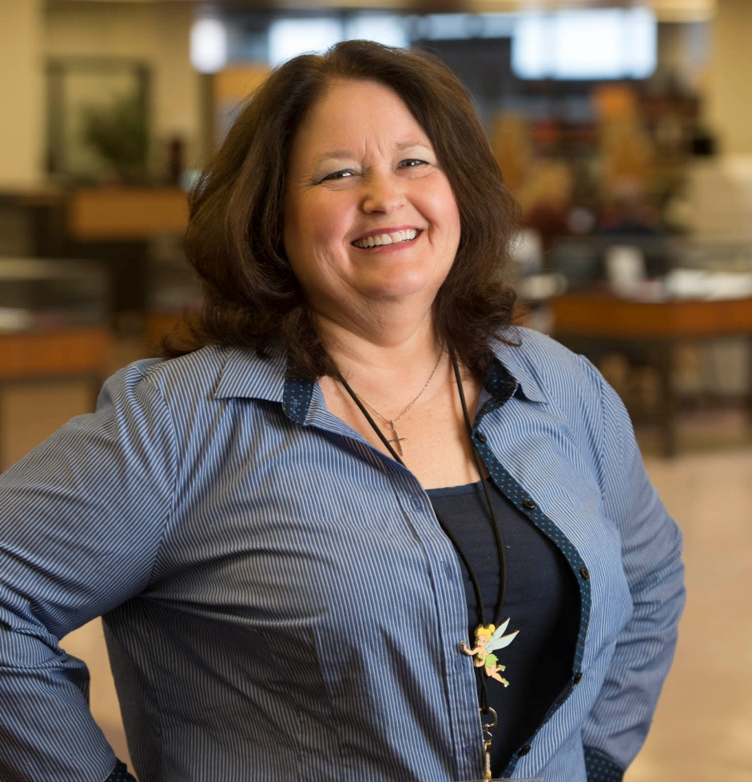
Cindy Tate 25 Years of Service
Information Technology Services

Slide 56
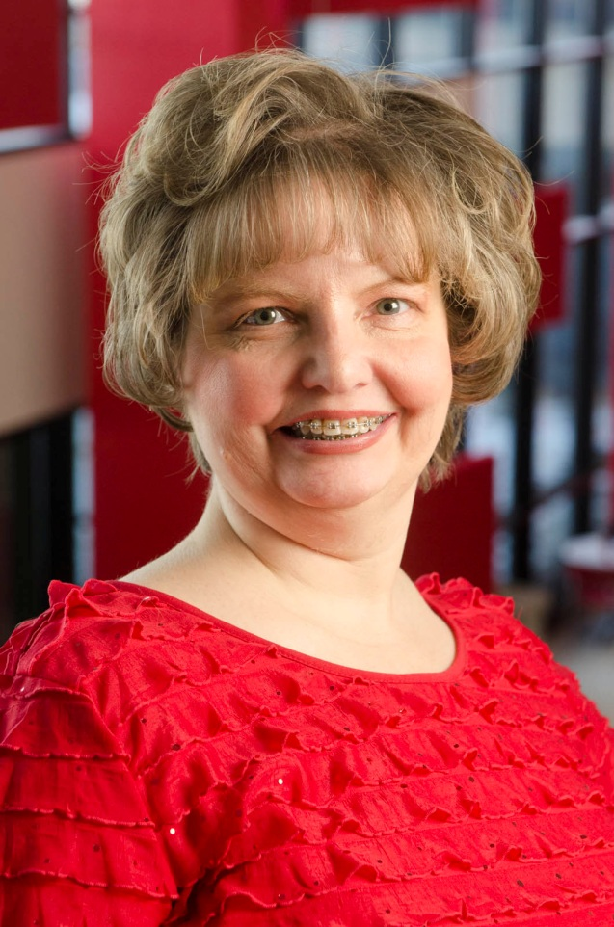
Toni Taylor 25 Years of Service
Student Financial Aid

Slide 57
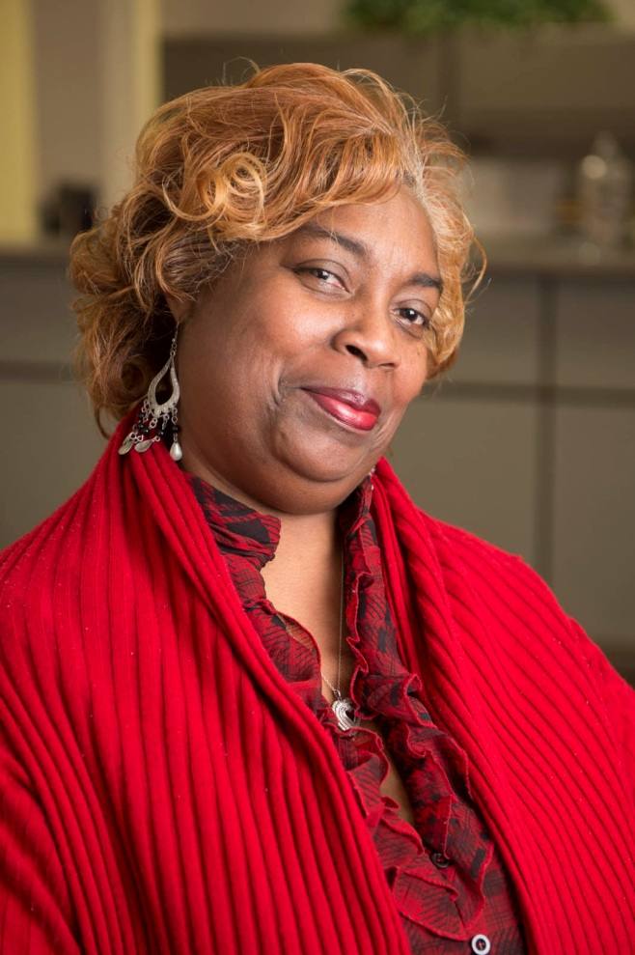
Curtiseena Wilson 25 Years of Service
University Services to East Saint Louis

Slide 58

Deborah Bailey 30 Years of Service
University Services to East Saint Louis

Slide 59

Busabun Catalano 30 Years of Service
Bursar

Slide 60

Angela Cotton 30 Years of Service
University Services to East Saint Louis

Slide 61

Julie Full-Lopez 30 Years of Service
Instructional Services

Slide 62

Edward Knowles 30 Years of Service
Information Technology Services

Slide 63

Annette Jackson 30 Years of Service
University Services to East Saint Louis

Slide 64

Robert Legate 30 Years of Service
Housing

Slide 65

Michael Ostrander 30 Years of Service
Campus Recreation

Slide 66

Dawn Reagan 30 Years of Service
Administrative Accounting

Slide 67

Shari Renken 30 Years of Service
Information Technology Services

Slide 68

John Williams 30 Years of Service
University Services to East Saint Louis

Slide 69

Dr. Richard Brugam 35 Years of Service
Biological Sciences

Slide 70
Congratulations to all
Honorees!

