Slide 1
2013 Service Awards

Slide 2
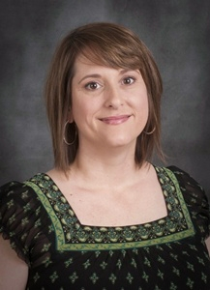
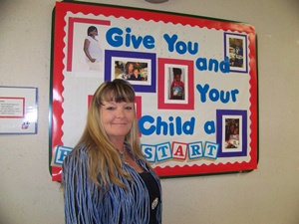
Employees of the Month
May 2012
April 2012
Sue Small
Head Start
Christine Gallagher
Psychology

Slide 3
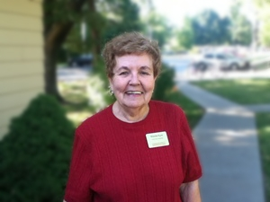
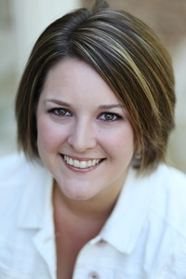
Employees of the Month
June 2012
July 2012
Winnie Kyro
University Housing/Facilities Management Department
Maggie Medema
University Housing

Slide 4
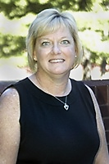
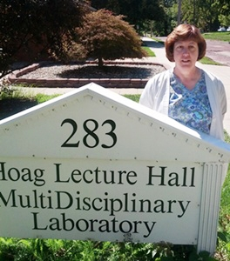
Employees of the Month
August 2012
September 2012
Starla Davis
Mass Communications
Nancy Inlow
School of Dental Medicine

Slide 5
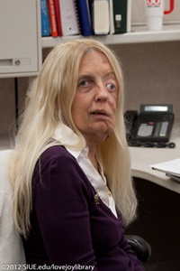
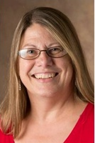
Employees of the Month
November 2012
December 2012
Rita Lesemann
Library Information Systems-Technical Services Department
Kathleen Feigl
Kinesiology and Health Education Department

Slide 6
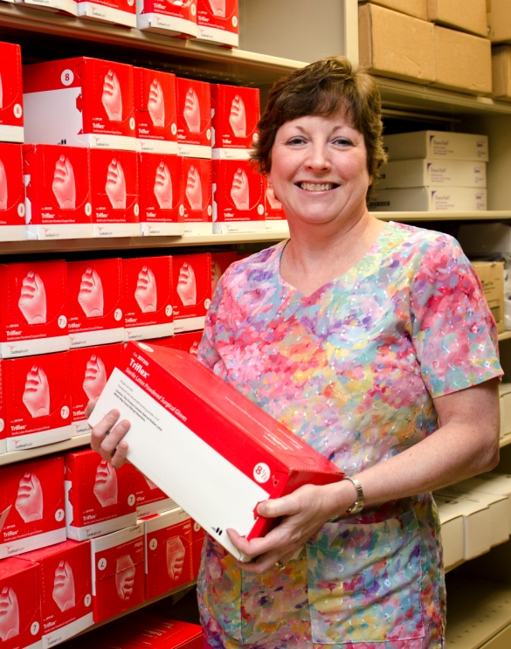
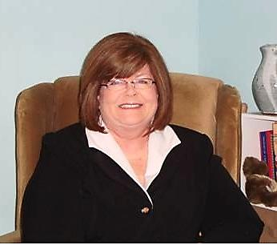
Employees of the Month
January 2013
February 2013
Vicki Kruse
University Governance
Robin Manning
School of Dental Medicine

Slide 7
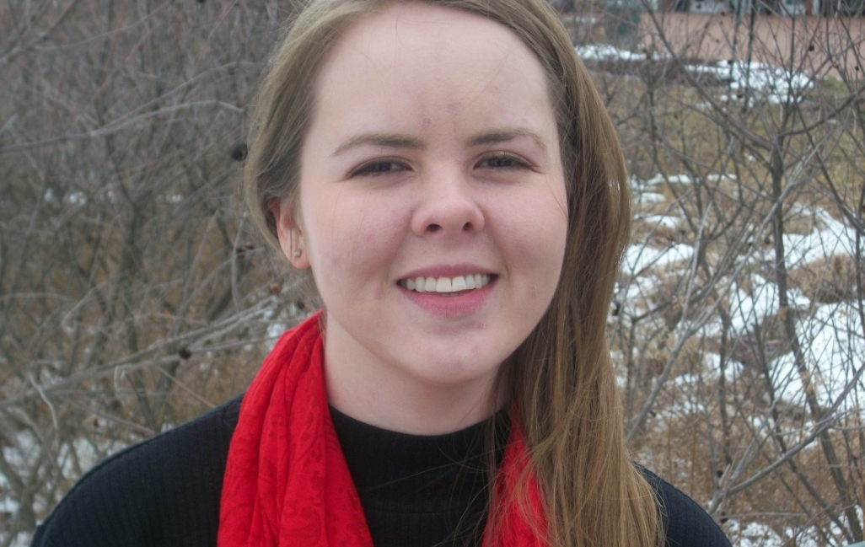
Employees of the Month
March 2013
Grete Graf
Office of the Chancellor

Slide 8
10 Year
Service Award
Honorees

Slide 9
15 Year
Service Award
Honorees

Slide 10
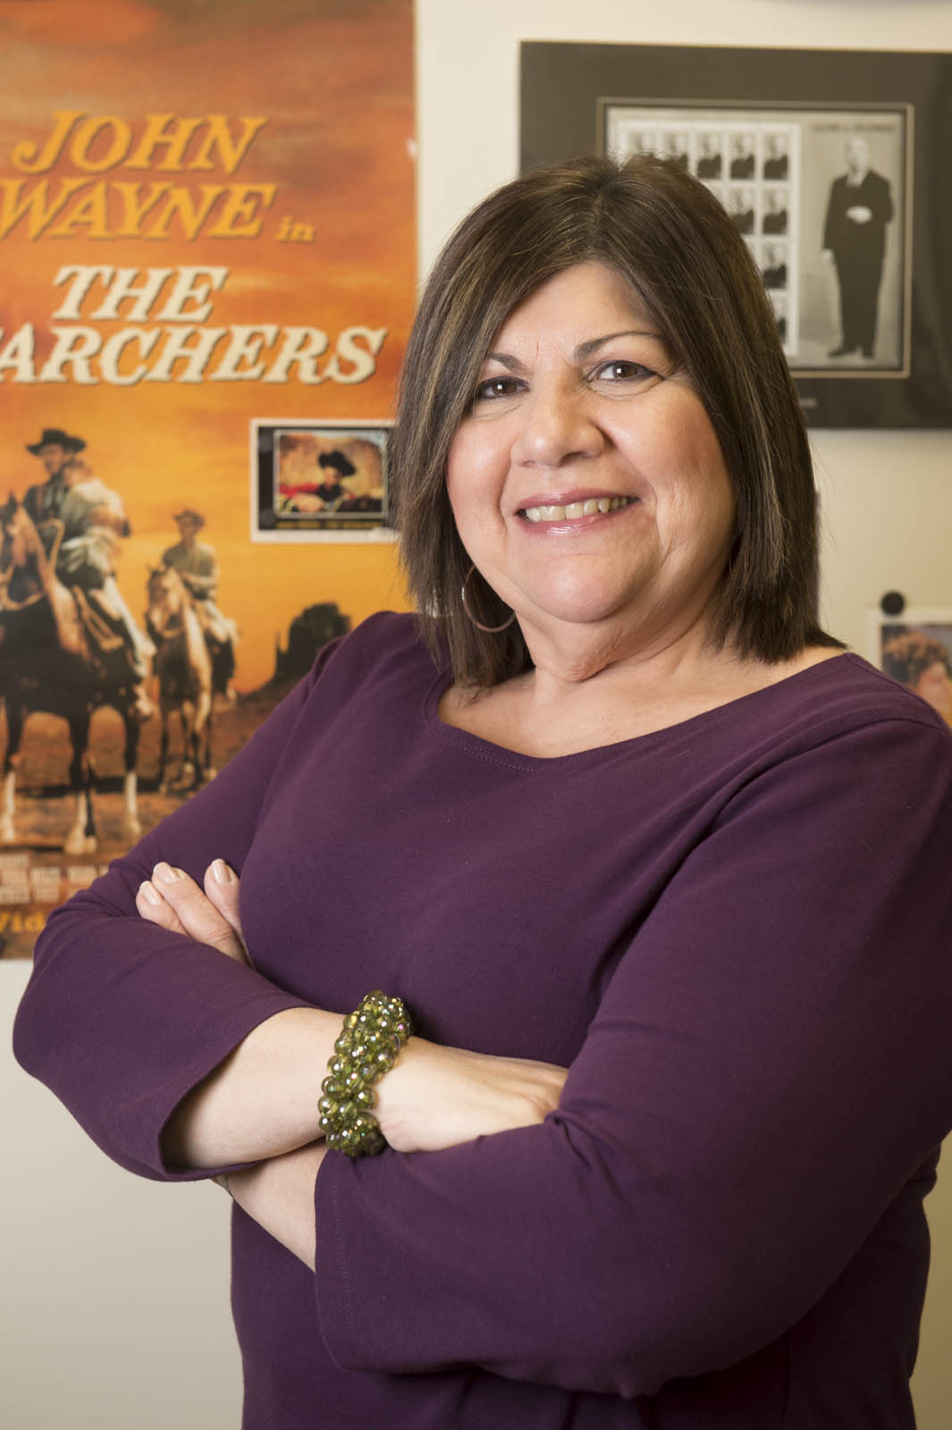
Nancy Avdoian 20 Years of Service
English Language & Literature

Slide 11
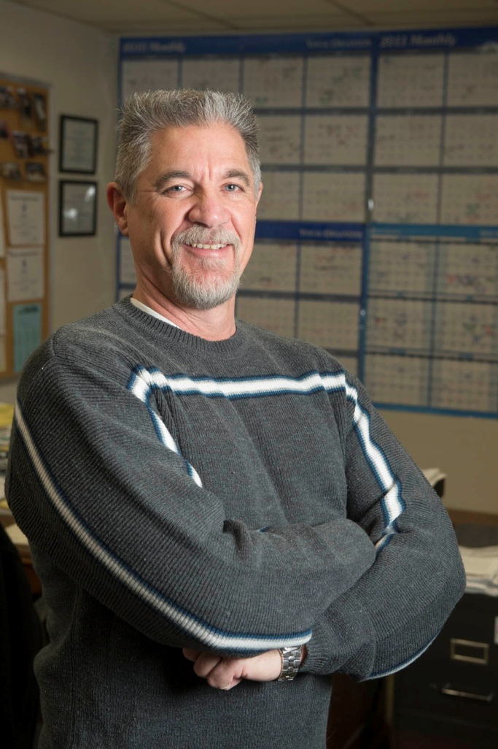
Kim Bateman 20 Years of Service
Environmental Resources Training Center
Psychology Department

Slide 12
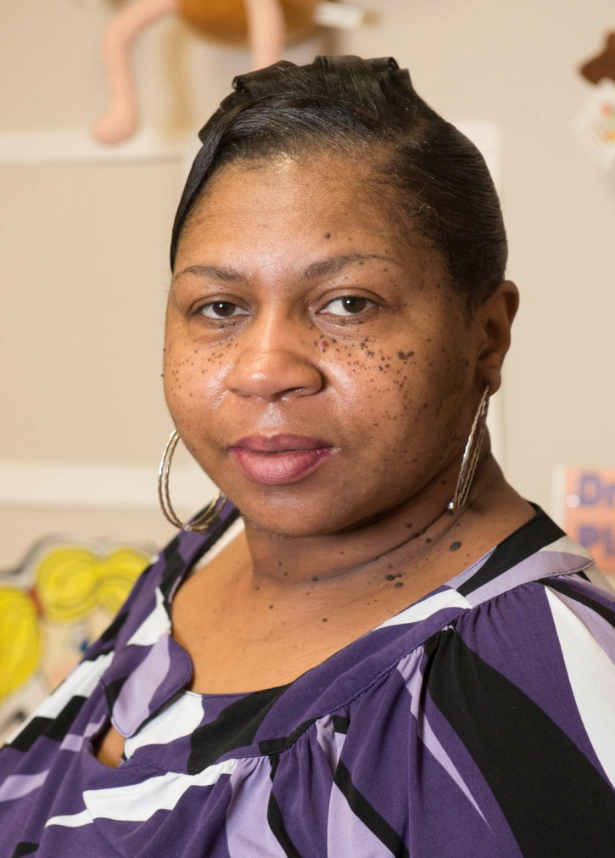
Janice Brown 20 Years of Service
East St. Louis – Head Start

Slide 13
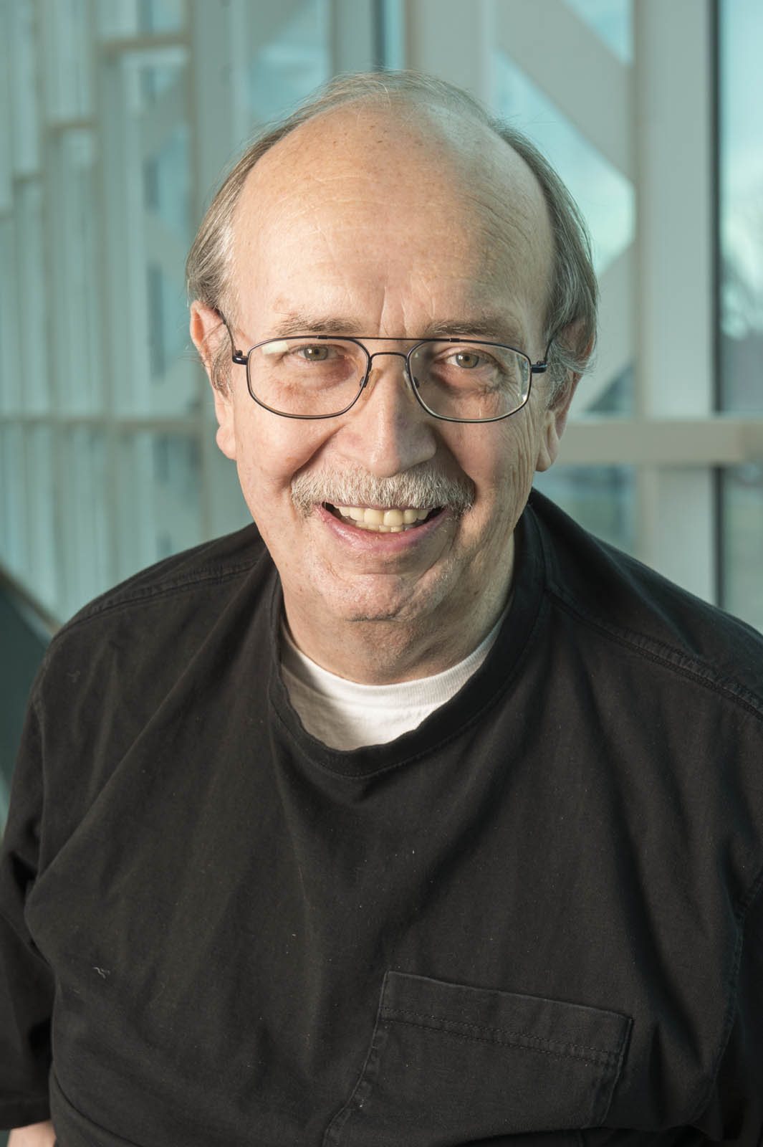
Phillip Busey 20 Years of Service
Information Technology Services

Slide 14
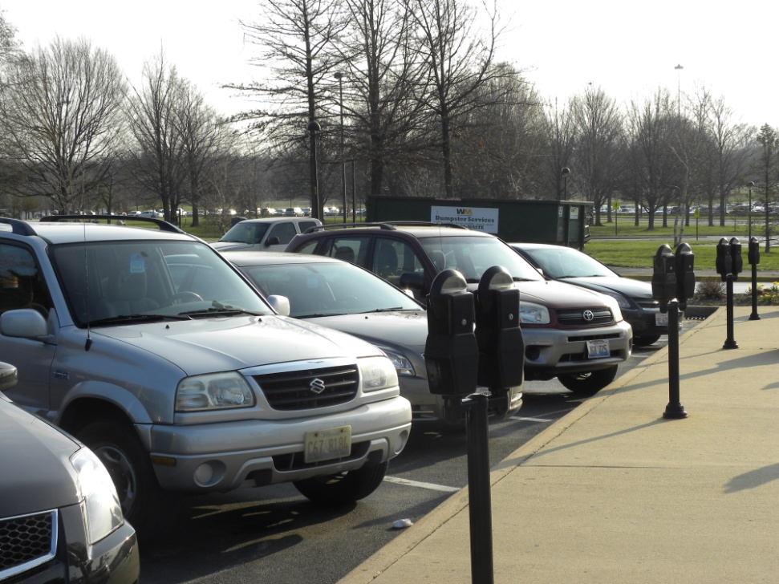
Timothy Clemann 20 Years of Service
Parking Services

Slide 15
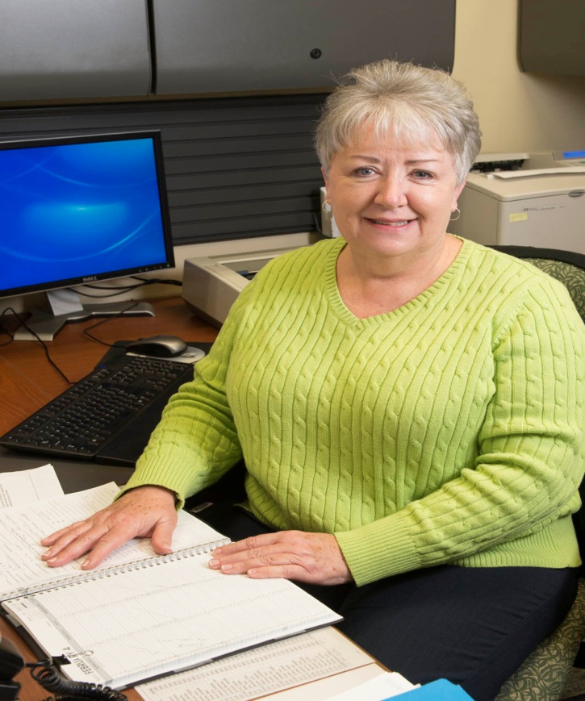
Sandra Compton 20 Years of Service
School of Nursing

Slide 16
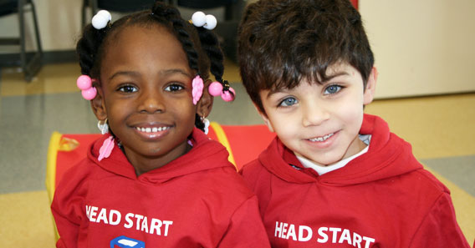
Kathy Cotton 20 Years of Service
East St. Louis – Head Start

Slide 17

Dr. Brad Cross 20 Years of Service
Civil Engineering

Slide 18
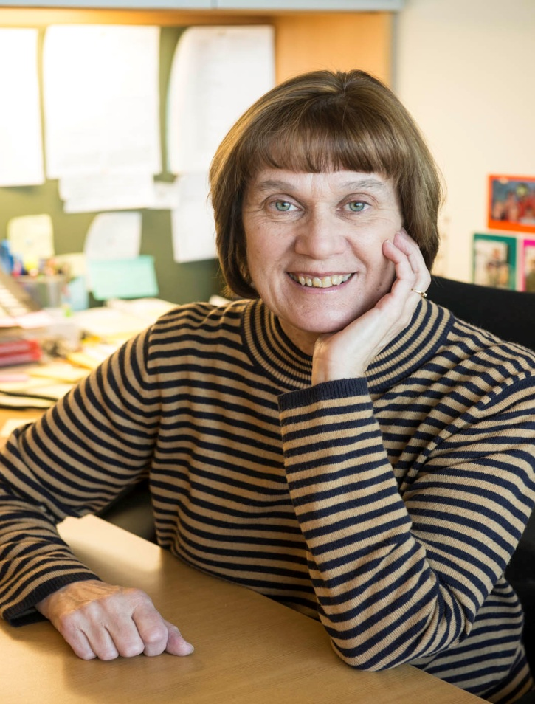
Rhonda Harper 20 Years of Service
Philosophy

Slide 19
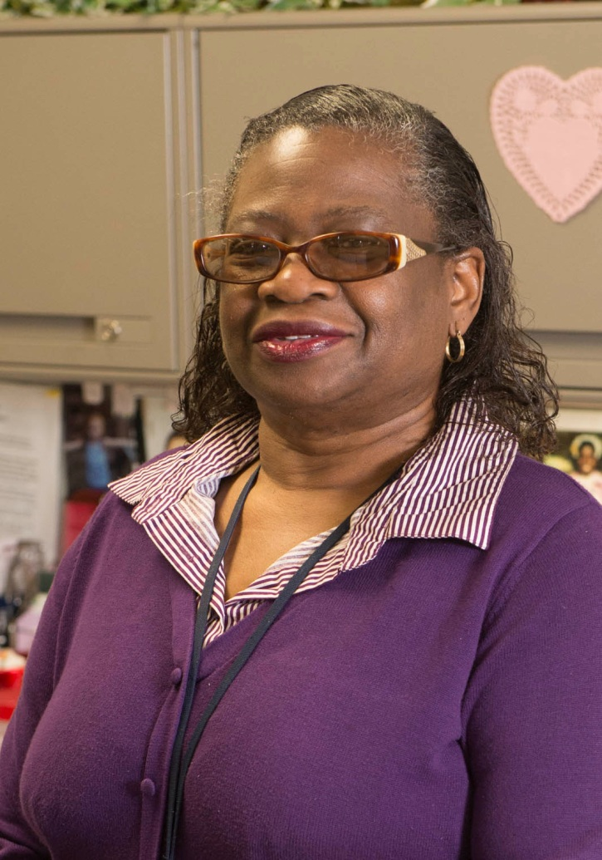
Deborah Hopkins 20 Years of Service
East Saint Louis – Office of the Director

Slide 20
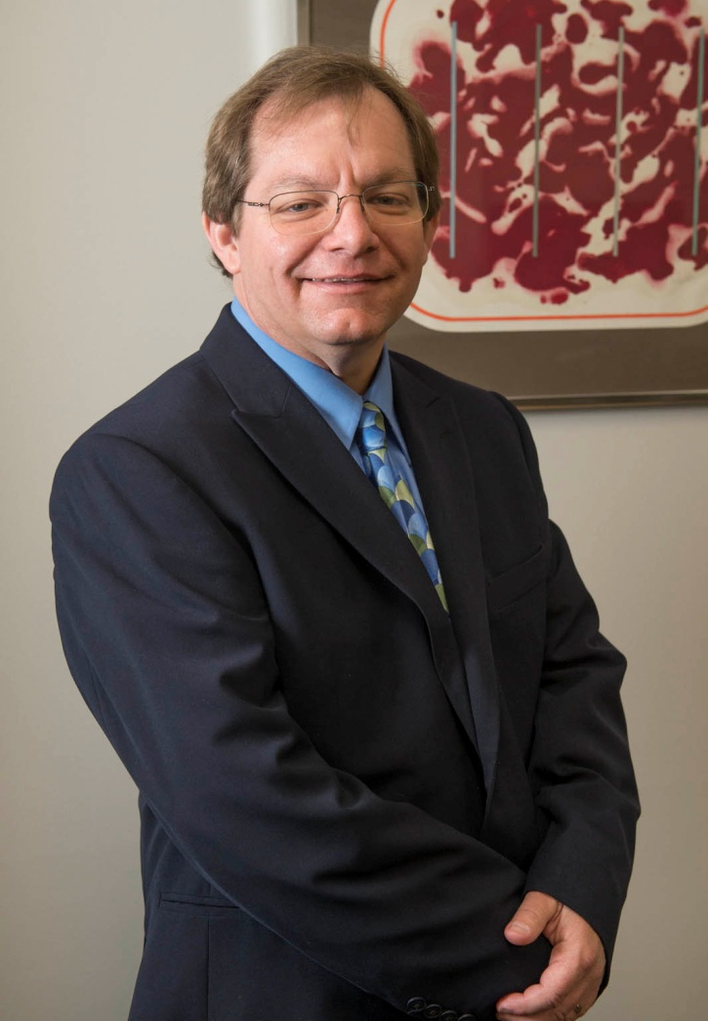
Steven Huffstutler 20 Years of Service
Information Technology Services

Slide 21

Dr. S. Cem Karacal 20 Years of Service
School of Engineering

Slide 22
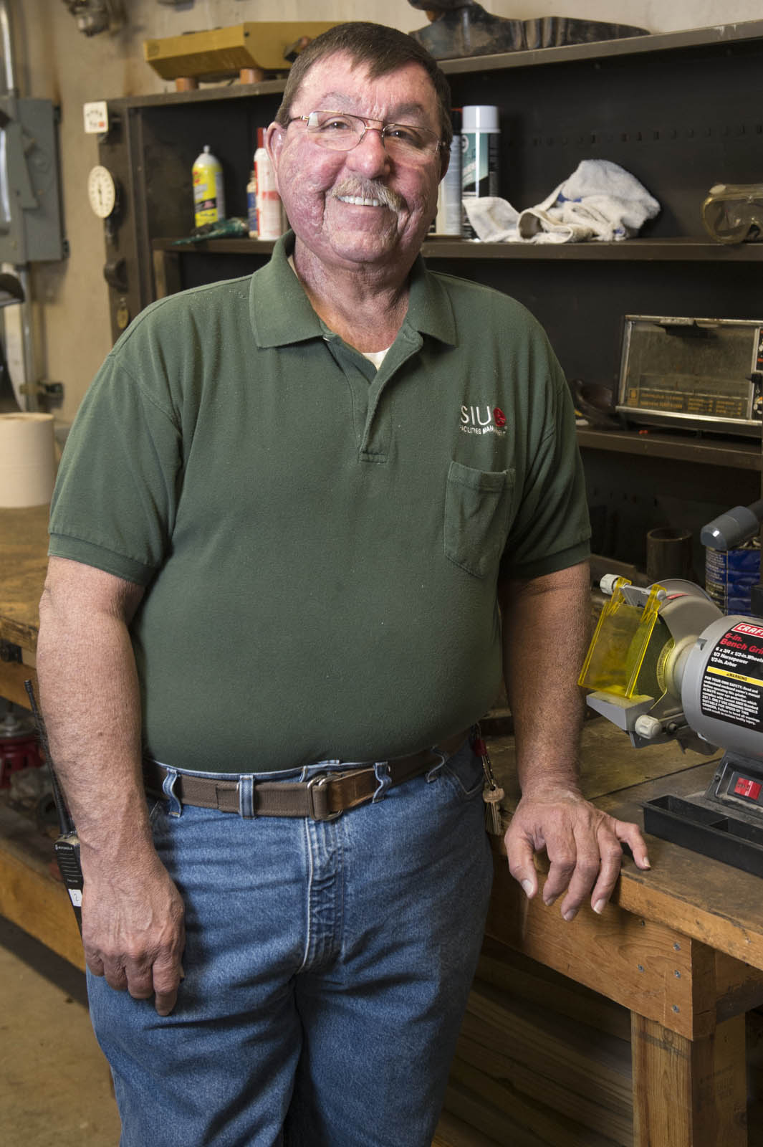
John Lopez 20 Years of Service
Facilities Management

Slide 23
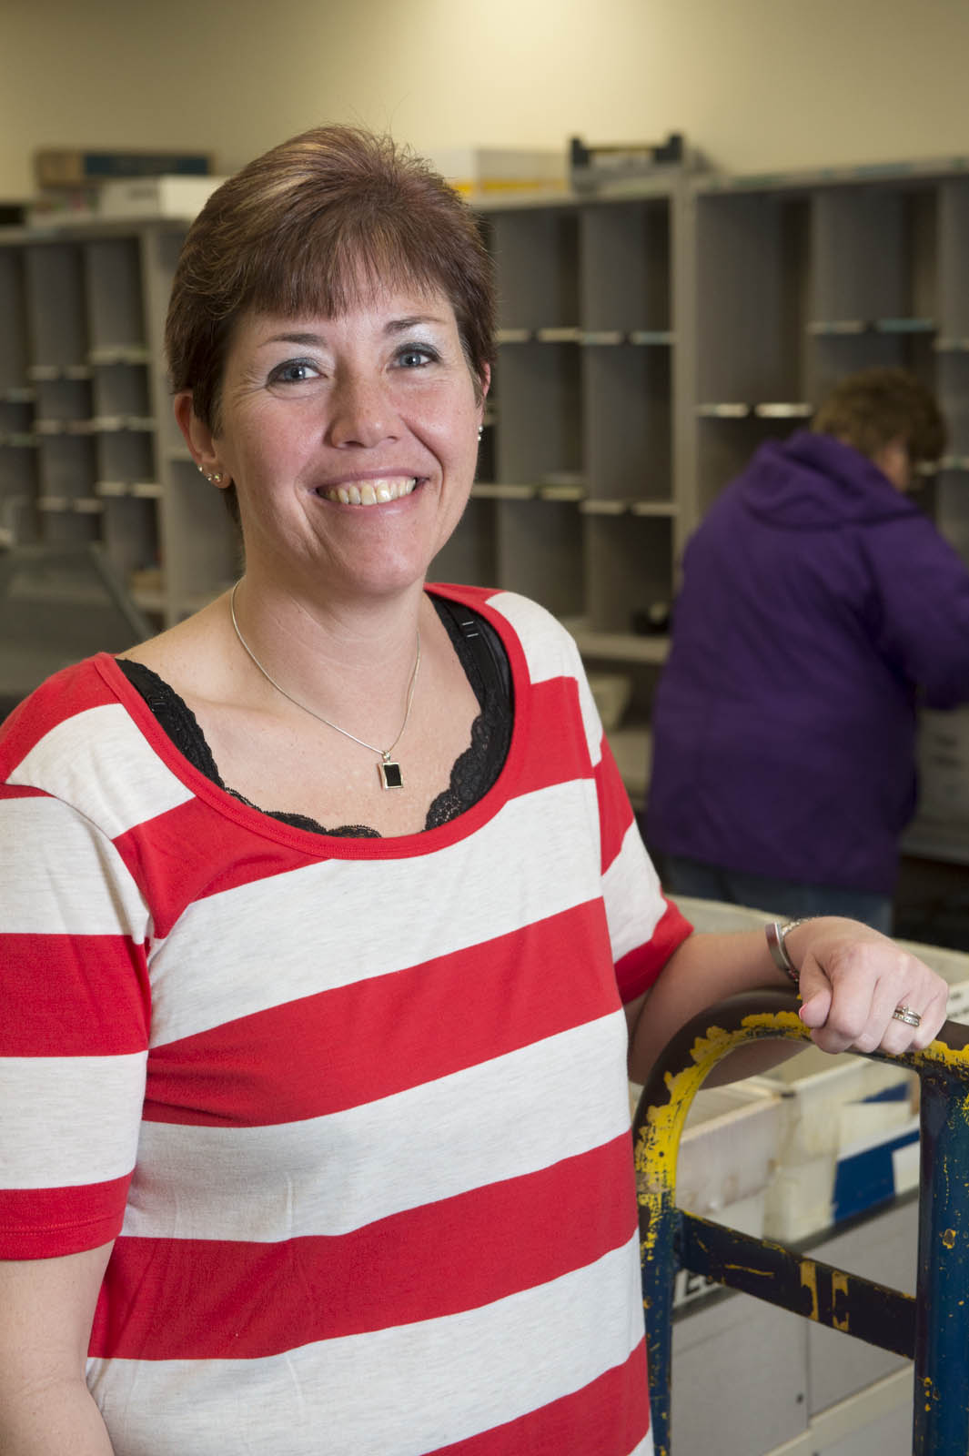
Kelly Lowder 20 Years of Service
Post Office

Slide 24
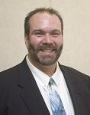
Norris Manning 20 Years of Service
School of Business

Slide 25
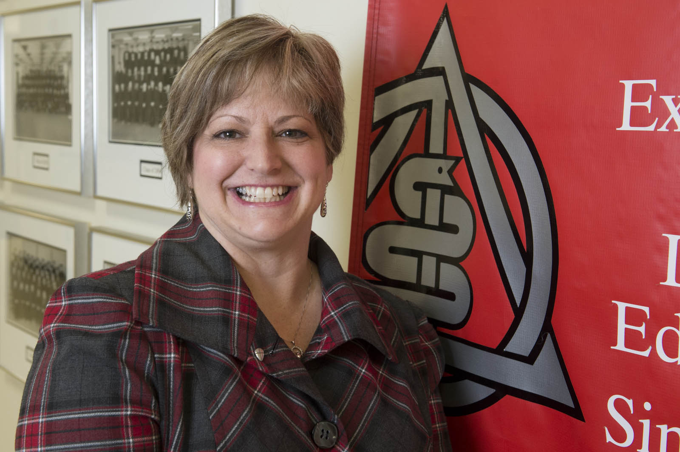
Teresa Militello 20 Years of Service
School
of
Dental Medicine

Slide 26
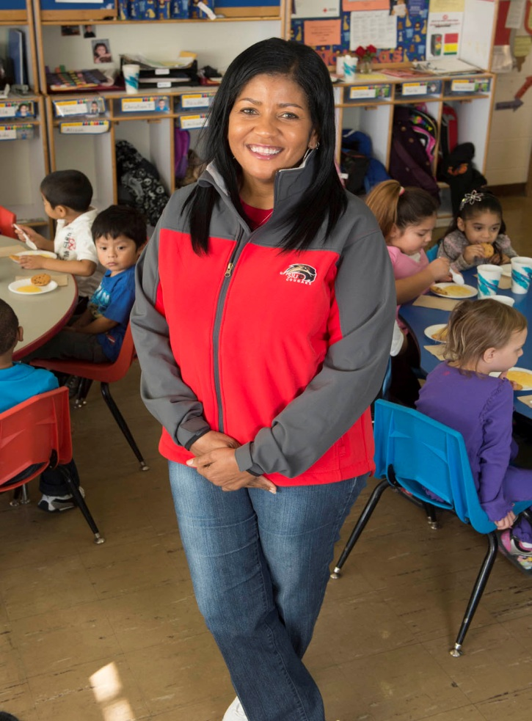
Judy Newell 20 Years of Service
East Saint Louis - Head Start

Slide 27
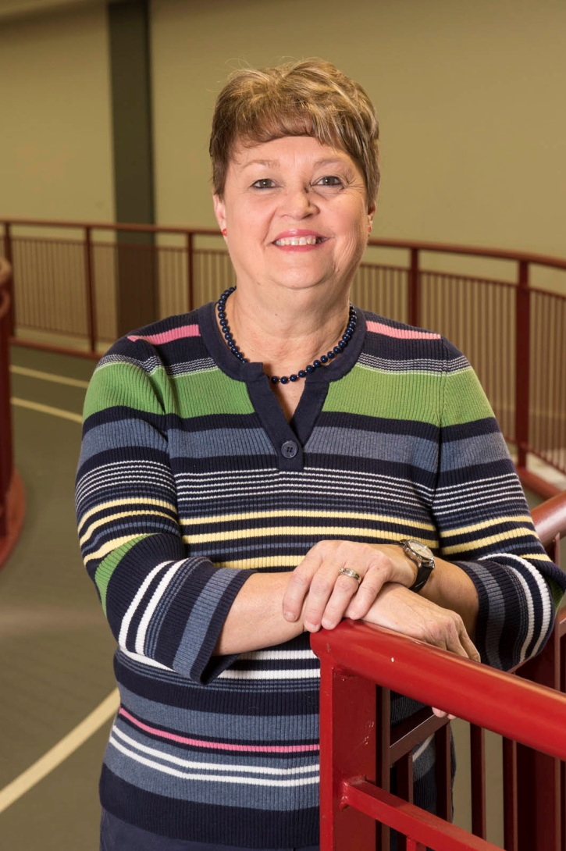
Brenda Newton 20 Years of Service
Campus Recreation

Slide 28
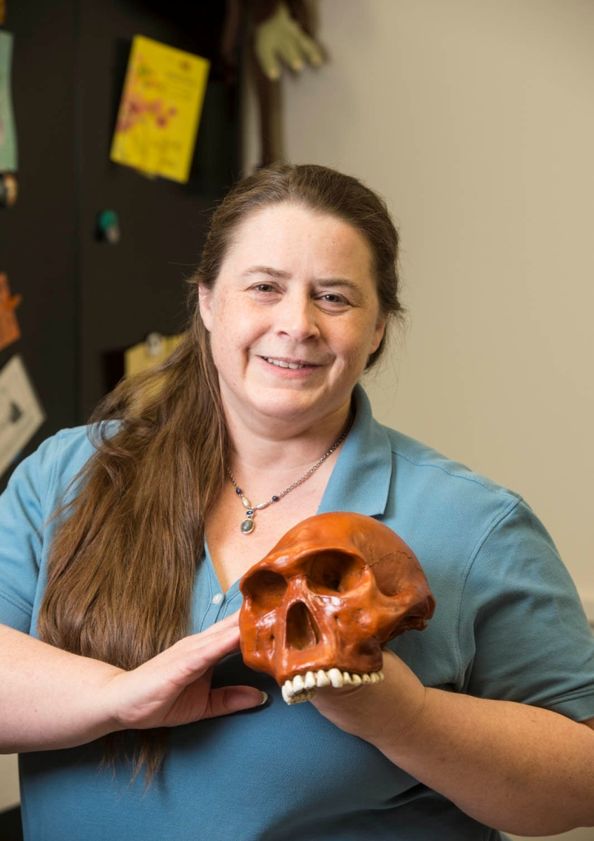
Dawn Olive 20 Years of Service
Graduate Studies & Research

Slide 29
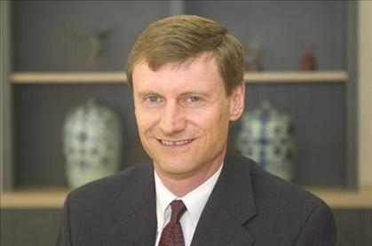
Dr. Timothy Schoenecker 20 Years of Service
Management and Marketing

Slide 30
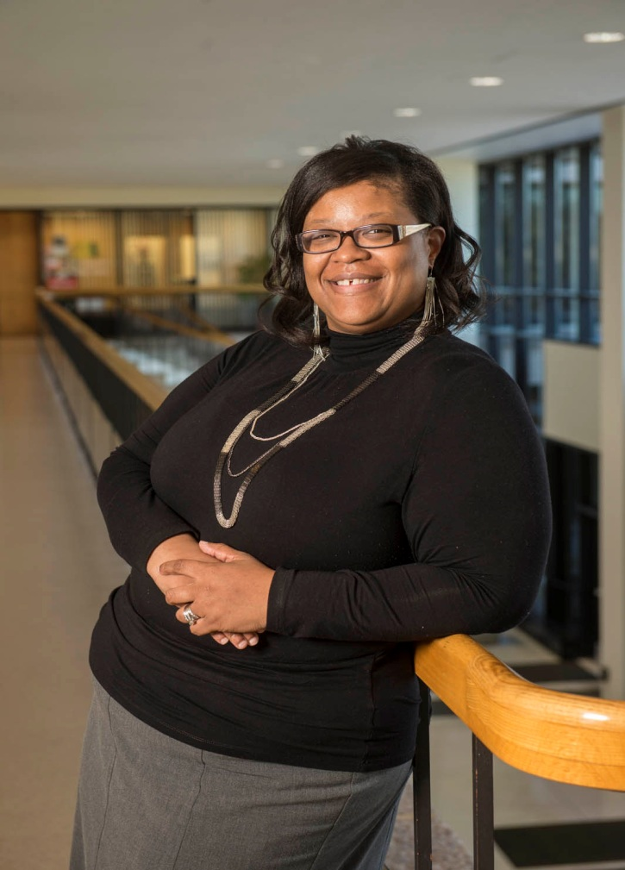
Tammy Smart 20 Years of Service
Graduate Studies & Research

Slide 31

Steven Varady 20 Years of Service
Facilities Management

Slide 32
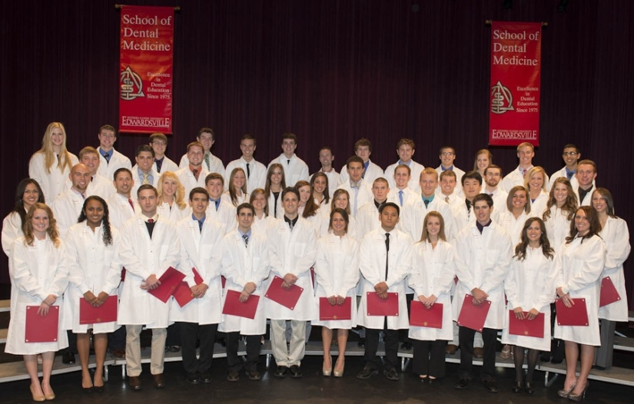
Deborah Webb 20 Years of Service
School of Dental Medicine

Slide 33
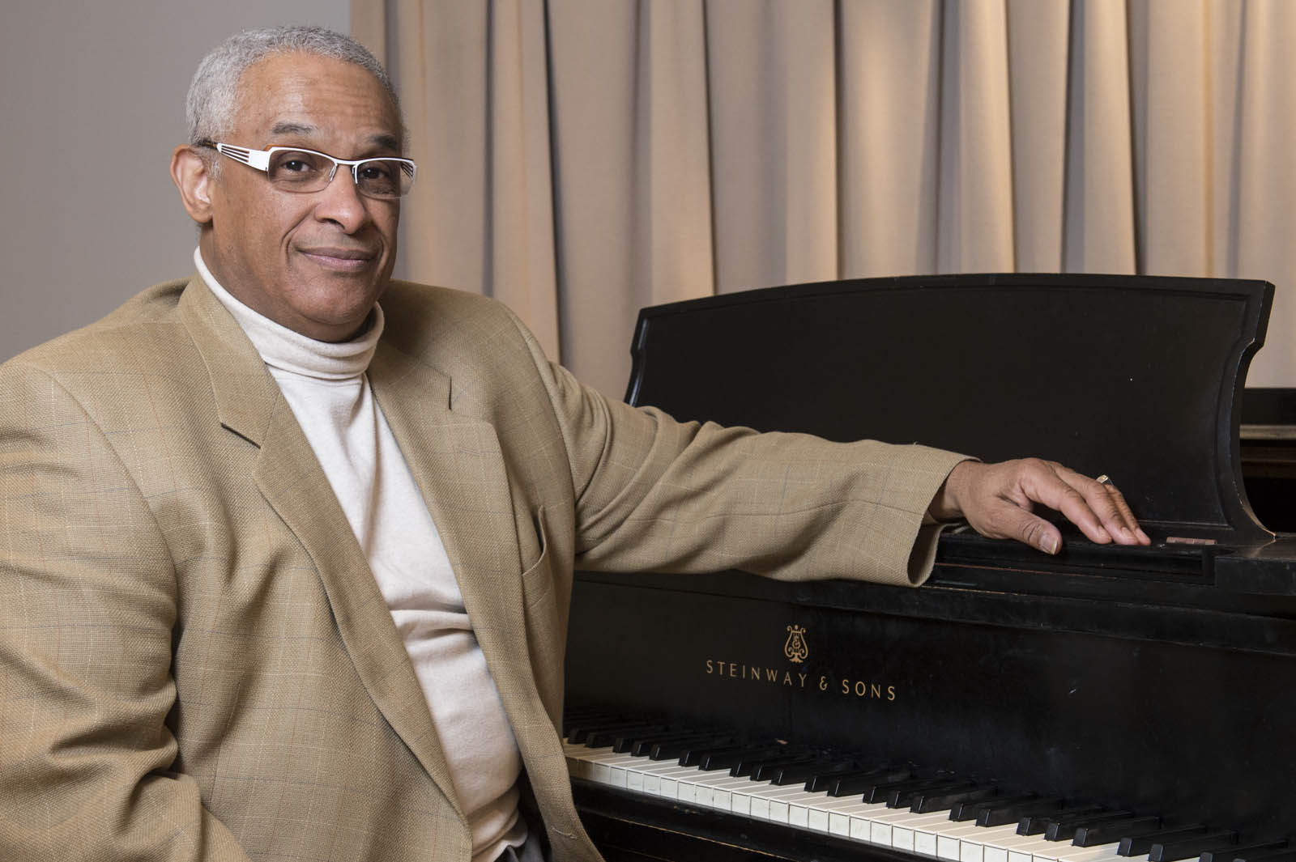
Dr. Prince Wells 20 Years of Service
Music

Slide 34
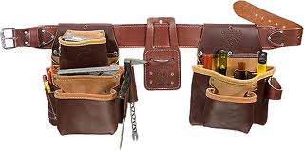
Carlos Williams 20 Years of Service
Facilities Management

Slide 35
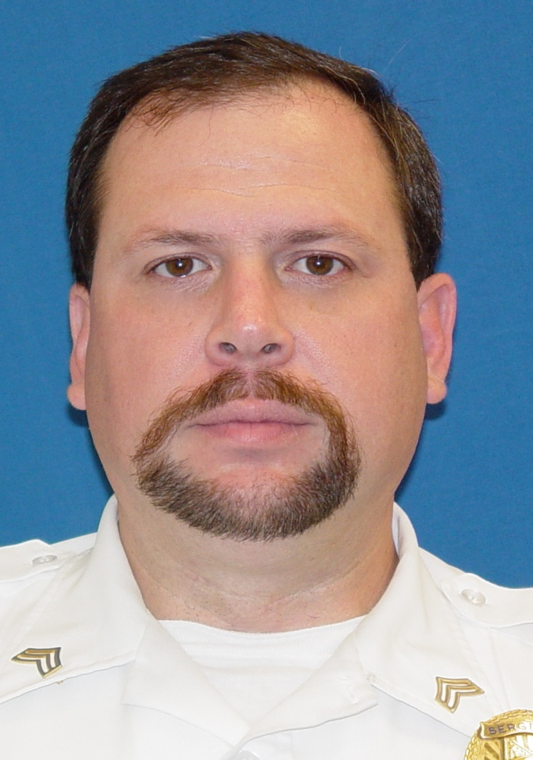
Sergeant Dwight Wright 20 Years of Service
Police Services

Slide 36

Nancy Andrews 25 Years of Service
Office of the Registrar

Slide 37
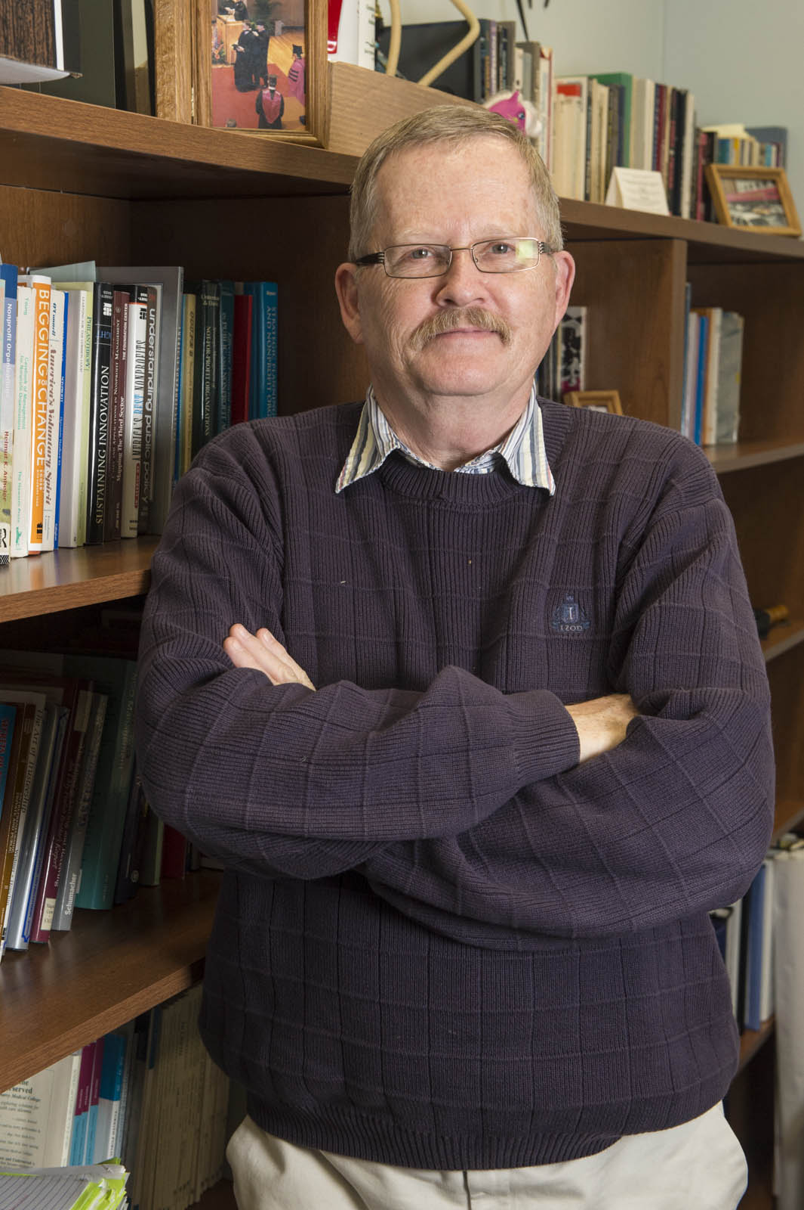
Dr. Richard Bush 25 Years of Service
Public Administration & Policy Analysis

Slide 38
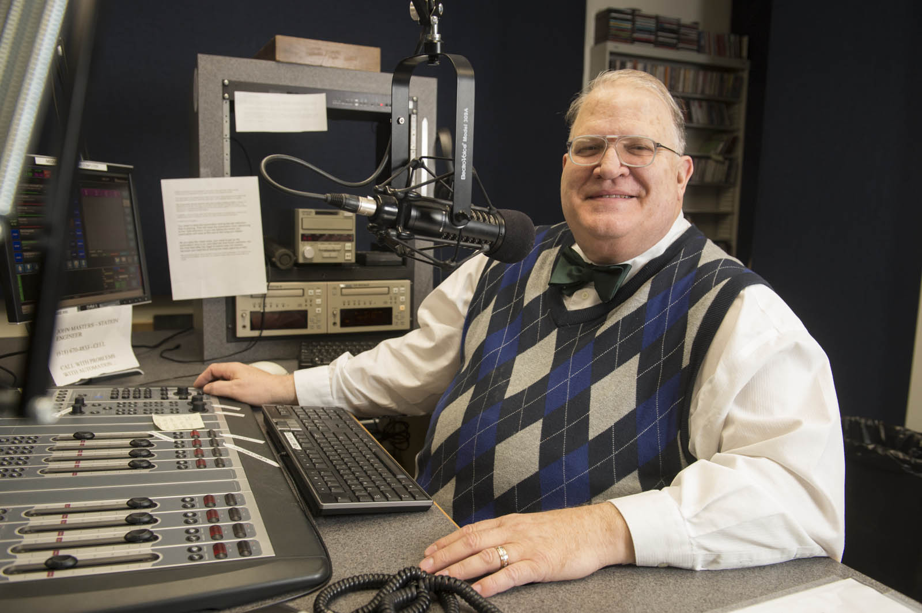
Gregory Conroy 25 Years of Service
WSIE-FM

Slide 39
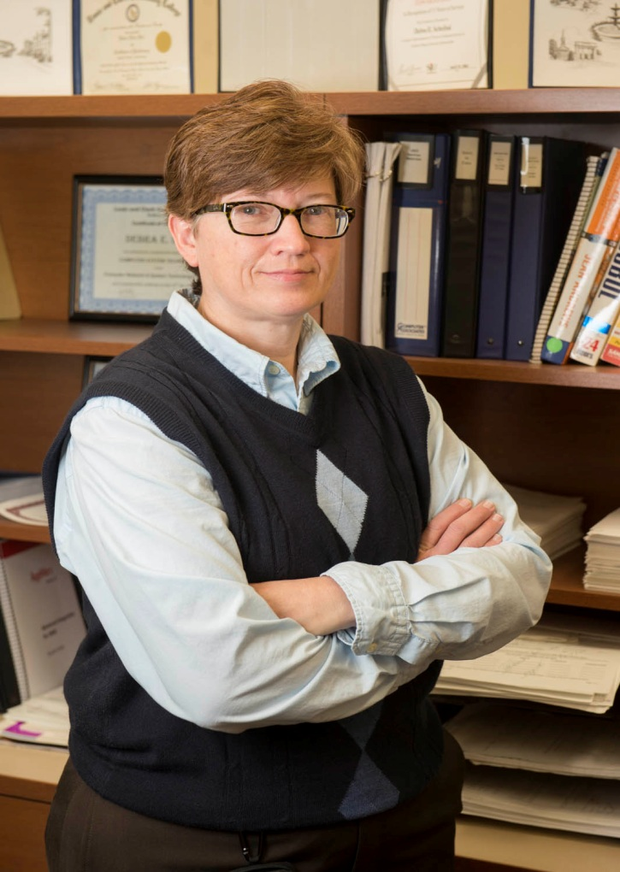
Debra Dial 25 Years of Service
Information Technology Services

Slide 40

Gary Dunn 25 Years of Service
Records Management

Slide 41
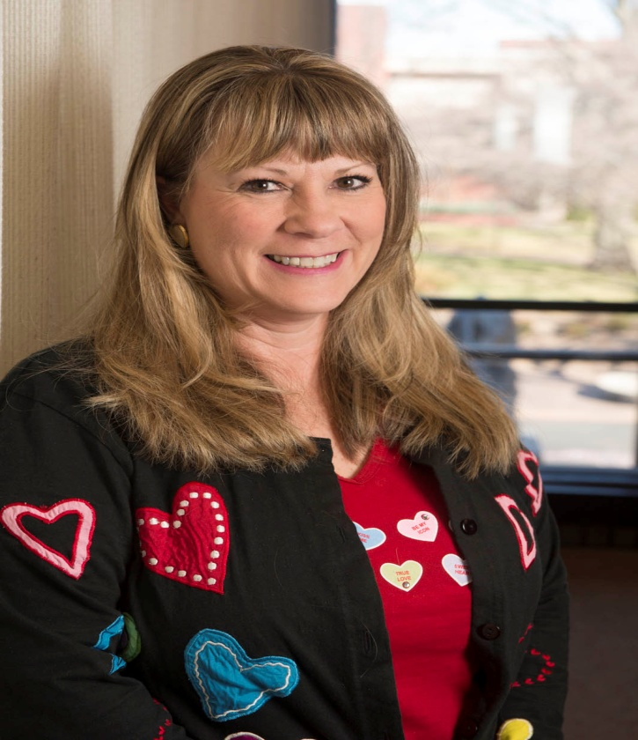
Karla Ellsworth 25 Years of Service
MUC Administration

Slide 42
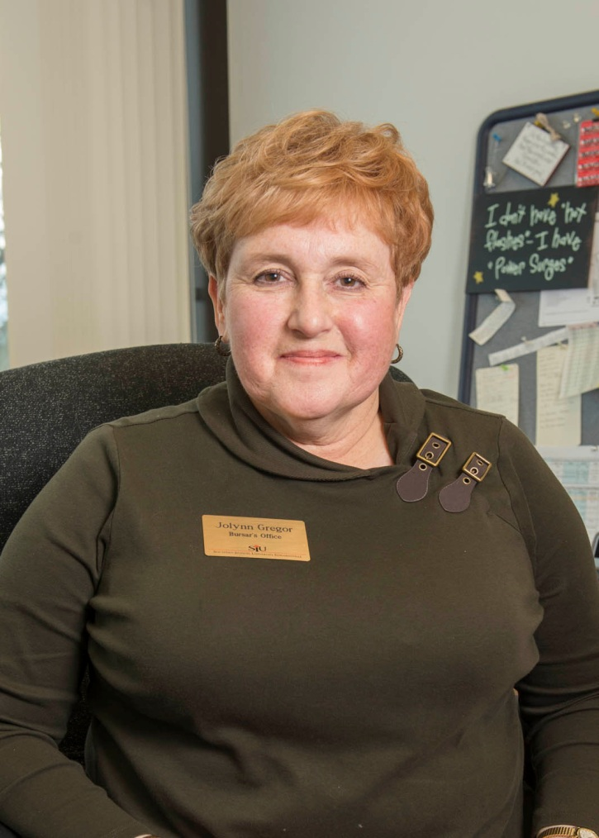
Jolynn Gregor 25 Years of Service
Bursar

Slide 43

Deirdre Johnson 25 Years of Service
Lovejoy Library

Slide 44
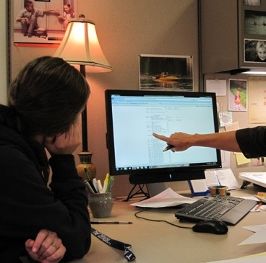
Janette Johnson 25 Years of Service
Academic Advising

Slide 45
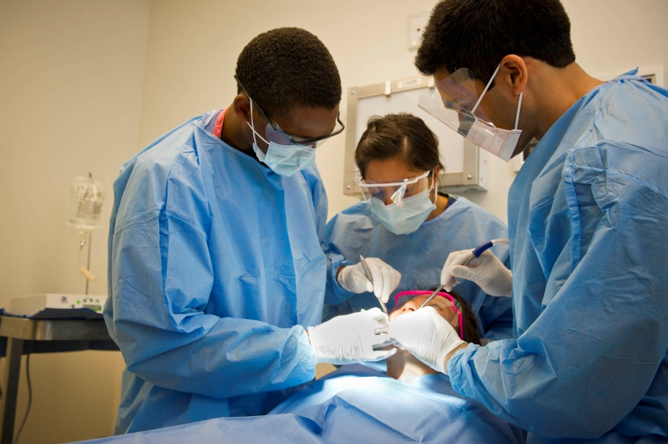
Dr. Eric Langenwalter 25 Years of Service
School of Dental Medicine

Slide 46
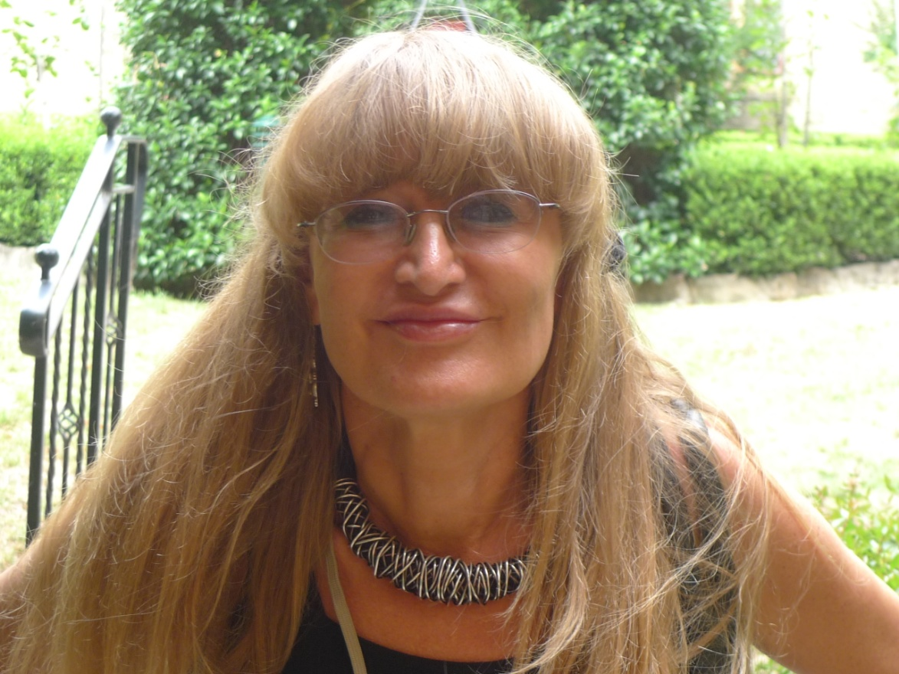
Dr. Urszula Ledzewicz 25 Years of Service
Mathematics &
Statistics

Slide 47
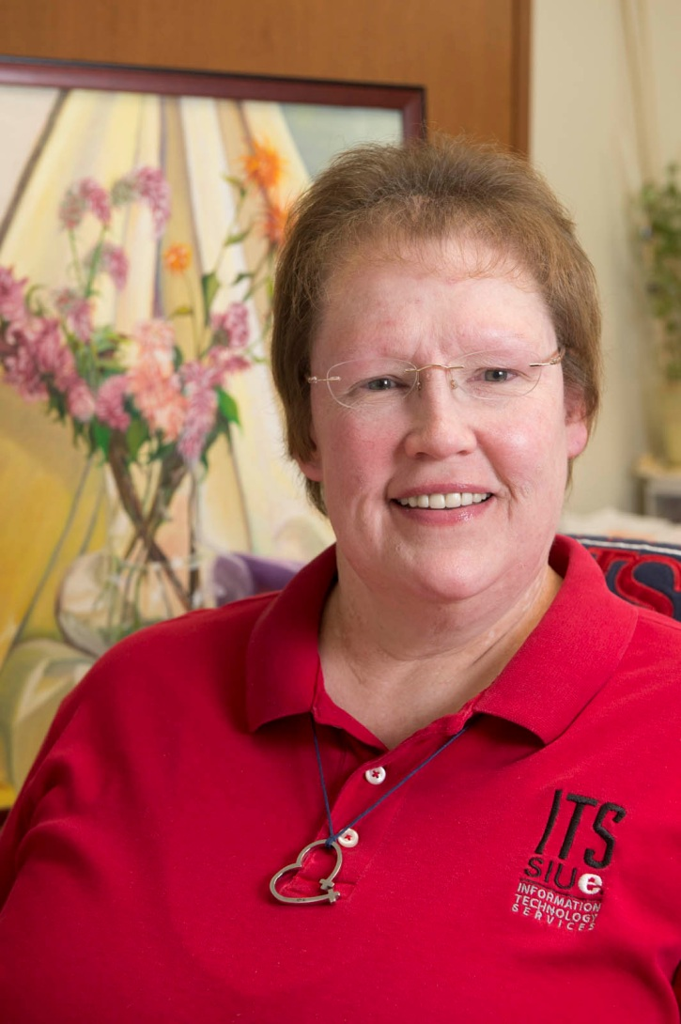
Anngela Mosby 25 Years of Service
Information Technology Services

Slide 48

Kelly Murphy 25 Years of Service
Facilities Management

Slide 49
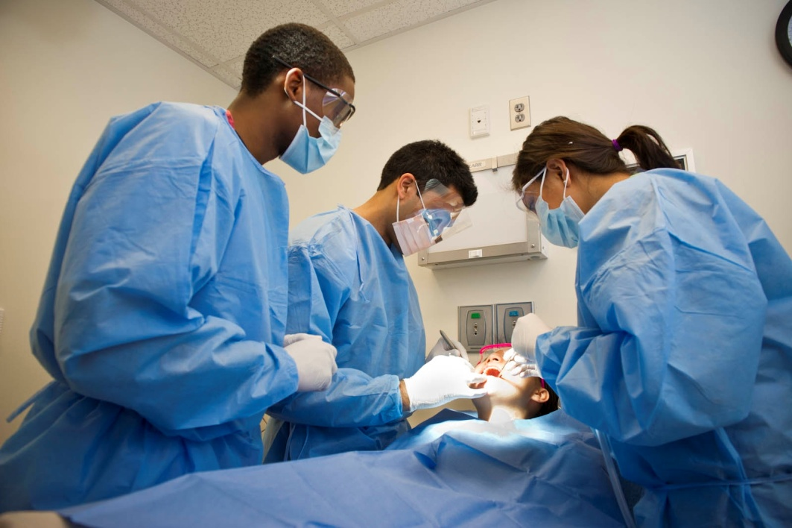
Dr. Lawrence Newquist 25 Years of Service
School of Dental Medicine

Slide 50

Lynda Pavia 25 Years of Service
Facilities Management

Slide 51
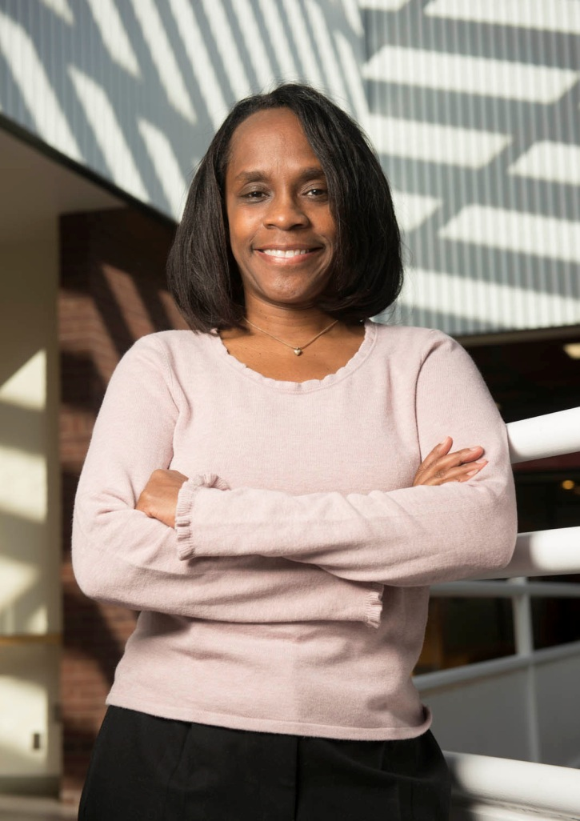
Rhonda Penelton 25 Years of Service
Institute for Urban Research

Slide 52
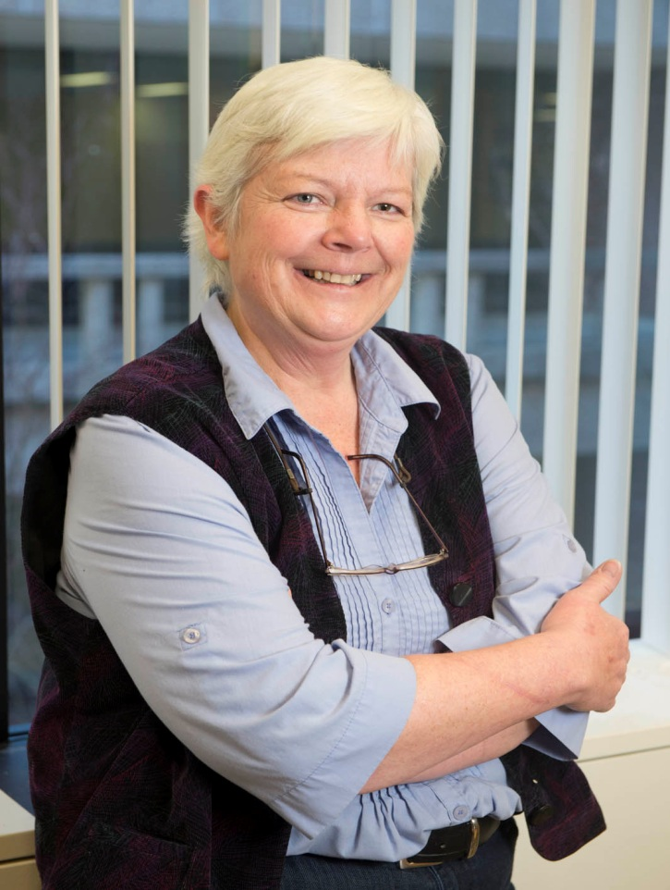
Dr. Nancy Ruff 25 Years of Service
English Language
& Literature

Slide 53
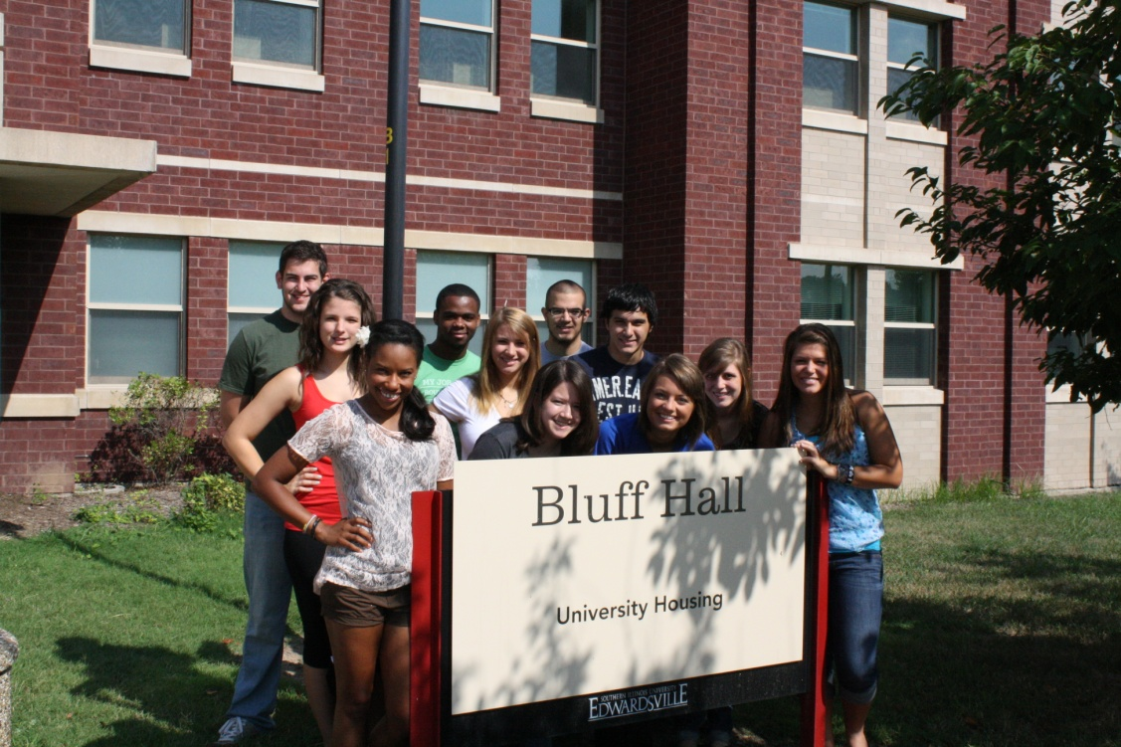
Laura Schade 25 Years of Service
University Housing

Slide 54

Dr. Jeffrey Skoblow 25 Years of Service
English Language & Literature

Slide 55

Roberta Stanford 25 Years of Service
Institutional Research
& Studies

Slide 56
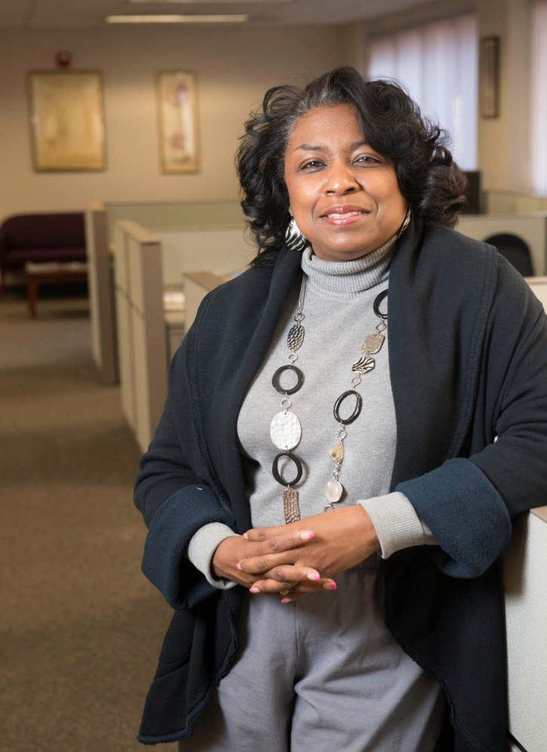
Janina Turley 25 Years of Service
East Saint Louis - Office of the Director

Slide 57

Dr. John Voller 25 Years of Service
English Language & Literature

Slide 58
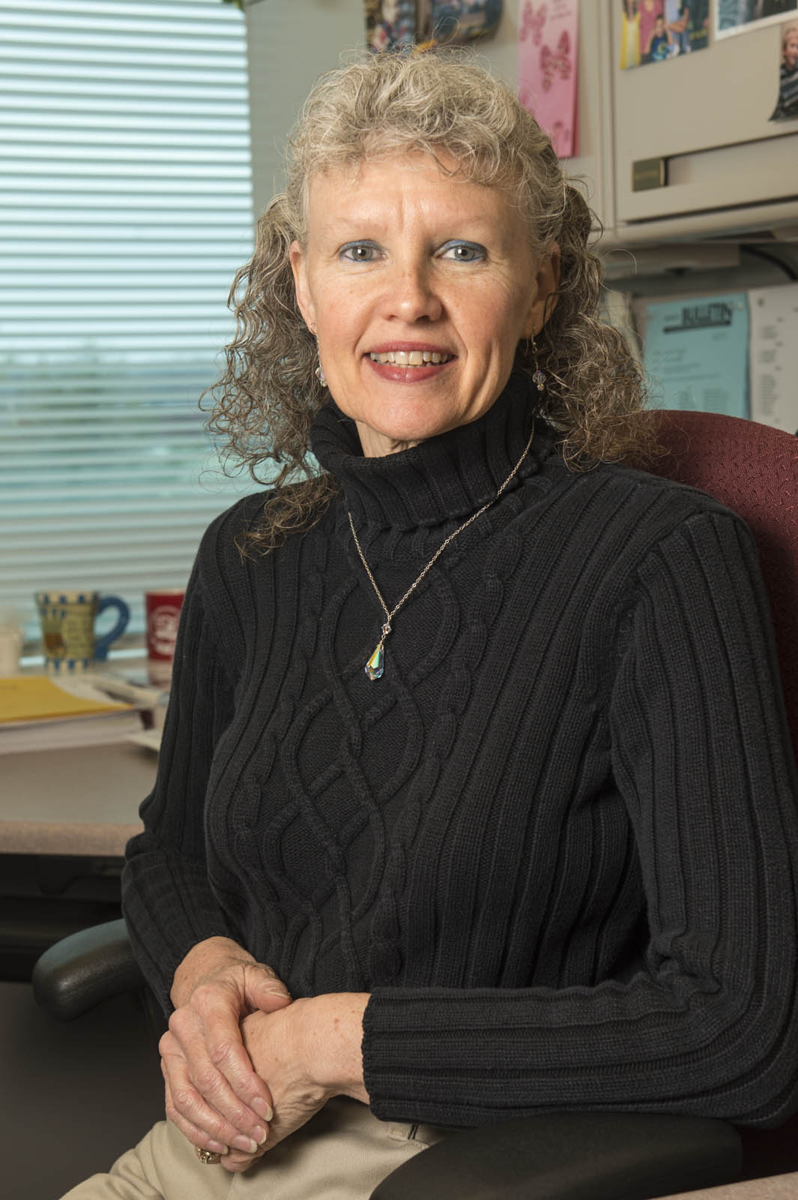
Theresa Wasylenko 25 Years of Service
School of Engineering

Slide 59
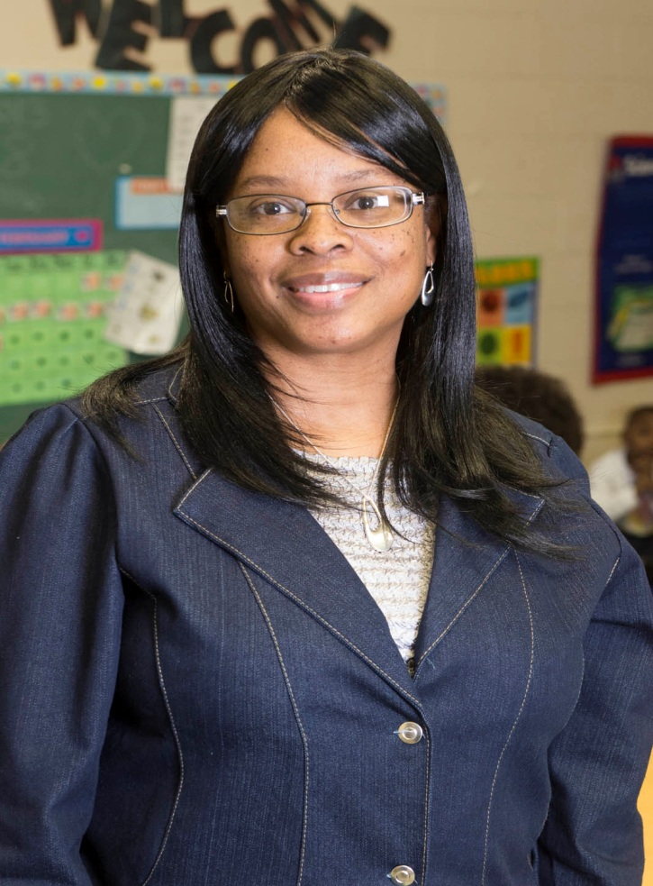
Jacqueline Young 25 Years of Service
East Saint Louis - Head Start

Slide 60

Rena Young 25 Years of Service
Educational Outreach

Slide 61

Nancy Zika 25 Years of Service
Administrative Accounting

Slide 62

Suzanne Eder 30 Years of Service
Graduate Studies & Research

Slide 63

Linda Etling 30 Years of Service
Information Technology Services

Slide 64

Dr. Sadegh Khazaeli 30 Years of Service
Chemistry

Slide 65

Vanessa Outlaw 30 Years of Service
East Saint Louis - Head Start

Slide 66

Dr. Mary Sumner 30 Years of Service
Computer Management and Information Systems

Slide 67

Dr. Paul Dresang 35 Years of Service
Art and Design

Slide 68

Donna Ireland 35 Years of Service
School of Pharmacy

Slide 69

Dr. John Meisel 35 Years of Service
Economics and Finance

Slide 70

Dr. Audrey Tallant 35 Years of Service
Music

Slide 71
Congratulations to all
Honorees!

