Slide 1
2016 Service Awards

Slide 2
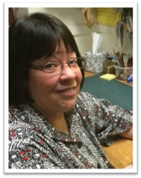
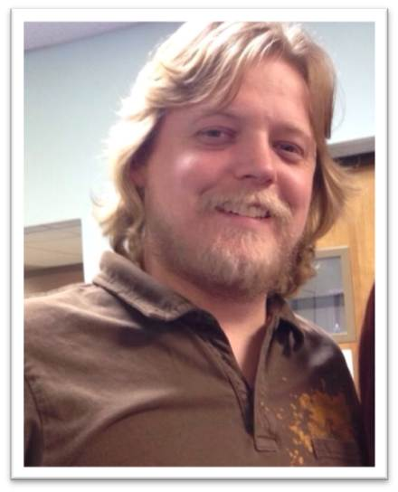
Employees of the Month
April 2015
March 2015
Melanie Schoenborn
Library and Information Systems
Ryan Woodson
Campus Recreation

Slide 3
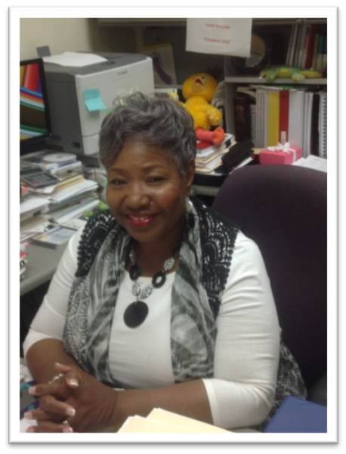
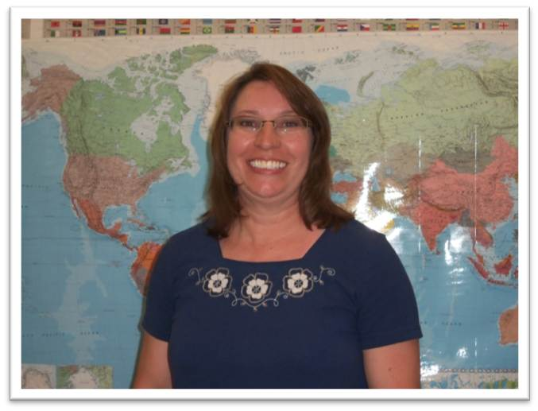
Employees of the Month
May 2015
June 2015
Ethel Coleman
Head Start
Wendy Cauley
Accounts Payable

Slide 4
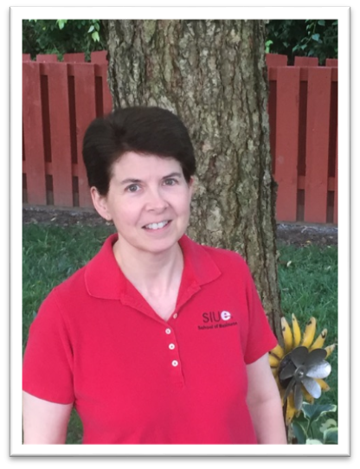
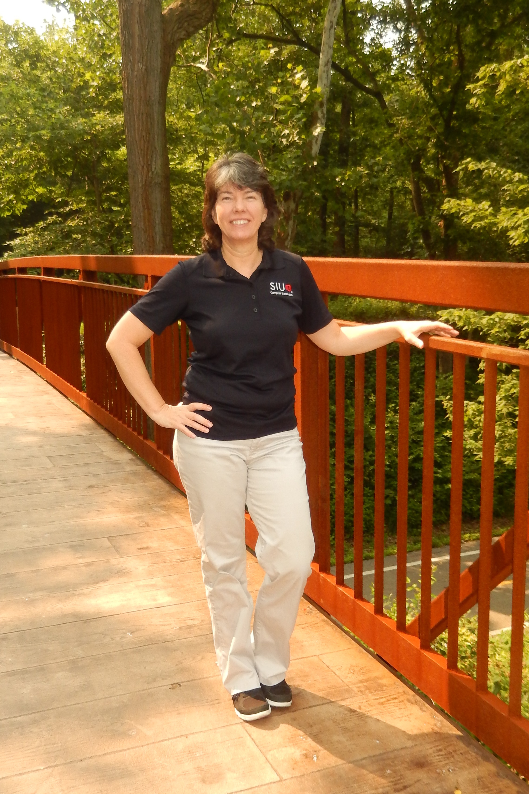
Employees of the Month
July 2015
August 2015
Paula Lenhardt
Campus Recreation
Dawn Munsey
School of Business

Slide 5
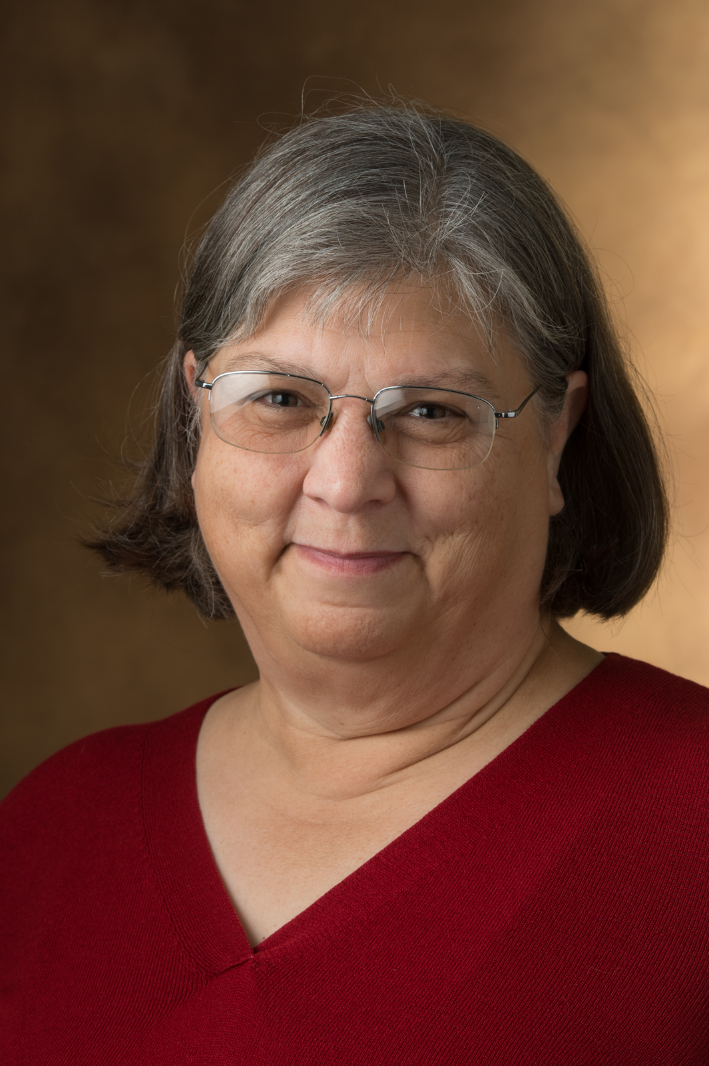
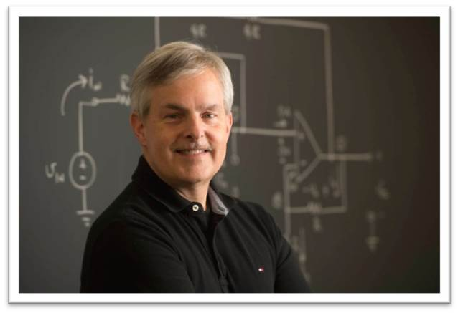
Employees of the Month
September 2015
October 2015
Steve Muren
Electrical & Computer
Engineering
Kathy Wanstreet
Instructional Services

Slide 6
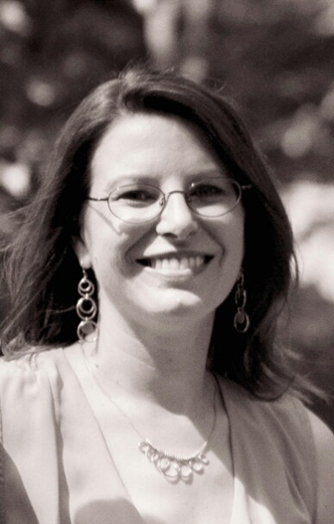
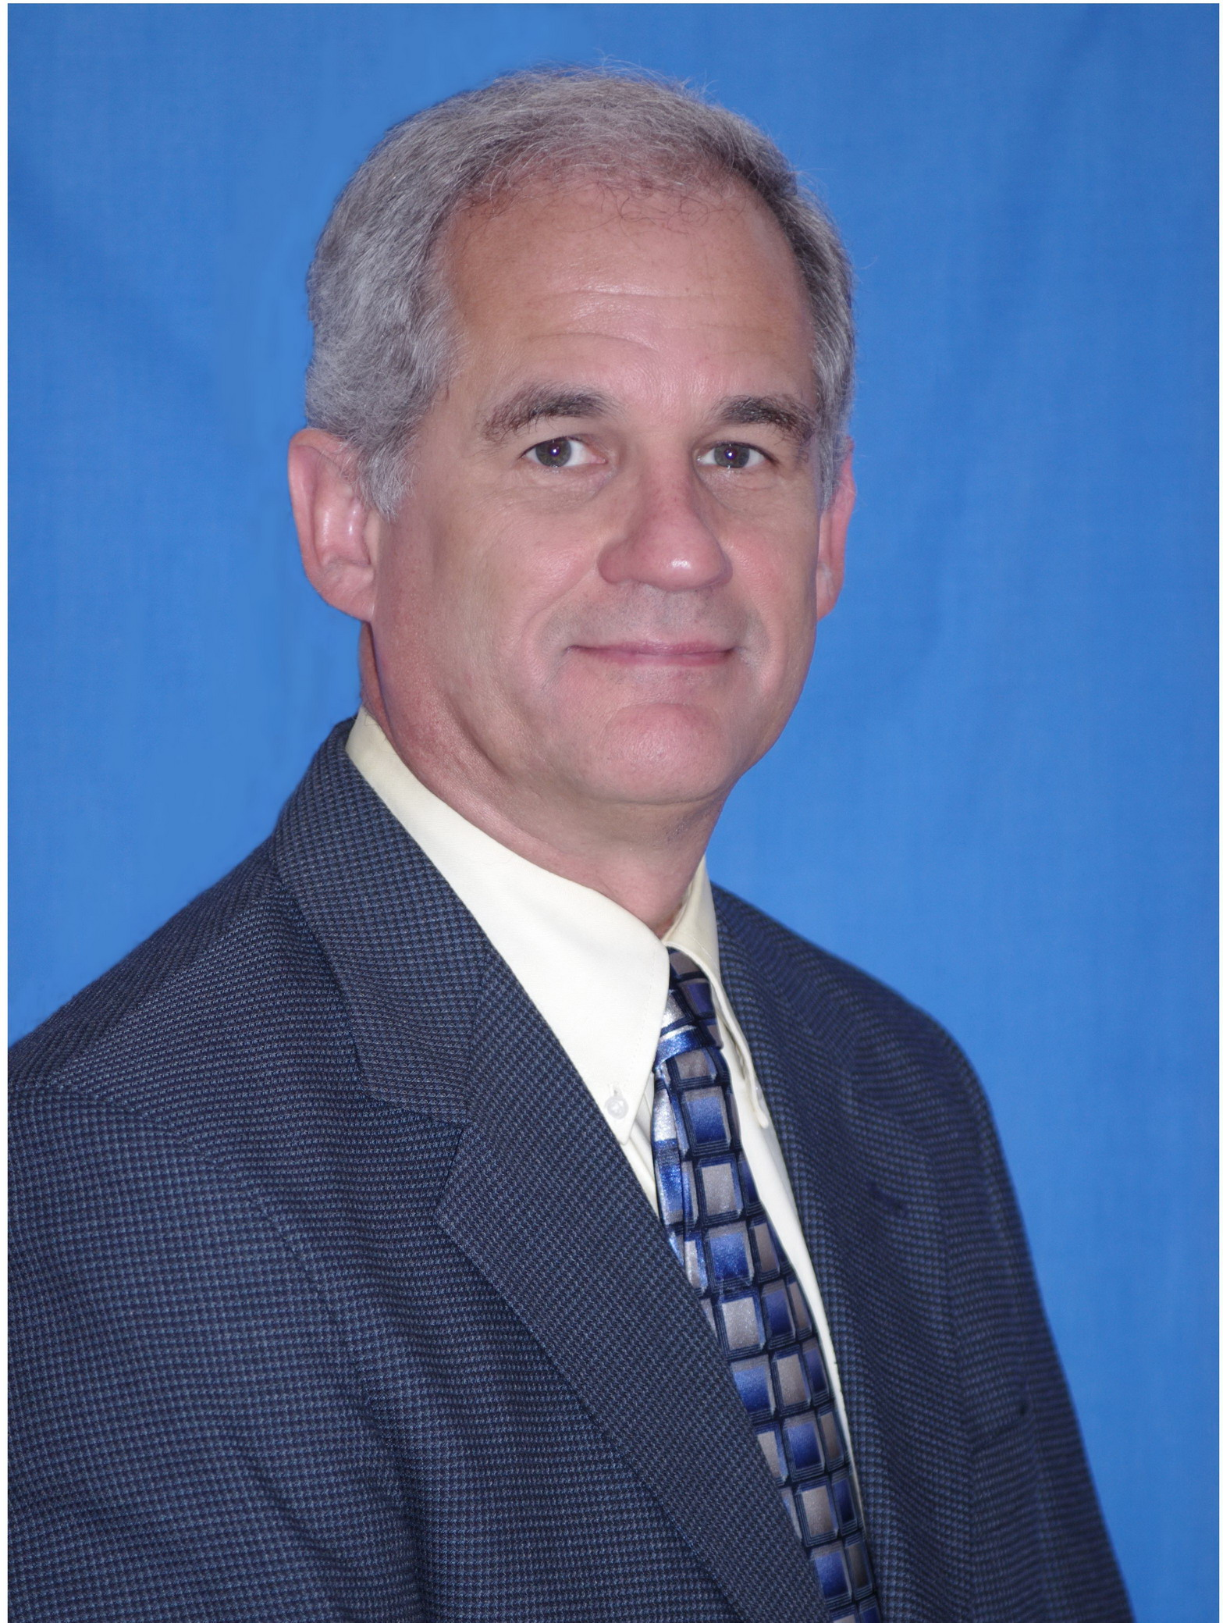
Employees of the Month
November 2015
December 2015
Mae Earleen Arnold
Student Financial Aid
Brent Vaughn
Civil Engineering

Slide 7
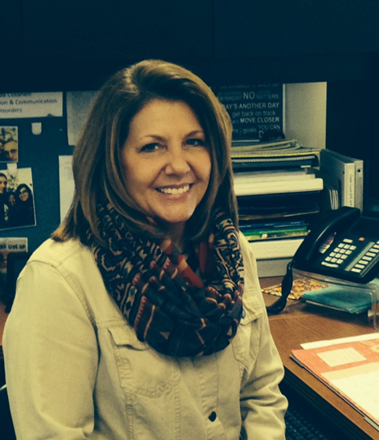

Employees of the Month
January 2016
February 2016
Brenda Cusanelli
Speech Pathology
Anna Pavlik
Morris University Center

Slide 8
Interim Chancellor
Stephen Hansen
2016 Service Awards
Address

Slide 9
10 Year
Service Award
Honorees

Slide 10
Group 1 10 Year Honorees
Dr. Kimberly Archer
Donald Basden
Maureen Bell-Werner
Kathleen Bettes
Debra Downey
Dr. Michael Dudley

Slide 11
Group 2 10 Year Honorees
Dr. Richard Essner
Dr. Ayse Evrensel
Dr. Thomas Fowler
Joanne Harrelson
Kristine Jarden
Roxana Jones
Sarah Kirkpatrick
Julie LaTempt-Brazier

Slide 12
Group 3 10 Year Honorees
Raymond McDaniel
Dr. James Panico
Dr. Caroline Pryor
Dr. David Sherrill
Nick Showalter
Dr. Walter Siganga
Dr. Marta Simidtchieva
Joy Stevens
Dr. Christopher Theodorakis
Kelly Thompson-Hess
Dr. Valerie Yancey

Slide 13
15 Year
Service Award
Honorees

Slide 14
Group 1 15 Year Honorees
Gregory Bartholomew
Connie Becerra
Kimberly Becker
James Boyle
Steve Brandenburg
Susan Buchmiller
Komie Bumpers
Victoria Cretton
Janet Crouch

Slide 15
Group 2 15 Year Honorees
Gerald Dodson
Terry Downey
Dr. David Duvernell
David Eckhardt
Gloria Emerick
Derek Forrester
Bevan Gibson
Marjorie Glassmaker
Sarah Goldammer
LaVontas Hairston

Slide 16
Group 3 15 Year Honorees
Janet Haroian
Rhonda Heiderscheid
Todd Heinemann
Dawn Huckelberry
Carolyn Jason
Dr. Tom Jordan
Shara Kayser
Tami Kershaw
Michael Klutho

Slide 17
Group 4 15 Year Honorees
Vicki Kremer
Jeffrey Lesicko
Dr. Yu Liu
Penny Lowe
Valerie Maupin
Anthony Mayes
Marcheta McCoy
Theresa McRae
Patricia Merritt
Brenda Newton
Colleen Potter

Slide 18
Group 5 15 Year Honorees
Cheryl Powley
Barbara Randle
Cindy Scarsdale
Todd Schmidt
Julia Simms
Dr. Mariana Solares
Michael Stedelin
Candice Stoverink
Tara Thornton
Matthew Toje
Sharon Voyles

Slide 19
20 Year Honorees

Slide 20
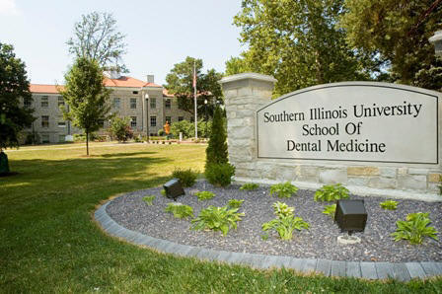
Debra Barnard 20 Years of Service
Facilities Management

Slide 21
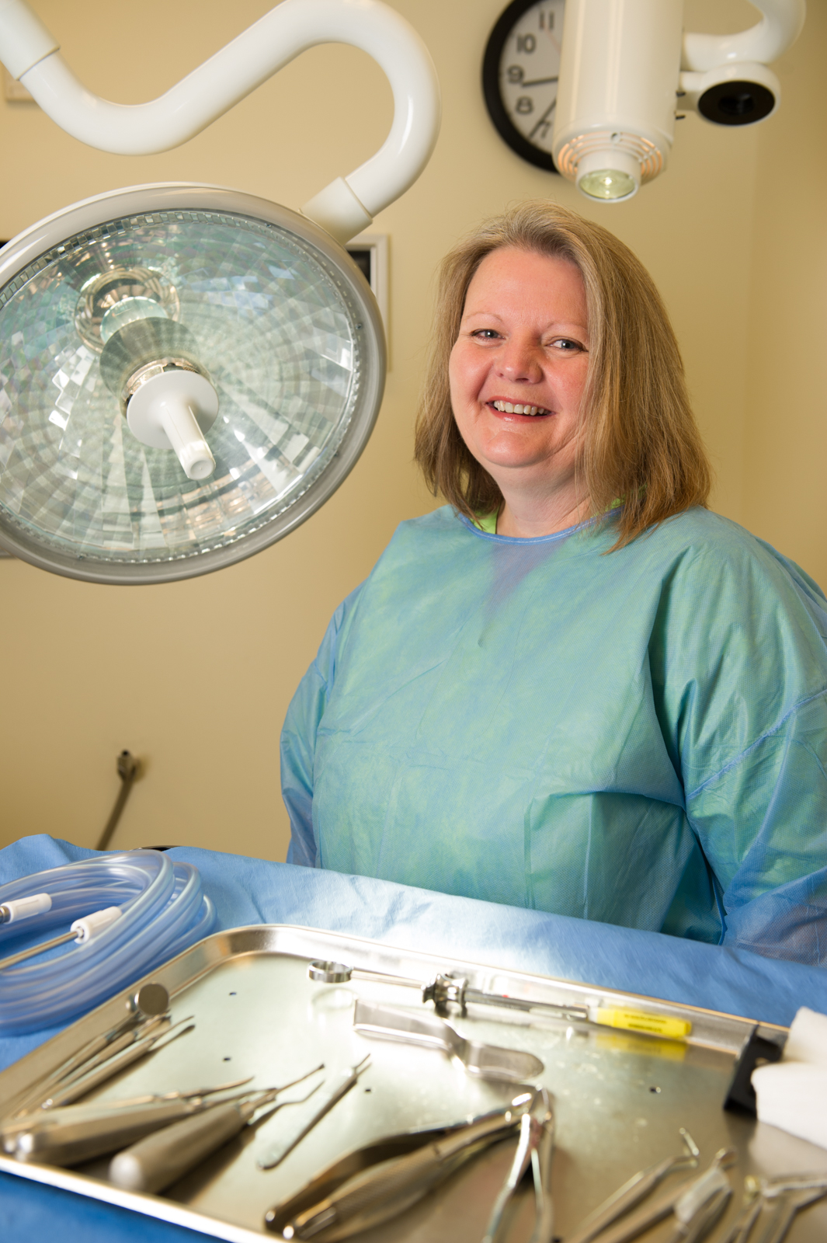
Melody Benoist 20 Years of Service
School of Dental Medicine
Psychology Department

Slide 22
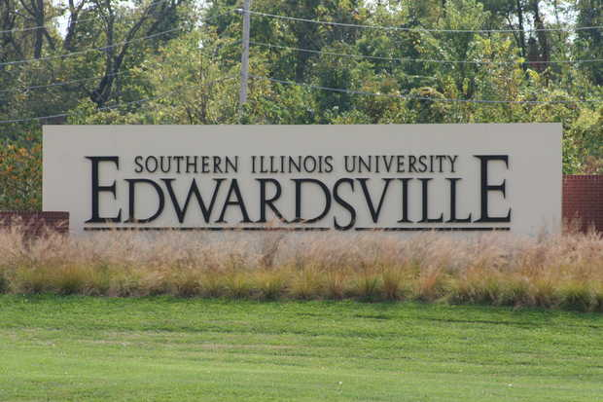
Melody Brimm 20 Years of Service
Facilities Management

Slide 23
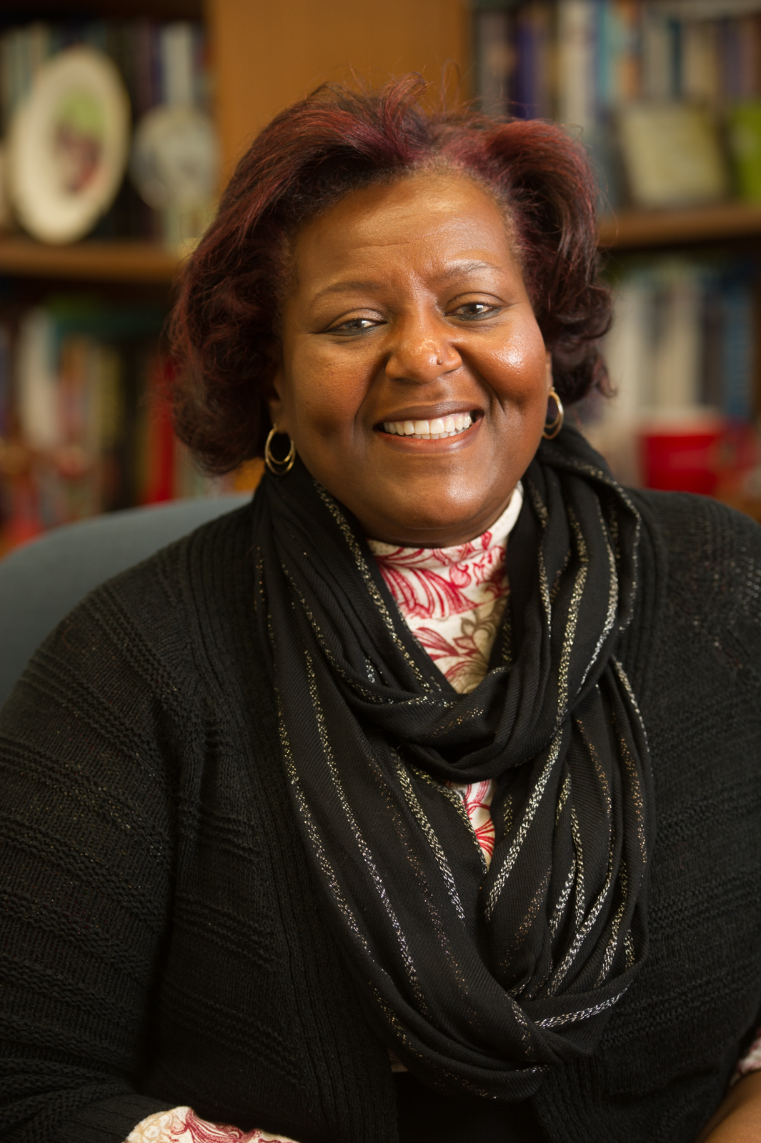
Dr. Venessa Brown 20 Years of Service
Office of the Chancellor

Slide 24
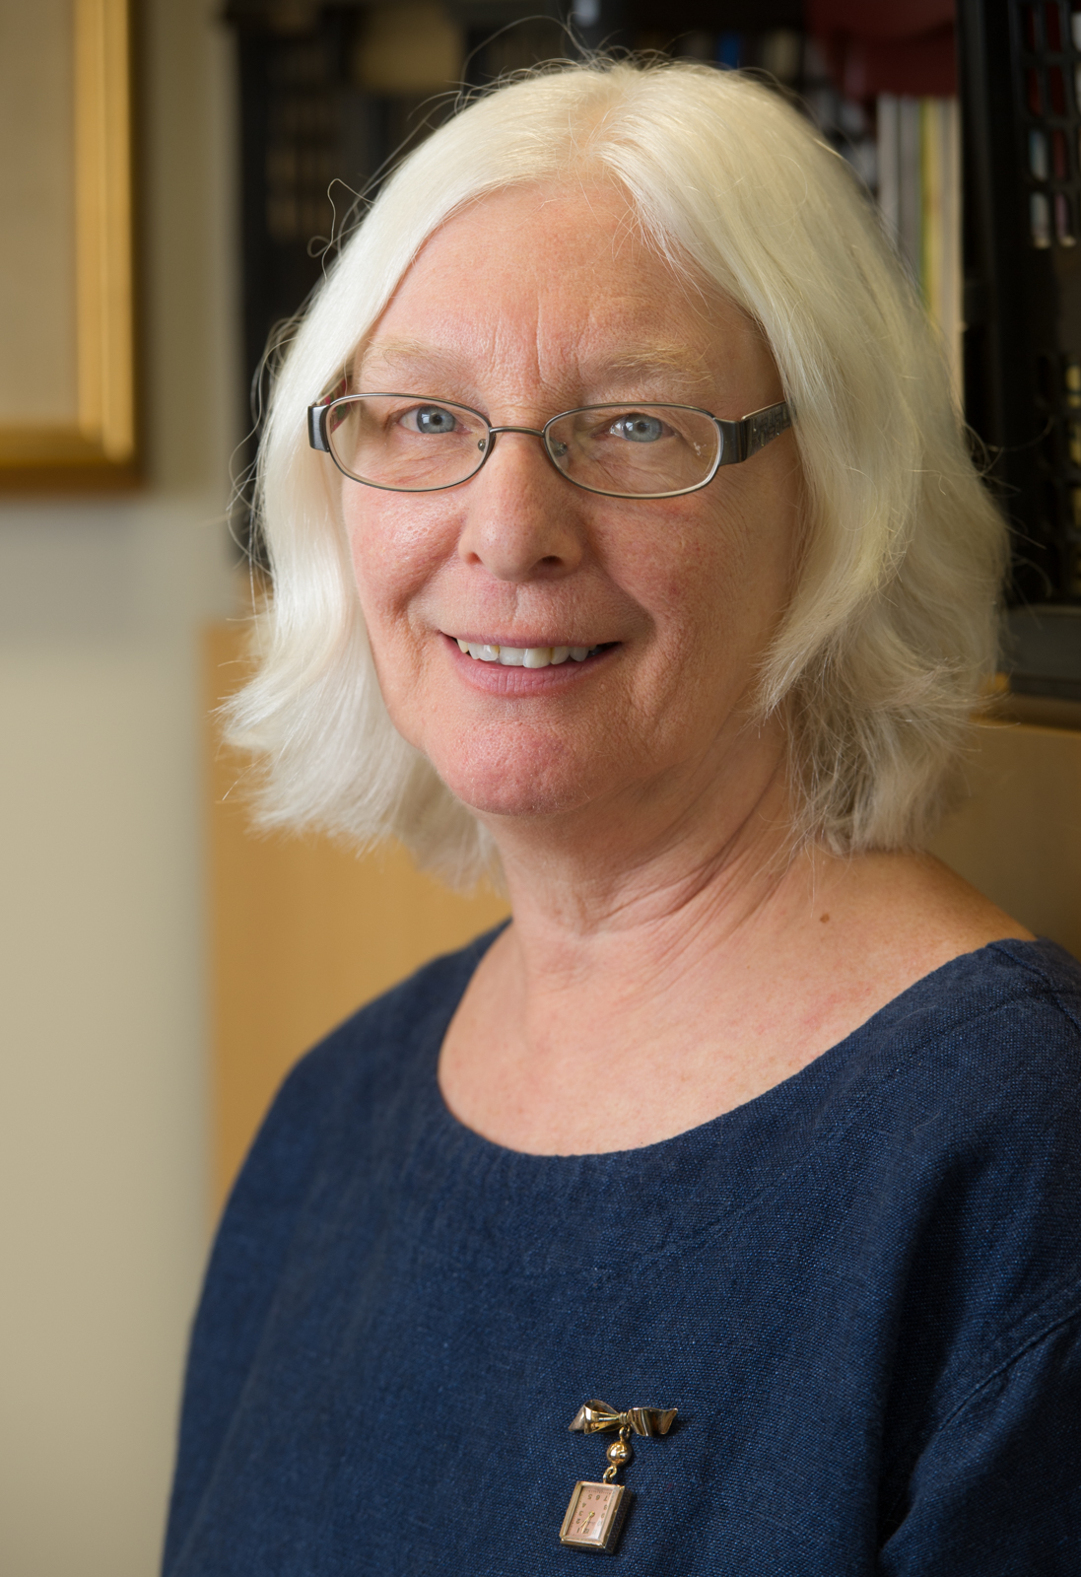
Dr. Sue Cataldi 20 Years of Service
Philosophy

Slide 25
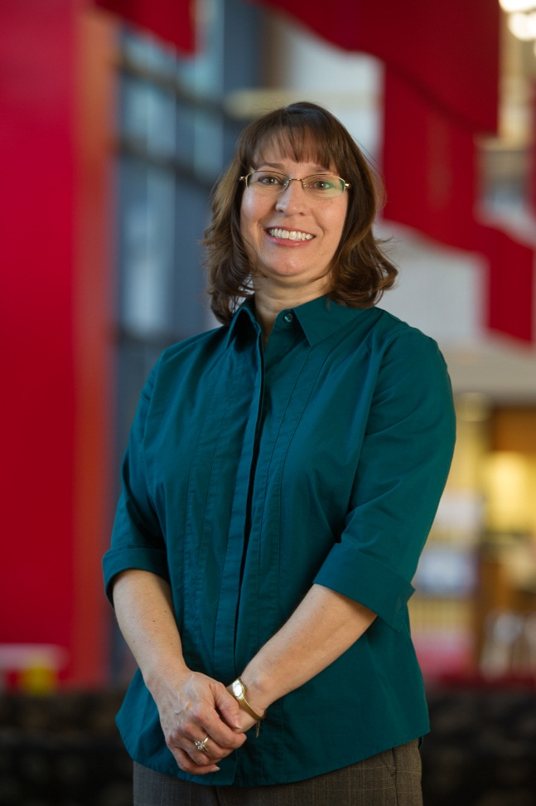
Wendy Cauley 20 Years of Service
Accounts Payable

Slide 26
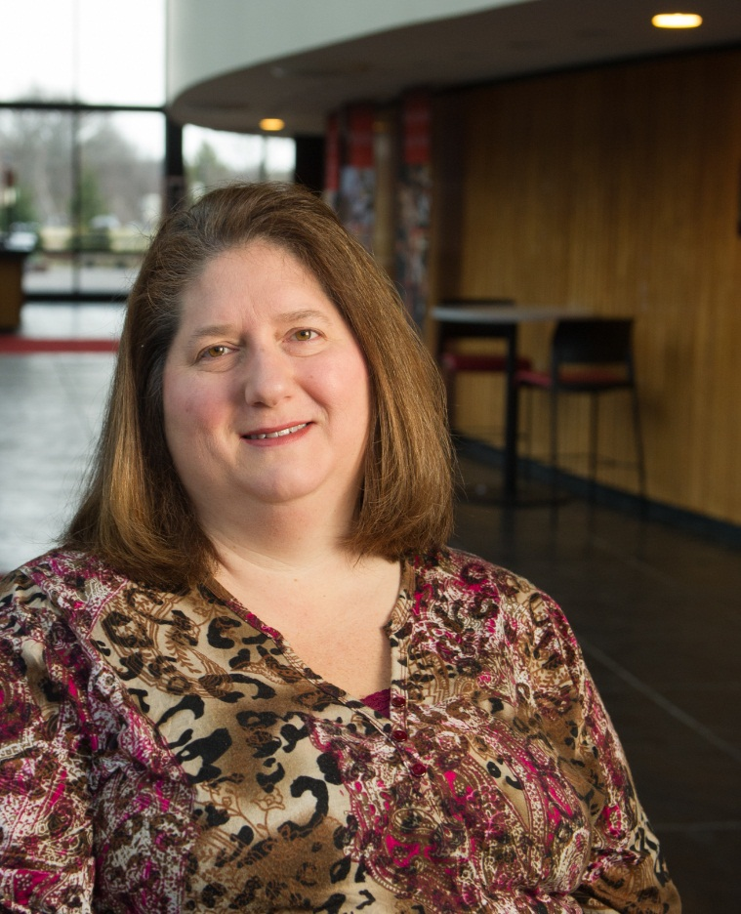
Anita Corradini 20 Years of Service
Information Technology Services

Slide 27
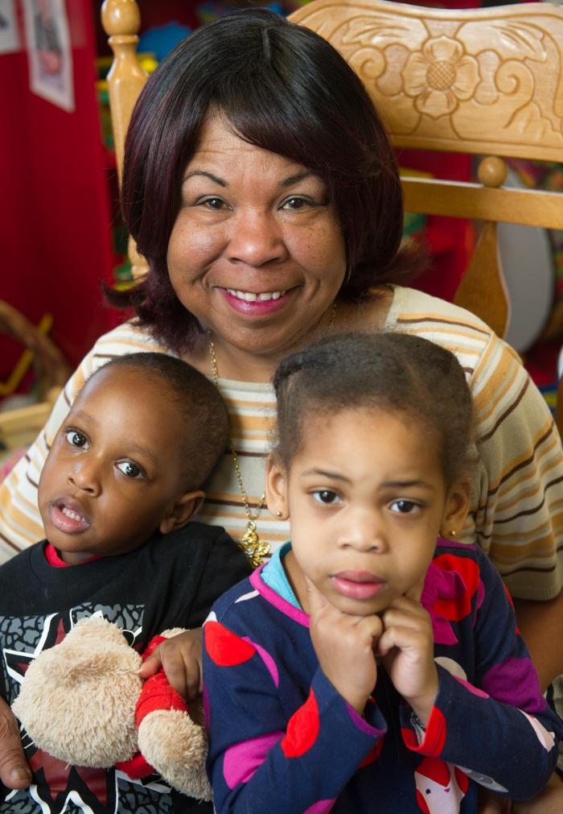
Charlyette Crape 20 Years of Service
University Services to East St. Louis

Slide 28
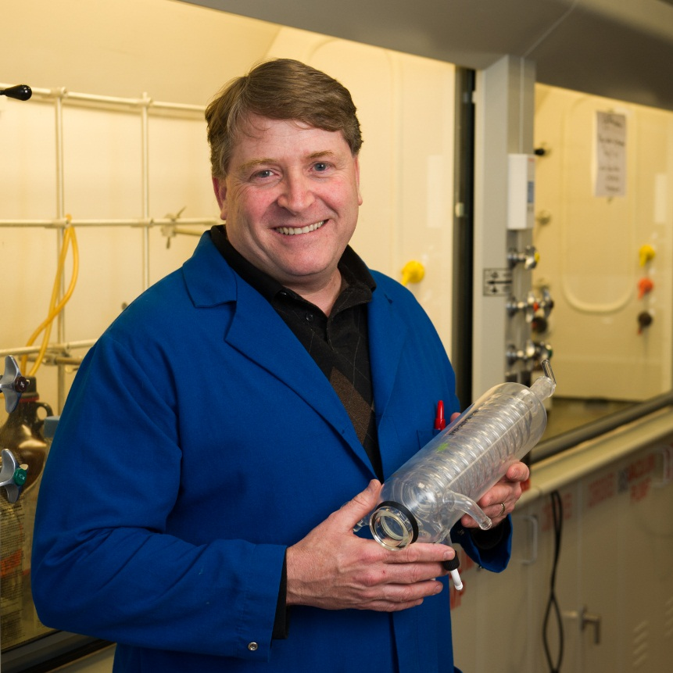
Dr. Robert Dixon 20 Years of Service
Chemistry

Slide 29
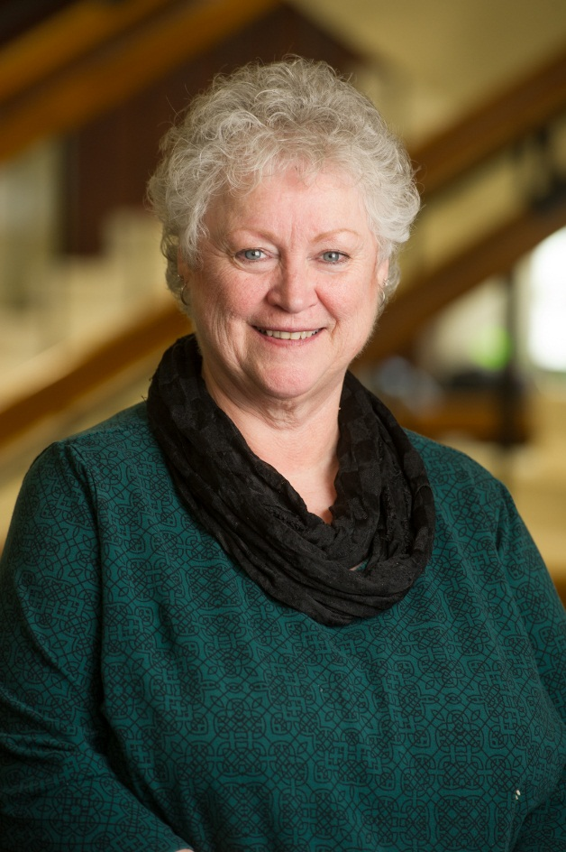
Tina Federer 20 Years of Service
College of Arts and Sciences

Slide 30
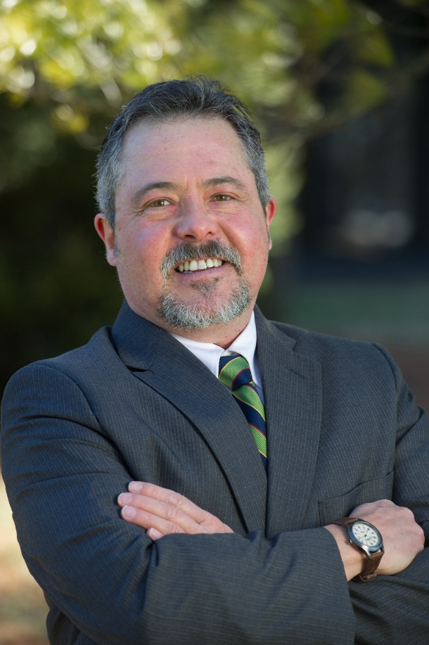
Dr. Gregory Fields 20 Years of Service
Philosophy

Slide 31
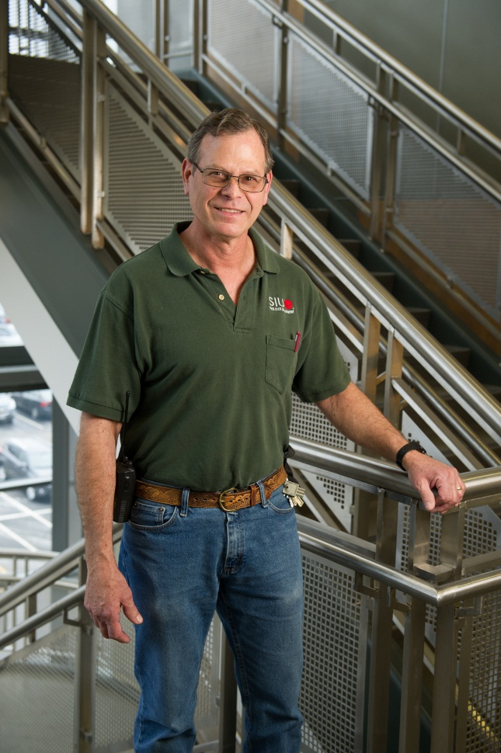
Floyd Frey 20 Years of Service
Facilities Management

Slide 32
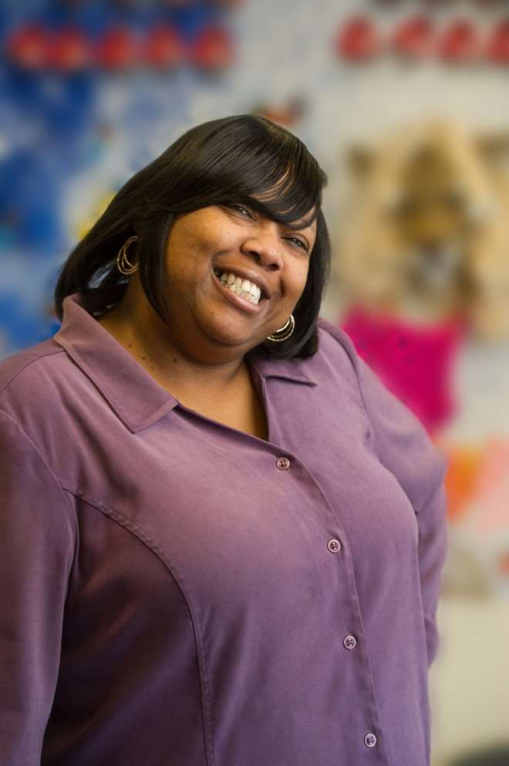
Denise Hunt 20 Years of Service
Human Resources

Slide 33
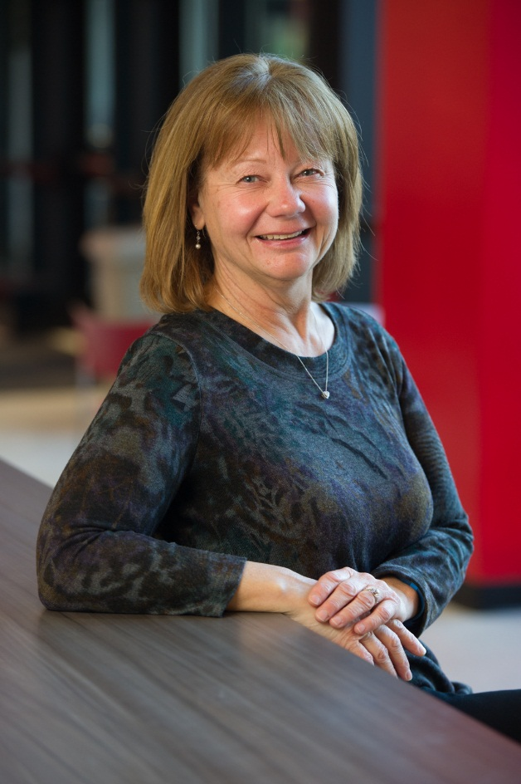
Tracey Kane 20 Years of Service
Housing

Slide 34
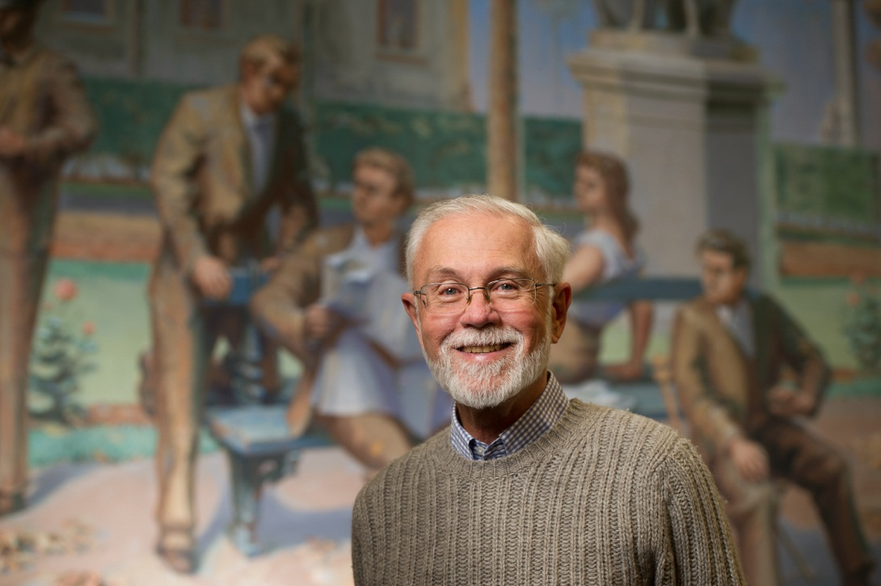
Dr. Stephen Kerber 20 Years of Service
Lovejoy Library

Slide 35
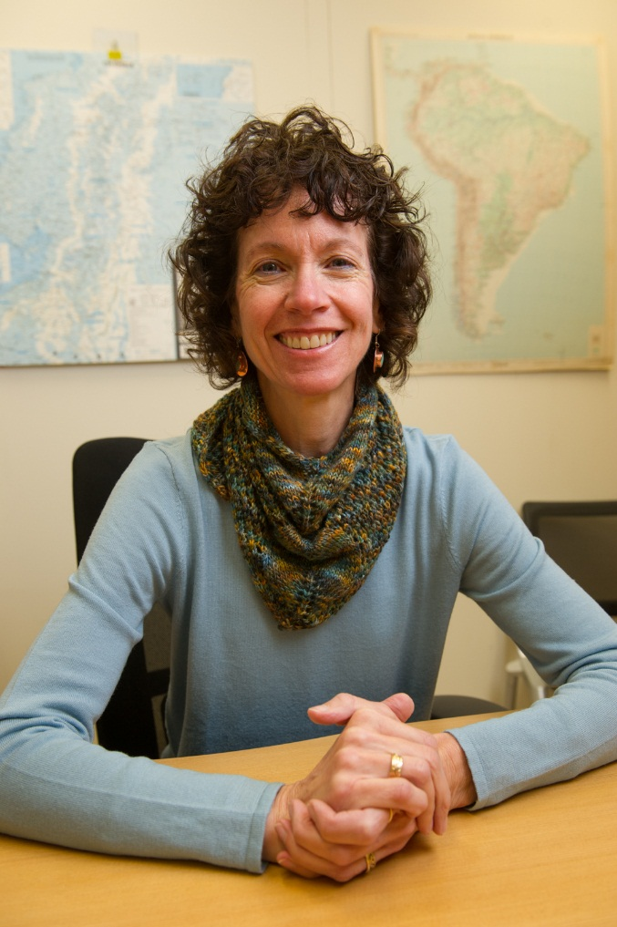
Dr. Alison Lamothe 20 Years of Service
Foreign Language and Literature

Slide 36
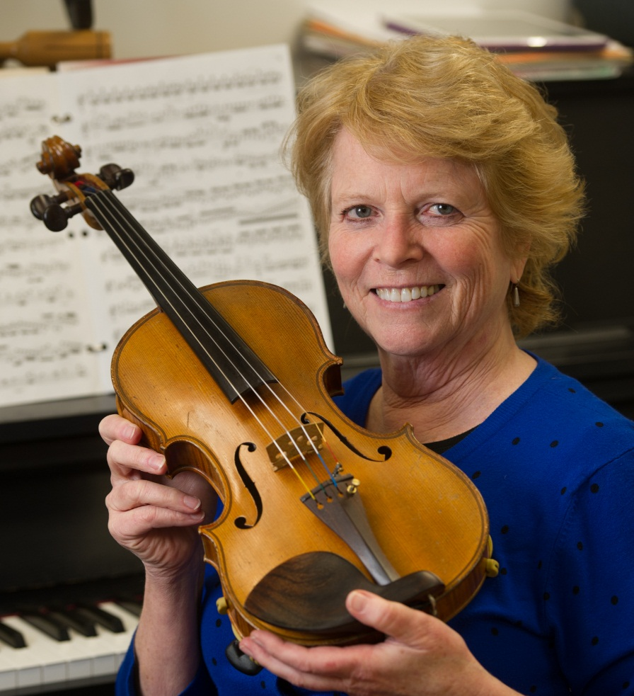
Vera McCoy-Sulentic 20 Years of Service
Music

Slide 37
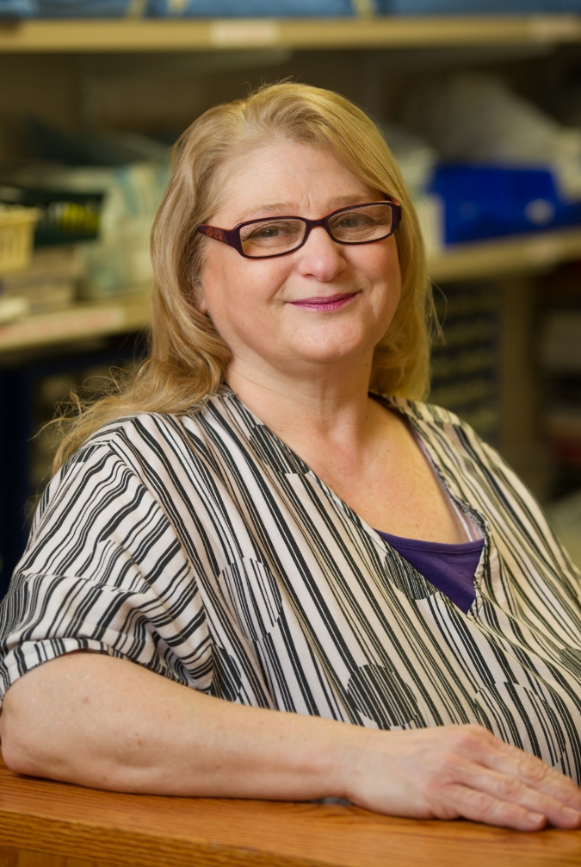
Beverly Miller 20 Years of Service
School of Dental Medicine

Slide 38
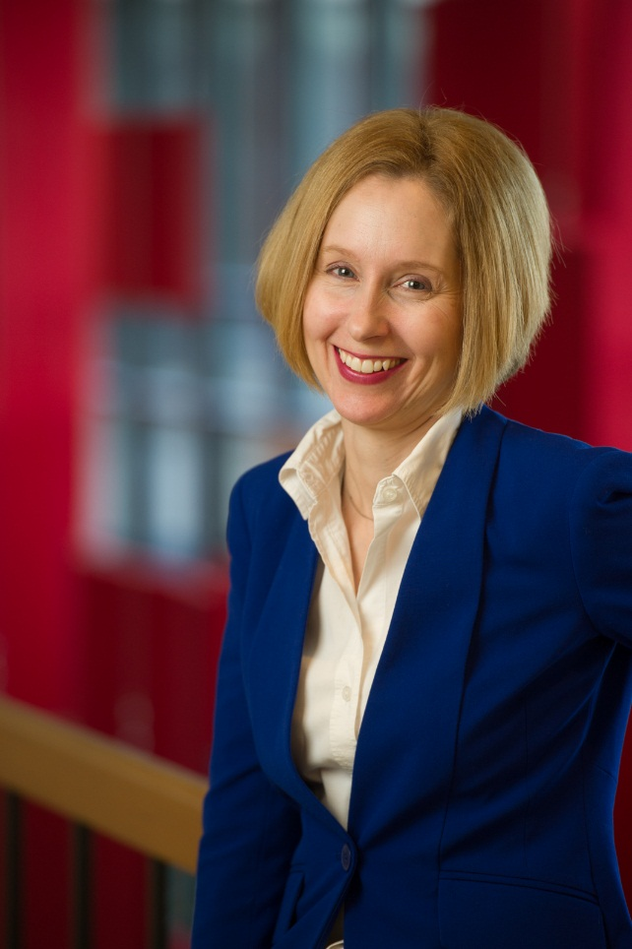
Dr. Susan Morgan 20 Years of Service
Research and Projects

Slide 39
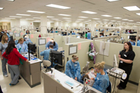
Lorna Moy 20 Years of Service
School of Dental Medicine

Slide 40
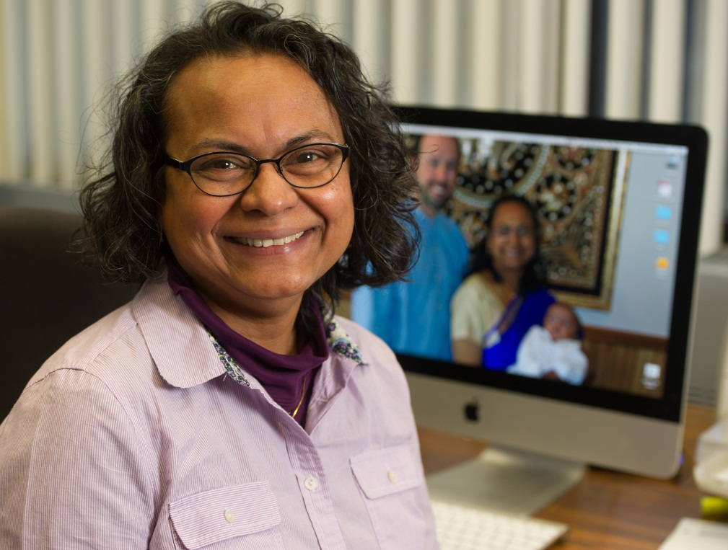
Dr. Gertrude Pannirselvam 20 Years of Service
Management and Marketing

Slide 41
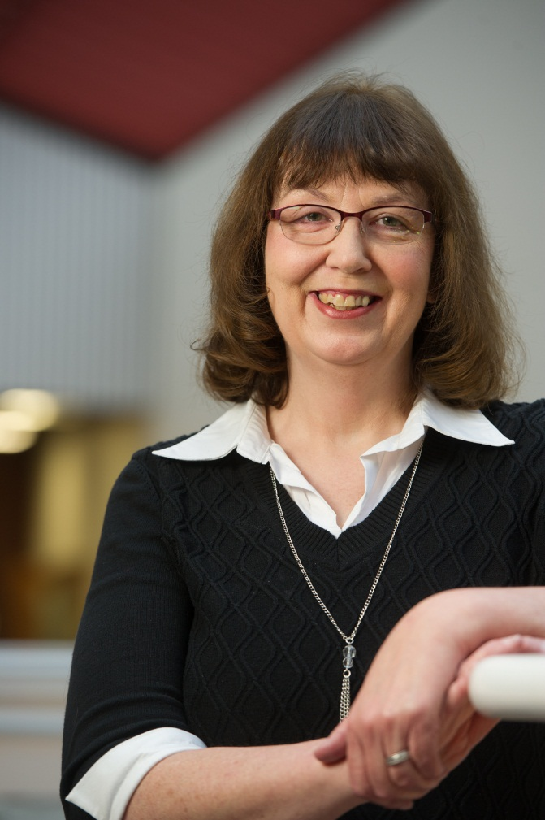
Diana Peters 20 Years of Service
Public Administration and Policy Analysis

Slide 42
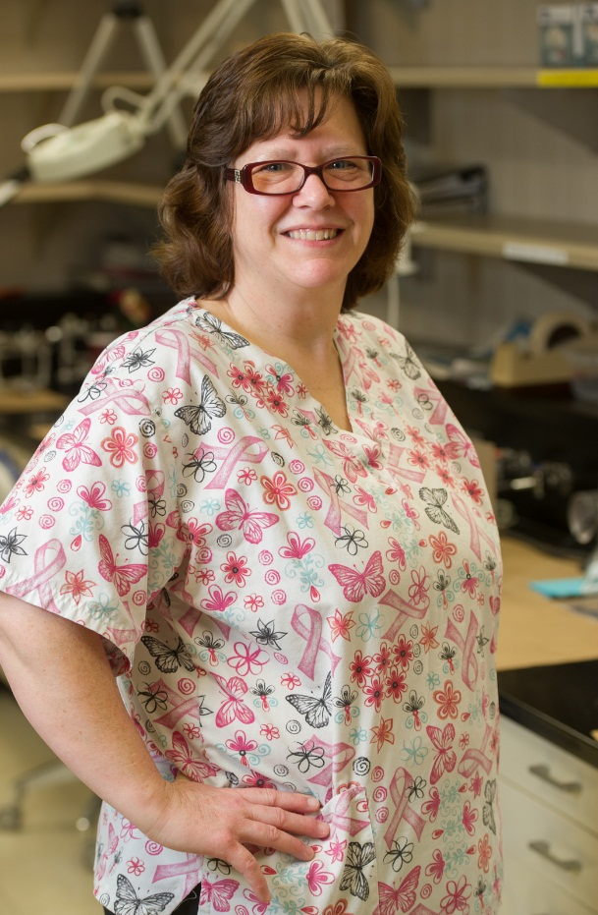
Judith Ritchey 20 Years of Service
School of Dental Medicine

Slide 43
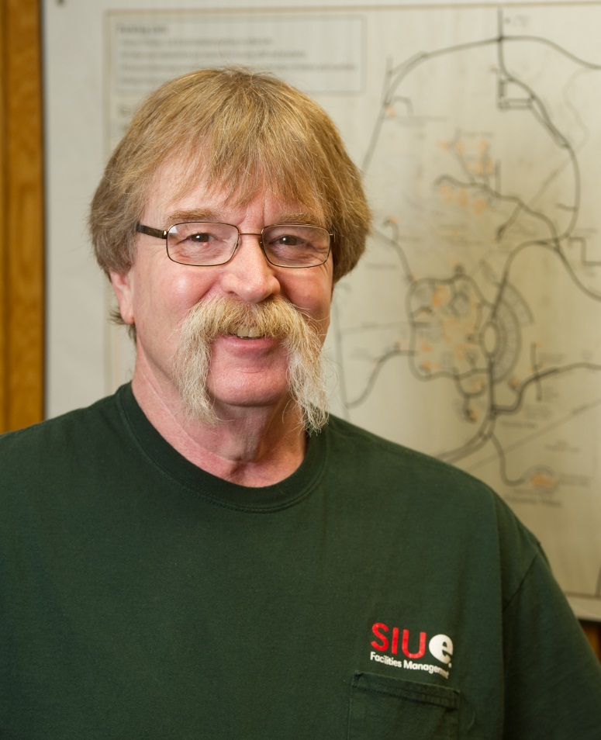
Garry Sammons 20 Years of Service
Facilities Management

Slide 44
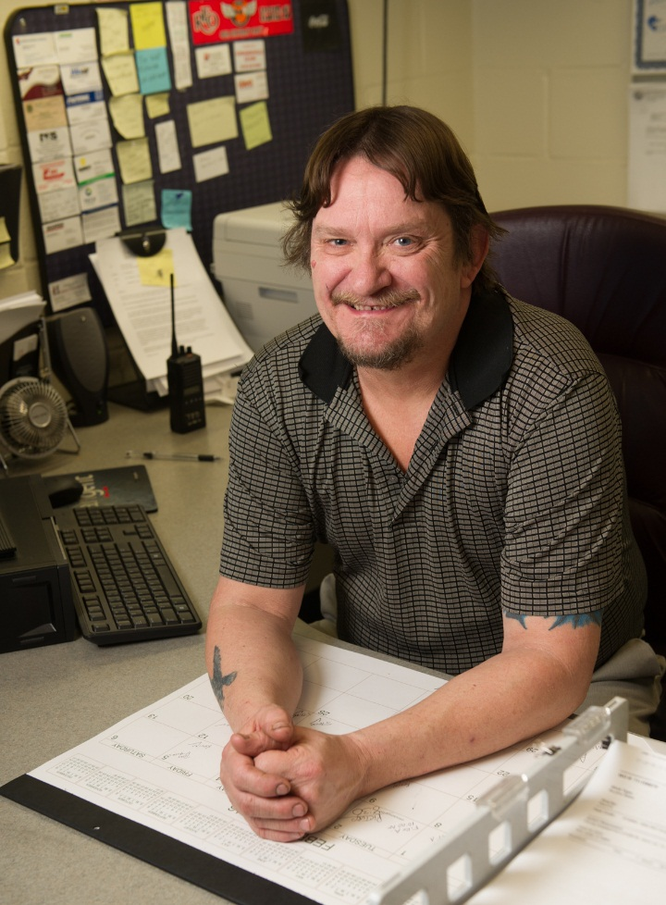
Teddy Snyder 20 Years of Service
Facilities Management

Slide 45
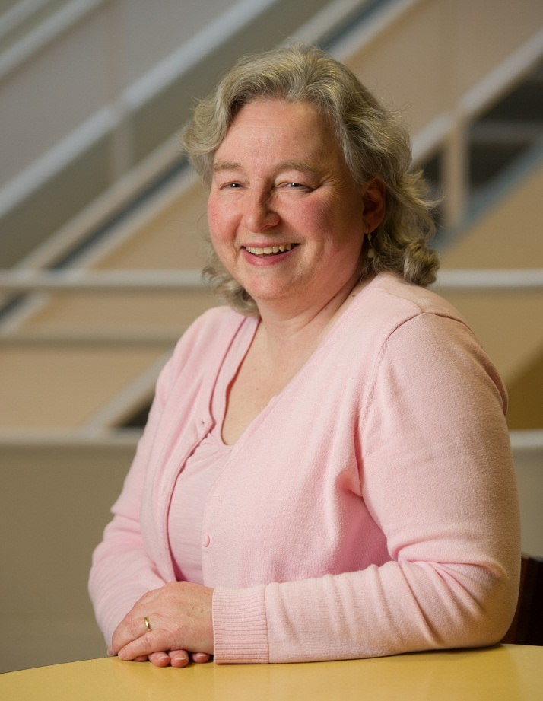
Jacqueline Twitty 20 Years of Service
Illinois Education Research Council

Slide 46
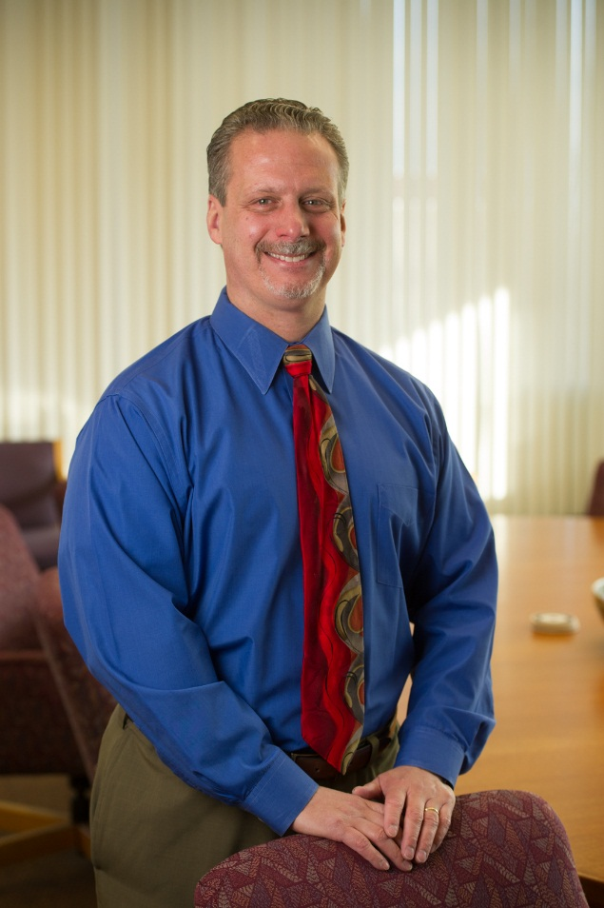
William Winter 20 Years of Service
Office of the Chancellor

Slide 47
25 Year Honorees

Slide 48
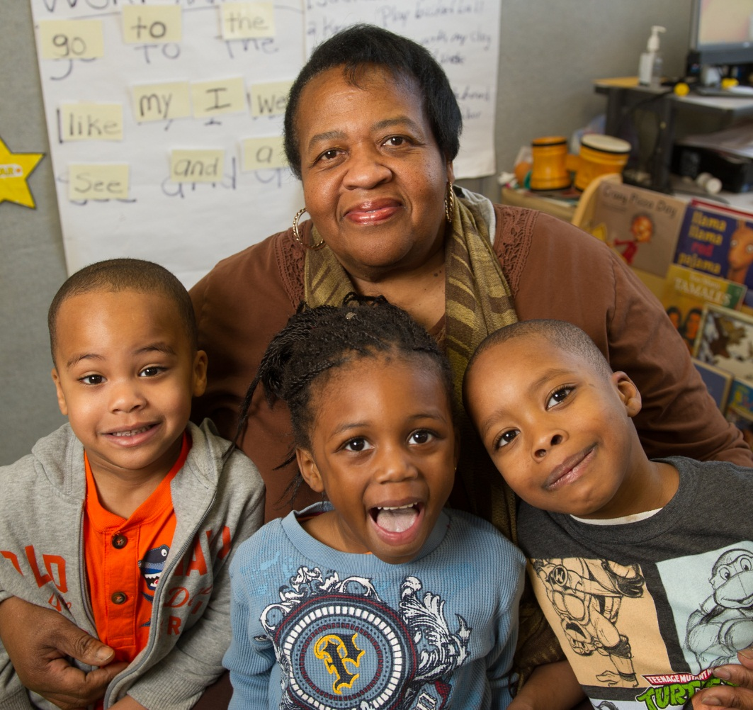
Joanne Baker 25 Years of Service
University Services to East St. Louis

Slide 49
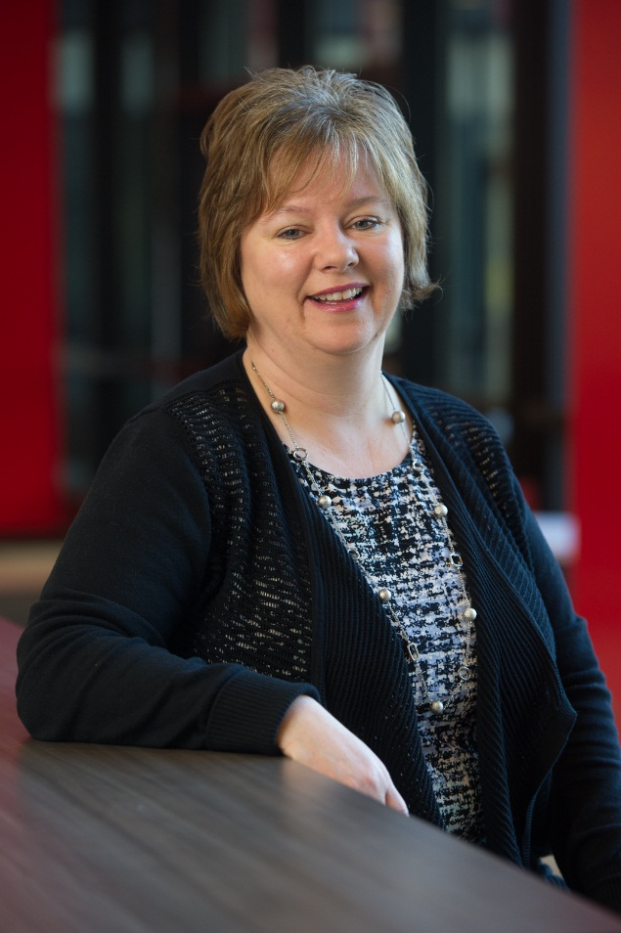
Paula Geiger 25 Years of Service
Bursar

Slide 50
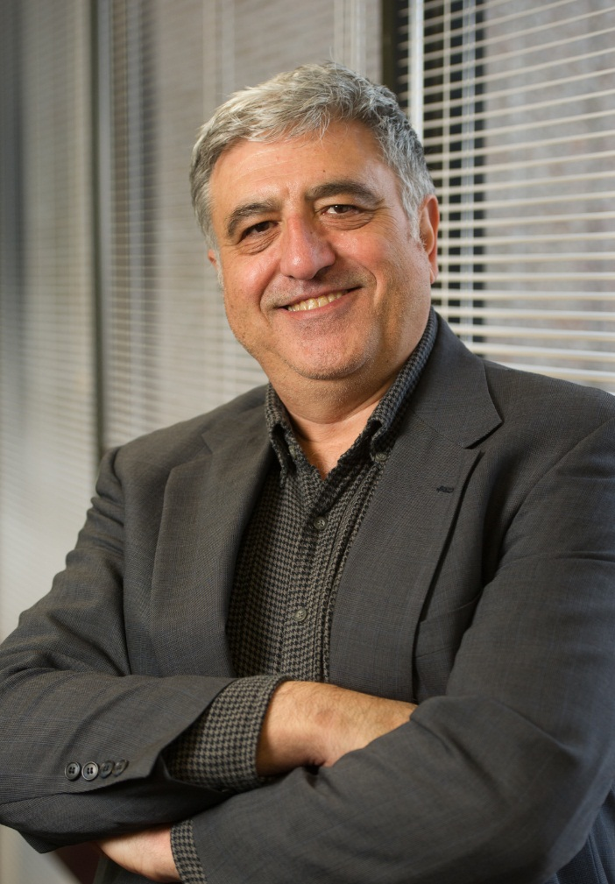
Dr. Ali Kutan 25 Years of Service
Economics and Finance

Slide 51
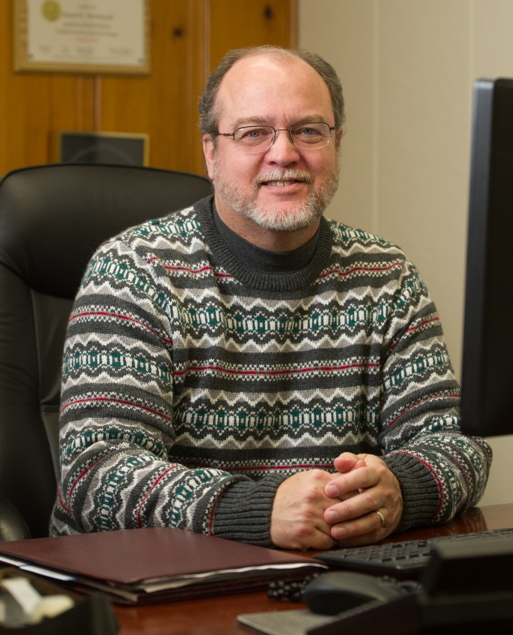
David McDonald 25 Years of Service
Emergency Management and Safety

Slide 52
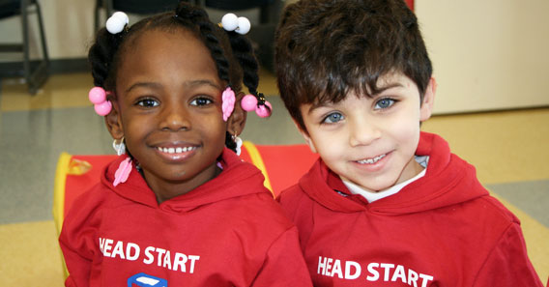
Geesia McIntosh 25 Years of Service
University Services to East St. Louis

Slide 53
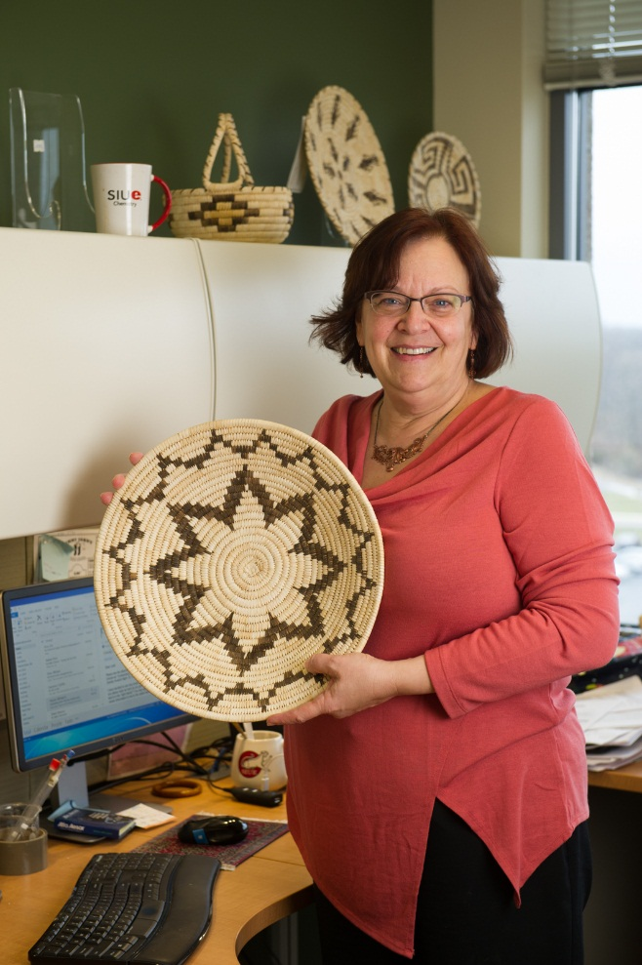
Dr. Leah O’Brien 25 Years of Service
Chemistry

Slide 54
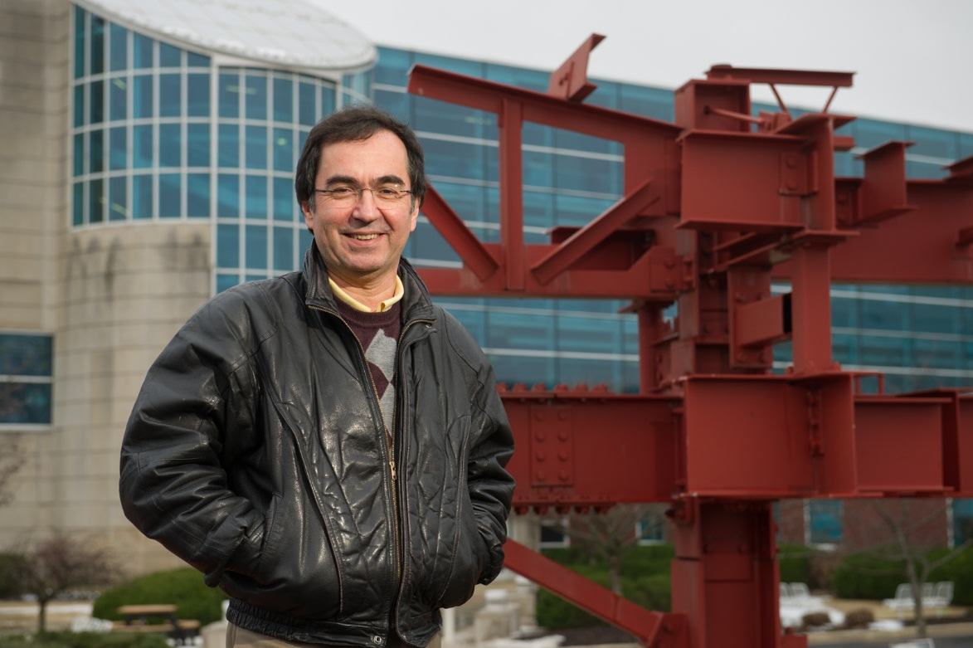
Dr. Nader Panahshahi 25 Years of Service
Civil Engineering

Slide 55
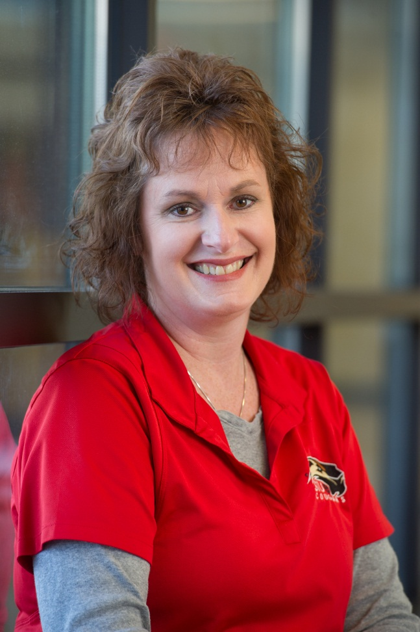
Michelle Pugh 25 Years of Service
Human Resources

Slide 56
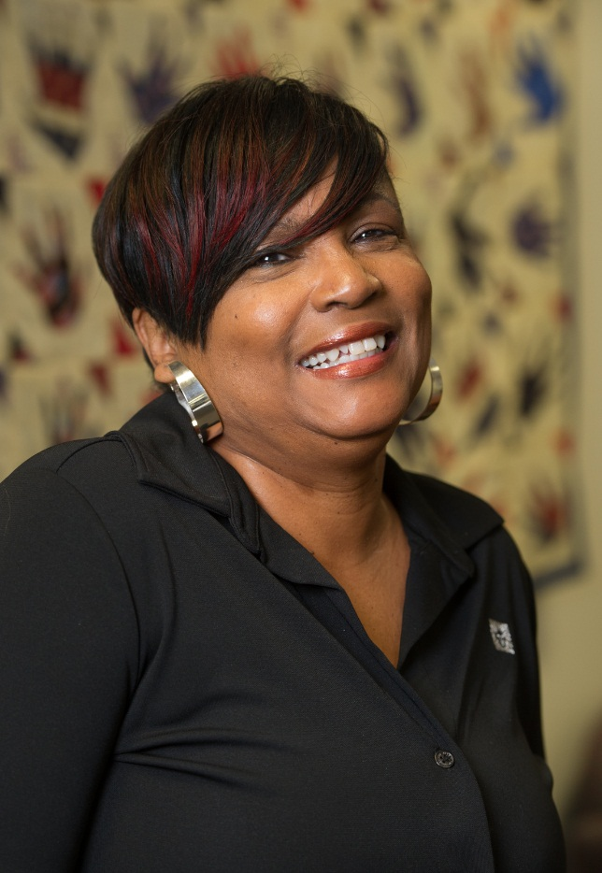
Valerie Samuels 25 Years of Service
University Services to East St. Louis

Slide 57
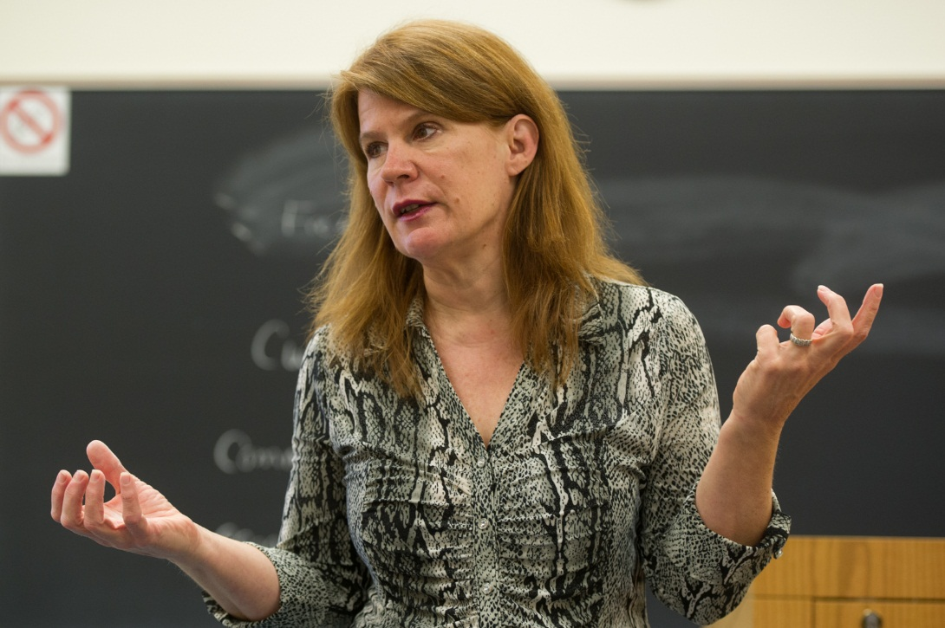
Laura Wolff 25 Years of Service
Economics and Finance

Slide 58
30 Year Honorees

Slide 59
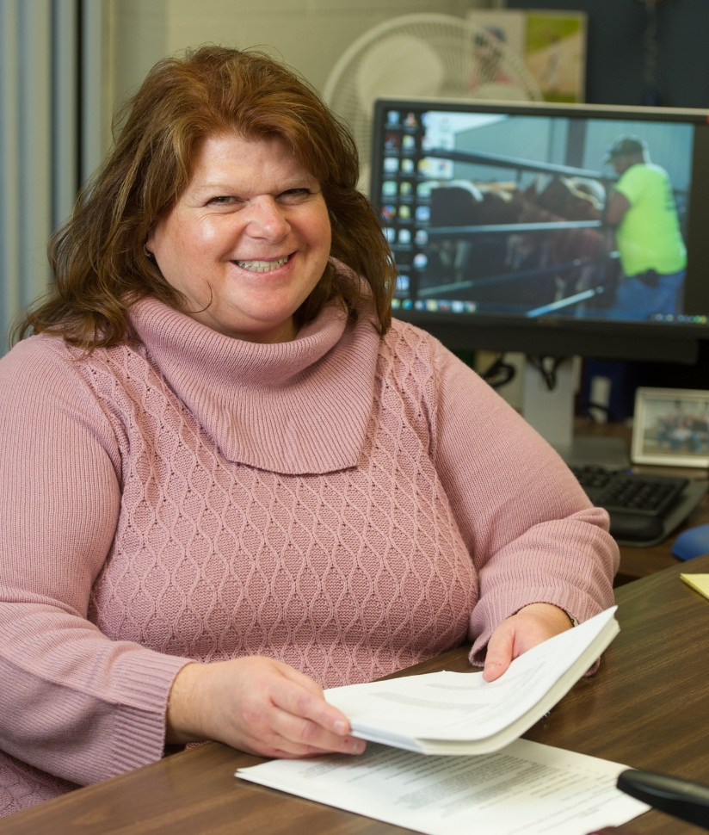
Michele Albert 30 Years of Service
Purchasing

Slide 60
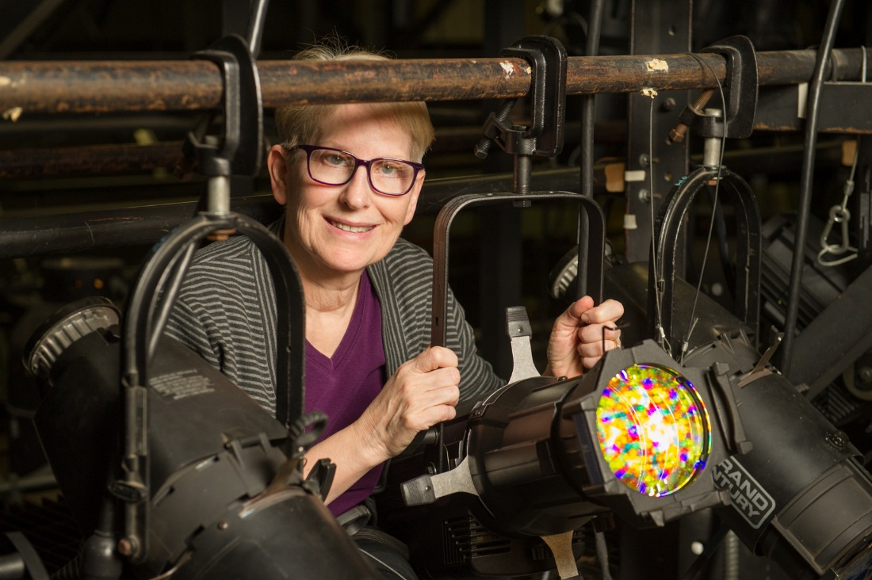
Valerie Goldston 30 Years of Service
Theater and Dance

Slide 61

Lora Miles 30 Years of Service
Student Affairs

Slide 62

Karen Montgomery 30 Years of Service
School of Nursing

Slide 63

Richard Walker 30 Years of Service
Vice Chancellor for Administration

Slide 64
Congratulations to all
Honorees!

