Slide 1


How to Maintain Vacation and Sick
Leave Balances in Banner
1

Slide 2
Vacation and Sick Leave (VSL) PEALEAV Administrator
The vacation and sick leave that is accrued by most employees is either updated bi-weekly via Department Time Entry or updated semi-monthly via the payroll process.
The amount, timing and types of paid leave employees earn are directly related to their position. Leave time is grouped by Leave Category.
Extra Help employees and Student Workers do not earn leave time.
For all eligible employees, leave benefits are recorded in the Banner Human Resource System. Amounts are cumulative.
2

Slide 3
Types of Leave Categories
Chart identifies and describes each of the SIUE leave categories.

Slide 4
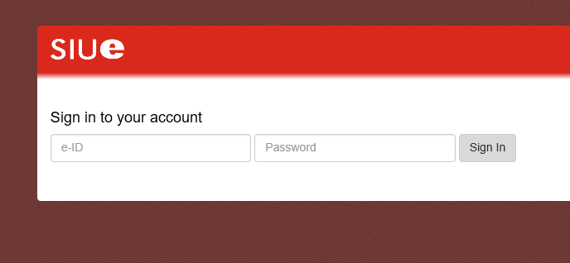
Maintaining VSL
Login into Banner; enter your username and password and select
“Sign In.”
4

Slide 5
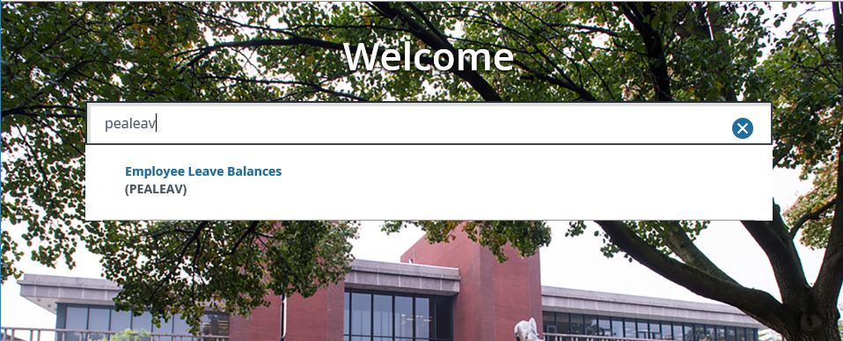
Maintaining VSL
Type PEALEAV into the Searh field
Press the Enter key

Slide 6
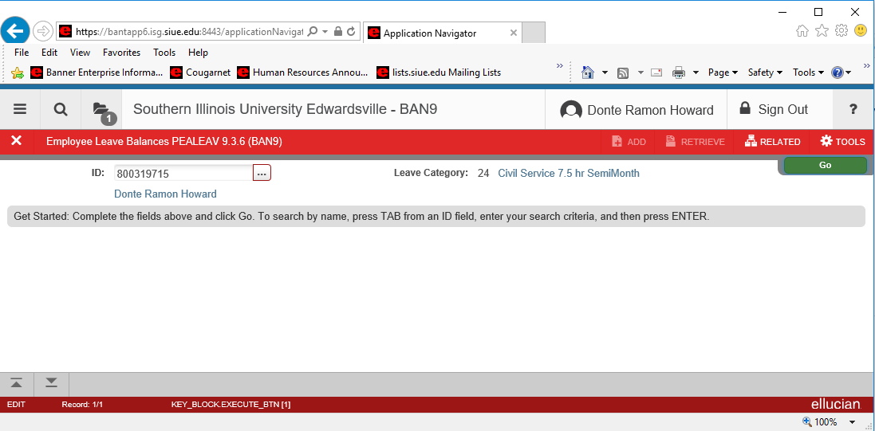
Enter Employee’s Information
Enter employee’s university ID (800 #) into the ID field
The other fields of information will automatically populate
Click (Next Section) or the Go button .
Eddie Cougar
800123123
Eddie Cougar

Slide 7
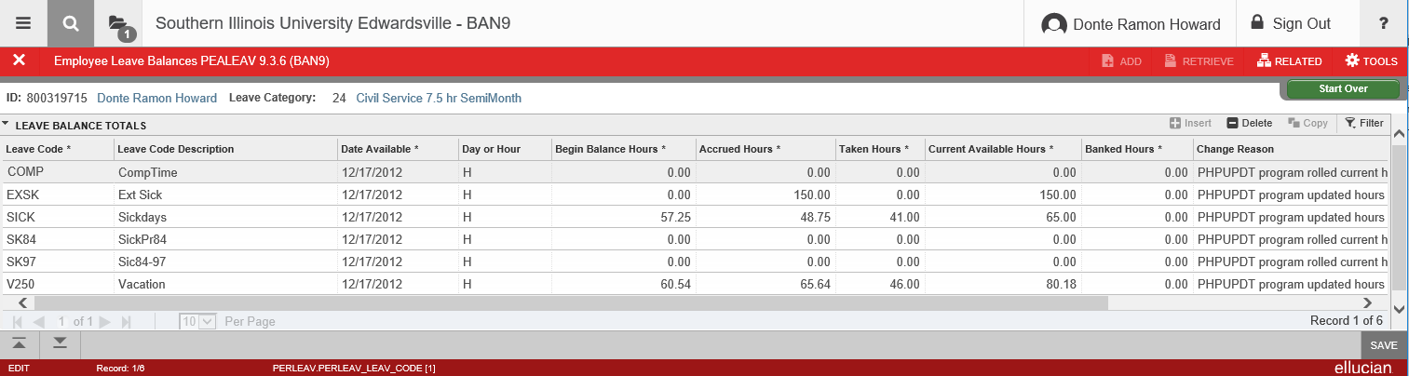
Employee’s Leave Information will Populate
Each accruable leave is associated with a code. (Please see the next slide for details about each Leave Code.)
Eddie Cougar
800123123
Eddie Cougar

Slide 8
Leave Codes
COMP = Comp Time
EXSK = Extended Sick
SICK = Sick Days (earned after 1997)
SK84 = Sick Days (earned prior to 1984
SK97 = Sick Days (earned between 1984-1997)
V250 = Vacation Days
Temp = Temporary

Slide 9
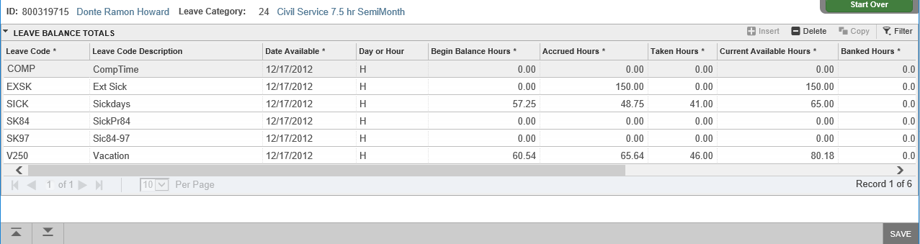
Adding Hours to the Taken Field
Leave balances are maintained by adding hours, the employee has used, to the Taken field. (Please see the next slide for details about each Leave Code field)
Eddie Cougar
800123123
*Adjust the hours in the Taken Field ONLY*

Slide 10
Date Available Employees original hire date.
Taken Amount of hours employee has classified as leave. Cumulative total for fiscal year
Begin Balance Employee’s leave balance at the beginning of the fiscal year.
Eddie Cougar
800123123
Eddie Cougar
Accrued
Amount of hours accrued since beginning of the current fiscal year.
Current Available
Amount of hours available to use toward leave balance for current fiscal year.
Banked
Amount should always be zero. This field is not used by SIUE.

Slide 11
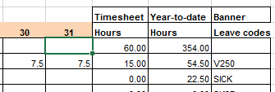
Adding Hours to the Taken Field (Continued)
The employee below began the month of January with 50 hours of Vacation available (Current Available Hours).
A timesheet indicating 15 hours of Vacation was used during January
These hours areadded to the cumulative total of hours in the Taken Hours field, and the Current Available field will automatically adjust.
January ‘Taken Hours’ (10) + Vacation hours used (15) = February ‘Taken Hours’ (25)
January
V250
Vacation
10.00
50.00
Timesheet
February
V250
Vacation
25.00
35.00

Slide 12
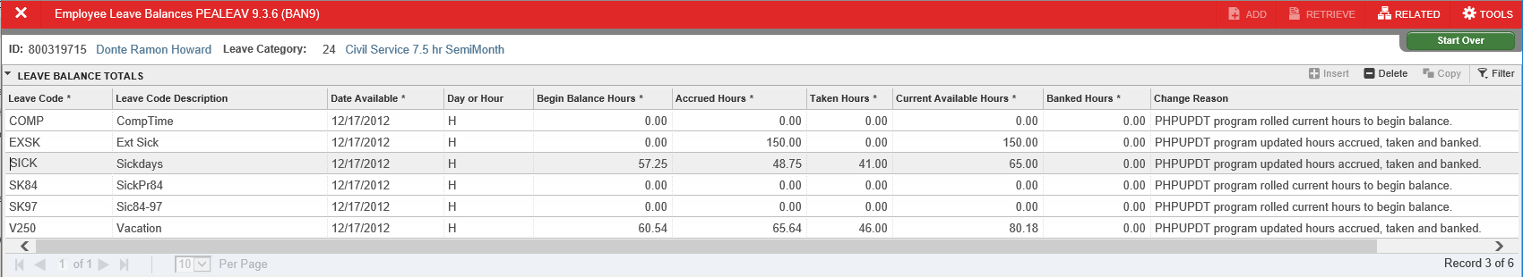
Add Change Description
After the Taken field has been updated, a change reason must be entered.
The timesheet indicates Vacation days were used on the 30th and 31st of the month.
Indicate the days and hours used in the Change
Reason field.
800123123
Eddie Cougar
25
35
1/30 (7.5), 1/31 (7.5)
Attention: The year-to-date on the timesheet should match the YTD in the taken field.

Slide 13
Adjusting More Than One Leave Code Balance
Repeat slides 9-12 for maintaining each Leave Code’s Taken field.
Click the Save icon .
Eddie Cougar
800123123
Eddie Cougar

Slide 14
Additional Resources
Employee Vacation Sick Leave Webpage
http://www.siue.edu/humanresources/benefits/vac-sick.shtml
Office of Human Resources
Phone: 618.650.2190
Fax: 618.2696

