Slide 1
How to Sign Up and Retrieve Your W-2 Tax Form

Slide 2
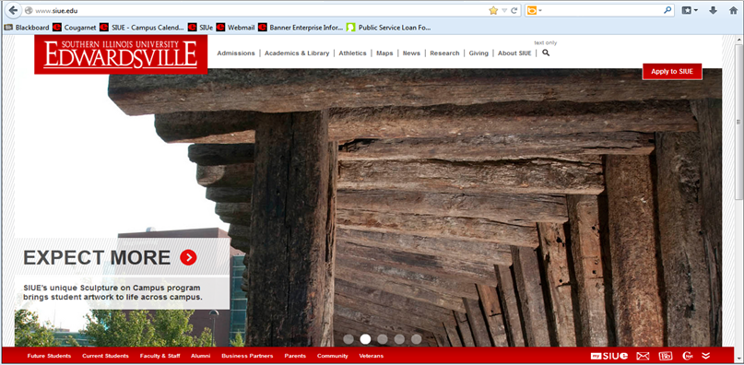
How to Access CougarNet
Type www.siue.edu into the address bar and press Enter.
Click the CougarNet icon.

Slide 3
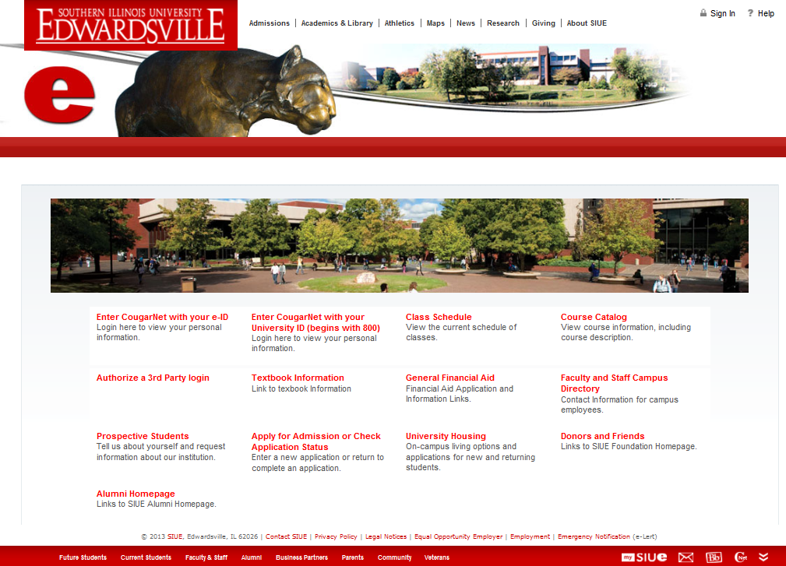
Enter CougarNet with your e-ID or University ID

Slide 4
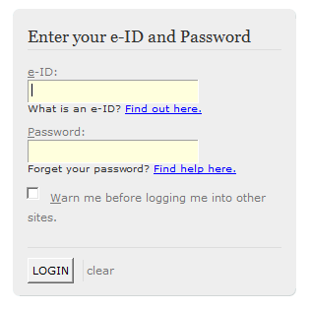
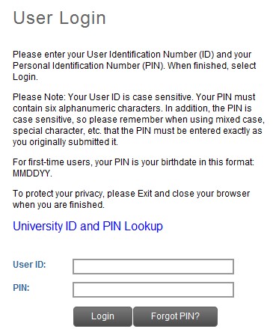
Login to CougarNet using the appropriate information.
Enter CougarNet with your e-ID
Enter CougarNet with your University ID
OR
*For assistance with PIN retrieval view slides 11 & 12.

Slide 5
Click: Employment
Tax Forms
Electronic W-2 Consent

Slide 6
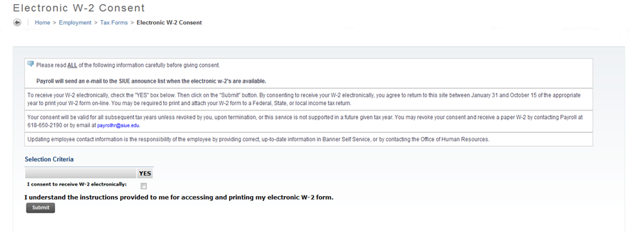
Read all of the information carefully before giving consent.
Check the box below YES
Click Submit

Slide 7
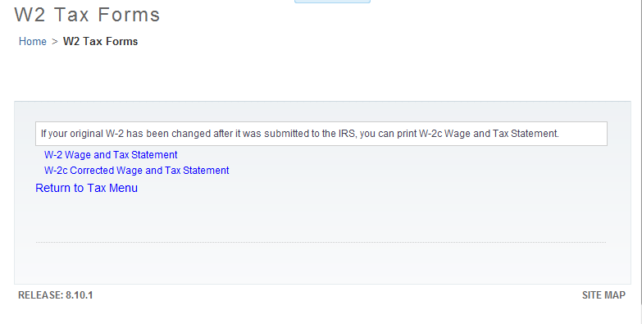
Click W-2 Wage and Tax Statement

Slide 8
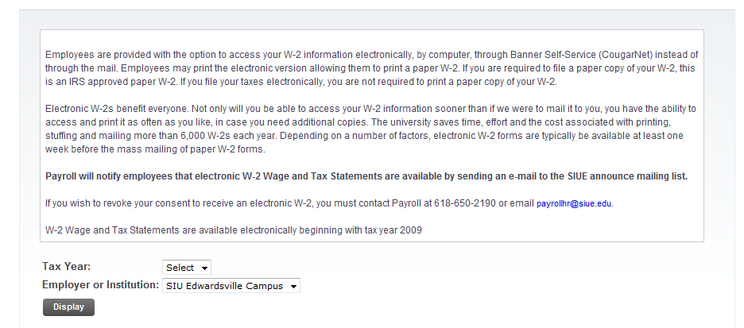
Select the appropriate Tax Year
Click Display
The W-2 form will appear on the screen.

Slide 9
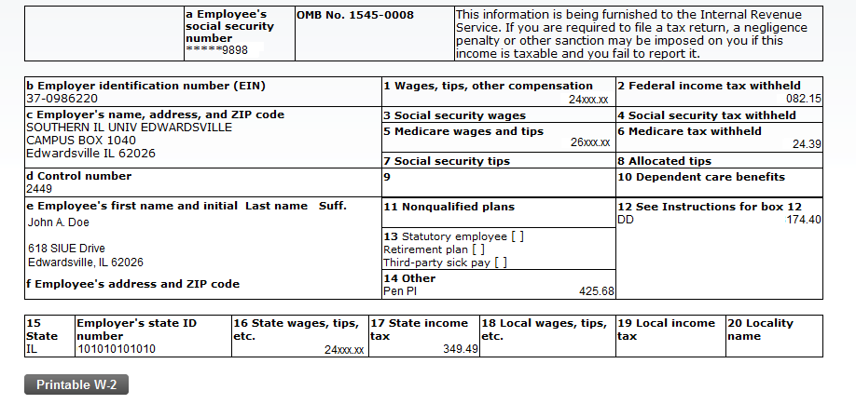
Click Printable W-2

Slide 10
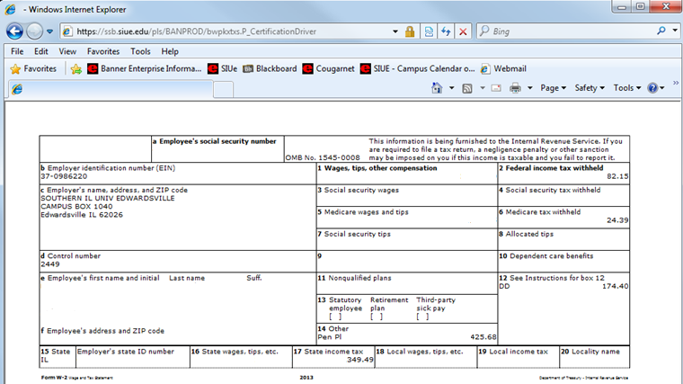
Your W-2 will appear
Click your browser’s Print button
Note: If using a computer running Microsoft Windows, press CTRL+P on the keyboard to print.

Slide 11
Lookup University ID and PIN
Click on Enter CougarNet with your University ID (begins with 800)
Once at the User Login page, click Lookup University ID and PIN.

Slide 12
Enter your e-ID and Password
Click Continue
The page below will load, displaying your University ID and PIN.

Slide 13
Who can I call for help?
For assistance or additional information about retrieving your W-2 tax form contact the Office of Human Resources at
(618) 650-2190.
For assistance or additional information concerning an
e-ID or password contact ITS Help Desk at
(618) 650-5500.
If you need your PIN number reset contact the
Service Center at (618) 650-2080.

