Slide 1
How to View and Print Earning Statements

Slide 2
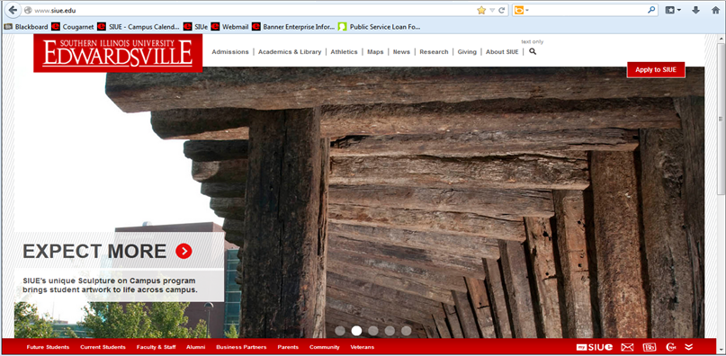
How to Access CougarNet
Type www.siue.edu into the address bar and press Enter
Click the CougarNet icon

Slide 3
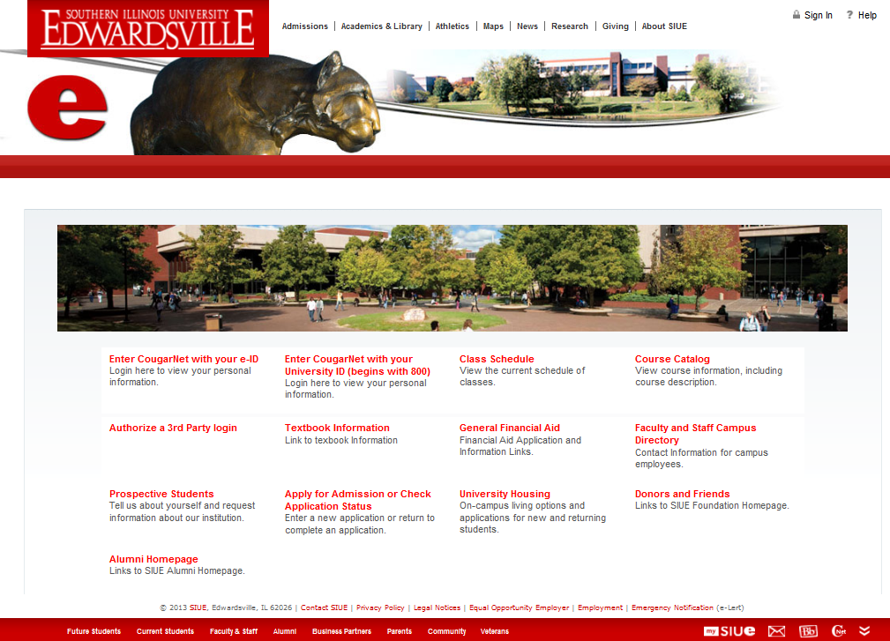
Enter CougarNet with your e-ID or University ID

Slide 4
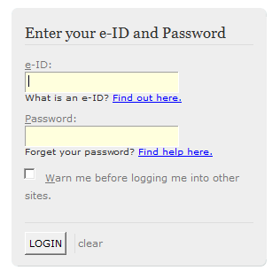
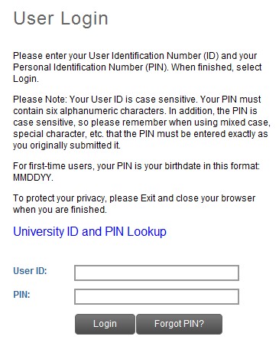
Login to CougarNet using the appropriate information.
Enter CougarNet with your e-ID
Enter CougarNet with your University ID
OR

Slide 5
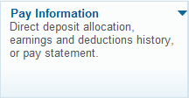
Click: Employment
Pay Information
Pay Statement

Slide 6
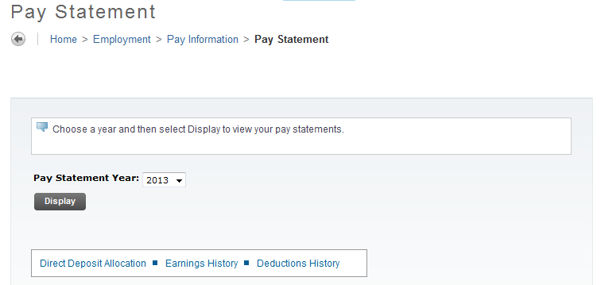
Select the appropriate year
Click Display

Slide 7
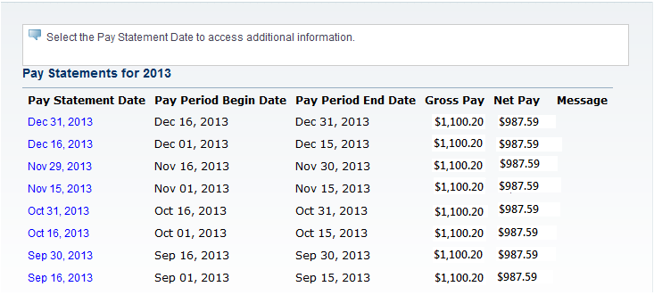
Pay statements for the selected year will populate
Click the desired Pay Statement Date

Slide 8
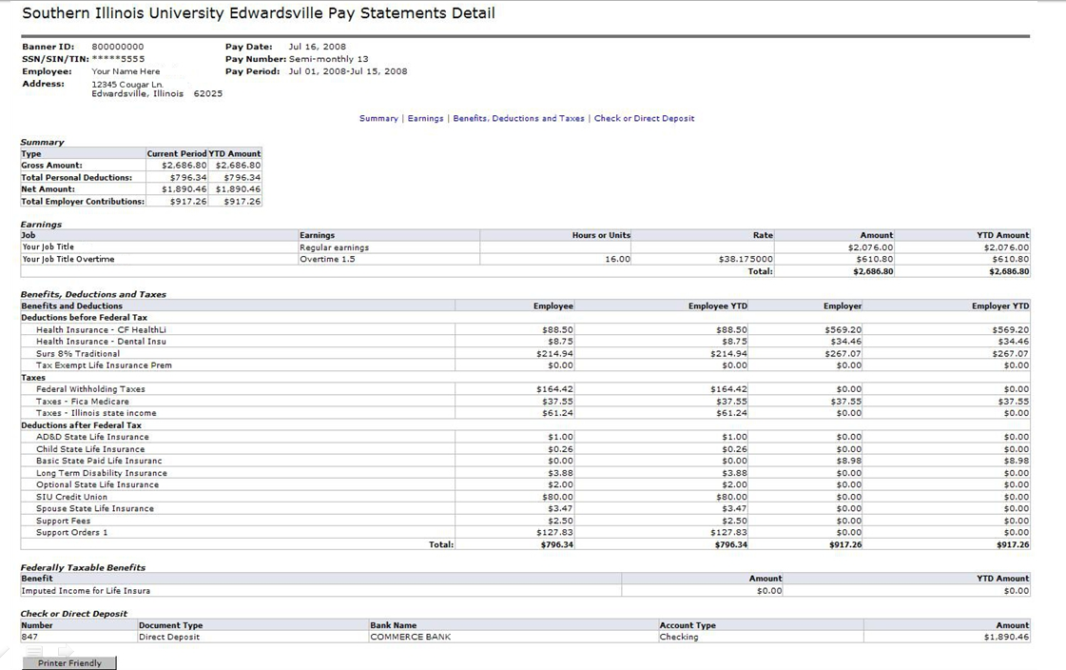
Click Printer Friendly

Slide 9
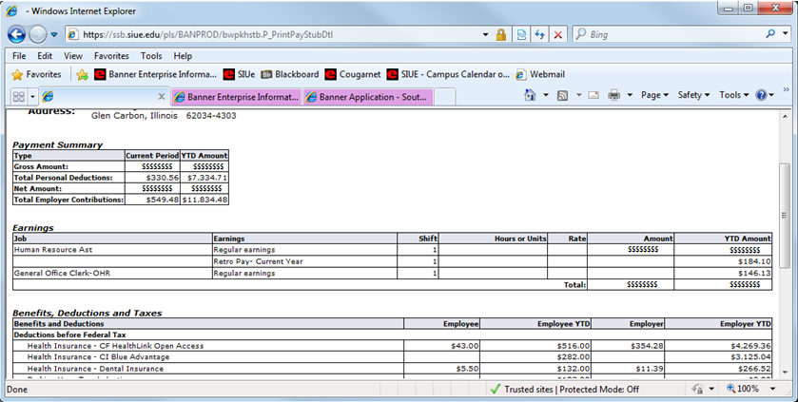
Your Pay Statement will appear
Click your browser’s Print button
Note: If using a computer running Microsoft Windows, press CTRL+P on the keyboard to print.

Slide 10
After printing, click the back arrow
Click Sign Out

Slide 11
Who can I call for help?
For assistance or additional information about retrieving your Pay Statement contact the Office of Human Resources at
(618) 650-2190.
For assistance or additional information concerning an
e-ID or password contact ITS Help Desk at
(618) 650-5500.
If you need your PIN number reset contact the
Service Center at (618) 650-2180.

