Slide 1
Thesis?
You’ve already come this far.
Just Get it Done!

Slide 2
This is an interactive slide show. Move through the presentation at your own pace. You’ll have options to take different paths along the way.
There is no audio in this presentation.
Use the arrows at the bottom of each slide to navigate.

Slide 3
We assume if you are at this point in the process that you have
a thesis topic a committee chair
I don’t have topic.
Click here.
I don’t have a committee chair.
Click here.

Slide 4
Your advisor says it’s time for you to begin working on your thesis.
That’s great.
But what is a thesis?

Slide 5

Many students don’t really know what a thesis is. They just know that they have to write one.

Slide 6
This presentation will discuss
What is a thesis?
Who is the audience?
How is a thesis organized?
How do I start writing or get unstuck?
You can follow the presentation linearly or jump to a section of interest. “Return” buttons will bring you here.

Slide 7
Let’s get started

Slide 8

Do any of these statements resonate with you?
[Click on the letters that correspond to the statements that do.]
A
“My thesis has to be the best written project I’ve ever completed.”
“My thesis is a hurdle that I have to jump through.”
“My thesis has to be long, and I’ve never written something that long.”
B
C
Return

Slide 9
“My thesis has to be the best written project I’ve ever completed.”
This idea—that the thesis has to be the best thing ever written—gives many students writer’s block or apprehension. The truth is, your thesis needs to be good, but it doesn’t have to be the absolute be-all-end-all.
Return to list of statements

Slide 10
“My thesis is a hurdle that I have to jump through.”
Well, kinda. The thesis is your culminating project, and so in that regard, you have to complete it in order to receive your degree. But if you view your thesis as an opportunity to stretch yourself as a scholar and engage deeply with a research question that interests you, the thesis doesn’t have to be a burden.
Return to list of statements

Slide 11
“My thesis has to be long, and I’ve never written something that long.”
A thesis is long-ish, averaging between 60-120 pages. Consider, though, that in your graduate program, you’ve probably written several “seminar” length papers of around 20 pages each. That’s almost the length of a thesis chapter. It’s really a manageable project when you think about it in that way.
Return to list of statements.

Slide 12
A thesis is…
An original piece of scholarship
An original argument with sufficient evidence to show your committee that you’ve thought deeply about a research question.
An independent research project
Long(ish)
Click on any box to get further information.
Skip to Organization
Return
Skip to Audience

Slide 13

The thesis is an independent project. However, it is important that you communicate regularly with your chair, who will be able to offer you advice and help you think through your project. Your thesis chair wants to talk with you, so avail yourself of the opportunity. (And your chair won’t charge you for advice!)
Being part of a writing group may also help you make progress on your project.
Return

Slide 14

In the thesis, you are providing analysis and interpretation of, for example, a text (Literature), or an event (History). You must also place your analysis within a larger framework of scholarship and develop your own argument about what your topic means.
Return

Slide 15

A thesis typically runs 60-120 pages, including references.
Return

Slide 16

The primary audience for your thesis is your committee. They are the people who approve of your final draft.
A secondary audience is the larger academic community.
Return

Slide 17
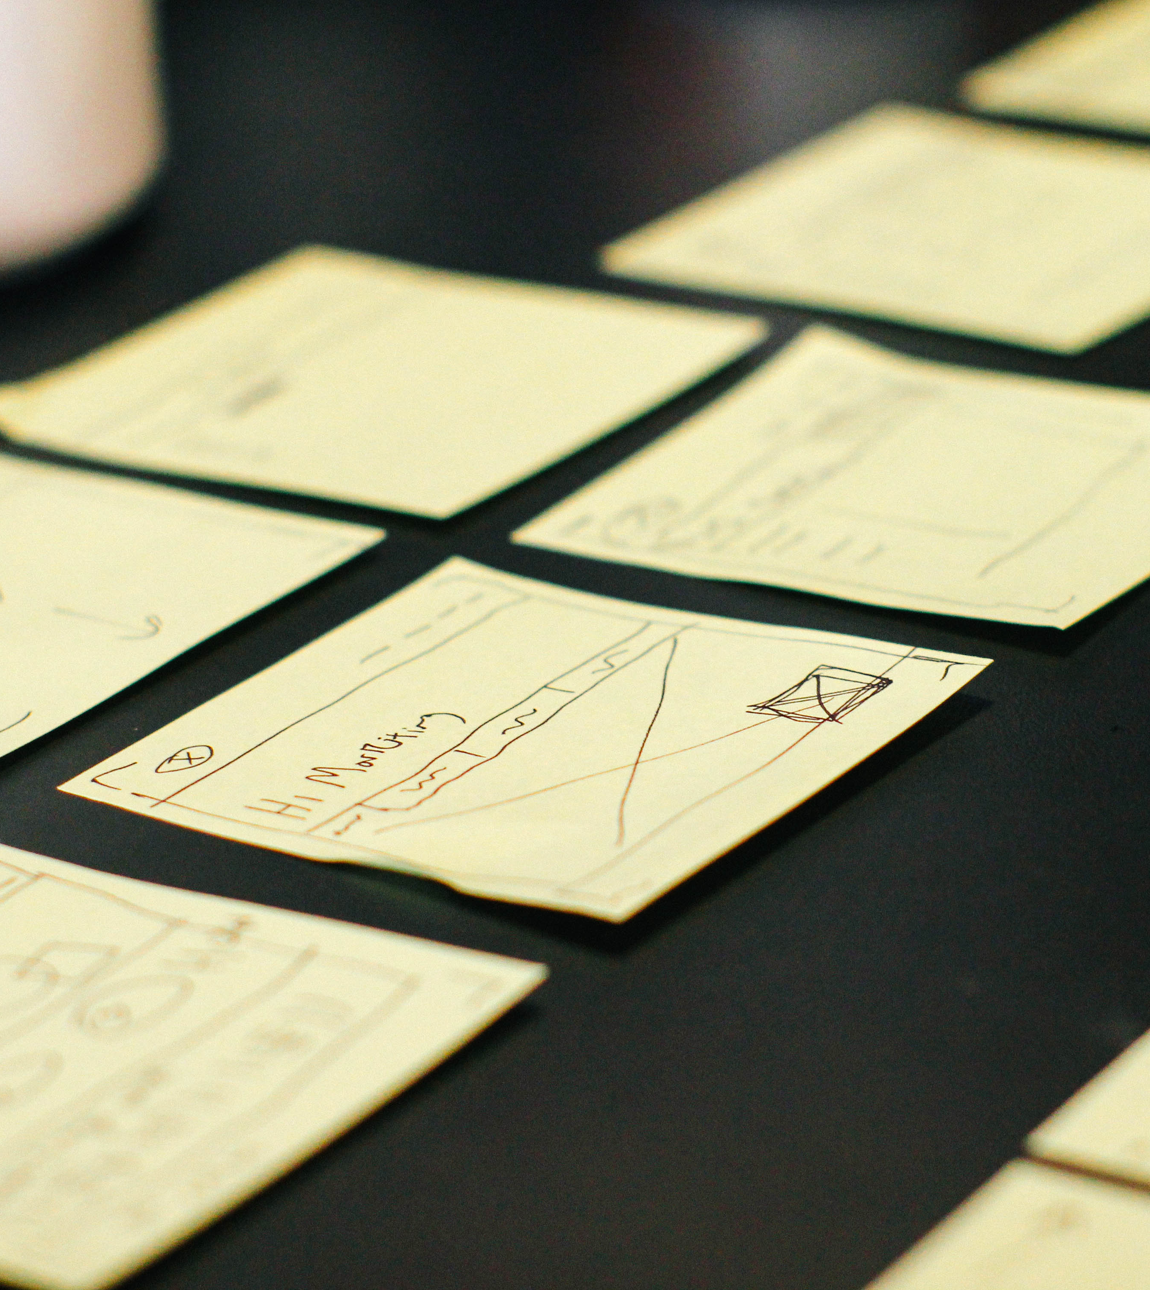
A thesis will have this basic organizational structure:
Introduction
1-3 substantive chapters
References/Works Cited
Talk with your chair about your specific project and how best to organize it.
Return

Slide 18

How do I start writing or get unstuck?
It’s common for writers to get stuck or have writer’s block on such a project. If this happens to you, know that you’re not alone. Here are few simple pieces of advice:
Keep writing! (Try free writing.)
Keep in contact with your committee chair, who can help you talk through ideas.
Join a writing group. Support and accountability are useful when completing a large project.
Return

Slide 19
As early as possible in your MA/MS studies, begin thinking about research questions that interest you, about a topic you want to pursue with further investigation.
Return

Slide 20
Choosing your thesis committee chair is an important decision. The chair is the faculty member you’ll work most closely with during the process, so choose someone whose interests and scholarly area align with your project. Also, it’s important that you select a chair with whom you feel comfortable working.
You’ll also need to select two additional committee members. Your chair can help with this decision.
Return

Slide 21
We want all of our MA/MS students to complete the exit work and earn their degrees. The Graduate Program Directors of each department, the department chairs, and the faculty are here to help you throughout the process.

Slide 22
If you have further questions about getting started with your thesis, please contact your committee chair or the Graduate Program Director as soon as possible.

Slide 23

Time
to
WRITE!

