Slide 1
Graduate Assistant Electronic Hiring Staff Training

Slide 2
Electronic GA Contract Benefits
GA contracts applied in a more timely manner
Student eligibility checked before they start working
Originator (hiring unit) able to view contract status and answer student questions
Any updates in GA policy or compliance training implemented seamlessly
Hiring unit no longer has to keep track of entire hiring packet

Slide 3
GA Contract Flow
Step 1: EPAF Creation
Step 2: EPAF and Student Check
Originates EPAF
Completes I9, tax forms, and Oral English Proficiency (TAs only)
Assigns approval levels
Checks EPAF accuracy
Checks student eligibility
Sends student link to online hiring packet
Monitors EPAF approvals
ORIGINATOR
GRADUATE SCHOOL
Step 3. Approvals
Step 3: Hiring Packet Completion
Checks EPAF
Approves EPAF
Acknowledges loan default, tuition waiver statement, and assistantship details
(New Hires)Uploads PDFs of Ethics, Not Anymore, Sexual Harassment and RCR training completion (RCR for certain grant accounts only)
APPROVER
STUDENT
Step 4: Payroll and Tuition Waiver Activation
Applies payroll record
Sends tuition waiver information to Financial Aid
GRADUATE SCHOOL
Notes:
*Currently, there are no electronic notifications with EPAFs so the originator may want to send an email to approvers once the EPAF is submitted.
*The I9 and Oral English Proficiency are sent to the Graduate School. Tax forms are sent directly to HR Attention-Semi-monthly payroll.
*The assistantship details that the student acknowledges as part of their online hiring packet, includes their GA contract terms (salary, job description, date ranges, etc.)

Slide 4
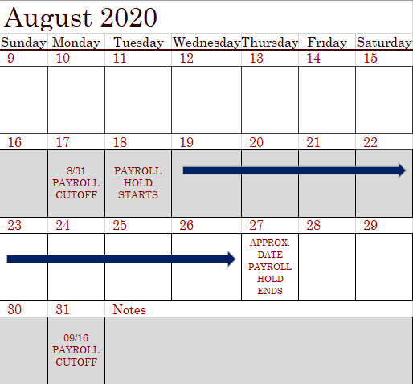
GA Contract Timeline
#1: EPAF originated with 8/16 start date.
#2: Graduate School checks EPAF and sends student link.
#3: Approvers approve EPAF.
#3: Student completes online hiring packet.
#4: EPAF applied
Ways to stay on track with timeline:
Proxy for fiscal officer quickly
Double check EPAF for accuracy
Submit as early as possible
Be mindful of payroll holds
EPAF originated with 8/16 start date. I9 and tax forms completed if necessary.
Graduate School checks EPAF and sends student online hiring packet link.
All approvers approve EPAF.
Student completes hiring packet.
EPAF applied.
Notes:
*This timeline is just a sample to show you the turn around times you could see with your EPAFs. Please feel free to originate your EPAFs earlier than this timeframe represents.
*HR payroll processing cutoff dates available here: https://www.siue.edu/human-resources/payroll/

Slide 5
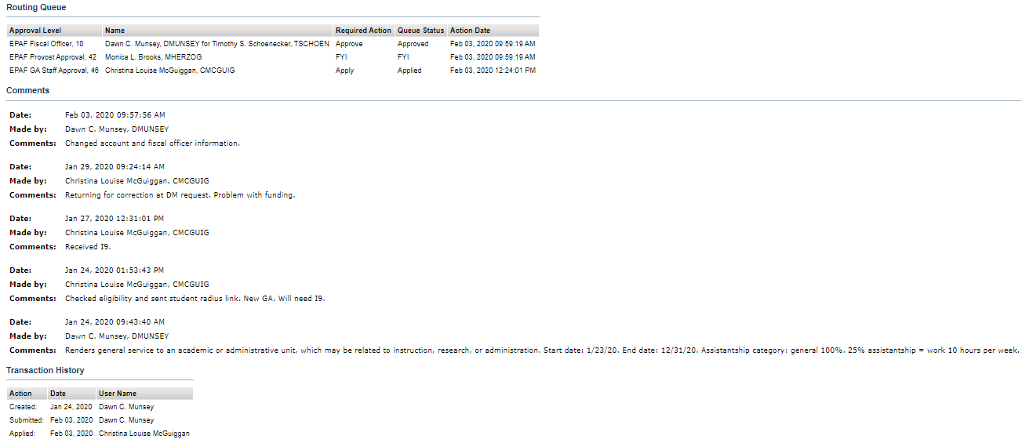
Example of Applied EPAF
Start date: 1/23/20. End date: 12/31/20. Assistantship category: general 100%. 25% assistantship = work 10 hours per week.
Notes:
*This routing queue example will be different than yours. Approvers are assigned based on units and fiscal officers.
*The EPAF will not be applied without a comment from the originator that includes job duties, break down of position classification, and the full-time semi-monthly salary base.

Slide 6
Additional Resources
Training materials emailed
GA Support Staff Email List
Email or call HR or Grad School
EPAF originated with 8/16 start date. I9 and tax forms completed if necessary.
Graduate School checks EPAF and sends student online hiring packet link.
All approvers approve EPAF.
Student completes hiring packet.
EPAF applied.
Notes:
* To sign up for the GA Support Staff Email List click here: https://siue.co1.qualtrics.com/jfe/form/SV_1Okrhh34gp9Ybhb
* HR contact info: sysstemshr@siue.edu
* Graduate School contact info: 618-650-3164 or graduateschool@siue.edu

