Slide 1
Title II Update, Accessibility and Universal Design
Cindy Poore-Pariseau, Ph.D.
Director, Office of Disability Services,
Rutgers Health
Adjunct Instructor
Rutgers and Bristol Community College
Notes:
Hello and thank you all for having me. I am Cindy Poore-Pariseau, Director for Disability Services for Rutgers Health Sciences programs and an adjunct instructor for Rutgers as well as for a Community College in MA. For the purpose of this presentation, I’ll also mention that my PhD is in Instructional Design.

Slide 2

Notes:
As Britt mentioned, I’m a cisgendered, disabled Hispanic who has worked in higher education for over 35 years. I entered college in the 80s and just never left. Because I always try to practice what I preach, I’ll always describe images on the screen, so there is no assumption that everyone can see the screen. I also use captions in case anyone cannot effectively hear what is being said. Also, throughout the presentation, I’ll be asking you questions and I ask that you not respond until you have the microphone. This is important because we never want to ask a crowd “can you hear me” because that can cause someone to out themselves as being hard of hearing when they may not be ready to disclose that information. Describe the image on the screen

Slide 3
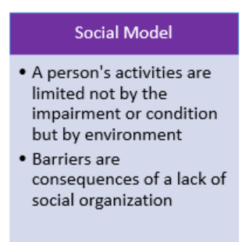
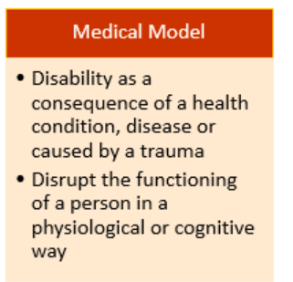
Models of Disability
Identity First Language Person First Language
Notes:
I also want to mention that I subscribe to the social model of disability so I will be using Identity first language and the term “disabled students” rather than what many of us grew up learning, that is person first language and term “students with disabilities” which comes from the medical model of disability. Distinguishing the differences among the various models of disabilities is an entire presentation on its own and I’ve promised to give only one presentation today.

Slide 4
Agenda
Updates to Title II of the Americans with disabilities act
Universal Design
Accessibility-broadly
Accessibility –more in depth
How Title II updates connect to accessibility and Universal Design.
Notes:
Today I’m going to talk briefly about the updates to Title II of the Americans with disabilities act, I’ll introduce the concept of Universal Design, then talk broadly about accessibility. I’ll end our time together by going more in depth into accessibility and the importance of the Title II updates in terms of accessibility and how the Title II updates and accessibility connect to Universal design. Overall, what I hope to convey is that accessibility benefits multiple populations, not just those who are disabled. Has anyone heard of the Title II updates to the ADA?

Slide 5
Title II update
ADA Title II now clearly requires digital accessibility for public colleges and universities
Websites, learning platforms, mobile apps, and digital documents must be accessible
Public higher-ed institutions (state & community colleges, public universities), including content from many third-party vendors
Accessibility must be proactive, not only provided after a student requests an accommodation
Notes:
The updates tell us that our electronic information must be fully accessible BEFORE we get that email from a student telling us they can’t access our materials.
What has changed? With the Title II updates, the ADA now clearly requires digital accessibility for public institutions. This includes Websites, learning platforms, mobile apps, social media and digital documents; anything that is electronic,
These updates apply to Public higher-ed institutions, including content from most of our third-party vendors.
And all of this matters because the accessibility of all things digital must now be proactive, not reactive. And as we’ll talk about later, when materials are accessible, multiple populations benefit, way beyond those with disabilities and that is what Universal Design is all about. In short: if the first time we think about accessibility is when an email about an inaccessible element in our course arrives, we’re already late to the party.

Slide 6
Curriculum and Course Design, Access, and Our Public Responsibility
Title II applies to digital curriculum and course and course materials
Access is shaped by design decisions
Accessibility is an institutional responsibility
If it worked perfectly on my computer… that’s where most access problems begin.
Notes:
In terms of accessibility, I want to start with a quick accessibility test.
Have you ever had a student tell you they couldn’t access your PDF—only to sit down at your computer and open it without any problem? In that moment, you might think, “Hmm… it worked perfectly on my computer.” Has anyone experienced this?
If you have, you’ve already experienced why today’s topic matters. That moment—when something works perfectly for you but not necessarily for everyone else—is exactly what course access is all about.
It’s rarely about effort. It’s rarely about intent. It is mostly about design.
As a public university, we have a responsibility to ensure that our digital course materials are accessible.
This is not about evaluating teaching methods. It is about how we design our courses.

Slide 7
What Counts as Curriculum and Course Material Under Title II
Syllabi and course schedules
Readings, slides, PDFs, and handouts
Videos, audio, and multimedia
Assignments, assessments, and rubrics
LMS course organization
If students can’t finish the course without it, Title II probably counts it as curriculum and course.
Notes:
In other words, when we talk about course design in this context, we are talking about the digital materials and structures students rely on to be able to effectively participate in our courses.
So, you might ask, what exactly is considered course materials? You can think of it this way: If students need the materials, or are offered materials needed to finish the course, Title II likely considers it course materials
I’ll say again: what we are talking about today is infrastructure, not pedagogy. You can think of it this way: course design is the course’s backbone, course design is not about your teaching style

Slide 8
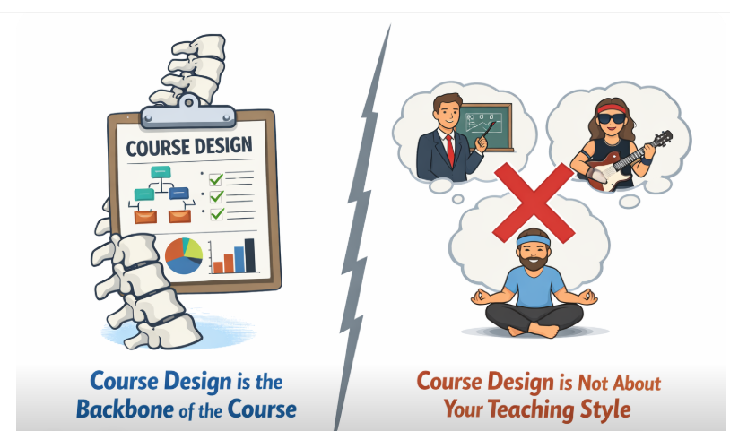
Notes:
Describe image on the screen

Slide 9
Curriculum and Course Design as Infrastructure
Curriculum and course design functions like academic infrastructure
Good design fades into the background
Poor design creates friction
You don’t notice infrastructure until it breaks—usually right before class.
Notes:
Course Design works like infrastructure, When it works well, no one notices.
You only notice infrastructure when it fails—usually five minutes before class begins, right?
Inaccessibility creates friction that pulls attention away from learning.

Slide 10
Digital Materials and Representation
Format affects who can access information
Structure, captions, and alternatives matter
Barriers are often invisible to the creator
Most barriers aren’t locked doors—they’re doors with the handle too high to reach
Notes:
Many access barriers are invisible to the person who creates the material. When creating our materials, we need to understand that:
Format affects who can access information. Paying attention to structure, providing captions, and alternatives matter.
Most barriers aren’t locked doors that keep everyone out—they’re doors with handles that are too high for some to reach.

Slide 11
Structure, Pacing, and Cognitive Load
Clear structure supports access
Predictable pacing reduces overload
Consistency supports navigation
When students say a course is confusing, they usually can’t find something.
Notes:
To take it a step further, When students say a course is confusing, they often don’t mean the ideas are confusing,
They often mean they don’t know where items are located.
That is a course design issue, not a student issue, not a pedagogy issue.
Read slide

Slide 12
Assessment Design as Access
Assessment format shapes access
Clear criteria is important
Rigor and accessibility coexist
Sometimes we assess learning—sometimes tolerance for a format.
Notes:
Not only must the content students are learning be accessible, so must our assessments, both summative and formative assessments.
Assessment formats can unintentionally restrict access.
Accessible assessment design helps ensure we are measuring learning, rather than how accessible our assessments are
And yes, Rigor and accessibility can and do coexist
When our course content and assessments are not accessible, we may be assessing tolerance for a particular testing format rather than assessing what students are learning.

Slide 13
Why Design Comes Before Accommodation
Proactive design reduces retroactive fixes
Built-in access is more sustainable
Fewer last-minute accommodation crises
Adding access later is like installing an elevator after the building is finished.
Notes:
Designing for access upfront is more effective than fixing problems later.
Retrofitting access is possible—but it is inefficient and can be very frustrating, for you and for your students.
We need to be proactive with accessibility upfront rather than reactive after the fact.
Creating accessible courses may reduce the number and types of accommodations that need to be implemented.
Not all accommodations can be eliminated by accessible course design, but many can be.

Slide 14
Shared Institutional Responsibility
Accessibility is not about individual fault
Faculty design curriculum and course; institutions support access
Shared responsibility enables scale
Shared responsibility means this isn’t one person’s fault.
Notes:
If I were a mind reader, I’d say many of you are thinking, but I’m just one person, I’m teaching five courses how can I do all of this in each of my courses?? The best answer is, you probably can’t, at least not on your own. Fortunately, Accessibility works best as a shared responsibility. Our institutions must be ready, willing and able to help us learn how to make sure our courses are accessible from the start.
This approach removes blame and supports sustainable access. We need to know who at our campus knows the technology needed to test for the accessibility of the materials in our courses. We need to know who can teach us how to make our materials accessibile on a 1:1 bases when necessary. We need to have an established process to retrofit our materials when this becomes necessary. In other words, we need to know who our support systems are.

Slide 15
Curriculum and Course Design for Access
Title II focuses on access to curriculum and course
Design enables compliance at scale
Accessible curriculum and course benefits many learners
The goal isn’t perfect courses—just fewer workarounds.
“Do the best you can until you know
better. Then when you know better,
do better.” - Maya Angelou
Notes:
Accessible course design is not about perfection. As our courses and technology evolve, we should always work towards full accessibility, but don’t be discouraged when you find bits and pieces here and there that are not accessible. Instead, make necessary changes and move forward. Maya Angelou said “Do the best you can until you know better. Then when you know better, do better.” and this is very applicable in terms of continuously looking for ways to make our courses more accessible.
The goal is fewer moments where students have to figure out how to navigate through the course instead of learning from it.
Course design is how we meet access expectations at scale one step at a time, or as you’ll see on the next slide . . . One bite at a time.

Slide 16
Designing for Accessibility …. One bite at a time
Universal Design
Notes:
Now we’re gonna get to the heart of this discussion and dig in deeper into what accessibility means and how universal design helps us to accomplish the goal of accessibility. Although there’s not enough time for me to walk you through, step by step, how to make each element of your course accessible, you’ll have access to this presentation and there are many easy-to-understand resources that’ll guide you through the process of making a variety of elements you may include in your courses accessible.

Slide 17
Powerful video from the government of England
Notes:
We all know that accessibility is the law. Some of you may design your own course content and some may utilize Instructional designers . What we all must consider, however, is the accessibility of the material placed into the course spaces or web spaces. The following 3 minute video from the government of England includes many important elements of accessibility. Although there are about 10 seconds of statistics that apply only to England, the rest of the video is applicable worldwide. (play video)
The US figures from the categories on the video are: 70 million people report having a disability, 90% acquired their disability during working age and Disabled people in the US have the spending power of 490 Billion dollars per year

Slide 18
Accessibility: What’s it all about?
Designing for Accessibility is NOT:
Hard (small changes make big differences)
Only for those with disabilities (impacts several audiences)
Someone else’s problem (we’re in this together)
An option (it’s a legal requirement)
Notes:
So, what is accessibility all about? First, let’s talk about what it is NOT. As you learned from the video, accessibility is not Hard; really, it is not difficult and it is important for you to know that small changes can and often do make big differences.
Have you heard the saying about how to eat an elephant, The answer is “one bite at a time”. This is also true in making your course materials accessible.
When I talk about the various elements of your course material that need to be accessible, it may seem like a daunting, elephant sized task, but I urge you to not look at the whole. Instead, break it down into bite sized, manageable tasks and tackle it, one element at a time.

Slide 19
Accessibility: What’s it all about?
Designing for Accessibility is NOT:
Hard (small changes make big differences)
Only for those with disabilities (impacts several audiences)
Someone else’s problem (we’re in this together)
An option (it’s a legal requirement)
Notes:
Designing for accessibility is not Only for those with disabilities (Accessibility and usability impact several audiences). For example, I wouldn’t have made it through my PhD program if I hadn’t been able to convert my course material into audio. That was a matter of my preferred learning style, audio vs. written, rather than any kind of disability. So had my instructors’ course materials not been accessible to a text to speech programs,, I probably wouldn’t have been very successful in my program

Slide 20
Accessibility: What’s it all about?
Designing for Accessibility is NOT:
Hard (small changes make big differences)
Only for those with disabilities (impacts several audiences)
Someone else’s problem (we’re in this together)
An option (it’s a legal requirement)
Notes:
Accessibility is not Someone else’s problem (we are all in this together). If we all work together, share ideas and resources like we’re doing now, the task is much more manageable.

Slide 21
Accessibility: What’s it all about?
Designing for Accessibility is NOT:
Hard (small changes make big differences)
Only for those with disabilities (impacts several audiences)
Someone else’s problem (we’re in this together)
An option (it’s a legal requirement)
Notes:
Accessibility is not An option (it’s a legal requirement). When someone tells me they don’t need to caption their videos because they’ve never had a student who is deaf in their course, I want to scream, but it’s the law! Instead, I help them to see the multiple populations who can benefit from captions.
I will add, however, that I know we’re all very busy and have limited time and limited resources. For this reason, I’ll once again emphasize “one bite at a time” and for those of us who are visual learners (next slide)

Slide 22
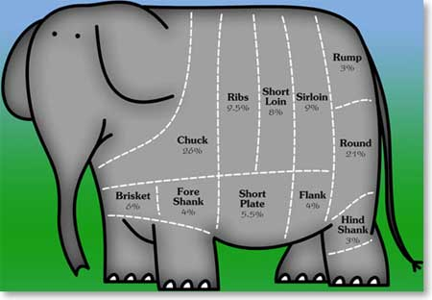
How to eat an Elephant
One Bite at a Time
Notes:
Take tasks on, One bite at a time. One step at a time, one piece at a time. I’ll describe the visual for anyone who may not be able to see it. On the screen is a picture of an elephant that is divided up into sections exemplifying one bite at a time.

Slide 23
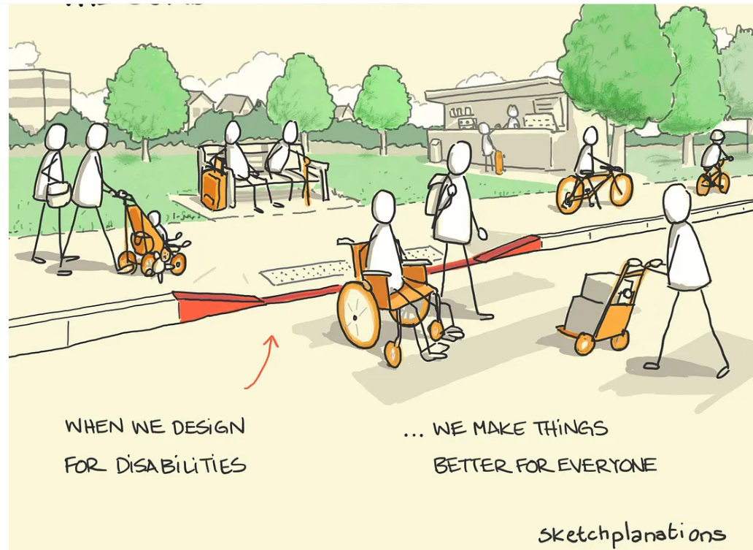
What is Universal Design?
Notes:
Now, Let’s switch gears for a moment and talk about Universal Design. Universal design (UD) is the concept of creating products, (such as our course content) environments (such as our buildings and classrooms), and services (such as libraries and cafeterias) that are inherently accessible and usable by all people to the greatest extent possible, without the need for adaptation, modifications or accommodations. Universal design aims to accommodate diverse abilities, ages, backgrounds and needs, ensuring inclusivity for everyone, as much as possible. In this image on the screen is Universal design in action. I’ll describe the image for anyone who can’t see the screen. The image appears to be a park setting with green trees and people sitting on a bench and other people moving around the bench. There is what appears to be a sidewalk with a curb cut leading into a street (refer to image) While the concept of a curb cut was originally created for people using wheelchairs, multiple people benefit from curb cuts. In this image, the populations who may use the curb cut are a cycler, someone with rolling luggage, someone with a baby stroller. Can you think of other populations who benefit from curb cuts?

Slide 24
Why is Universal Design Important to Higher Education?
• Increasingly diverse student populations
• Varying abilities, backgrounds, and learning preferences
• UDL proactively reduces barriers instead of retrofitting accommodations
Notes:
So, Why is Universal Design important to Higher Education? We are Increasingly supporting more and more diverse student populations: •
These diverse populations Vary in abilities, backgrounds, and learning processes or preferences
Universal design proactively reduces barriers for the diversity our student populations bring, instead of overreliance on retrofitting or accommodations.

Slide 25
What Is Accessibility?
Earlier we defined what accessibility is not.
Accessibility can be defined as:
The ability for an individual to effectively access or utilize a product, service, or facility — with or without accommodations.
Notes:
I’ve talked a lot about the term “accessibility” and while I told you what accessibility is not, it is time now to define what, exactly, it is:
Accessibility can be defined as: the ability for one to effectively access or utilize a product, service, or facility with or without accommodations.

Slide 26
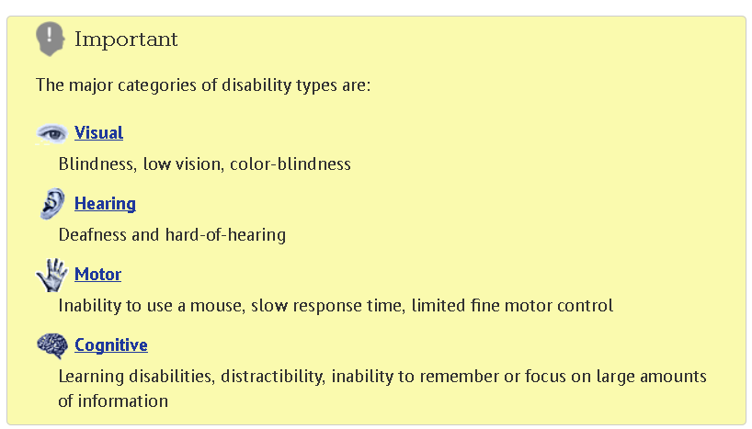
Categories of Disabilities from WebAim.org (Web Accessibility in Mind
Notes:
There are various types of disabilities; some are readily apparent and visible, and some are not. A disability may be visual in nature (read slide)

Slide 27
How is Universal Design related to accessibility?
Web Accessibility Perspectives
Text to speech (:53)
Video Captions (:47)
Keyboard Compatibility (:48)
Voice recognition (1:11)
Notes:
Because we tend to remember more if we can observe information, I want to spend the next 4 or so minutes allowing you to observe why accessibility of your course space is important for a variety of populations. As you observe the following information, see if you can pick up on the universal design components that are mentioned.
First is text to speech—that is, the text on the screen being read out loud. Can you think of situations in which someone may need or want to hear the text on the screen? (Blind, dyslexia) –play video. So, if our materials are not designed properly, a student’s screen reader, such as JAWS which stands for Job Access Without Sight, or their text to speech program cannot read the page, rendering your important information inaccessible to the student.
Next is video captions. In what situations might one need or want to be able to read what is on the screen instead of listening? (play video) Although screen captioning has become easier over the years, it still takes time and planning. If you know you’ll have a video in your course, plan ahead to have the video captioned, not only for the possibility of a student who must have captions, but also for the many other populations who would benefit from captions.
Next is keyboard compatibility –what do you think this means. What are some instances in which a person may not be able to use a mouse (physical disability, mouse broken, mobile use)? When planning your electronic forms, tests, quizzes, you’ll want to think about the potential of a person who cannot use a mouse or doesn’t have a mouse availaible. Play video
The next accessibility feature to consider is voice recognition—something many of us every day and might not even recognize this as an accessibility feature—who knows what I am talking about? (phone) In what other instances might one need or want voice recognition technology? (mobility impairment, processing issues,) play video

Slide 28
What’s an instructor to do?
Understand that:
People with a variety of disabilities utilize text to speech programs or screen readers to access their course material. A screen reader is software that processes text and reads it aloud.
Microsoft Accessibility Resources
Checking your Word document for accessibility
Apple Accessibility
Notes:
So, given what may seem like a monumental task, what’s an instructor to do? First and foremost is to gain an understanding of the issues. That is what we are working through today. Let’s use text to speech programs as an example. It is important for each of us to understand that People with a variety of disabilities, backgrounds and preferences use text to speech programs to access text or in other words, to read their course material. A text to speech programs and screen reader programs are software that process text and reads it aloud. However, in order for this software to process the text, it must first be able to access the text.
One way to tell if the text you’re going to post in your course space is accessible is to see if you are able to highlight and copy and paste the text. If the answer is yes, then the text of your document is probably accessible for a student who uses a text to speech program or a screen reader. If the answer is no, then a student who uses these software programs such as a student who has a visual impairment or is blind or a student with a reading-based disability or someone like me whose primary learning style is auditory, will not be able to access your document. If you find this to be the case, you can correct this by following the instructions in the tutorials on this slide or by contacting the resources you have on campus.

Slide 29
What’s an instructor to do, cont’d
Understand that:
In many cases, individuals using screen readers navigate Web pages and course documents using a keyboard only. Structure is crucial; without the use of a mouse, one is dependent on how a document is “set up”
Accessible Power Point tutorial
Accessible Word document tutorial
Checking your Word document for accessibility
Notes:
As instructors, we must also Understand that:
In many cases, individuals using screen readers don’t have access to a mouse or may have an injury and can only navigate digital content using a keyboard. So, imagine going through your course pages without ever being able to use a mouse.
Before posting your document in your course space, see if you’re able to access every element of your course using only your keyboard. If you aren’t able to do so, your documents will not be accessible for a student who is unable to manipulate their computer screen with a mouse. If you run into this issue, you may resolve the issue after reviewing the tutorials on this slide.

Slide 30
What’s an instructor to do, cont’d
3. Look for captioned videos and/or provide transcripts of videos:
how to make captioned videos
4. Provide “meaningful alt text” on graphics/pictures:
how to add “alt text”
Notes:
We must also understand that, for people who cannot hear or who may be reviewing our course materials in a noisy environment, captions are necessary. There are many videos available on the Internet that already have captions. Whenever I use google or search YouTube for a video, I always include the topic I’m searching for along with the word “captioned”. If you can’t find a captioned video for your purposes, you can provide a transcript, but captions are a much better option. I believe that SIU also has a tool called YuJa that can be used to add captions to videos. Another option, as a last resort, is to produce your own video and load it into YouTube. The first link on this slide will walk you through the process of adding captions to your own YouTube videos. A note of caution, however, is that you must proofread the captions before using—otherwise the results can be very funny (or embarrassing).
Although there are many, many more elements necessary to make documents accessible, the final one that I want to review is adding meaningful alternative texts, also known as “alt text” to your graphics or images; this allows a person who can’t see or visualize your graphic or image to still access the message you’re trying to convey. I want to emphasize “meaningful” ; this is important so that the student who can’t see the image can still benefit from the image as much as the person who can see it. Typing out the word “graphic” or “picture” as the alt text, for example, will hold no meaning for the person trying to interpret what, exactly, your picture or graphic is trying to convey.

Slide 31
Other Considerations
Good course design benefits all learners, not only those with disabilities.
Concentration should be placed on content rather than flashy graphics or audio.
Following are some simple guidelines to meet the needs of various users.
Notes:
Along with the previous hints and suggestions, I’d like to add a few more: Good course design benefits all learners, not only those with disabilities.
Concentration should be placed on content rather than flashy graphics or audio.
Following are a few more simple guidelines to meet the needs of various users.

Slide 32
Screen layout
Maintain a simple, standard page layout.
Buttons, links and logos should appear in the same place throughout the site and not move position from page to page.
Notes:
Screen Layout
Maintain a simple, standard page layout. Buttons, links and logos should all appear in the same place throughout the site and not move position from page to page. Why do you think this could be important

Slide 33
Background
Keep backgrounds simple and make sure that there is adequate contrast between the background and the text.
Notes:
Background
Keep backgrounds simple and make sure there is adequate contrast between the background and the text. Why is this important

Slide 34
Buttons
Make sure that buttons are large enough to be accessed by someone with limited fine motor skills using a standard mouse. Button location should also be predictable.
Notes:
Buttons
Make sure that buttons are large enough to be accessed by someone with limited fine motor skills using a standard mouse. And also make sure your buttons are accessible by keyboard only for anyone who can’t use a mouse or doesn’t have a mouse available.

Slide 35
Graphics
Provide alternate text for each graphic and include descriptive captions for pictures.
Notes:
Graphics
Provide meaningful alternate text for each graphic and image .

Slide 36
Link Descriptions
Make links descriptive so that they are understood out of context. Label links to embedded documents – instead of www.elearning/assign1/css101/, try: Assignment 1
Notes:
Link Descriptions
Make links descriptive so they are understood out of context. Label links to embedded documents – instead of a long URL www.elearning/assign1/css101/, try typing out Assignment 1 and embed the link.
Of course, if someone prints out your document, they will need access the full URL, and best practices tell us that if we want to or think we should include the URLs, they should all be placed together at the end of the document.

Slide 37
Audio
Audio
Be sure to provide captioning and transcription for video or sound clips.
Notes:
Be sure to provide captioning for video or sound clips.

Slide 38
And Plan Ahead
Learning platforms are usually accessible
But it is up to you to ensure
the materials you post to the
platforms are accessible . . .
One bite at a time
Notes:
Learning platforms are usually accessible, But it is up to us to ensure the materials we post to the
platforms are accessible . . .
One bite at a time

Slide 39
Resources
Accessibility video (audio only format)
Web Accessibility Perspectives: 10 topics/videos
Accessible Power Point tutorial
Accessible Word document tutorial
Checking your Word document for accessibility
How to make captioned videos
“Alt Tags”
More Tips

Slide 40
Resources with Links
Powerful video from the government of the UK
Accessibility video (audio only format)
Web Accessibility Perspectives: 10 topics/videos
Accessible Power Point tutorial
Accessible Word document tutorial

Slide 41
Resources with Links
Checking your Word document for accessibility
How to make captioned videos
“Alt Tags”
More Tips

Slide 42
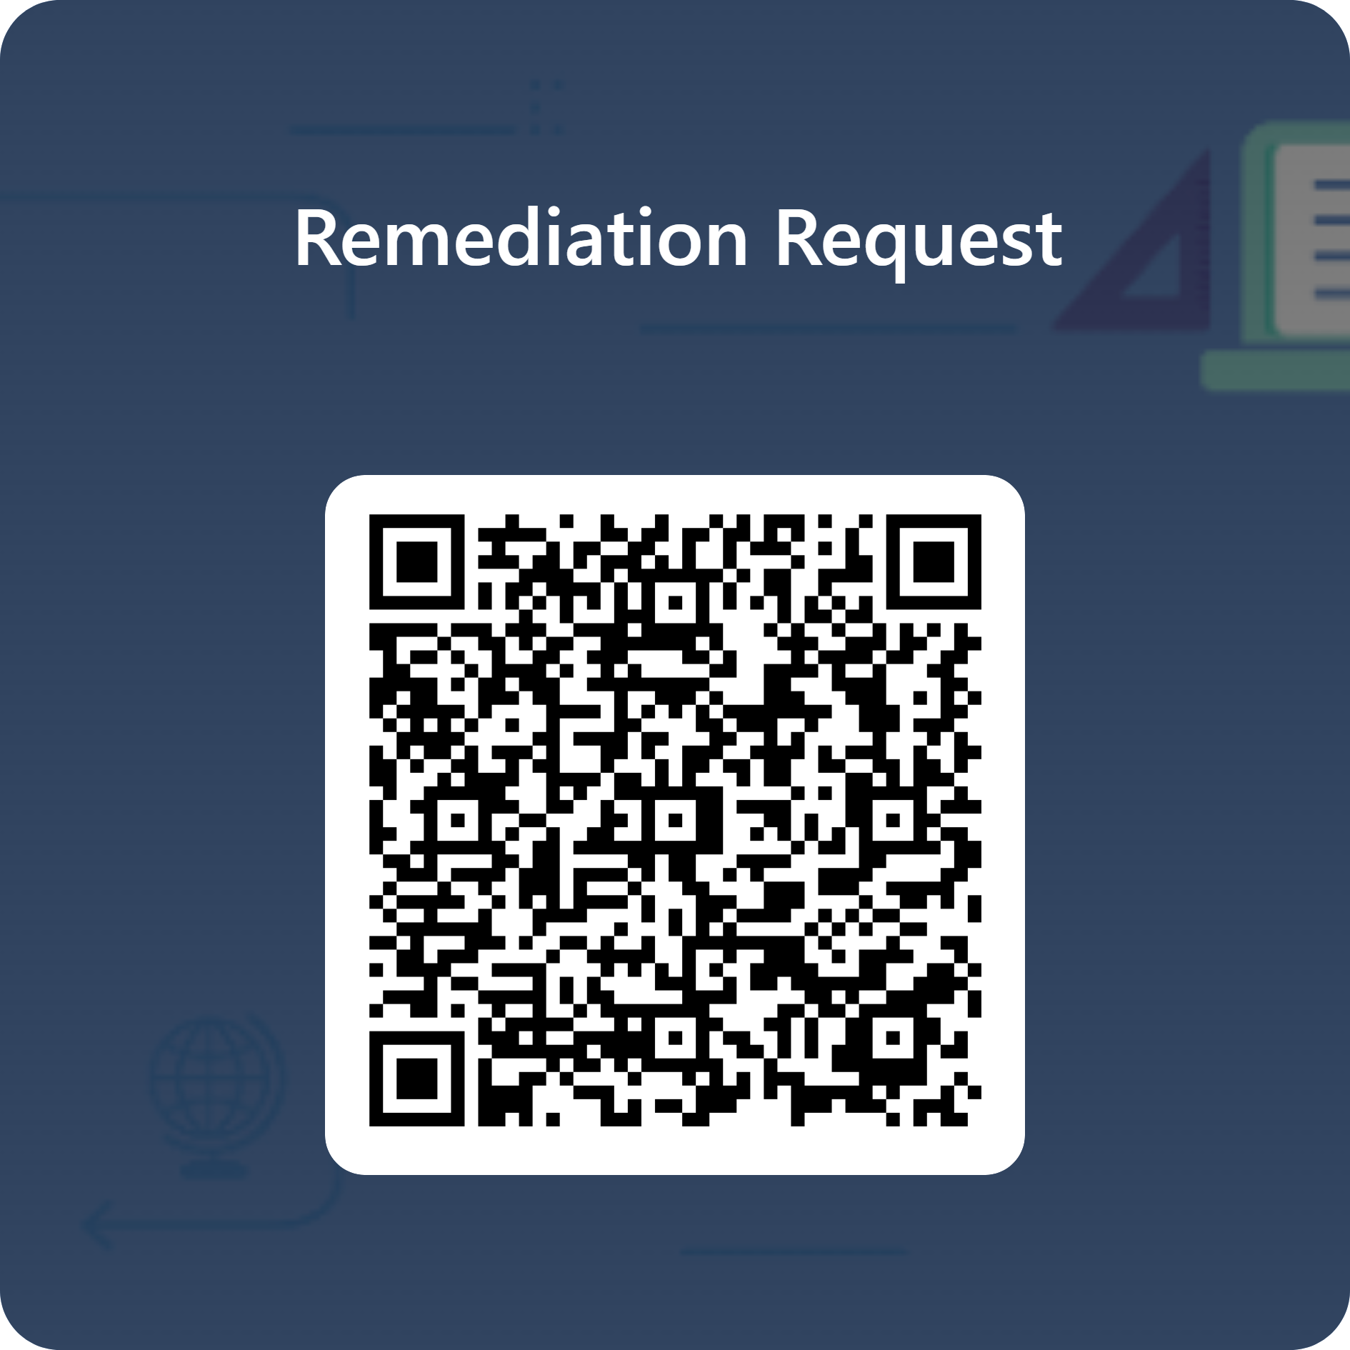
SIUE Resources
Course Shell Remediation Request
Email Contact – Connects with ACCESS, IDLT, and CFDI Accessibility@siue.edu
Digital Accessibility Help Desk
M-F 8am-4:30pm, Lovejoy 2048 (inside the Center for Faculty Dev. and Innovation)
Digital Accessibility Open Labs, Wednesday, March 4th 8-10am, Science East 2268
Thursday, March 19th 2-4pm, Founders Hall 0303
Monday, April 6th 10am-12pm, Dunham Hall 2009
Digital Accessibility Workshop Series
Registration & Recordings available on the CFDI Website

Slide 43
Questions?
Cindy Poore-Pariseau, Ph.D.
Director, Disability Services
Rutgers Health
cindy.poorepariseau@rutgers.edu
(C) 973-640-0058
Notes:
I know that was a lot of information to take in in a short period of time. If you have any questions or would like any additional information, call, or send me an email. My email address is cindy.poorepariseau@rutgers.edu. My phone number is 973-972-5396 and the office fax number is 973-972-7596 Thank you and welcome from the Office of Disability Services.

