Slide 1


West Granite City Storm Water Sewer System
Final Presentation
Bradley Kullmann, Brock Mitchell, Chase McCorkle, Jordan Lewis

Slide 2
Contents
Introduction
Current Issues
Current System
Drainage area
Design Criteria
New sewer system and Lay out
Retention basin
Auxiliary pump
Construction methods
Cost estimate
Sustainability
Permit Considerations
Risk Analysis
Acknowledgements

Slide 3


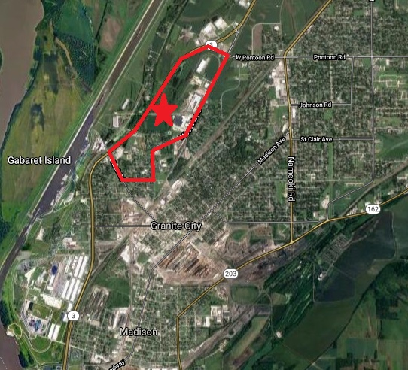
Introduction
Location: West Granite City, Madison County Illinois
Design new system to relieve flooding issues
Retain rainwater with a slow release
Prevent back up flooding of west granite through system

Slide 4
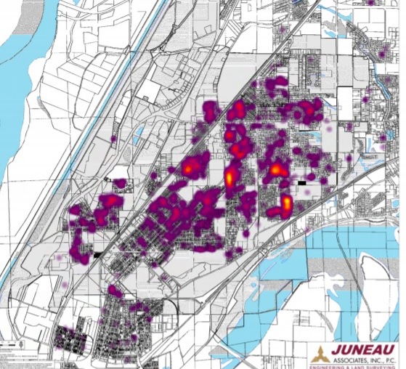
Current issues
Regular flooding of basements and streets of west Granite City under heavy rain events.

Slide 5
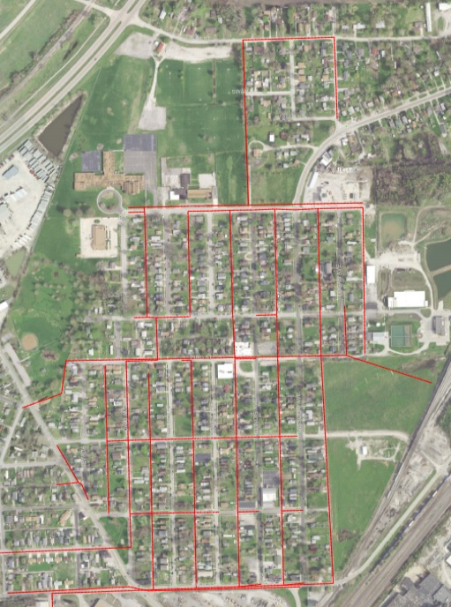
Current Sewer System
Combined Storm and Sanitary System
System is overloaded during heavy rain events and often will cause back up flooding of homes and streets
No retention basin
Outflow into east granite city.
Outflows

Slide 6
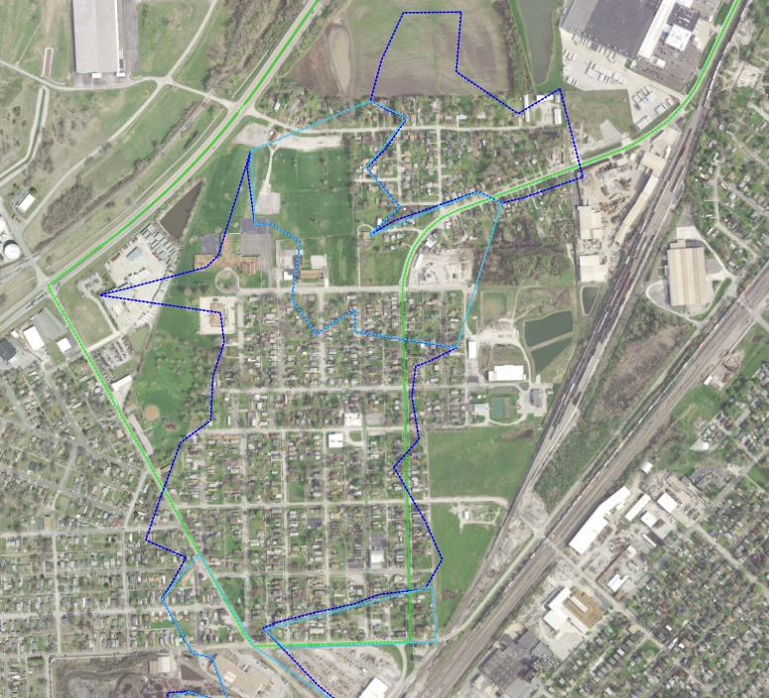
Drainage Areas
Used lidar data provided by Juneau to draw maps.

Slide 7
Design Criteria
Health and Safety of Inhabitants is #1.
Cost Effective means of preventing flooding
Protection against future increased flooding
Green infrastructure considerations
Use standard construction materials and methods
Maximize on-site retention ponds

Slide 8
New sewer lay out
Outfalls water to retention pond – Not into East Granite city
new 12” feeder sewer pipes that separate the sanitary system from storm system
new inlets at street corners and new manholes
New main trunk line that goes from south to north in alley between Dewey Ave. and Illinois Ave. at 0.2% slope
Main trunk Line starts as one 12” pipe and ends as two 72” pipes.
Designed for 10-year 30-minute duration rain event

Slide 9
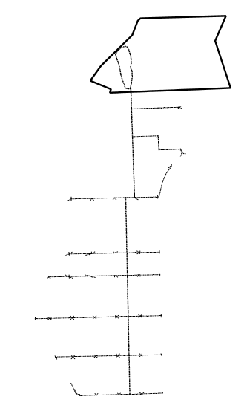
New Sewer System
System was designed based off maximum flow from the three drainage areas.
Average pipe Gradients are not attainable from level ground

Slide 10
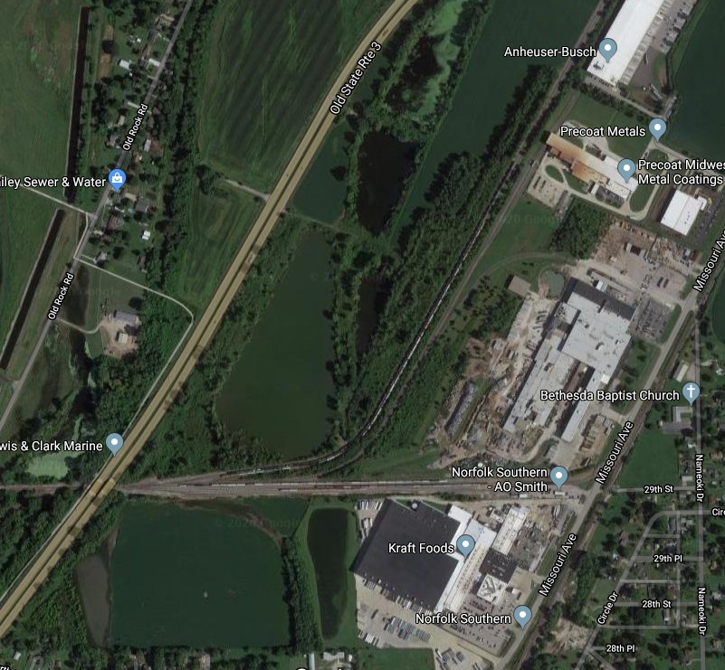
Retention Basin
utilize the whole southern parcel as one retention pond (37.2 acres 5 ft deep)
Current On-Site Ponds

Slide 11
ADVATAGES OF ONLY ONE RETENTION BASIN
ONE LANDOWNER
INCREASED WATER CAPACITY
EARTH WORK – $6 CBYD VS $1200 PER FT PIPE RAMMING A CULVERT
SMALLER AUXILARY PUMP FREES BUDGET FOR EMERGENCY GENERATOR
REDUCED RISK TO citizens

Slide 12
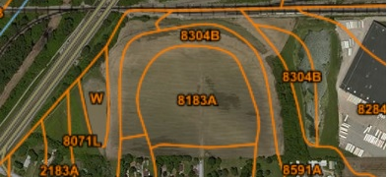
Retention Pond design
Designed to slowly release water through soil/sand layer into the aquifer
Soil percolation rate of 0.45 cfs USDA Soil Survey
100-year rain event in 30-minute duration (6.06 in/hr)
Peak allowable in-flow Rate 601.82 cfs
Prevent back up flooding into system

Slide 13
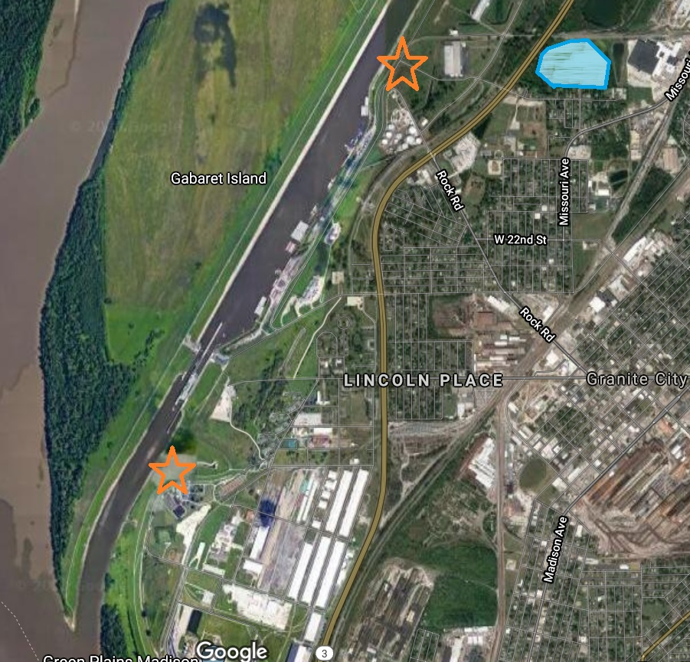
Auxiliary Pump
Removes excess water in retention pond under emergency situations
Outfall- Mississippi river or chain of rocks canal
Ensures protection from flooding if larger then design in flows happen

Slide 14
Construction Methods
Design uses typically construction methods of sewer pipe installation according the IDNr Manuals.
Back fill for pipes to consist of approved engineered back fill (Minus Rock under Structural elements and soil in green spaces)
On-Site and Lab Testing will be needed to ensure construction is built to spec.
Complete replacement of alley above main sewer line trunk – 10 ft
Use permeable asphalt 3” thick to reduce run Off
Normal weight asphalt 3” thick and 3 ft strip to be constructed for feeder pipes

Slide 15
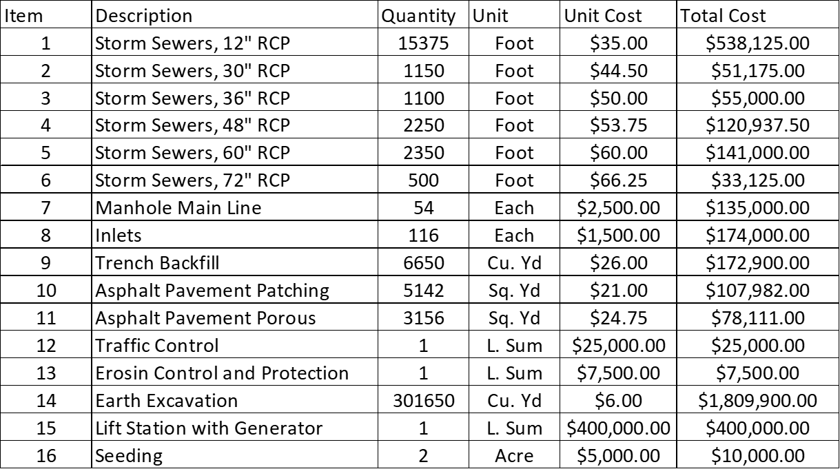
Cost Estimate
This list provides a subtotal of approximately $3.9 million
Other costs such as mobilization, acquisition, and construction need to be Considered as well

Slide 16
Cost Estimate
Total Estimated cost of the project is $6 Million

Slide 17
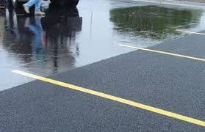
Sustainability
Supports local economic growth
Locally Sourced Materials
Concrete pipes
Back fill
Permeable asphalt for alley way
Reduces run off into system
Improves current on-site conditions of gravel

Slide 18



Permit considerations
United States Army Corps of engineers NPDES permit to outflow water in Mississippi river from auxiliary pump
IDNR Endangered species permit
General construction permit from granite city
Idnr - Shpo permit for historical preservation

Slide 19
Risk Analysis
Recognized risk of continual flooding to the citizens of West Granite City if changes are not made
Sewer pipe system Designed for 10-year 30-minute duration rain event (3.66 in/hr).
Retention basin Designed for a 100-year rain event with a 30-minute duration. (6.06 in/hr)
Not a guarantee that a 10 or 100-year rain event will only happen once in 10 or 100-years, but it’s a probability of its reoccurrence
Changes to this design or omittance of certain aspects can result in increased risk
New sewer system may be overloaded during rain event greater than 10-year 30-minute duration design spec.

Slide 20

Acknowledgments
Brian Kulick of Juneau & Associates
Staff and Facultiy of SIUE
THANK YOU!

Slide 21
Resources
IDOT Drainage Manual. Illinois Department of Transportation, Bureau of Bridges and Structures, 2011.
https://www.google.com/search?q=juneau+engineering+logo&rlz=1C1CHBD_enUS888US888&source=lnms&tbm=isch&sa=X&ved=2ahUKEwi0y-379f_oAhURWqwKHWUGB3gQ_AUoAXoECAwQAw&biw=1280&bih=610#imgrc=5dxug5RW92jpYM
https://www.google.com/search?q=siue+logo&rlz=1C1CHBD_enUS888US888&oq=SIUE+logo&aqs=chrome.0.69i59j0l6.4600j0j9&sourceid=chrome&ie=UTF-8
https://www.google.com/search?q=porous+asphalt&rlz=1C1CHBD_enUS888US888&source=lnms&tbm=isch&sa=X&ved=2ahUKEwiet5S6_P_oAhUOKa0KHVmxBLwQ_AUoAXoECA0QAw&biw=1280&bih=610
https://www2.illinois.gov/dnr/Pages/default.aspx
https://www.usace.army.mil/
https://www.google.com/maps/place/Granite+City,+IL/@38.7187193,-90.1568069,568m/data=!3m1!1e3!4m5!3m4!1s0x87df51f57da79853:0xc829fc9168c2e514!8m2!3d38.7014389!4d-90.1487199
http://www.granitecity.illinois.gov/
https://www.co.madison.il.us/

Slide 22
Thank You!
Questions?

