Slide 1
Sports Park Drive Design
Crawford, Murphy, & Tilly Engineers & Consultants
Senior Design CE 493 – SIUE- Spring 2020
Group members
Ali Alsamir
Jacklynn Calvert
Jasper Capriotti
Michael Crow

Slide 2
Presentation Outline
Project Description and Location
Sign Details
Cost Estimates/Materials
Stormwater Drainage system Design
Typical Section
Pavement Design
Cross-section
Design vehicles
Horizontal curves
ADA and ADAAG ramps
Sustainability/Risk Analysis

Slide 3
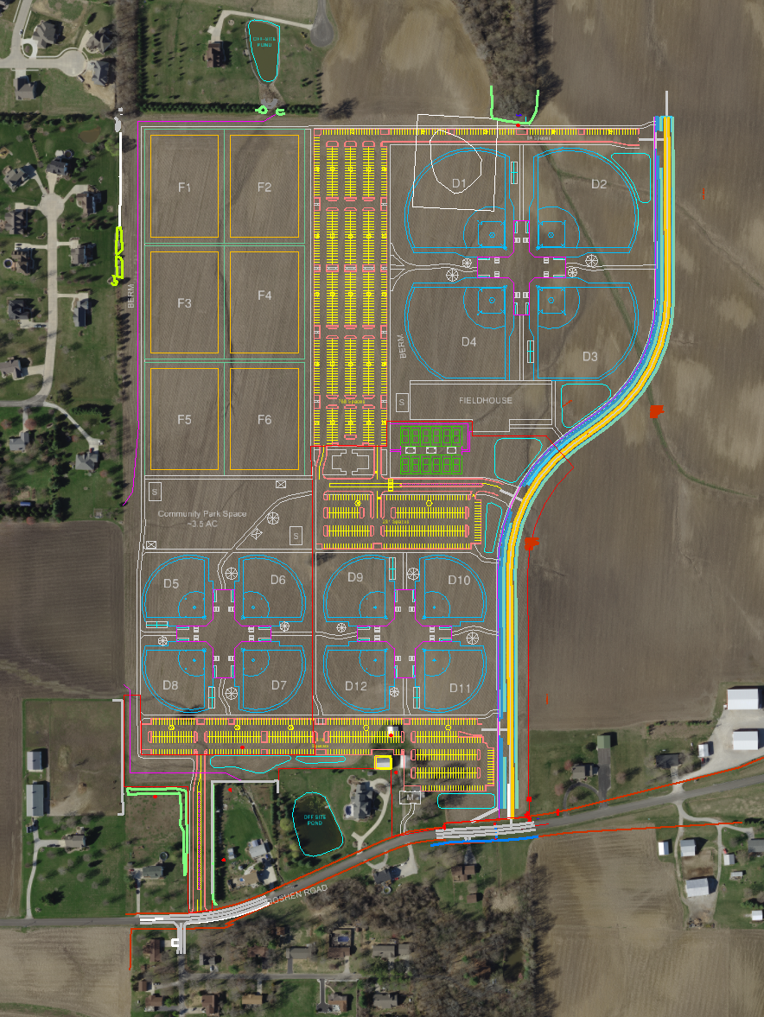
Project Description
Design a new roadway (Sports Park Drive) for a proposed new sports park in Edwardsville, IL.
Roadway must meet design standards (including drainage) and accommodate entrances to the Sports Park site plan.
Location: Goshen Road to approximately 0.4 miles north through greenfield, ending at a logical point to tie in an adjacent project (Pin Oak Development)

Slide 4
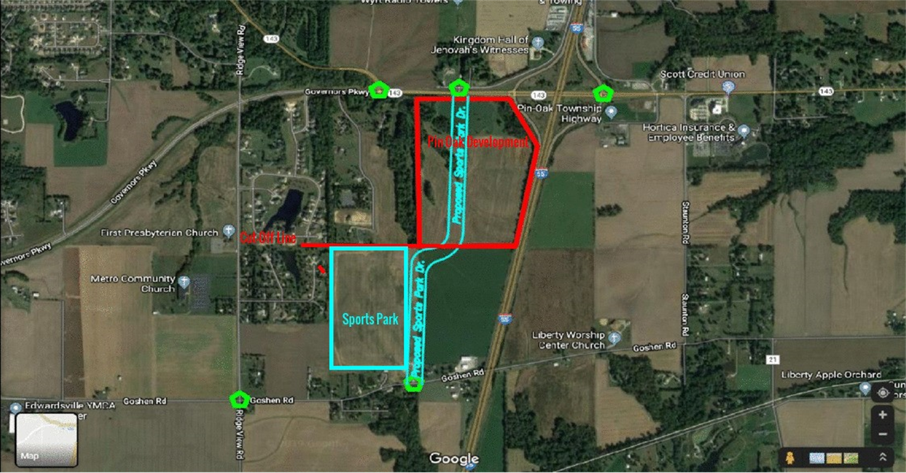
Project Location

Slide 5
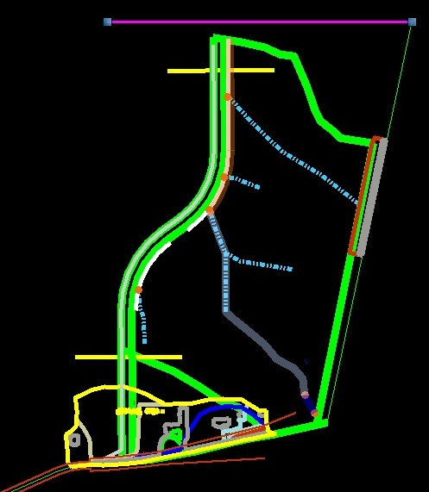
Phase 1 : Stormwater Study Drainage ditch Profile
2 watersheds depend on the water flow direction/ Area topography:
Watershed 1 (North): 43.6 Acres
Watershed 2 (South): 5.5 Acres
50-year return period hydrology analysis, IDOT-Drainage manual 2018.
Rational method Q=C.i.A

Slide 6
Drainage Hydrology Study
Phase 2: Culverts Analysis
10-year Return period for the stormwater analysis
Robert Manning’s hydrological analysis
culvert pipe Dia.= 12 inch [1 ft]
Phase 3 : Pavement Drainage
Pavement Drainage, Inlets Spacing study
11 inlets total (pairs)
2 Inlets type :
Sag profile : Grate Inlet Type 3V
Grade profile: Grate Inlet type 24

Slide 7
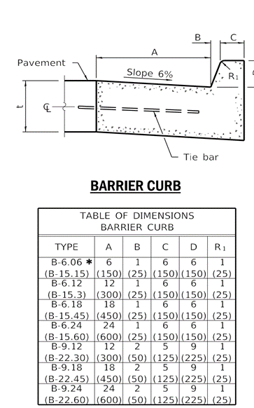
Typical Section
A ‘typical section’ is a detailed cross section which depicts the principal elements that are standard between certain station or milepost limits.
Multiple are often needed for a project. For example, a typical section might be added to show driveways, changes in the number of through lanes, the addition of dedicated turn lanes, the addition of medians, etc.
For this project, a three-lane section will be used with a Barrier Curb Type-B.24. This is a 24” inch curb which will allow for 2’x 2’ drainage grate inlets to be set inside the gutter
Requirements for this design come from the IDOT BLR Manual

Slide 8
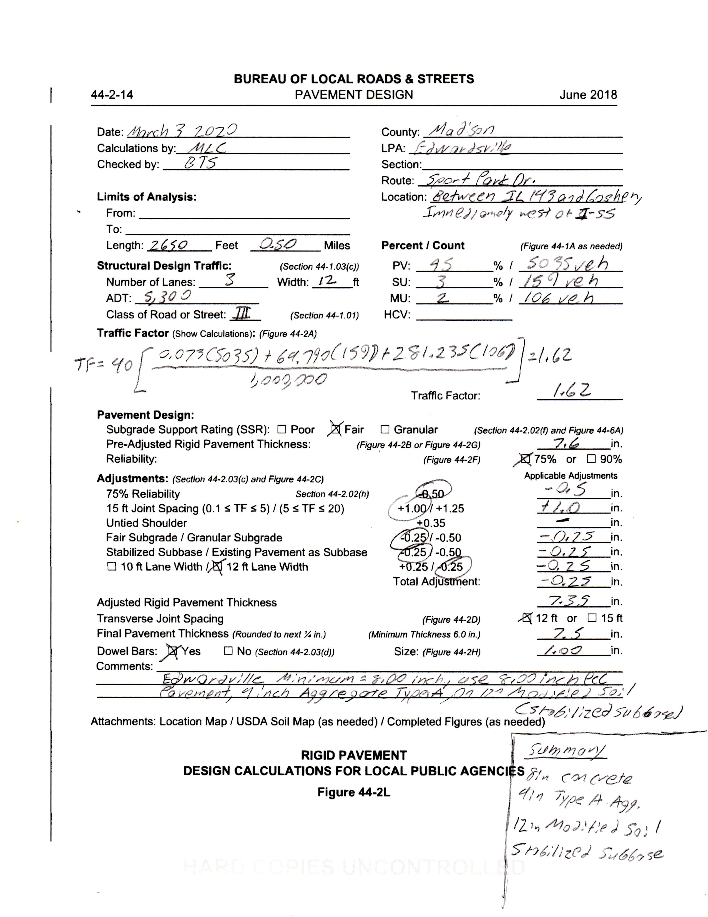
Pavement Design
The City of Edwardsville wanted a concrete road for Sport Park Dr.
Because this road is a new one begin made the road classification and design requirements had to be found.
This had to follow the design requirements by both the city and IDOT
This design comes from chapter 44 of the IDOT BLR Manual
ADT number comes from a study CMT did
The city required a minimum of eight inches of PCC, a type A aggregate to be used and 12 inches of a modified soil subbase
The pavement design had to be shown for both the typical section and the cross section

Slide 9
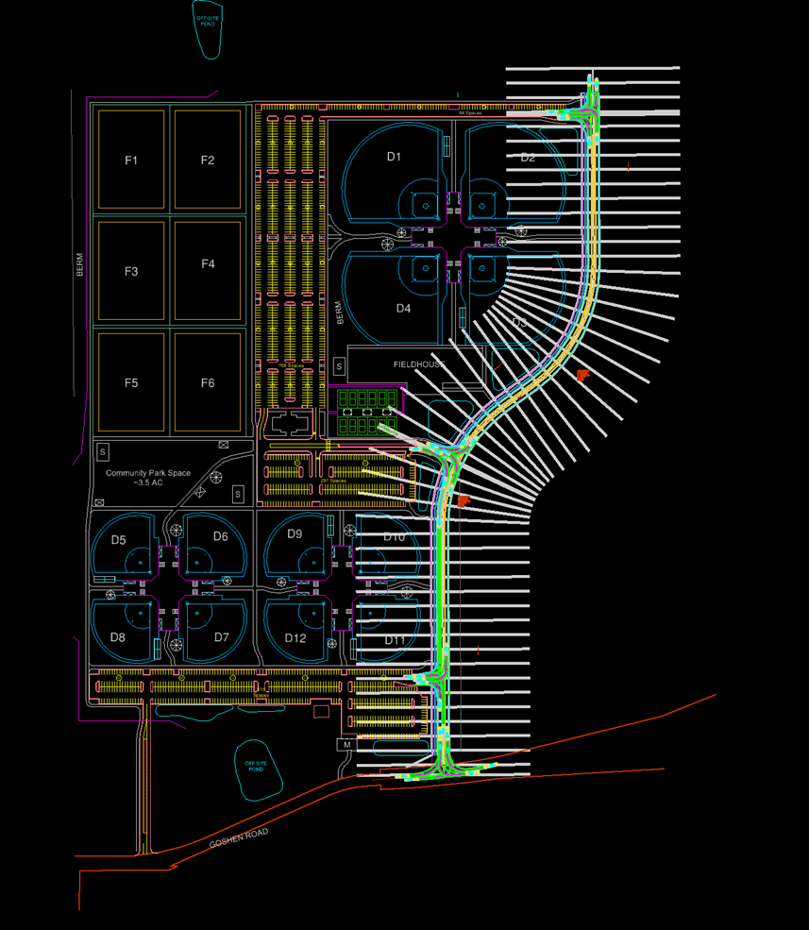
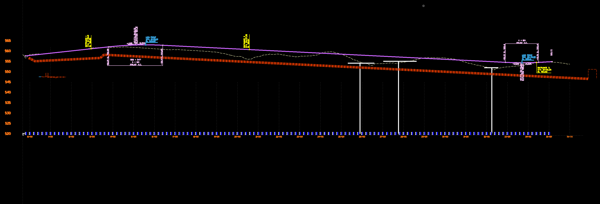
Cross Section
Cross sections are a horizonal view of the road made every set amount of feet at strategic locations which might require specific attention
For this project, the cross sections begin at Goshen Road (STA 10+00.00) and end at a logical terminus point to the north (STA 36+00.00), for a total distance of 2650 feet (0.5 miles)
Ditch had to be reformed to allow for ease of construction and ease of drainage design

Slide 10
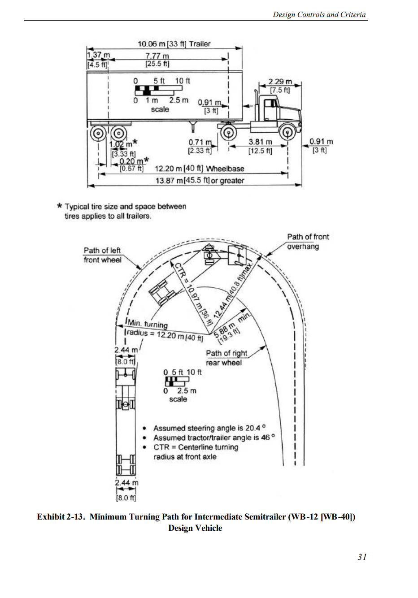
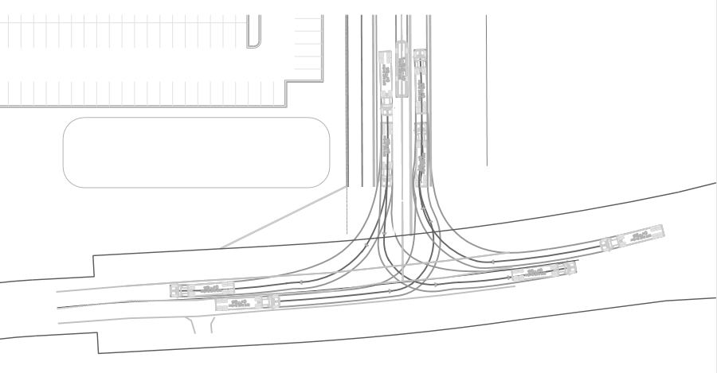
Horizontal Curves
WB-40 AASHTO 2018 (US)
A Policy on Geometric Design of Highways and Streets Fourth Edition (2001)
AKA: AASHTO Green Book

Slide 11
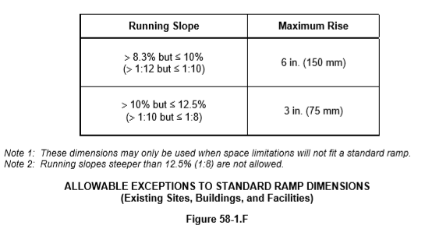
Americans With Disabilities Act (ADA) Compliance
Illinois Bureau of Design and Environment Manual 58-1.08 Ramps (Left)*
Illinois Bureau of Design and Environment Manual 58-1.09(c) Detectable Warnings (Not Shown)*
Illinois Bureau of Design and Environment Manual 58-1.09 (e) Crosswalks (Not Shown)*
Illinois Bureau of Design and Environment Manual 58-1.10 Roadway Approach Grades (Not Shown)*
* More Details in BDE or BLR Manual

Slide 12
Sustainability
This project will be maintained on an as needed basis.
The gutter and drainage systems will be regularly checked to ensure there is no clogging.
The pavement will be evaluated at regular intervals to ensure damages such as cracks and potholes to not exist.
Maintenance on this site will be left to the City of Edwardsville and Illinois Department of Transportation.
12

Slide 13
Risk Analysis
If any possible risk appears during the construction phase of the project we will need to:
Identify the risk
Analysis the risk
Develop a plan
Most of these plans will most likely result in the work of project being delayed if it can be fix quickly
As a result of these delays the city will be informed about it.
Due to the project still in the preliminary phase of the plan it is subject to change.
13

Slide 14
Cost Analysis

Slide 15
Special Thanks!
Crawford, Murphy & Tilly Engineers & Consultants
Brad Spanberger, E.I.T
Jack Blakemore, P.E.
For making all the resources available for us to make this project successful.

Slide 16
References
AASHTO. (2001). A Policy on Geometric Design of Highways and Streets. Washington, D.C.: American Association of State Highway and Transportation Officials.
IDOT. (December 2018). Bureau of Local Roads and Streets Manual. Springfield, Illinois: Illinois Department of Transportation, Bureau of Local Roads and Streets.
IDOT. (February 2020). Bureau of Design and Environment Manual. Springfield, Illinois: Illinois Department of Transportation, Bureau of Design and Environment .
IDOT. (July, 2014). Illinois Standard Highway Signs Book. Springfield, Illinois: Illinois Department of Transportation, Bureau of Operations.
IDOT – Drainage manual 2011, Illinois Department of Transportation, Bureau of Local Roads and Streets.
MUTCD. “Design Guidelines.” MUTCD, 2019, mutcd.fhwa.dot.gov/SHSm/design.pdf.
U.S. Department of Transportation Federal Highway Administration. (2012, May). 2009 Edition of MUTCD. Retrieved from 2009 Edition with Revision Numbers 1 and 2 Incorporated: https://mutcd.fhwa.dot.gov/pdfs/2009r1r2/pdf_index.htm.
Yanchulis, Dave. “ADA Accessibility Guidelines (ADAAG).” ADAAG, Sept. 2002, www.access-board.gov/guidelines-and-standards/buildings-and-sites/about-the-ada-standards/background/adaag#4.7.

Slide 17
Questions?
Email us!
We can be reached here:
Jacklynn Calvert: jcalver@siue.edu
Ali Alsamir: aalsami@siue.edu
Jasper Capriotti: jcaprio@siue.edu
Michael Crow: microw@siue.edu

