Slide 1
Senior Project Presentation
Joshua Dorries, Martin Witges, Robert Foy

Slide 2
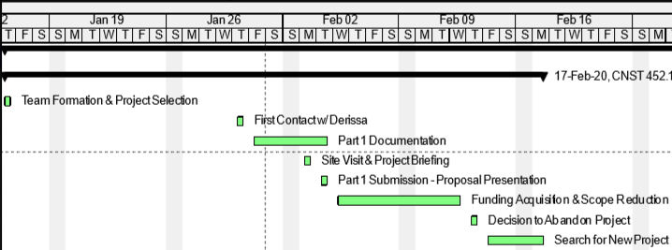
Shed Project
Original project was a garden shed/garage for the Tiny Children's Garden in Washington Park
Began project by completing initial steps:
Met with owners
Established a scope of work
Devised a preliminary schedule
Created a cost estimate

Slide 3
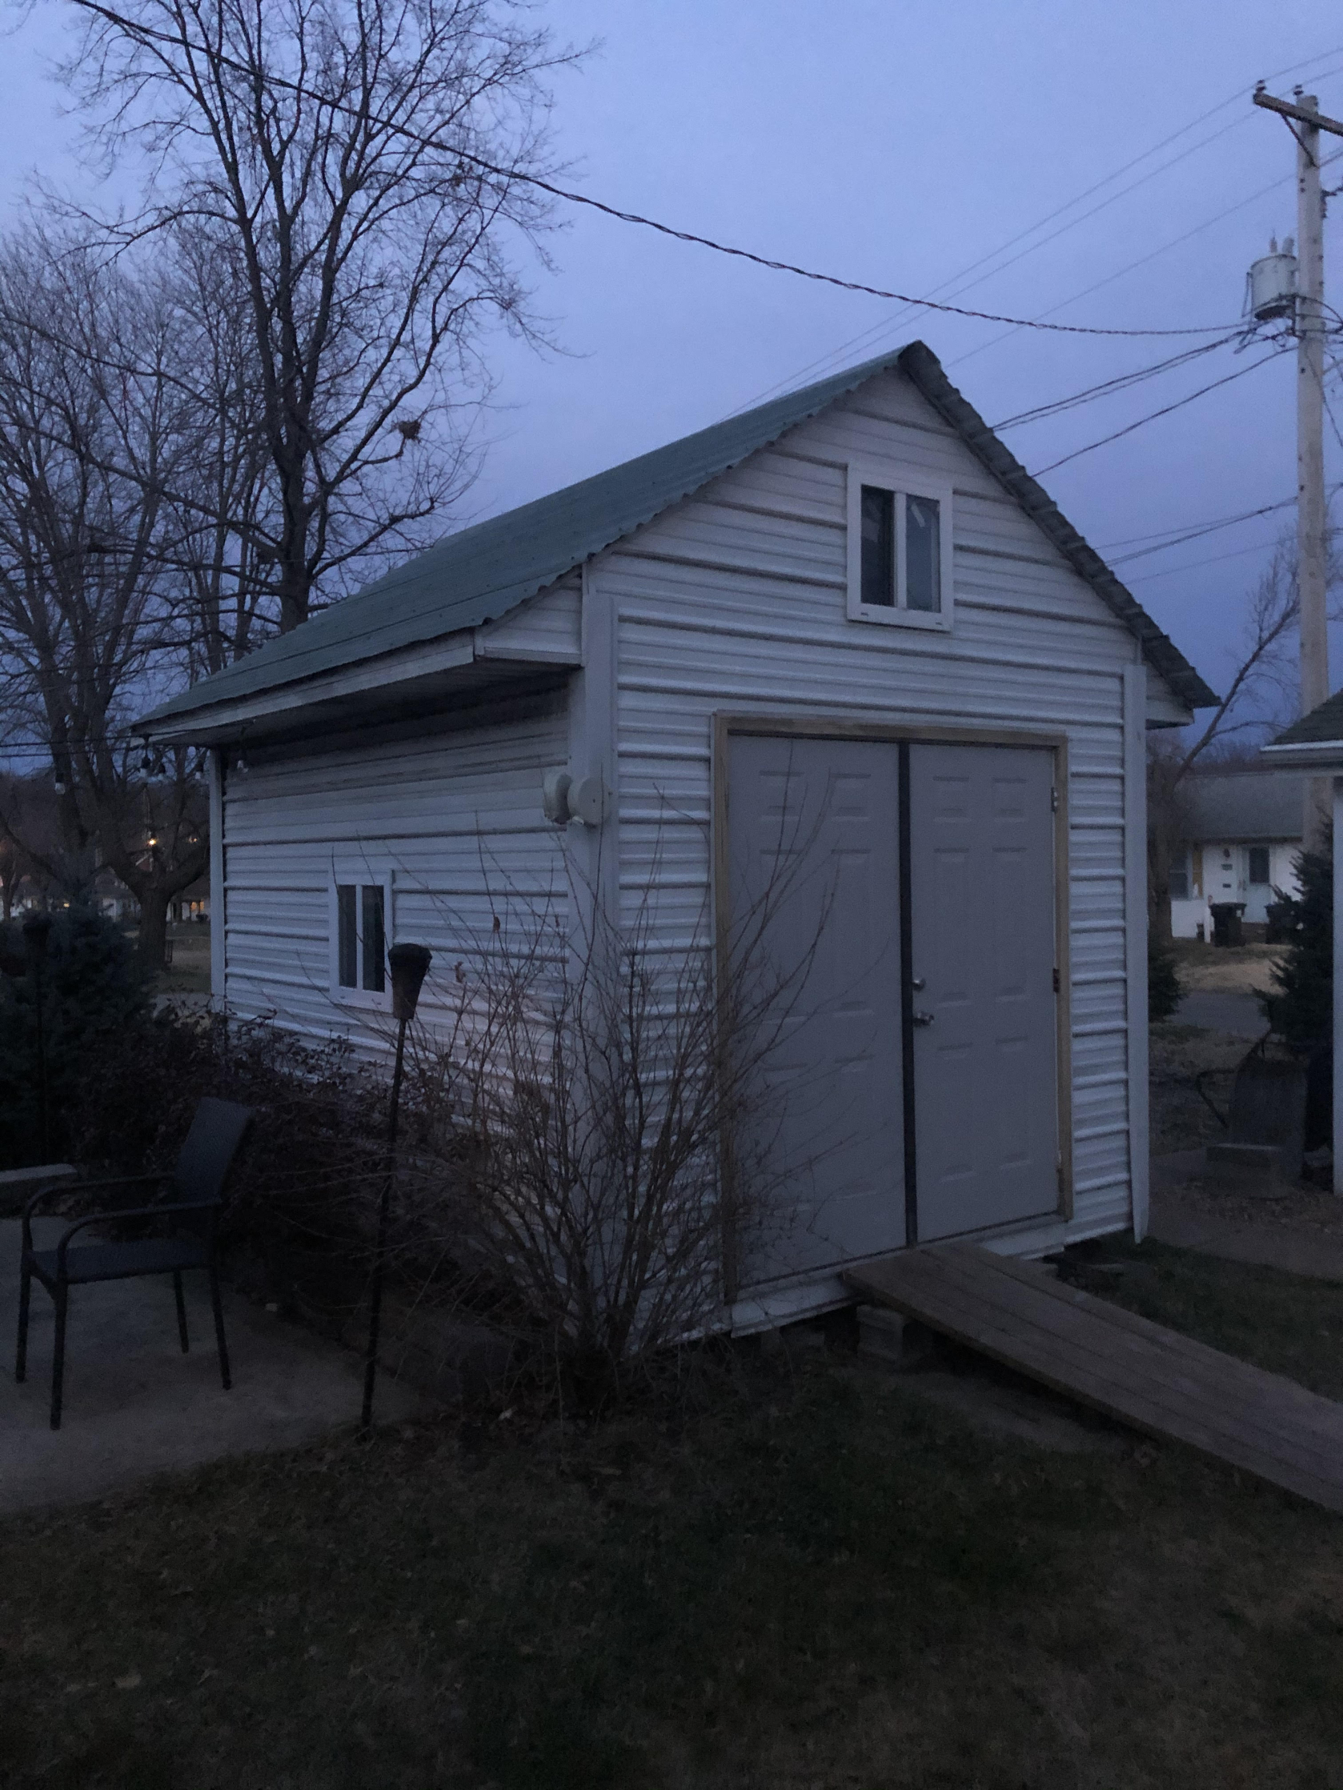
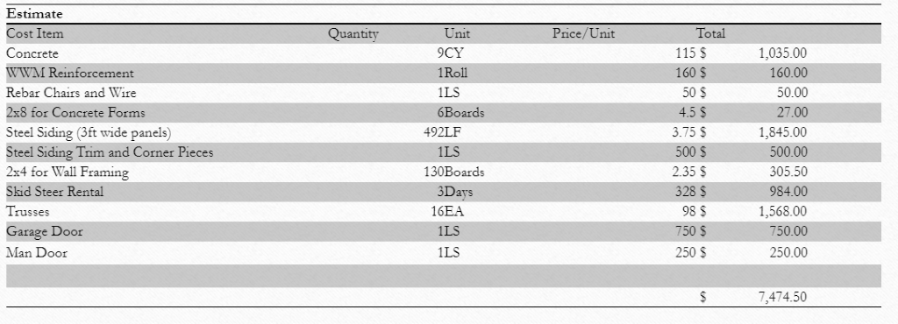
Shed Project
Decision to move on:
Lack of funding
Size of scope
Skills and qualifications we didn't have

Slide 4
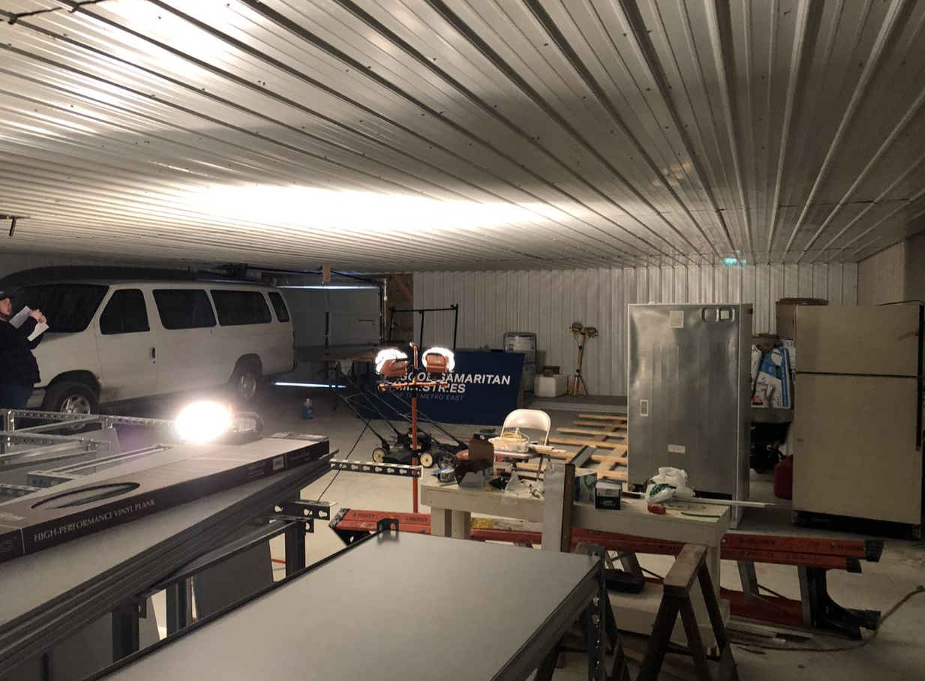
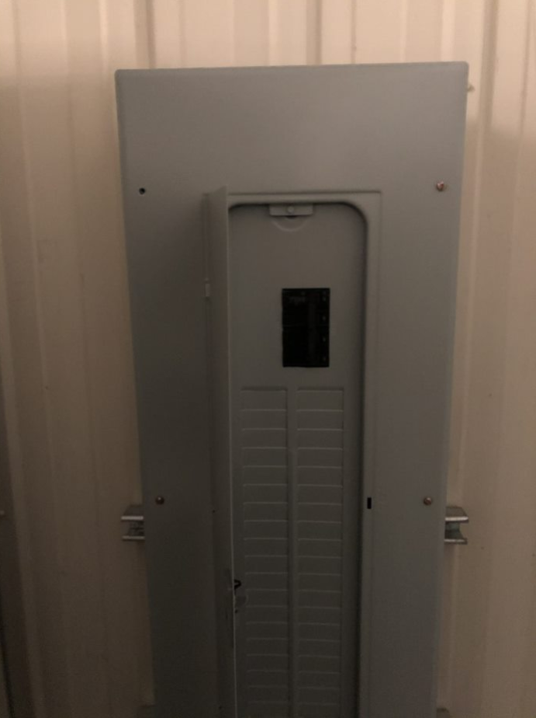
Introduction
Our project was an Electrical and Lighting installation for Good Samaritan Ministries.
Good Samaritan Ministries is community center in Washington Park that provides after school programs, food pantry, clothes closet, and laundry and shower facilities amoungst other endeavors
Good Samaritan Ministries had recently built an addition to their building to add a workshop, classroom, garage parking, and storage.
There was no electric or lighting in the room at all besides a distribution panel and one outlet.
We picked this project due to our previous experience and desire to learn more about wiring and electrical installation

Slide 5
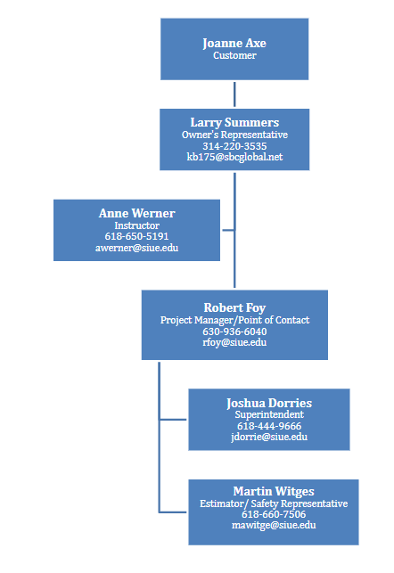
Company Description
Very Good Construction Co.
We do safe, quality work.
Our Team
Robert Foy – Project Manager
Joshua Dorries – Superintendent
Martin Witges – Estimator/Safety
Good Samaritan Center Project

Slide 6
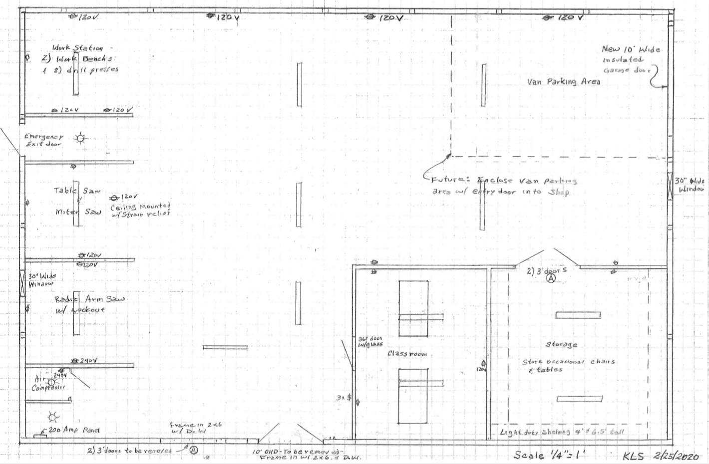
Scope of Work: Client Programming

Slide 7
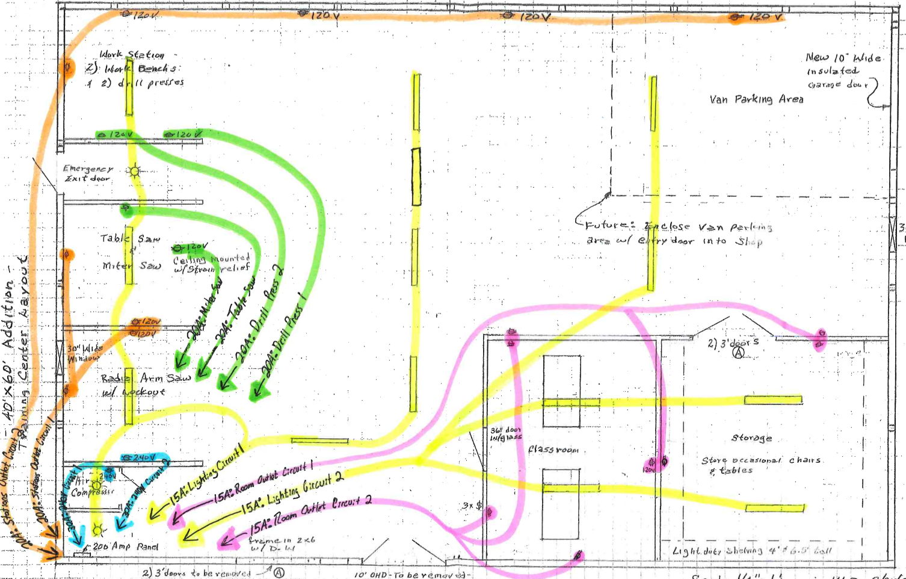
Scope of Work: Design Development

Slide 8
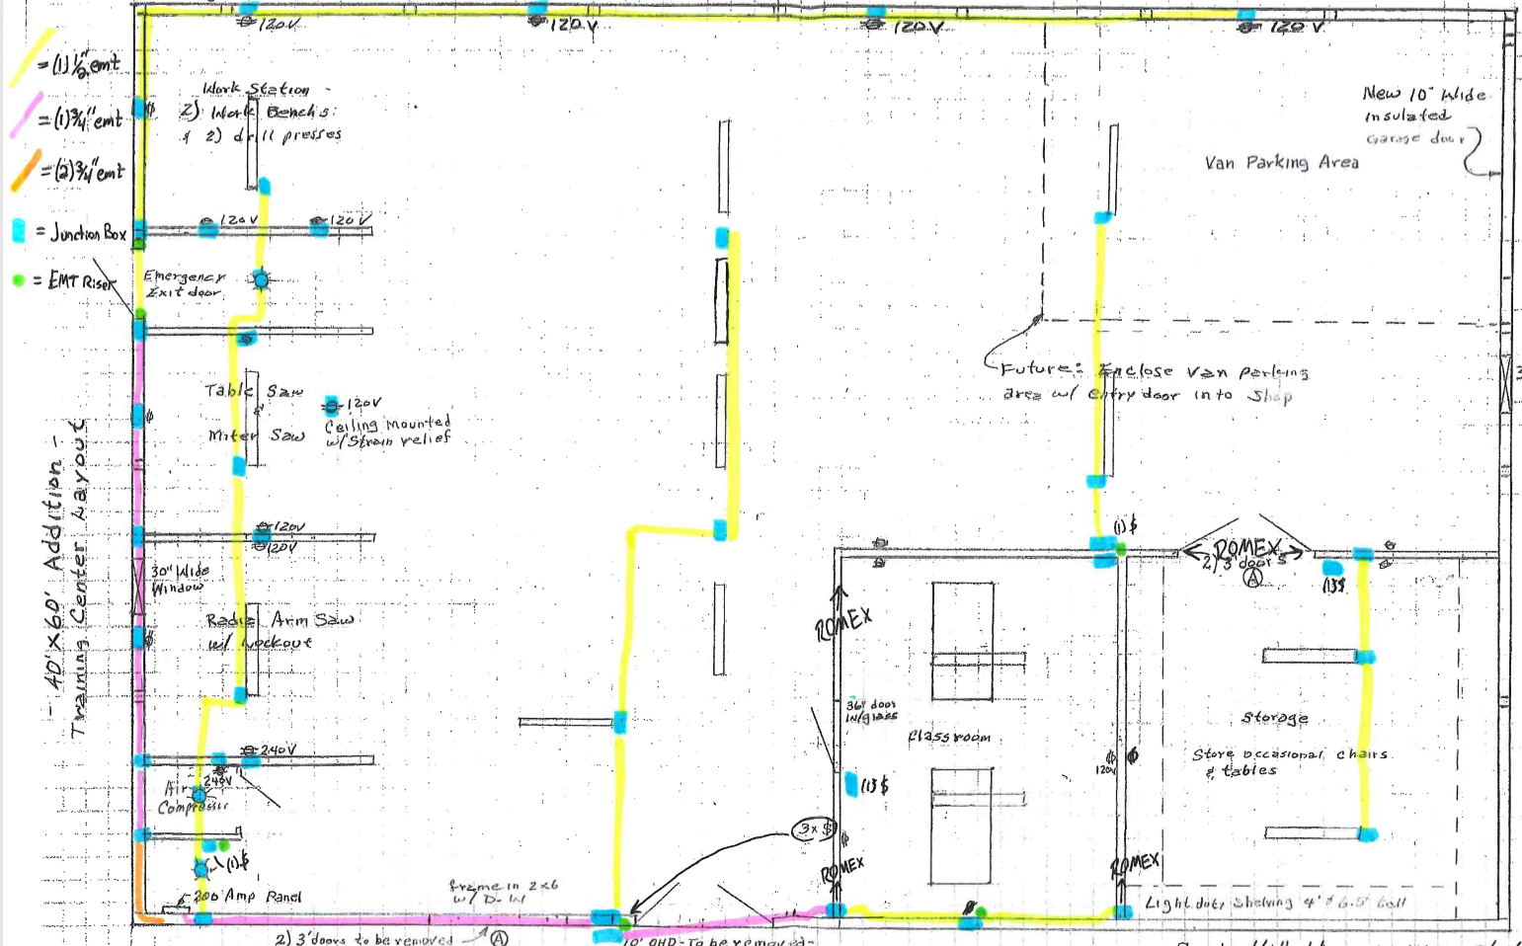
Scope of Work: Final Design

Slide 9
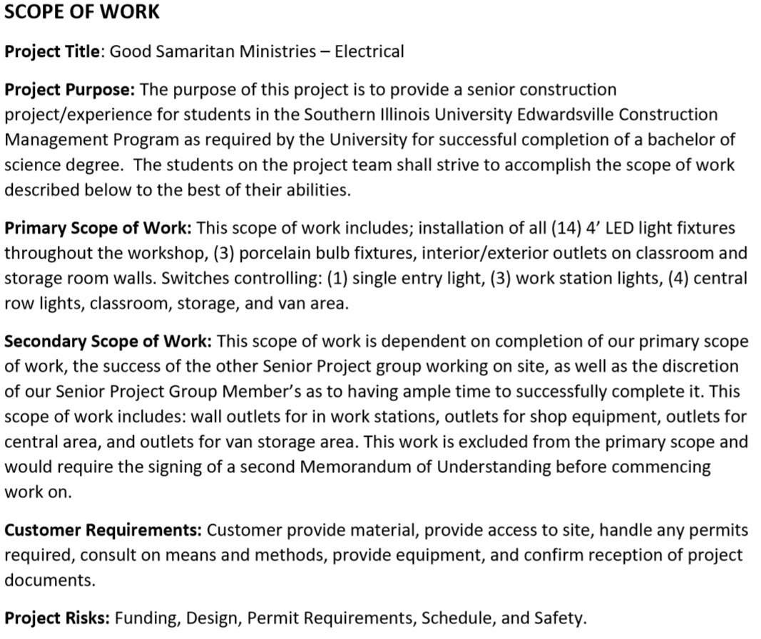
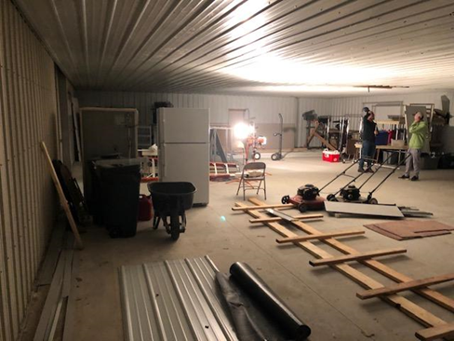
Scope of Work: Finalization

Slide 10
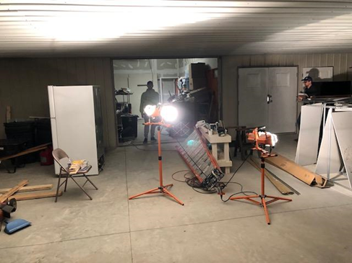
Feasibility and Constructability
There were no legal, physical, & regulatory constraints to feasibility
Due to our prior experiences we deemed constructable
Some methods would be left to field determination
Owner was to provide:
Temporary power and lighting
Material delivery
Basic site clearing/access
Waste disposal
We identified we may need to provide:
Assistance w/ material offloading & inventory
Addition clearing of obstructions as required

Slide 11
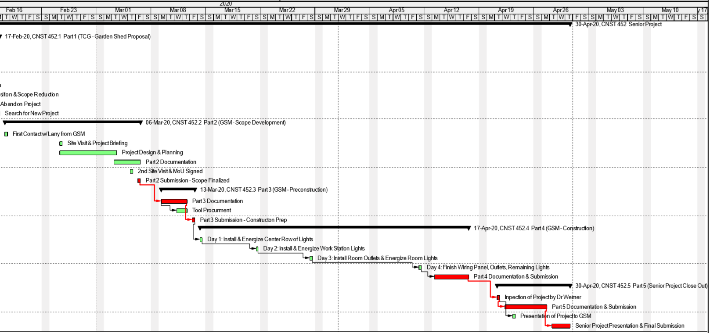
Project Schedule

Slide 12
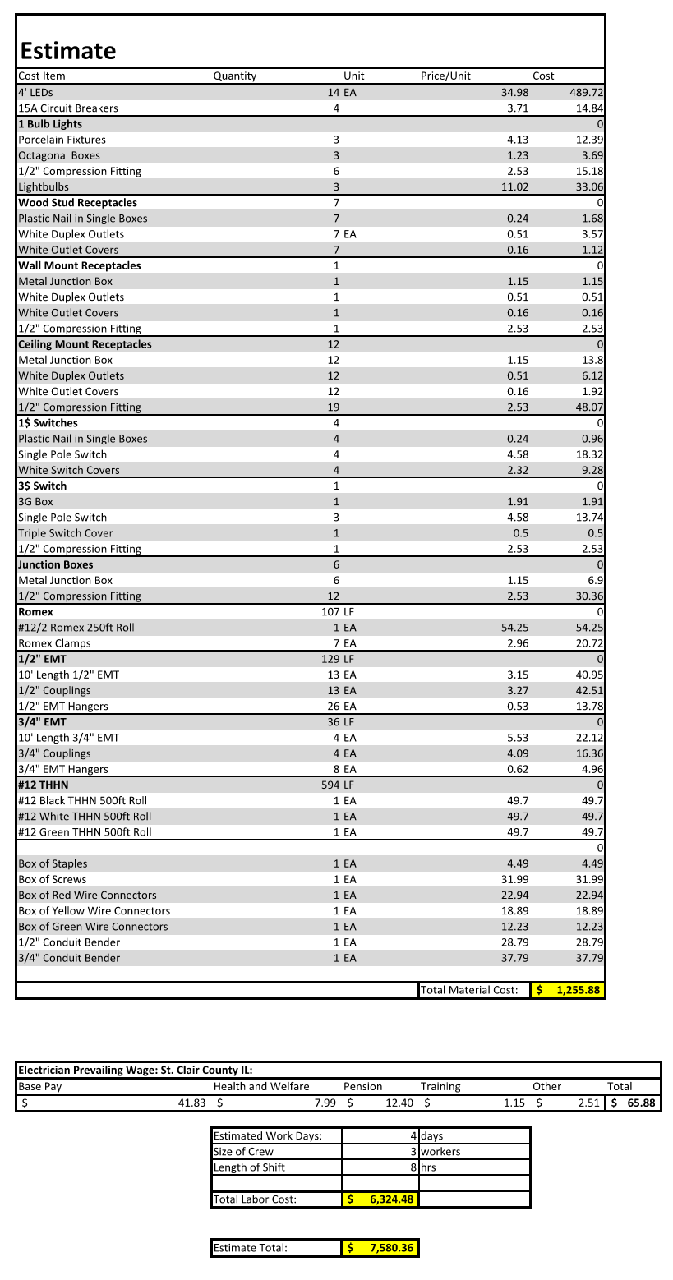
Estimate
Going into the job our initial estimate was $7580.36
We estimated 4 days of work to complete our initial scope
Around 170 ft of conduit, 17 fixtures, 8 receptacles

Slide 13
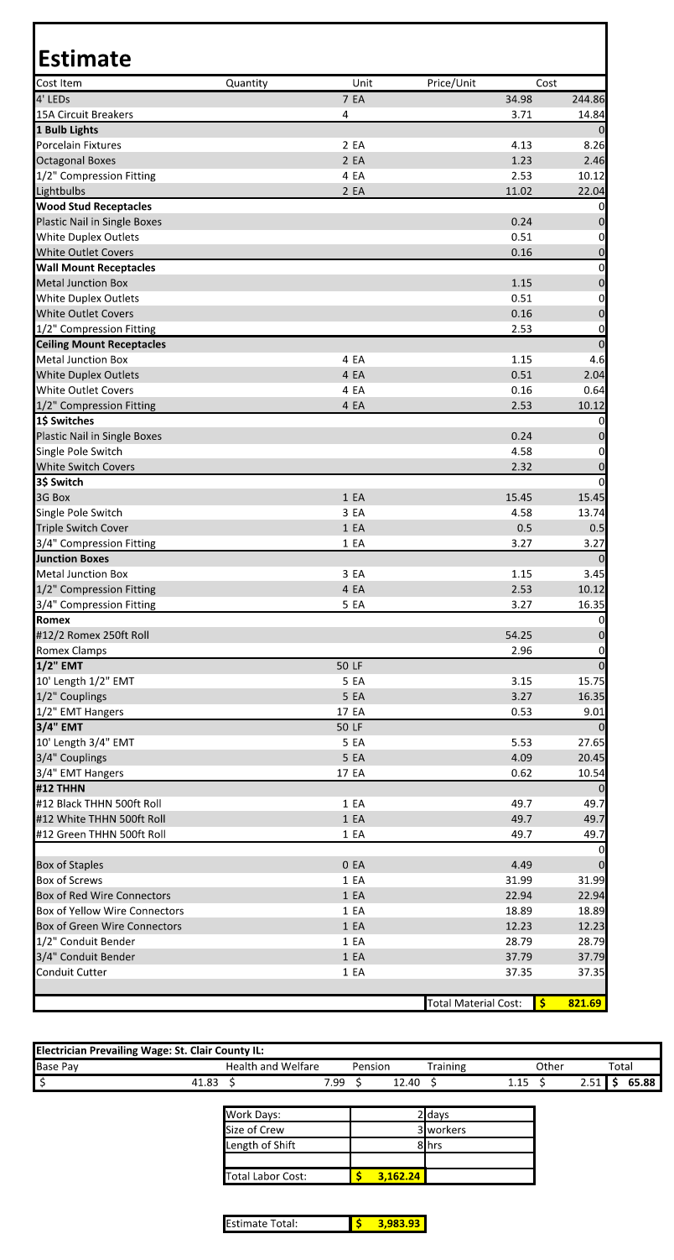
Estimate cont.
Final cost estimate for the project was $3983.93
Worked on site for 2 days
Around 100 ft of conduit, 9 fixtures, no receptacles

Slide 14
Safety Plan
Program goals:
Zero injuries
PPE at all times while engaged or around construction activities
Tools safely stored and out of the way when not being used
Not using the top two ladder rungs if working up in the air
Setting up the proper lighting and never working alone
Have water and breaks available while working
Have all team members involved in ensuring power is turned off then back on at the start and finish of each workday

Slide 15
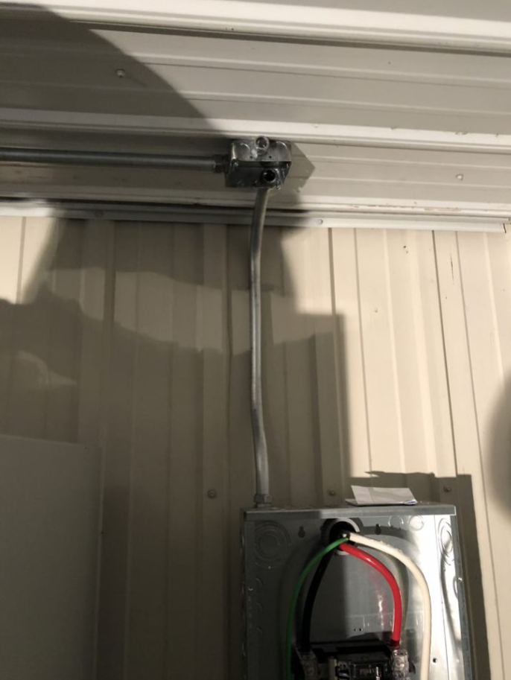
Safety Plan cont.
Tripping Hazard – keep work area tidy.
Fall Hazard – keep off the top two rungs
Electrical hazard - ensure all conductors were off before work
Hand tool and power tool hazards – use all tools properly, wear appropriate clothing, know nearest medical facilities
Security Hazard – keep doors locked to limit access
Disease hazard - use of hand sanitizer when going on and off site, limit number of people

Slide 16
Project – Risk Management Plan
We utilized risk reduction, risk avoidance, and risk transfer to handle our risks.
We found that if we kept safety in mind, mitigating our risks using our plan worked great.

Slide 17
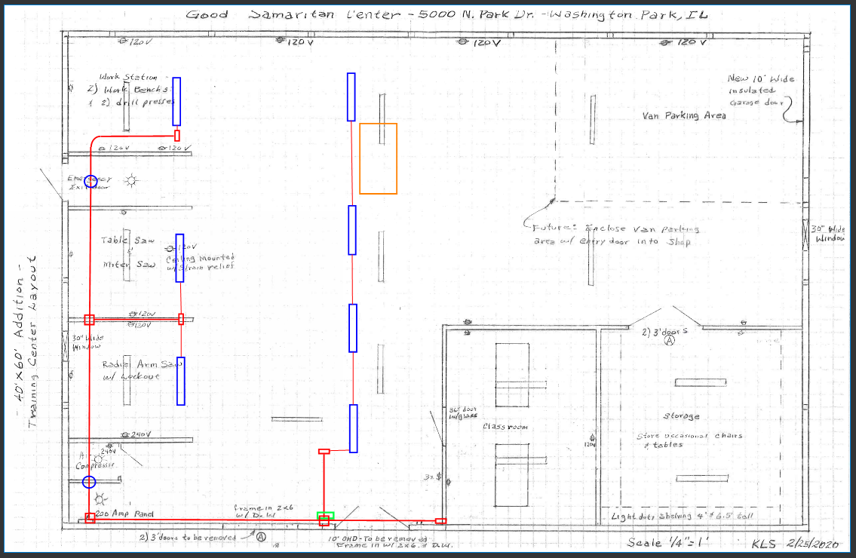
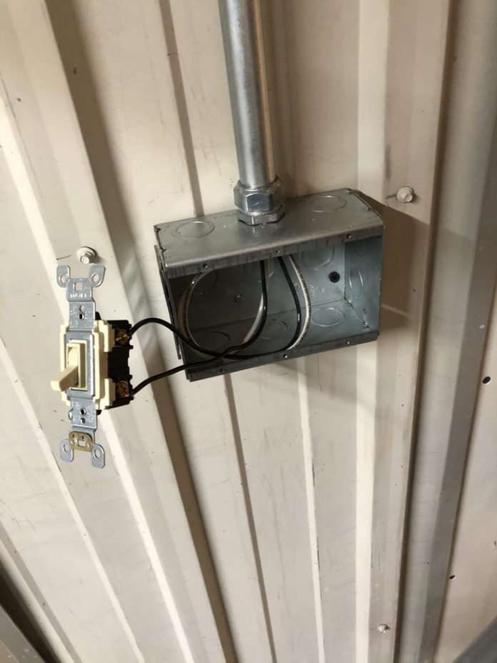
Summary Project Outcome - Challenges
Design changes
Lots of clutter to work around
Had to obtain a metal 3g box due to new 3$ location
Coronavirus

Slide 18
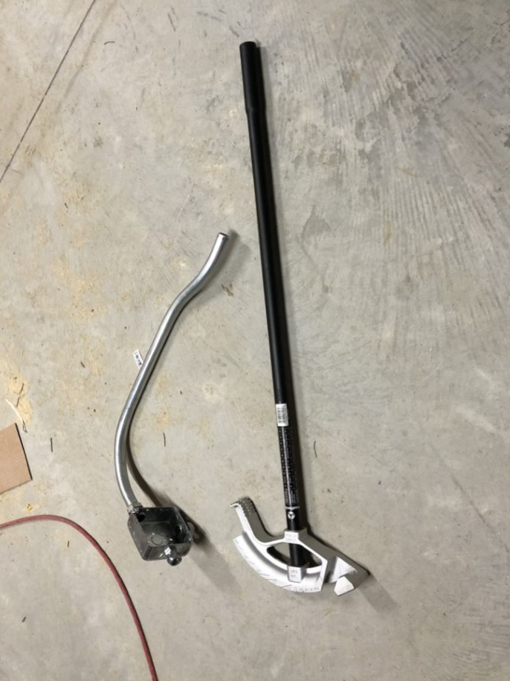
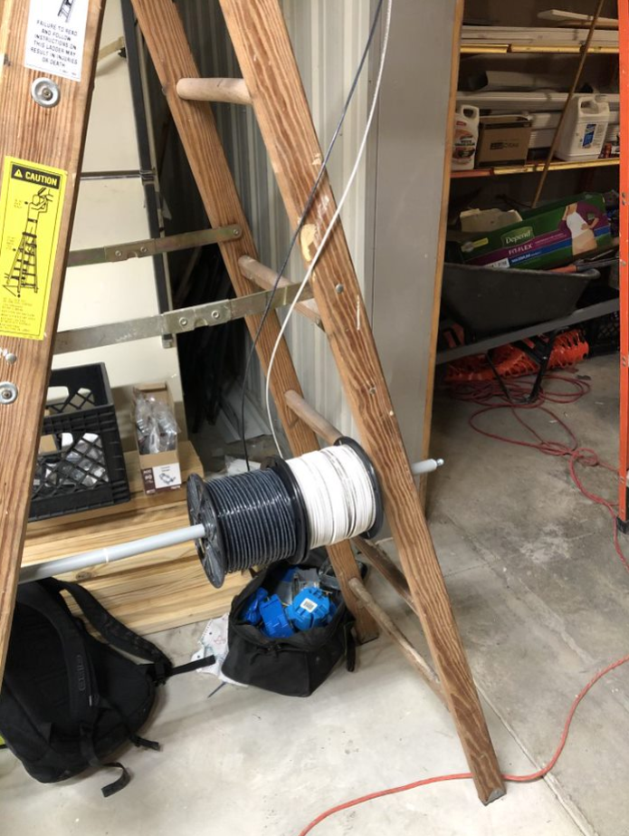
Summary Project Outcome – What we learned
We installed electric similar to home wiring, gained useful experience.
We learned how to use conduit benders.
If a project is not feasible, the shed, it is best to move on to one that is, the Good Samaritan Center.
We saw first-hand the way projects are changed during construction.

Slide 19
Questions?

