Slide 1

Senior Design final
Rockford Hospital Pedestrian Link
Cannon Design
Jacob Savage, Grace Melton, Daniel Smith, and Marcassja Vaughn

Slide 2
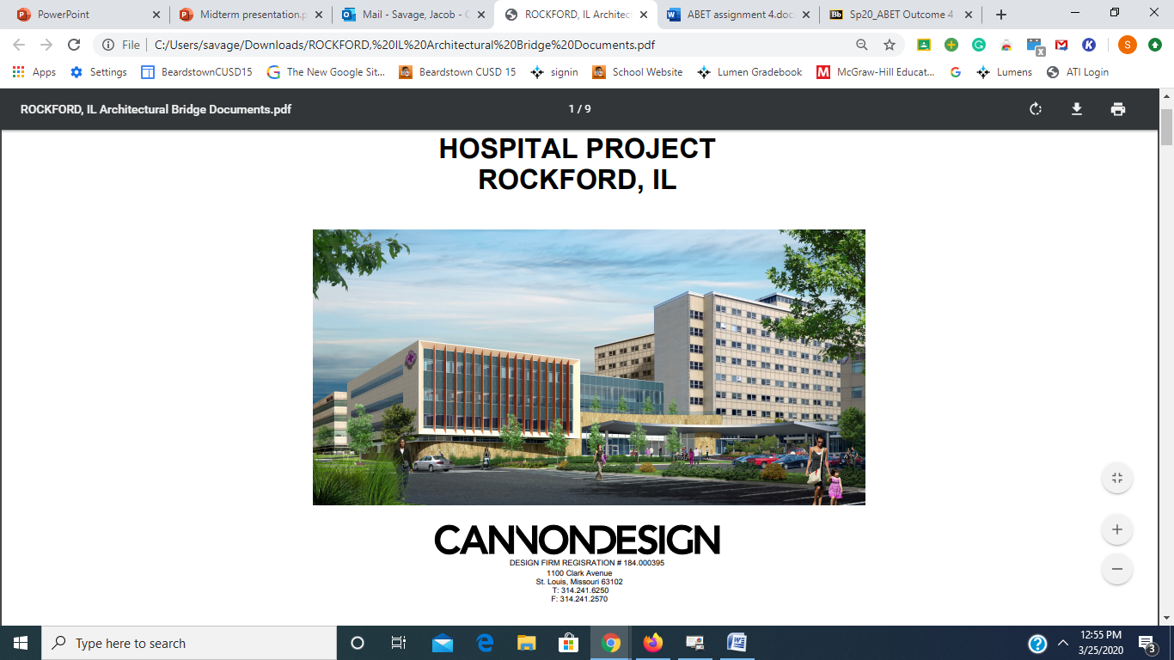
Introduction
Project Location: Rockford Il
Project Type: Pedestrian Bridge
Type of Bridge: Steel Truss
Host Company: Cannon Design in St. Louis
  Lead: Kurt Bloch

Slide 3
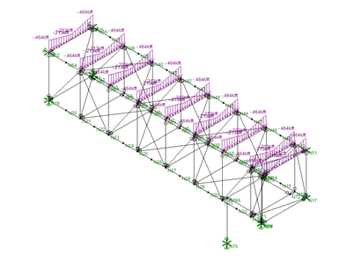
Structural loads
Gravity loads
Dead Load
  Floor: floor slabs, extra concrete, & MEP
  Roof: deck, plywood, insulation, MEP
  Curtain wall
Live Load
  Lobby & Roof live load
Snow load
  Includes snow drift
    Snow drift length = 6.25'

Slide 4
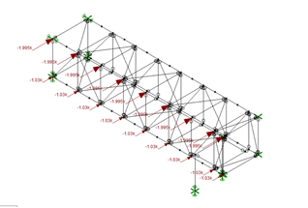
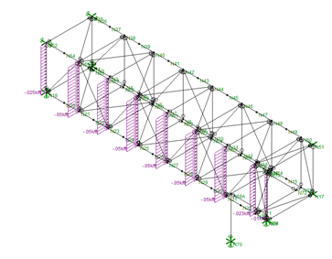
Structural loads lateral Loads
Wind Load
  MWFRS
  Risk Category IV
  Determines wind pressure, p
    Enclosed buildings and parapets
Seismic Load
  Equivalent Lateral Force (ELF)
  Spectral response acceleration parameters

Slide 5
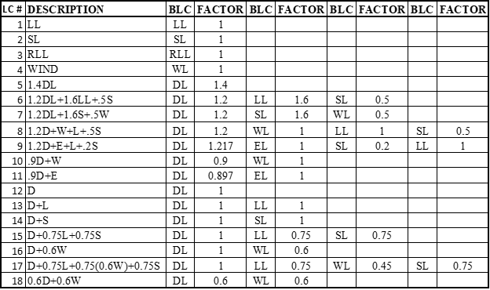
risa model & load application
Place nodes at member connections
Create section sets with desired materials
Place members by connecting to nodes
Used calculated area loads and converted them to member or point loads based on tributary areas covered & place loads
  Gravity applied vertically (distributed member loads)
  Lateral applied perpendicular (joint load and acceleration)
Build the LRFD & ASD load cases in load combinations, giving each load a factor
Solve the model and start analyzing the results!

Slide 6
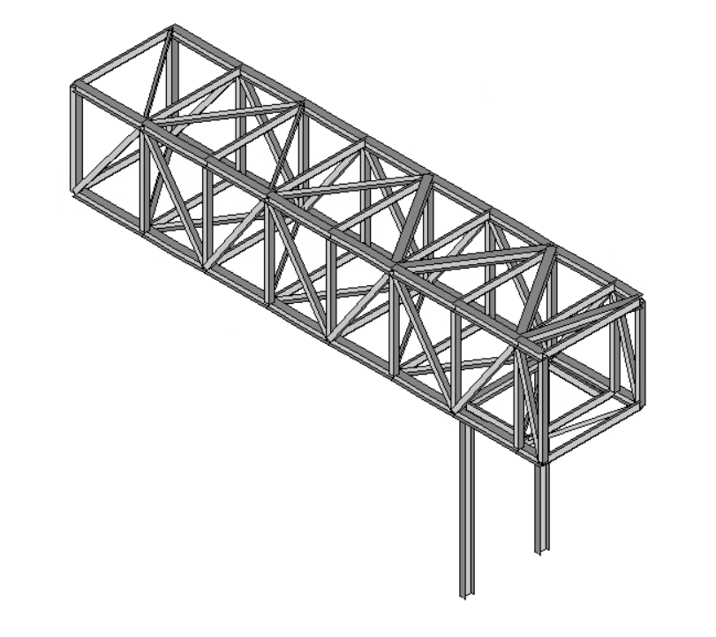
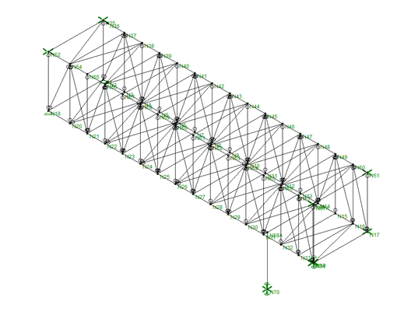
Risa models original & Economic models
Pros
  Smaller tributary areas for loads
Cons
  Too many members/joints
  too complex/expensive
Pros
  Reduced amount of members and steel
Cons
  Increases unbraced lengths of bridge girders
  Increases tributary area
    Also increases
    load magnitudes

Slide 7
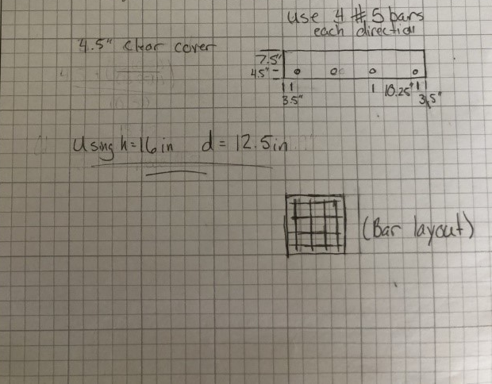
Foundation
Two square concrete footings
  Area is 16 square feet for each (4'x4')
  F'c = 4 ksi normal weight concrete
  4 - #5 steel bars
Foundation design
  Obtain loads from RISA Model
    73 kips
  Design Using ACI code requirements

Slide 8
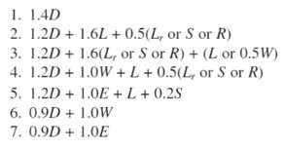
Risk analysis
Used LRFD load combinations to design for worst-case scenario
  Ensures structure can withstand it
RISA solved batch combination and gave max/min axial loadings for each member

Slide 9
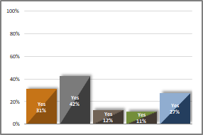
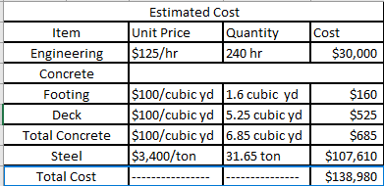
Sustainability & Cost analysis
Sustainability
  Steel members composed of recycled steel
  Used Envision Checklist
Cost estimate
  Engineering Cost
    $125/hr
  Steel Cost
    31.65 tons
  Concrete Cost
    6.85 cubic yards

Slide 10
Plan Drawings
Using AutoCAD software
Foundation Plan (Foundation Cross-section Drawing)
Bridge Floor/Deck Plan
Bridge Roof Plan
Bridge Truss Elevation Plan
Bridge supporting Column Plan
Bridge Foundation Detail

Slide 11
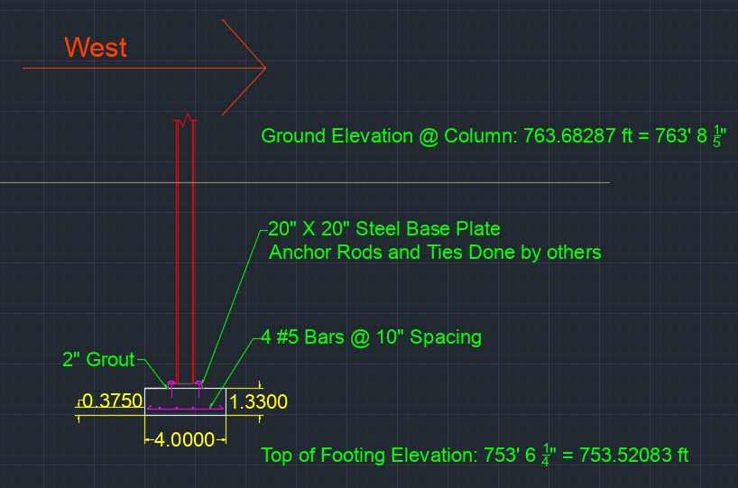
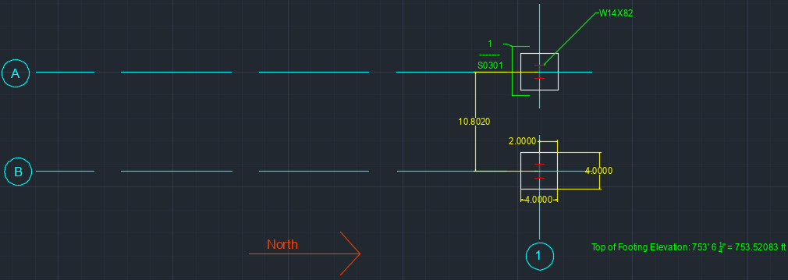
Foundation Plan and Detail

Slide 12
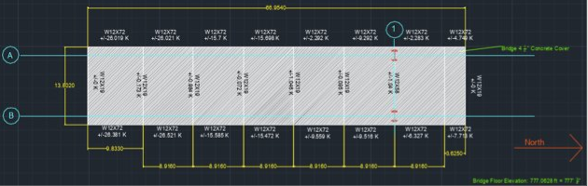
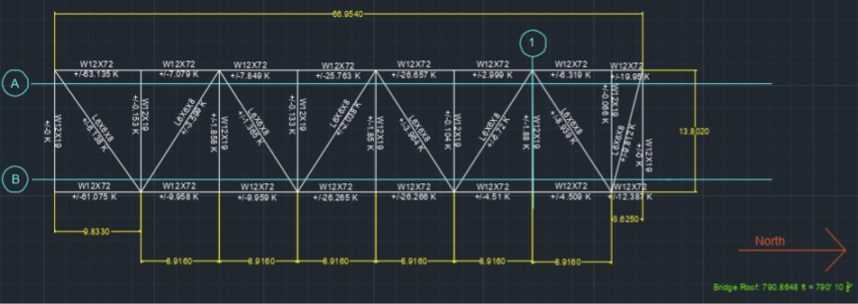
Bridge Floor/Deck Plan & roof Plan

Slide 13
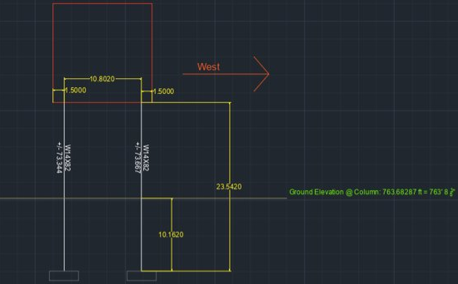
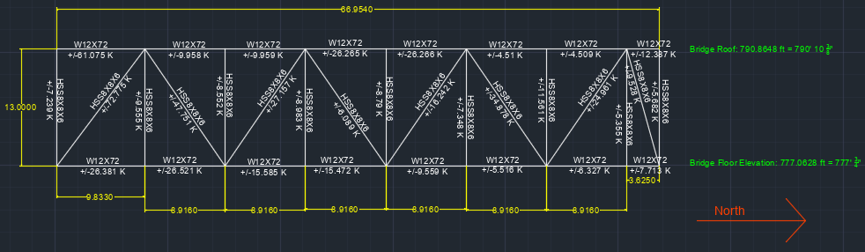
Bridge Truss Elevation Plan &
Bridge supporting Column Plan

Slide 14
Acknowledgements & Conclusion
Thank you to Cannon Design and especially our host engineer, Kurt Bloch, for providing guidance during this project
Through this project we designed a pedestrian link bridge using engineering practices, codes, and technologies to span between two hospital buildings, that is equipped to withstand all potential forces

Slide 15
Questions???

