Slide 1
Chassis Subteam Design Justification Presentation

Slide 2
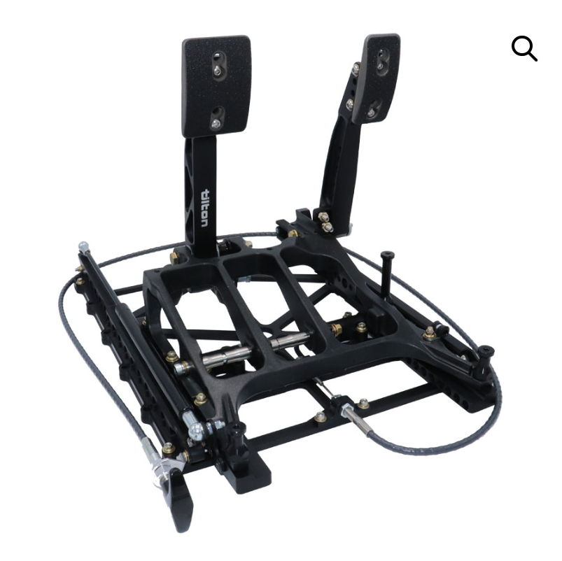

Design Objectives
Build a chassis that complies with FSAE rules
  Satisfies all chassis safety / mounting rules
Safety / Impact Compliance
  Validate via simulations / tests
  Integrate roll hoops, impact attenuator, etc. per rules
Minimize the weight of the car
  Use optimized tube sizing / remove excess members
  Improves acceleration, braking, handling
Account for Driver’s height
  Design an adjustable pedal box system
  Make seat one-size-fits-all for all potential drivers
  Place steering wheel and shifter in an ergonomic position with sliding adjustment
Tilton’s 850-Series 2-pedal
Notes:
Tammy = 700 lbs => chassis estimated around
Current = estimated to be around 75 lbs
0.047 < tube
2.0+ mm or 0.08+ in is required for main and front hoops
Image: Tilton’s 850-Series 2-pedal SKU: 72-851-S

Slide 3
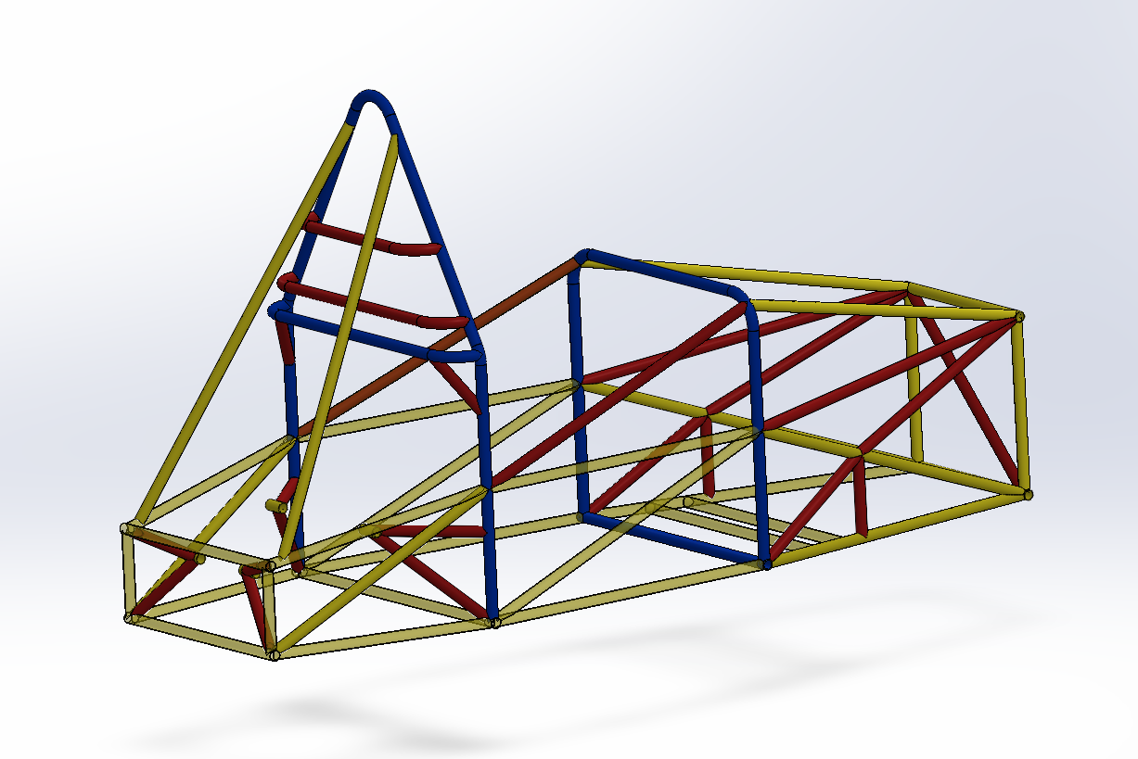
Design Theory & Accomplishments
How we accomplish our goals of safety, weight, and cost
  Tammy is 115lbs, new car is 75lbs. 25.71% lighter
.065 in
.049 in
.095 in

Slide 4
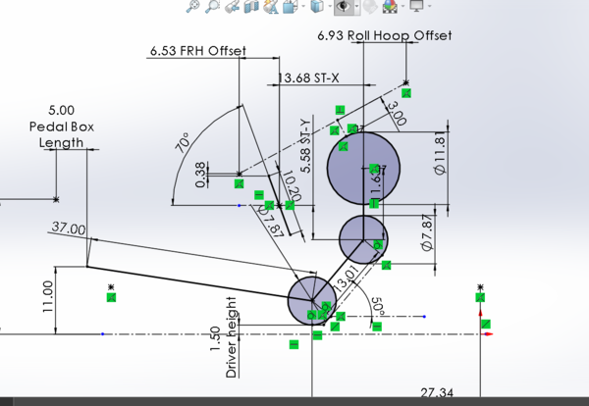
Design Theory
Safety
  Structurally sound chassis
  Side impact tubes to absorb force impacted on the car
  Protects the driver
  Abide by rules to ensure safety (see next slide)
Cost
  Welding the chassis ourselves
  Making a custom Pedal System
  Making our own Driver’s Seat
Performance (Weight Saving)
  4130 chromoly instead of 1020 steel
    Stronger alloy allows for less material for the same strength
    Less material = less weight
  Looking into using carbon wherever possible
  Favoring lower-weight solutions over easier solutions

Slide 5
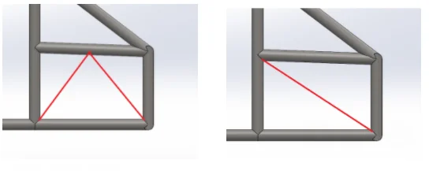
Rule Adherence
Stiffness & Safety
  Chassis should be able to withstand bending, torsion, impact loads
  Provide rigid suspension mounting
Node-to-Node Requirements
  Structural tubes MUST form triangular openings (triangles are strong)
  F.1.17, F.5.6.3
Side Impact Structure Minimum Tubes
  At least 3 tubes on each side of cockpit
  9.44 - 12.6 inch height range
Harness Mounting / Weld Eyes Rule
  Must have shank inserted into steel threaded insert
  Cannot weld pad eyes nor tabs directly to chassis tubes
Notes:
Stiffness & Safety - Description provided
Node-to-Node Requirements - roll hoop should bend below where the hoop braces attach with triangular tubes in order to support the bends. A bend cannot be the reliable load path
Side Impact Structure Minimum Tubes - These tubes are necessary due to them absorbing and spreading out the force impacted on the car in order to protect the driver
Harness Mounting / Weld Eyes Rule - You can no longer make your own weld eyes (eye bolts). They have to be the same as those supplied with the harness. This is to create better safety, be reliable, create better load transfer

Slide 6
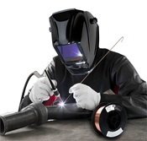
Material Selection and Justification
1020 Steel
  Easily weldable
  No post-weld treatment needed
  Easy to bend and easy to cut
4130 Chromoly
  Weldable, heat treatment is required
  Needs more careful fabrication to avoid brittleness
6061-T6 Aluminum
  Welding is difficult
  Heat from welding reduces strength near joints unless heat treated

Slide 7
Material Selection and Justification
Material | Yield strength | Ultimate tensile | Density
4130 chromoly | 435 MPa | 560-670 MPa | 7.85 g/cm^3
1020 steel | 295 MPa | 395 MPa | 7.85 g/cm^3
6061-T6 Aluminum | 240 MPa | 290-310 MPa | 2.7g/cm^3

Slide 8
Material Selection and Justification
Material | Wall Thickness | $/Inch
6061-T6 Aluminum | 0.049” | $0.95/in
6061-T6 Aluminum | 0.065” | $0.97/in
6061-T6 Aluminum | 0.095” | $1.74/in
4130 Chromoly | 0.049” | $2.76/in
4130 Chromoly | 0.065” | $1.68/in
4130 Chromoly | 0.095” | $2.02/in
1020 Steel | 0.049” | $0.58/in
1020 Steel | 0.065” | $0.54/in
1020 Steel | 0.095” | $0.67/in

Slide 9
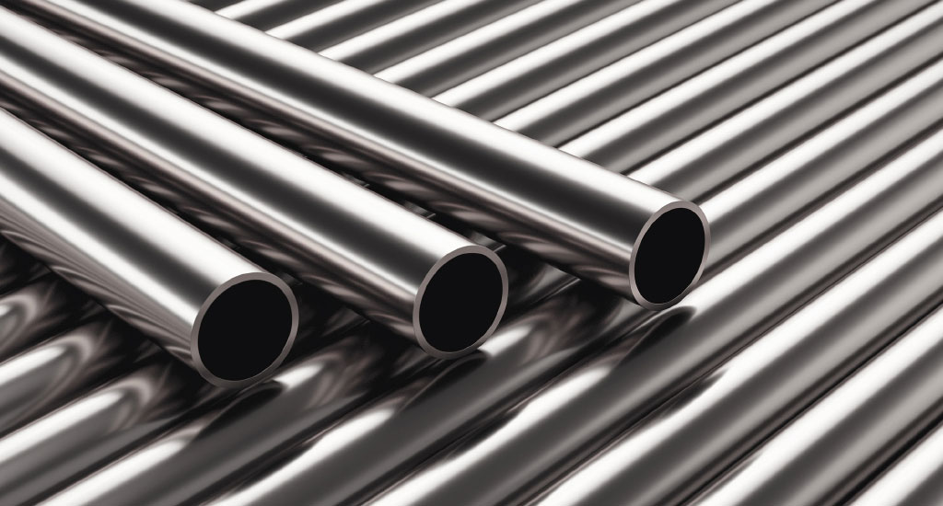
Material Selection and Justification
Why we choose 4130 Chromoly
  4130 has higher yield and tensile strength so we need less to make the chassis strong and meet FSAE Safety requirement - cuts weight
  4130 resists bending better and keeps suspension geometry stable and will improve overall handling
  4130 chromoly is the industry standard for race car frames and roll cages and has well-documented performance, reliability, and wide availability in tubing sizes

Slide 10
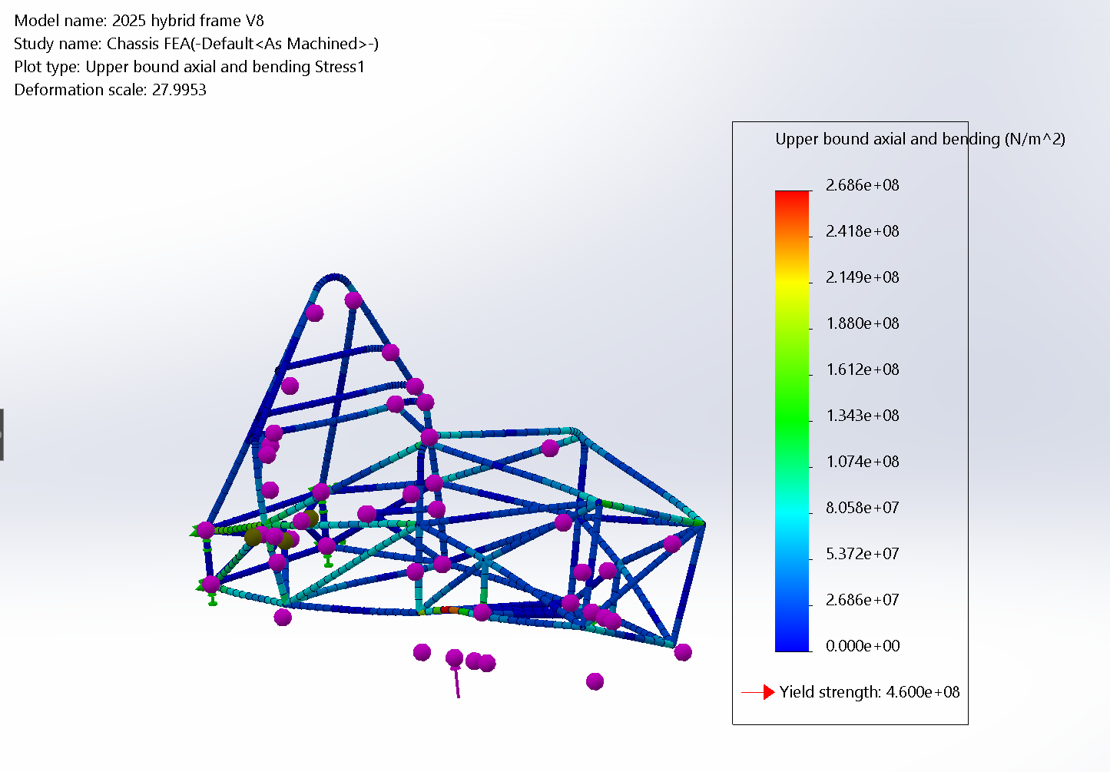
Load Case Analysis/ FEA Results
Stress Test
  Upper bound axial and bending:
    2.686 * 10^8 N/m^2 -> 38955.77 psi
  Yield Strength:
    4.8 * 10^8 N/m^2 -> 69615.66 psi

Slide 11
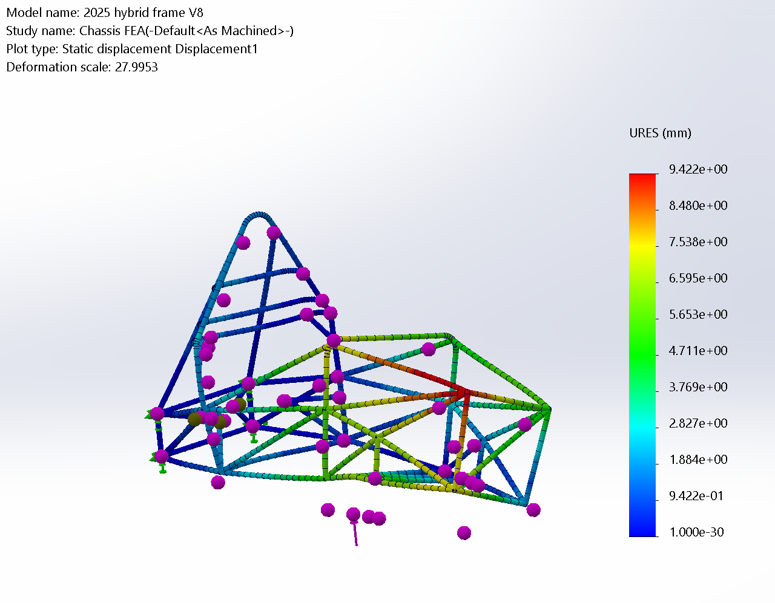
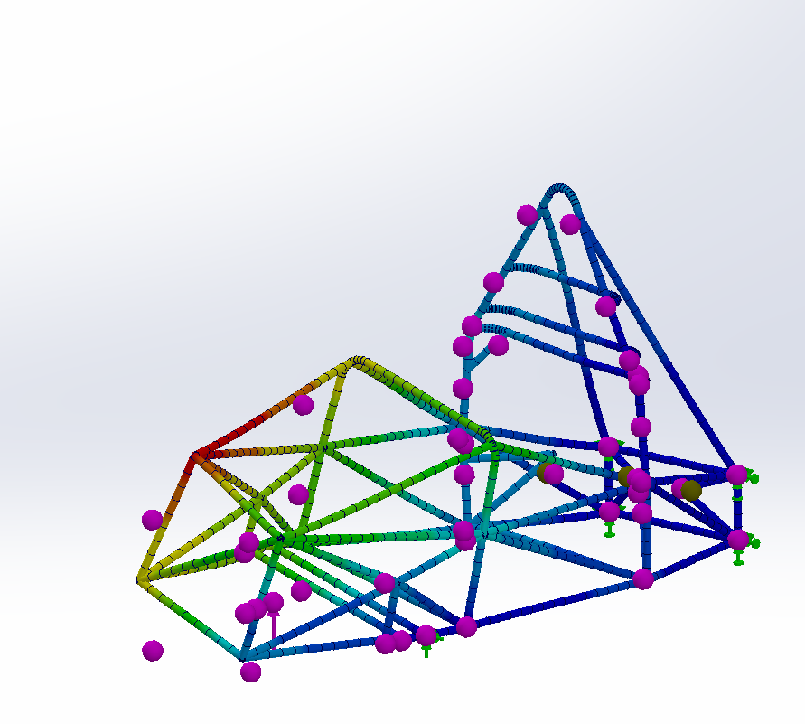
Load Case Analysis/ FEA Results
Deflection test
  Max Deflection:
    9.422 mm
    0.371 in

Slide 12
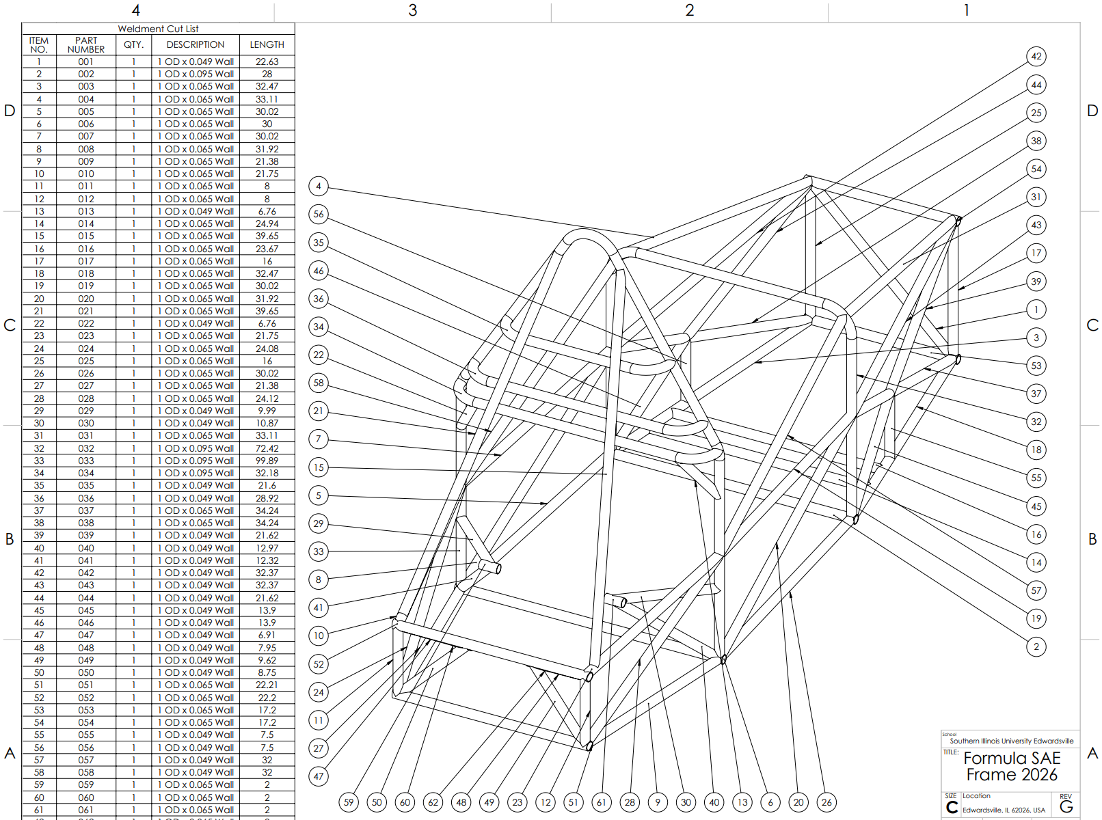
Manufacturing Methods and Timeline
Place order for tubes, laser cutting, and bending (10/9)
Tubes arrive (11/11) assuming 4-week turnaround and 5 days for shipping
Welding begins, have chassis welded by Winter Break (12/13)

Slide 13
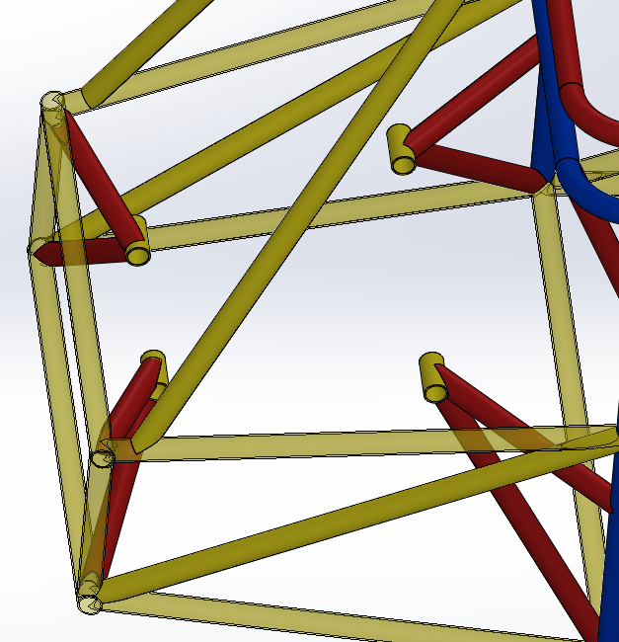
Integration to Powertrain
Four-Point Engine Mount
  0.065” x 1” tubing
Supporting Brackets
  Dual supports for all four mounting points
  0.049” x 1” tubing
Guard Mounting Tabs
  Heat Shield, Chain
Battery/ECU
  Box of either Plastic or Metal depending on location with drain holes for battery
  Flanges for ECU
Additional Tabs may be needed

Slide 14
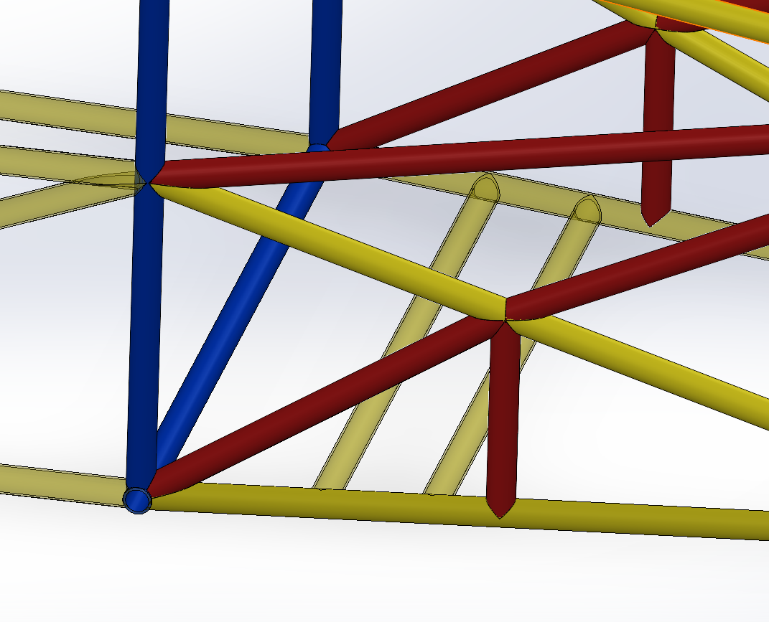
Integration to Suspension
Multiple redesigns for adequate suspension hardpoints
  Tie rods must clear members of the Chassis
May need further communication on any other specific mounting points

Slide 15
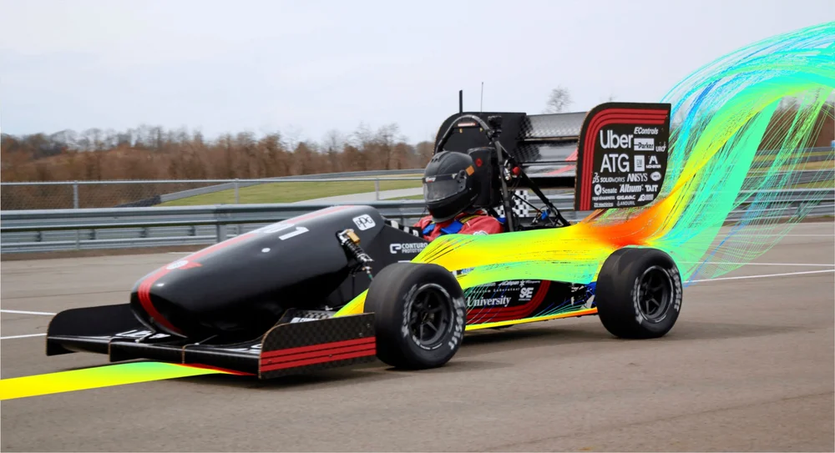
Integration to Aero
Bodywork
  Undecided on location but mounting points for dzus tabs will be installed
Aero Kit
  Undecided on mounting into suspension or frame
  If Suspension, further investigation on hardpoints needed
  If directly to Chassis, more communication on where the mounting points must be

Slide 16
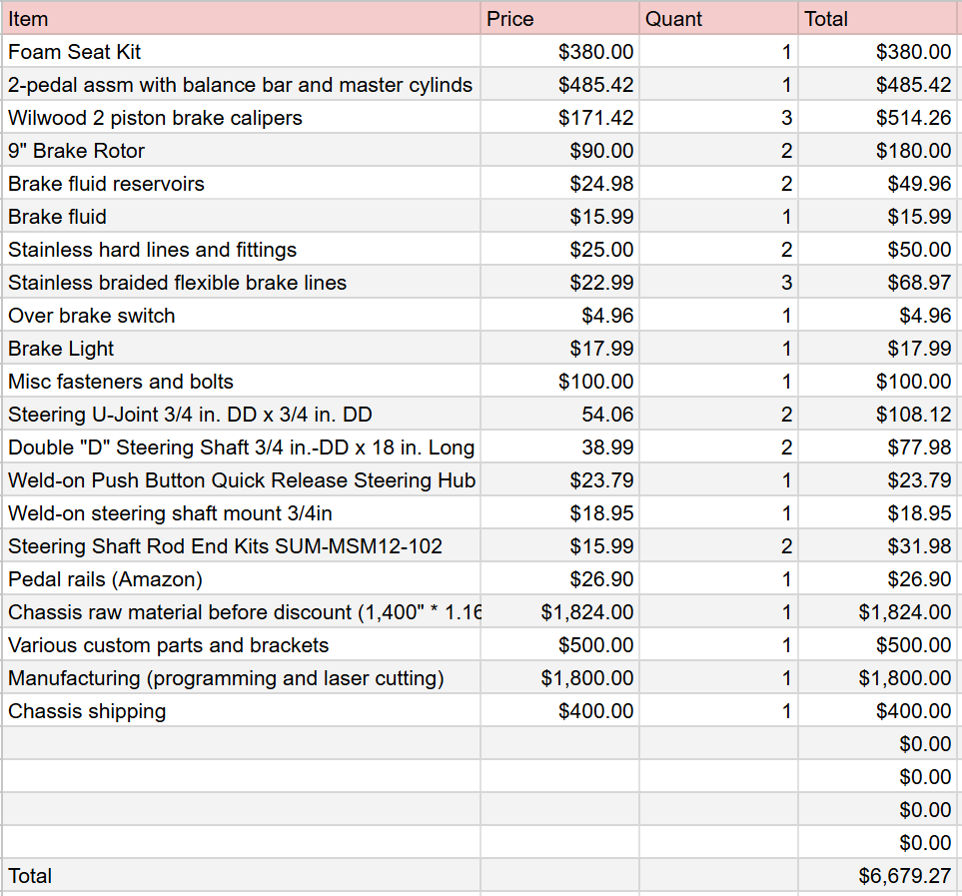
Budget Estimation
Certain items can be reduced in price by designing and making them ourselves
  Pedals (<$400)
  Seat kit (<$100)
Majority of cost comes outsourcing tubes to be cut and bent
  Benefits include reduce cost of purchasing tooling, guaranteed fitment of members, minimal room for error, reduced need for fixtures
  Drawbacks include -$4,000

Slide 17
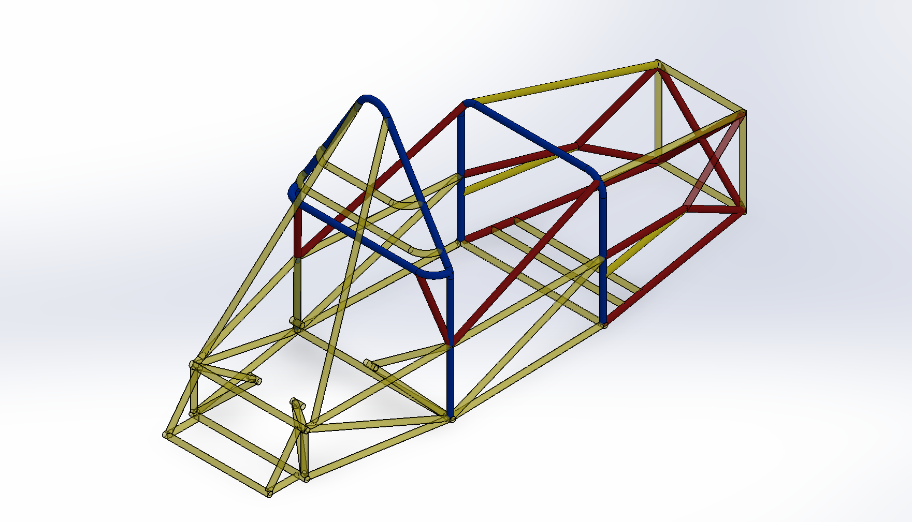
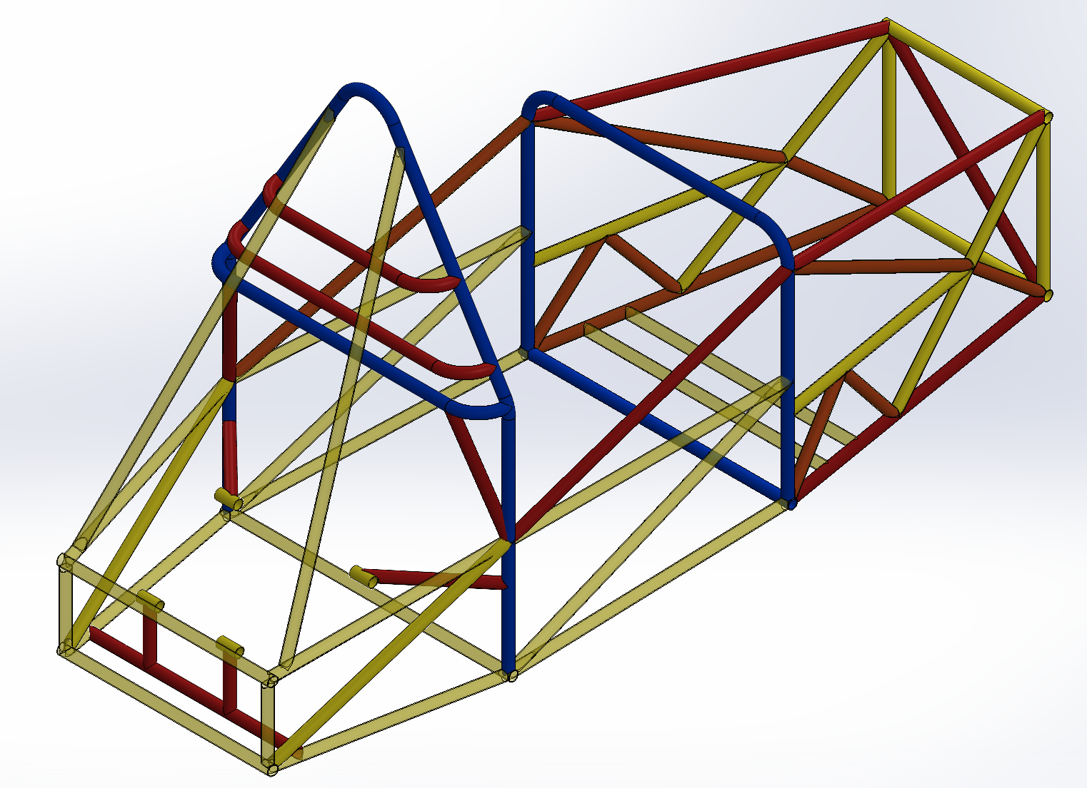
CAD Models
Model V3
Model V4

Slide 18
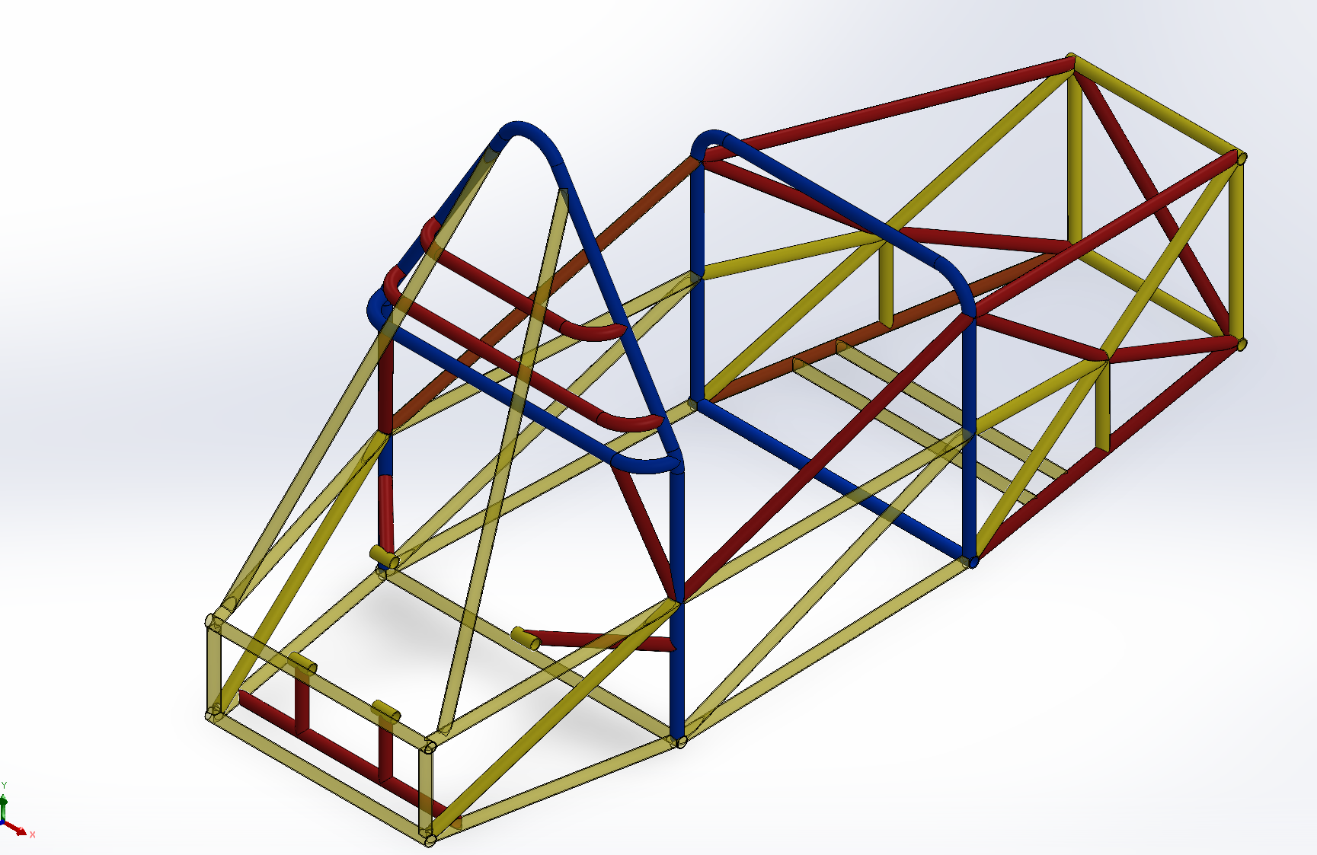
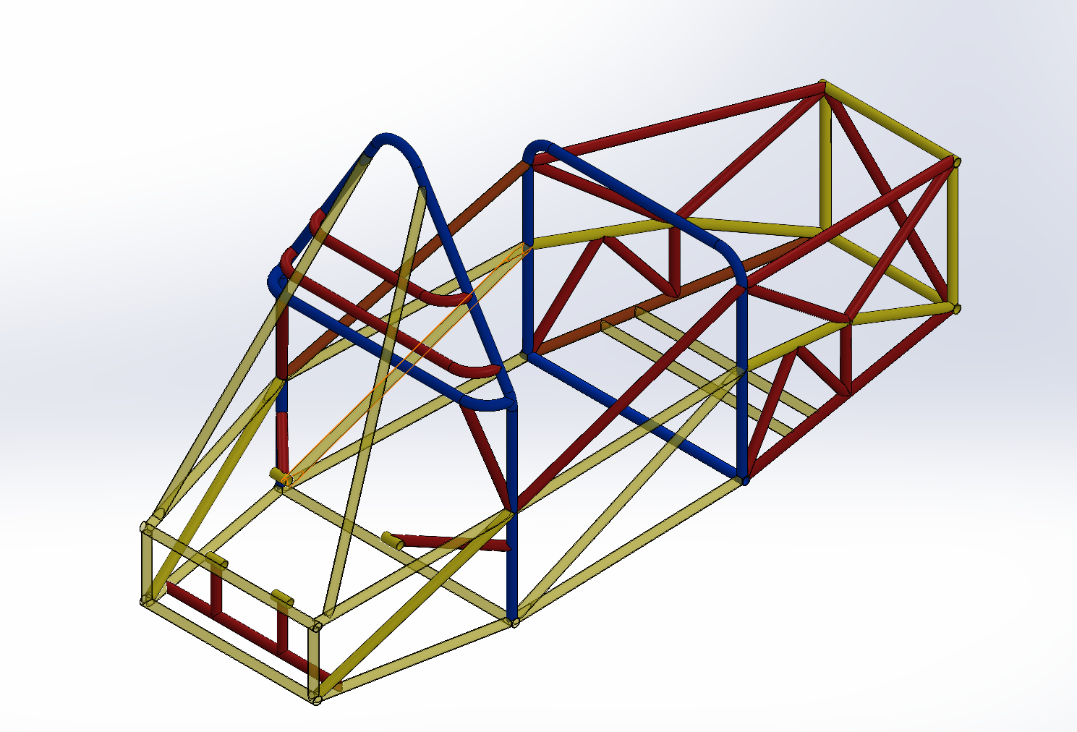
CAD Models
Model V5
Model V5 Chevron

Slide 19
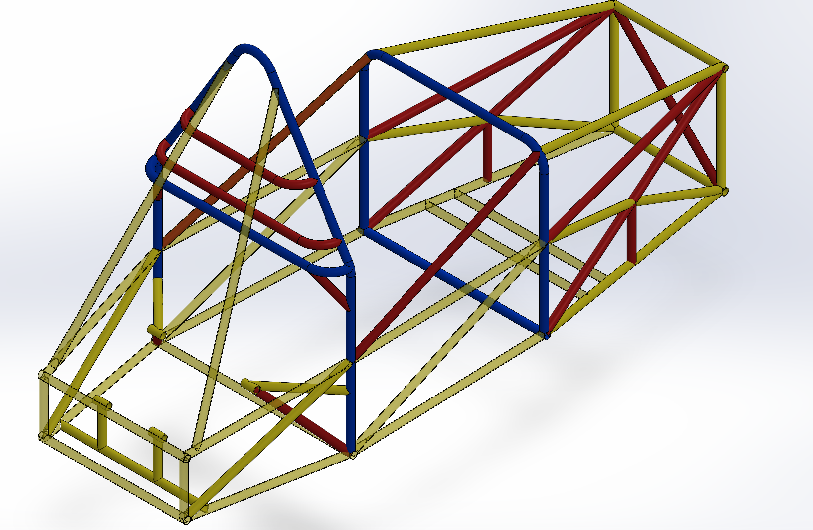
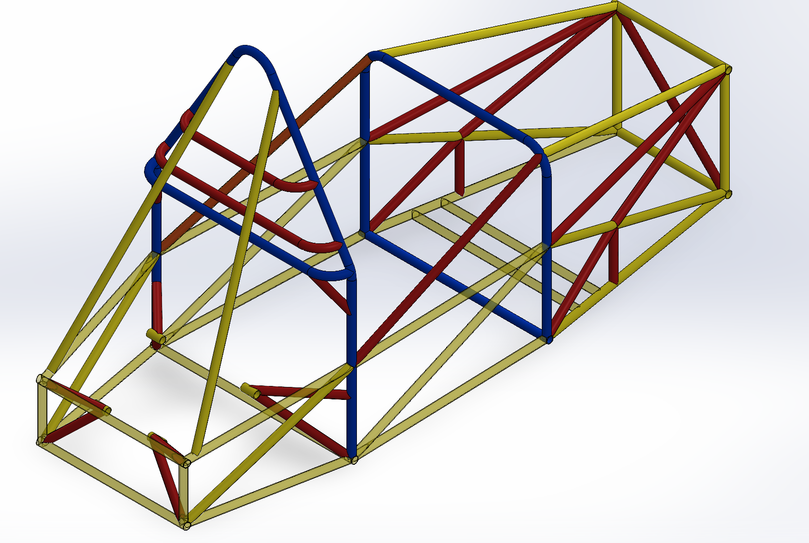
CAD Models
Model V6
Model V7 NB

Slide 20
Questions?

