Slide 1

Southern Illinois University Edwardsville
Student Health Insurance Plan

Slide 2
Your Insurance Team
Academic HealthPlans
United Healthcare
Academic HealthPlans (AHP) is your plan administrator.
We provide the following services:
  Website
  Plan Materials
  Waiver
  Enrollment
  Billing
  Customer Care for Enrollment
  On-campus Support
United Healthcare (UHC) is your insurance carrier.
UHC provides the following services:
  Claims Administration
  Claims Customer Service
  Distribution of ID Cards
  Access to a Large Network of Providers

Slide 3

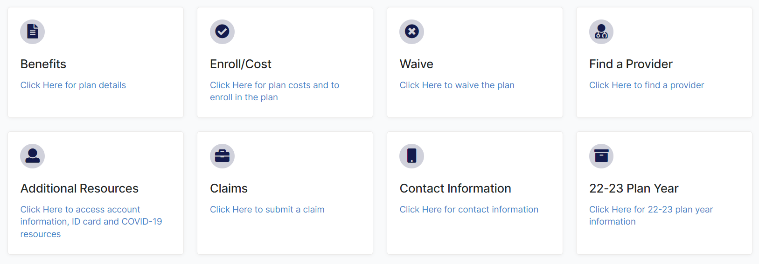
siue.myahpcare.com
26-27
26-27

Slide 4
Eligibility Guidelines
Each full-time student with at least one on-ground class will be enrolled in the student health insurance with the ability to provide proof of comparable insurance via the waiver process. If you do not waive coverage by the deadline, the premium will not be removed from your student account.
Full-time students are defined as:
Students | Fall/Spring | Summer
Undergraduates | 12 Hours | 6 Hours
Graduates | 9 Hours | 3 Hours
Graduate Assistants | 6 Hours | 3 Hours
Pharmacy | 12 Hours | 12 Hours
Dental | 12 Hours | 12 Hours

Slide 5
Eligibility Guidelines
DNP and School of Pharmacy students, no matter how many classes they are enrolled in, will be enrolled in the student health insurance with the ability to provide proof of comparable insurance via the waiver process. If you do not waive coverage by the deadline, the premium will not be removed from your student account.
Each international student, no matter how many classes they are enrolled in, will be enrolled in the student health insurance with the ability to provide proof of comparable insurance via the waiver process. If you do not waive coverage by the deadline, the premium will not be removed from your student account.
Part time students are not eligible. Students who take online classes exclusively, regardless of if they meet the credit hours requirement above, are not eligible.
Dependent coverage is available. Payment must be made directly to Academic HealthPlans and may not be billed to the student’s account. Dependents will NOT automatically be re-enrolled. You will need to re-enroll them by each semester’s deadline.

Slide 6
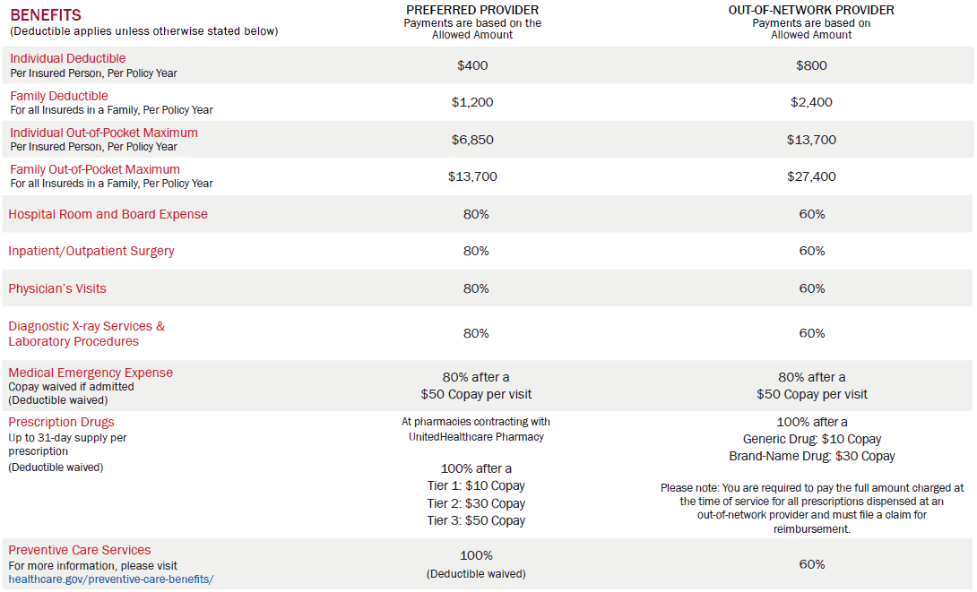
Your Plan Benefits Explained
Preferred Provider Organization (PPO): A type of health plan that contracts with medical providers to create a network of participating providers. You pay less if you use providers that belong to the plan's network.
Deductible: The amount you will pay out-of-pocket before the insurance company begins to pay.
Out-of-Pocket Maximum: The amount you will be responsible for before the insurance company begins to pay claims at 100%.
Co-insurance: The percentage that the insurance company will pay for the listed services, after you meet your deductible and before your out-of-pocket max is met.
Copayment: A fixed dollar amount you will have to pay when services are received.

Slide 7
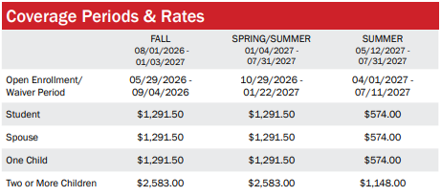
Open Enrollment:
Dates during which you can enroll in the plan.
Coverage Period:
The dates that your health insurance will pay your claims for the current plan year.
Premium:
The amount that you will pay per semester for your coverage. (If an annual coverage period is offered, you may purchase insurance for the entire year.)

Slide 8
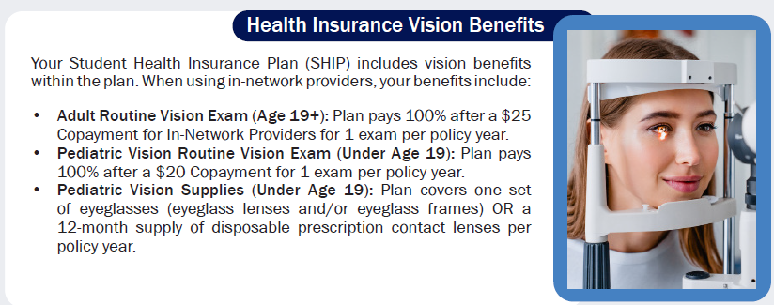
Vision Benefits Available

Slide 9

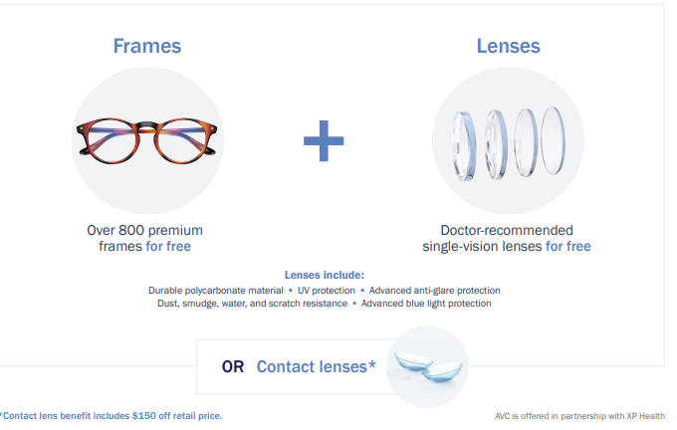
Academic Vision Care (AVC)
AVC Makes it easy to care for your vision needs, all while saving time and money.
Covered in full eyewear with AVC
On average, save $150 in out-of-pocket costs. No hidden fees, no copays.
Virtual and home try-on kits make checking frames out easy.

Slide 10

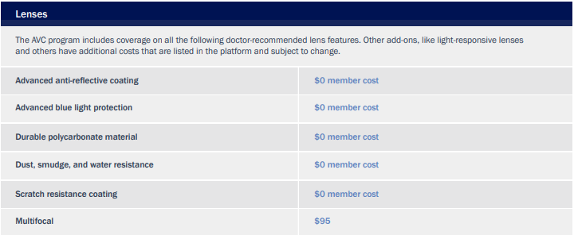
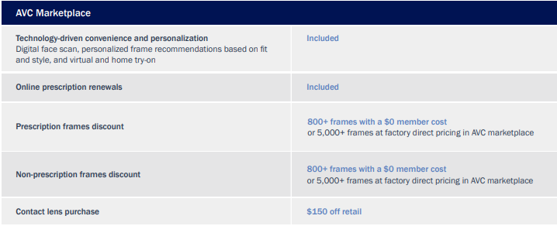
Summary of AVC Benefits

Slide 11

Academic Emergency Services (AES)
Immediate access to assistance if you experience a travel related crisis.
Emergency medical evacuation - If you are overseas and an emergency occurs; we will get you out of there ASAP.
Medically advisable repatriation - If you are studying in the U.S., we will make sure you get back home if your health depends on it.
Visit by family or friends - If there is a medical emergency and you are hospitalized; we will make sure the ones that care about you most are there to support you.
Pre-travel information, lost luggage assistance, prescription assistance, translation assistance, emergency message transmittal.
If you need medical or travel assistance, regardless of the nature or severity of your situation, please contact AES 24 hours a day / 7 days a week
TOLL FREE: 1 (855) 873-3555
OUTSIDE THE US: 1 (610) 263-4660
EMAIL: assistance@ahpcare.com

Slide 12

Academic Student
Assistance Program (ASAP)
Unlimited assessment, counseling and individual crisis intervention
Support for stress, depression, family and relationship concerns, and substance abuse
Verified referrals to community programs and resources
Online searches for child and elder care services, schools, pet resources, etc.
Legal, financial, and identity theft consultations and resources

Slide 13
AcademicLiveCare (ALC)
Virtual visits 24/7 from a smart phone, computer or other mobile device.
Urgent care, psychiatry, therapy, and nutrition services
Immediate access to urgent care
Easy to schedule behavioral health visits
$0 copay
Visit academiclivecare.com to get started.

Slide 14

Add-On Coverage Options
Dental Insurance
Cigna Dental Plan
Dental coverage can be added for an additional cost.
Most medical plans will cover accidental injuries to natural teeth, but not routine examinations, fillings or braces.
Dental for insureds under the age of 19 is often covered in medical plans.

Slide 15

SIUE Health Service
As an enrolled student, you have access to Counseling and Health Service providers, laboratory and our pharmacy.
Schedule an appointment by calling (618) 650-2842
Located in the lower level of the Student Success Center, Room 0222 (adjacent to Visitor Parking Lot B).

Slide 16




Choosing Where to Go for Care
Student Health Center / Primary Care Physician
Telehealth
Urgent Care Center
Emergency Room
Visit for preventive care or treatment for routine physical or behavioral health conditions. If you have a student health center, check there first.
24/7 urgent care services or schedule appointments for behavioral health services via desktop or mobile device.
Same day services that can handle a variety of medical problems that need to be treated right away but are not considered life threatening.
Only for medical conditions that are considered emergencies because they can require rapid or advanced treatments (such as surgery) that are only available in a hospital setting.

Slide 17
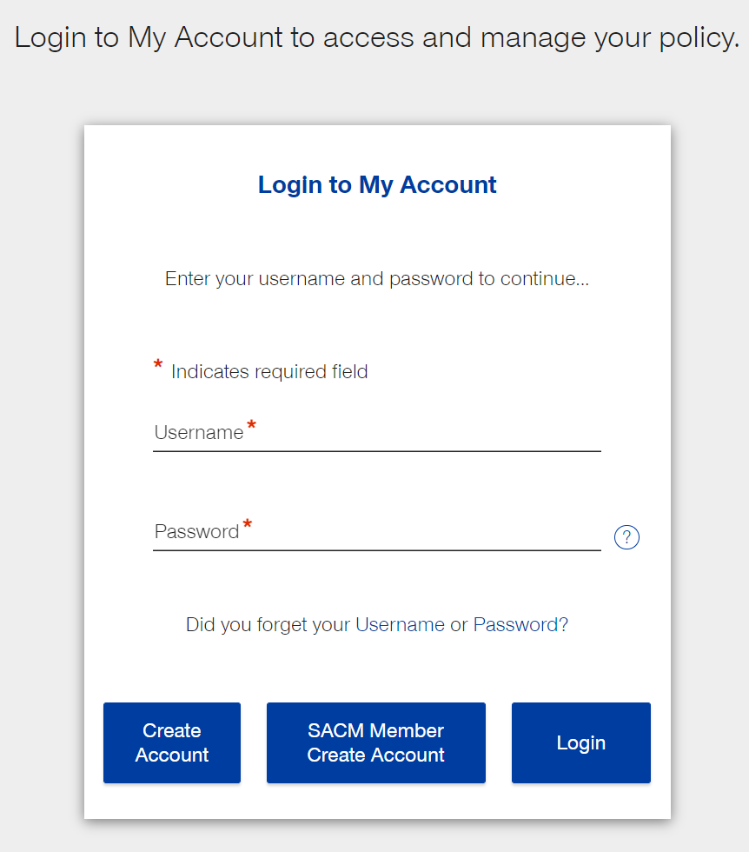
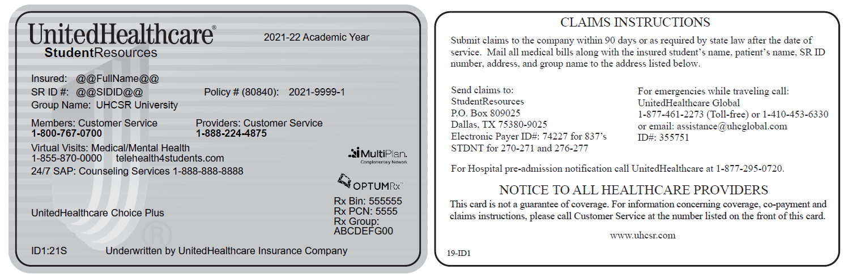
Managing Your Health Insurance with My Account
Visit uhcsr.com/CreateAccount or download the UHCSR Mobile App from your preferred App Provider. Just search for UHCSR.
Once you’ve created your My Account, just log in with your username and password at uhcsr.com/MyAccount and access your account online, at your own convenience.
  View coverage details
  View or print your ID card
  Review Message Center electronic notifications
  Check claim status and Explanations of Benefits (EOB)
  Review claims letters
  Update personal information
  Search for a preferred provider
  Provide other insurance information, accident details, or Personal Representative Appointment
  Provide tax information for IRS Form 1095-B

Slide 18
Health Plan Pro Tips
If you need more information on your plan,
siue.myahpcare.com should be your first stop.
This site has all the details you need to make informed decisions on using your health insurance.
Your carrier has negotiated discounted rates with
in-network providers. Always choose an in-network
physician to save money. You can use the web tools
at siue.myahpcare.com to find one.
Brand-name drugs are often more expensive than the
generic equivalent. Ask your provider to prescribe
generic drugs to save money.
Keep a copy of your electronic ID card easily accessible
on your phone and always keep receipts of all payments made for medical services and prescriptions.
Keep us and your school informed of any address changes. There may be important health insurance information that will be sent to you.

Slide 19
Questions?
Enrollment Information
Academic HealthPlans
siue.myahpcare.com
help.ahpcare.com
Claims & Benefit Information
UnitedHealthcare StudentResources
1 (800) 767-0700
customerservice@uhcsr.com

