Slide 1
Corporations

Slide 2
WHAT IS A CORPORATION?
Entity that has a legal status separate from the individuals that make it up and whose goal is to carry on business.
Corporations may sell stock and have shareholders which provide capital and legally own the company.
Board of directors and managers act as checks and balances.
Corporations have the status and rights of an individual, which means that they can be sued and the individuals within them are protected unless they have been found guilty of fraud.

Slide 3
Adam Smith on Corporations
“The directors of such companies, however, being the managers rather of other people’s money rather than of their own, it cannot well be expected that they should watch over it with the same anxious vigilance with which the partners in a private copartnery would watch over their own….Negligence and profusion, therefore, must always prevail, more or less, in the management of the affairs of such a company…They have, accordingly, very seldom succeeded without an exclusive privilege, and frequently have not succeeded with one” (1776: 439).
Notes:
Adam Smith, author of wealth of the nations, was very worried about corporations because he thought separating managers from owners would allow more fraud.

Slide 4
History of Corporations
First commercial corporation in modern times: Dutch East India Company (1602) which traded spices in Europe. This corporation sold stocks to increase investments.
Monopolistic
Controlled Dutch government
Could wage wars
Could establish colonies to ensure its goods

Slide 5
Social Construction of Corporations in US
In the U.S, the government first allowed corporations to form only in cases in which goods were being produced that benefited the public at large, for example, railroads and roads.

Slide 6
Social Construction of Corporations in US
Early in U.S history, it was illegal for corporations to:
Own stock in other corporations nor own any property that was not essential to fulfilling their chartered purpose.
Cause public harm.
Make any political or charitable contributions nor spend money to influence law-making.
Further, owners and managers were responsible for criminal acts committed on the job.
Corporations were required upon application for a charter to cease after the public good was complete.
The laws and policies helped citizens in U.S maintain their farms because corporations couldn’t grow too large.

Slide 7
Social Construction of Corporations in US
BUT THEN…..dah, dah, dah……
Corporations weren’t too happy with these constraints as they were very profitable and wanted to pursue more profit.

Slide 8
Social Construction of Corporations in US
So corporations appealed to Supreme Court.
After 1886, Santa Clara Country vs. Southern Pacific Railroad, courts began to interpret the ruling such that corporations could be treated as persons.
Consequences:
Limited Liability (managers are protected)
Cloak of Privacy (right to privacy..thus employment at will)
Notes:
n 1976 the Supreme Court determined in Buckley v. Valeo that money spent for political purposes is equal to exercising free speech, and since “corporate persons” have First Amendment rights, they can contribute as much money as they want to overturn ballot initiatives or referenda

Slide 9
Social Construction of Corporations in US
Another very influential law was the 1890 Sherman anti-trust act which made monopolies illegal.
Businesses responded to the illegality by getting larger and growing vertically ( gobbling up the “food chain” of the industry and organizing around vast hierarchies.)
The U.S. now has some of the biggest corporations in the world because of the above law.

Slide 10
Example of Vertical Integrtation
Vertical Integration of a Multinational Car
Car dealership
Car wholesaling
Car manufacturing
Electrical engineering
Mechanical engineering
Steel mill
Rubber plantationIron ore/coke mill

Slide 11
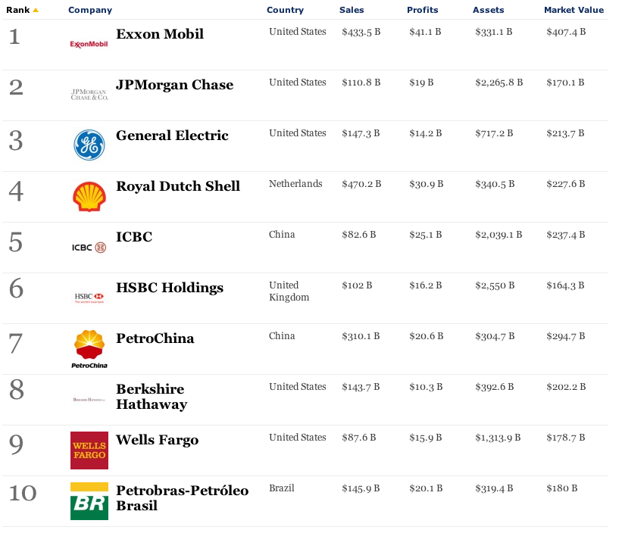

Slide 12
Social Construction of Corporations in US
Corporations look different in different countries (and over time).
For example,
CAUSAL FACTORS THAT AFFECT THE GROWTH OF CORPORATIONS:
Political Factors: For example, U.S. laws made monopolies illegal.
Institutional Factors: Businesses responded to the illegality by getting larger and growing vertically.
Social Factors: Ideologies accepted large corporations and the power they hold which allows them to grow even more. We LOVE our MNCs!

Slide 13
4 Concerns about Corporate Power
1) Economic power:
Economies of scale and control over technology prevent entry and sustainability of smaller businesses.
Lack of competition = price control, innovation, growth and jobs (Wal mart and predatory pricing)
Downsizing: Moving to other countries, technological displacement, marginal employment, while increasing stock prices, reduces employment.
Interlocking Economies –
Interlocking Directorates coordinating different industries
Banks Control – Banks get to decide who gets money

Slide 14
4 Concerns about Corporate Power
2) Political Power
Lobbying: Corporations are more likely than groups without money to have the opportunity to explain their position to lawmakers.
Bush’s Cabinet
Clinton’s Cabinet

Slide 15
4 Concerns about Corporate Power
3) Disrupt Democracy:
Prevent Innovation
Harm Environment
Prevent meaningful work
Reward those in power
Prevents meritocracy

Slide 16
4 Concerns about Corporate Power
4) Control over media
Concentration of Ownership
In 1981, there were 46 owned or controlled media outlets.
In 2007, there were 8: Disney, Vivendi Universal, Time Werner, Sony, Viacom, The News Corporation, GE, Bertelsmann.
Manufacturing Consent: Counter-ideological ideas are less likely to be heard on media….
FILTER 1: “MEDIA ARE OVERWHELMINGLY CONTROLLED BY A SMALL NUMBER OF CORPORATIONS”
FILTER2: MEDIA CORPORATIONS MUST ATTRACT ADVERTISERS
FILTER 3: MEDIA CONNECTED WITH OTHER POWERFUL GROUPS – GOVERNMENT, POLITICAL PARTIES
FILTER 4: NEGATIVE CONSEQUENCES FROM COUNTER-IDEOLOGICAL MESSAGES
FILTER 5: Those who criticize are called anti-American

Slide 17
Aren’t Monopolies Illegal?
If monopolies are illegal, how do large corporations have power?
Oligopolies: As we saw in media, only a few industries hold power.
Vertical Integration: Own so much of production process, control other industries
Size as Power: Hold a majority of market so can dictate rules of game (for example Wal Mart and music industry) or “too big too fail.”
(Students: Make sure to look at mulitnational monitor list in box)

Slide 18
Case Study: BroadBand
1 What’s going on with U.S internet?
South Korean and most European countries have internet that is faster, cheaper and serves more people. What’s going on?
For examples, South Korea has must faster speed than we do in the US., it’s twice as cheap and reaches 94% of the population.
,

Slide 19
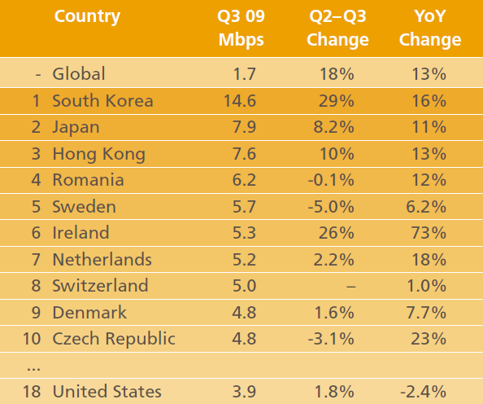
Notes:
This is 2010 but there isn’t much change. http://www.advancedtechnologykorea.com/9942

Slide 20
Case Study: Broadband and Comcast
1) Comcast is the biggest digital provider in the U.S.
It controls banks – the ability for rivals to come into market
It just bought NBC – what is shown on television
It controls costs – we pay more for slower internet; cable bills keep rising.
PROBLEM: Cable is not as quick as fiber optics…..but fiber optics cost money and those companies are not getting help from government like Comcast.
Notes:
Work by Susan Crawford. http://business.time.com/2013/01/09/is-broadband-internet-access-a-public-utility/

Slide 21
2) How did Comcast get so powerful?
A) Since 1998, it along with other cable providers, have spent 500,000,000 dollars lobbying the government.
B) People on the FCC (who control mergers of media giants) have moved into the industry to become the lobbyists.
3) Cable companies, like Comcast, have spent money on cable infrastructure and now they reap the rewards. They must keep competition out to make money.

