Slide 1
“FYI”: The Effects of New Communication Tools on Student performance in SW Illinois
Talayna McQuillan

Slide 2
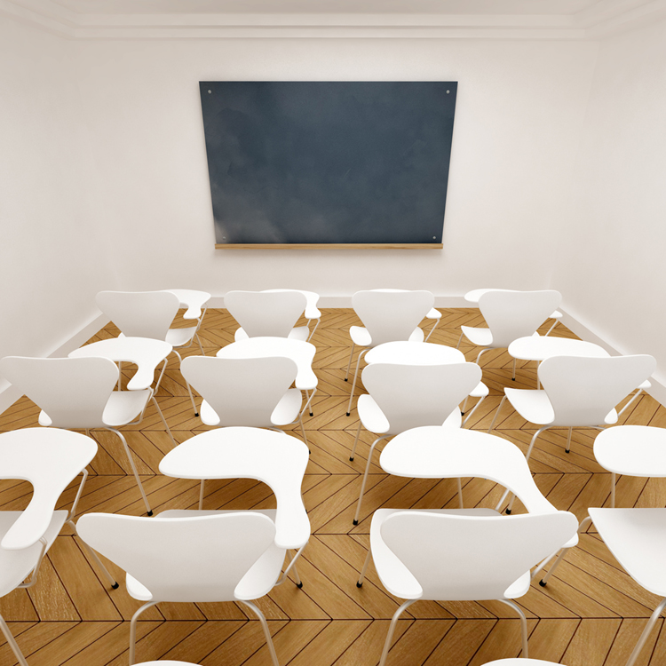
Introduction
Belleville West High School
Mckendree College
SIUE

Slide 3
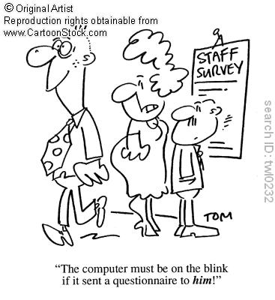
Methods
Semi structured interviews
      Open and close ended
      Face- to- face
Self administered questionnaire
      Close ended

Slide 7
Teacher Interviews
4 out of the 6 teachers said they noticed a difference in student performance
Misspellings, abbreviations, punctuations, and capitilizations
Textspeak affects how they speak and write

Slide 11
Question: Ways in which media might affect face to face interaction with friends, family, and others
Statements: | Seniors | Freshmen | Total
reduces interactions | 10 | 15 | 25
easier to communicate | 11 | 10 | 21
more accesible using new media | 8 | 4 | 12
keep in contact because of distance | 9 | 3 | 12
face to face interaction withering | 3 | 5 | 8
loose interaction skills | 5 | 3 | 8
media has no affect | 3 | 3 | 6
new media is distracting | 1 | 4 | 5
new media can cause conflict | 3 | 0 | 3
dislike media | 1 | 1 | 2
help maintain contact | 1 | 1 | 2
creates friendships | 1 | 1 | 2
creates unity | 2 | 0 | 2
creates distance between others | 1 | 0 | 1
use media very little | 1 | 0 | 1
avoids conflict | 1 | 0 | 1
keeps u in contact | 1 | 0 | 1
Face to face is crucial | 1 | 0 | 1
makes u more outgoing | 0 | 1 | 1
media creates unintelligence | 0 | 1 | 1

Slide 12
Acknowledgments
Dr. Cory Willmott
Anthropology teachers
Students at SIUE and McKendree
Teachers at Belleville West
Parents

