Slide 1
Making Stone Tools
An Exhibit of Flintknapping Virtuosity
Sarah Strowmatt

Slide 2
Research Question
What criteria are used to measure quality in flintknapping?
  Virtuosity: The technical skill, fluency, or style exhibited by the maker of a composition.
  Flintknapping: An ancient tradition of making stone tools that is still practiced and studied today.

Slide 3
Thesis Statement
I found that there are three main characteristics used to measure both the aesthetic and functional quality of a stone tool but those characteristics depend upon the aesthetic or functional context of use.

Slide 4
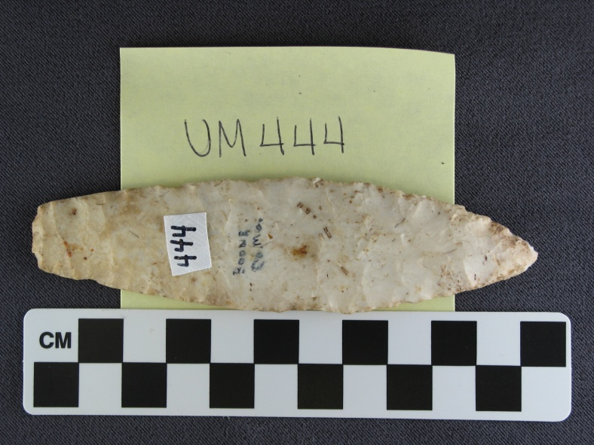
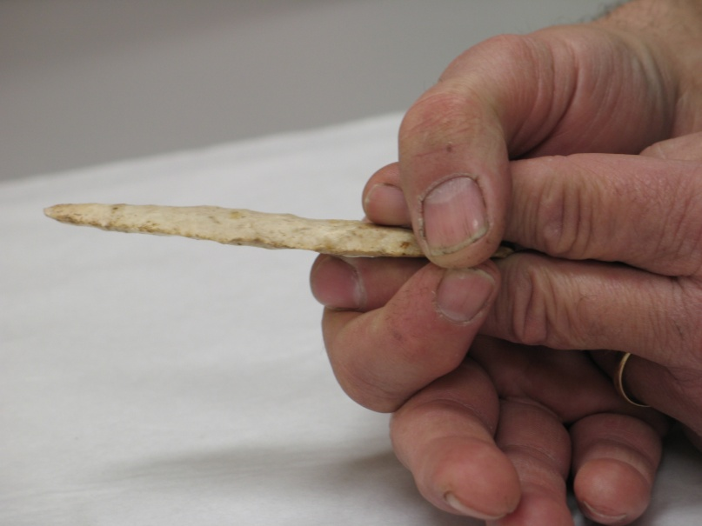
Methods
Identification of artifacts through texts
Photo documentation of artifacts
Mike Dothager demonstrating how the point would have gone on to the handle.

Slide 5
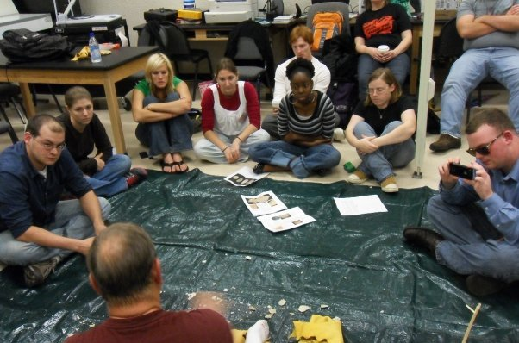
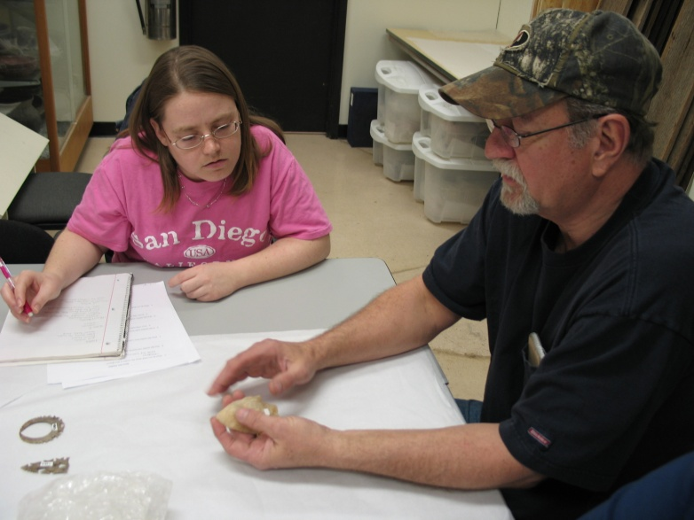
Methods cont.
Artifact elicitation interviews
Participant observation

Slide 6
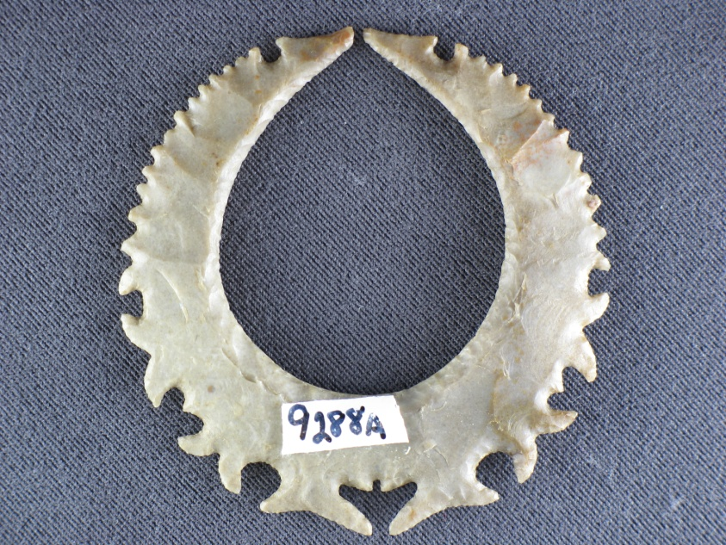
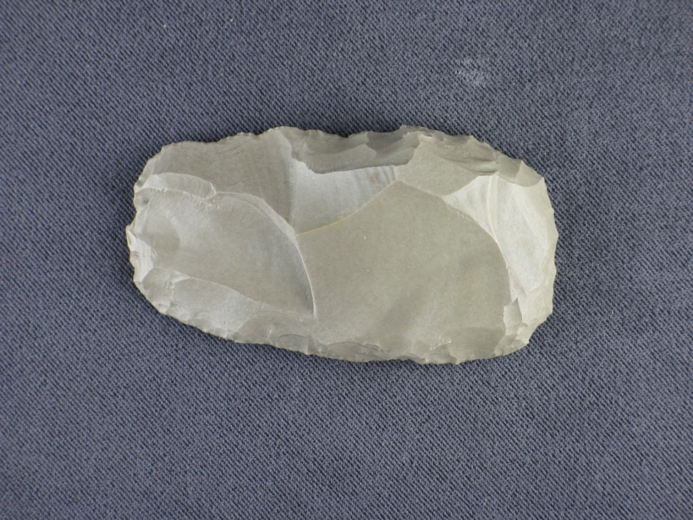
Characteristics of Quality
Aesthetic vs Functional
Aesthetic: A work that is meant to be beautiful or pleasing to look at.
Functional: A work that can be considered mundane but still has a useful purpose.

Slide 7
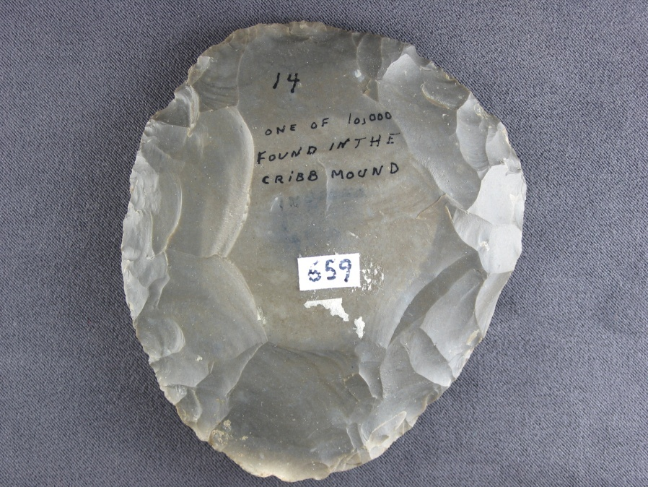
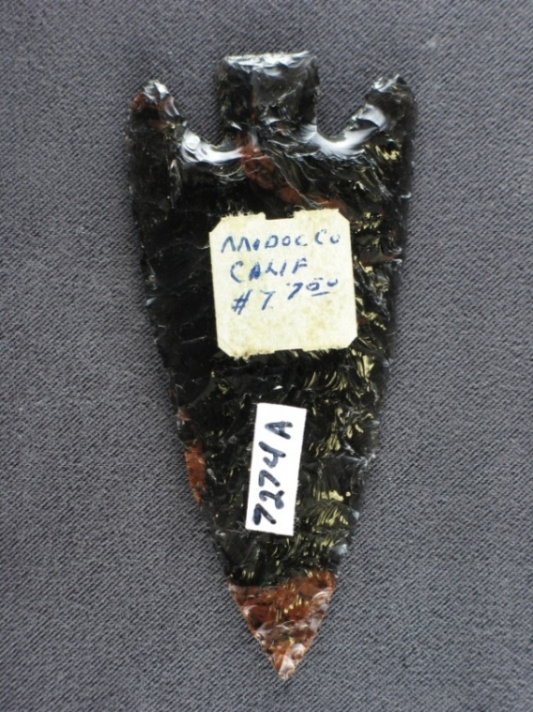
Material
Type of chert and heat treatment
  Chert: A silicate rock often used to make stone tools.
Aesthetic
Functional

Slide 8
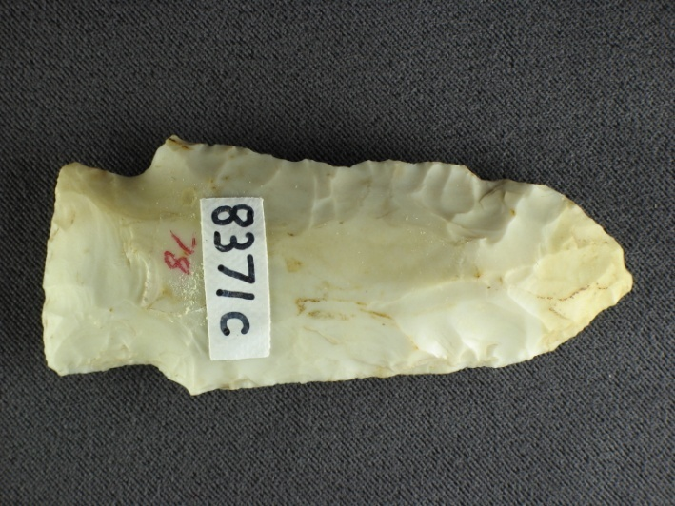
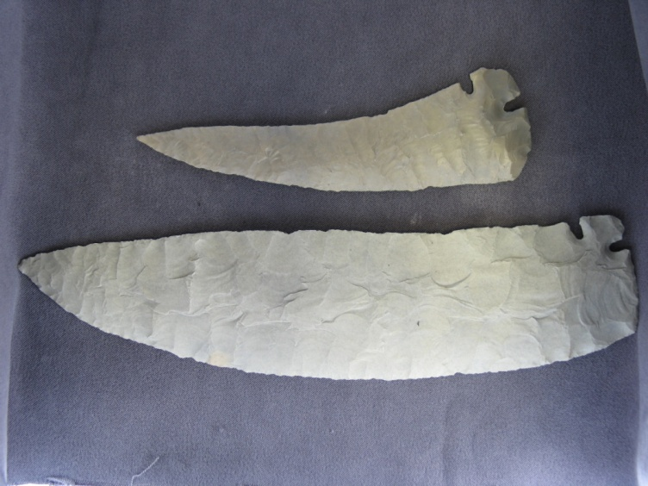
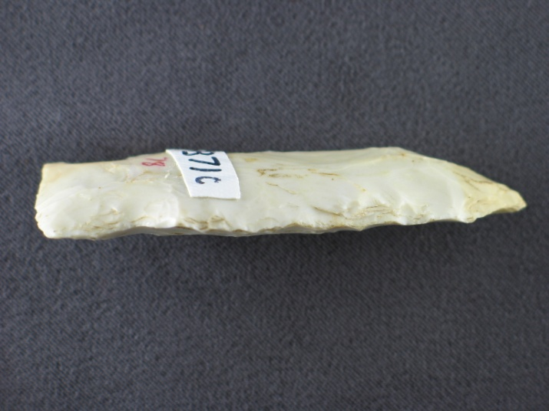
Shape
Symmetry and ratio
Aesthetic?

Slide 9
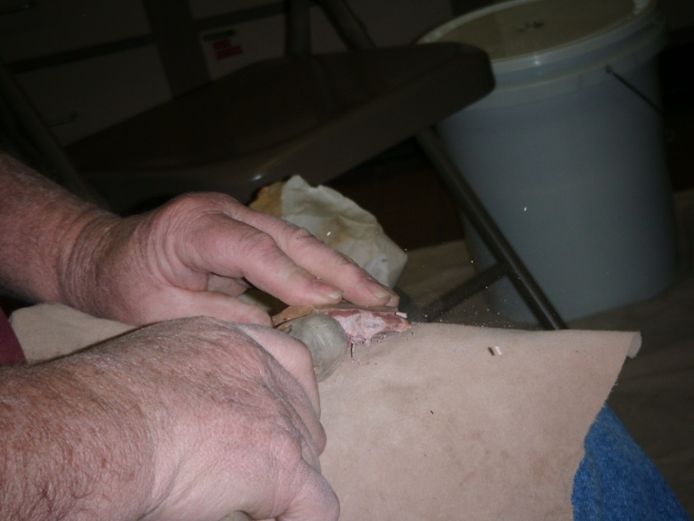
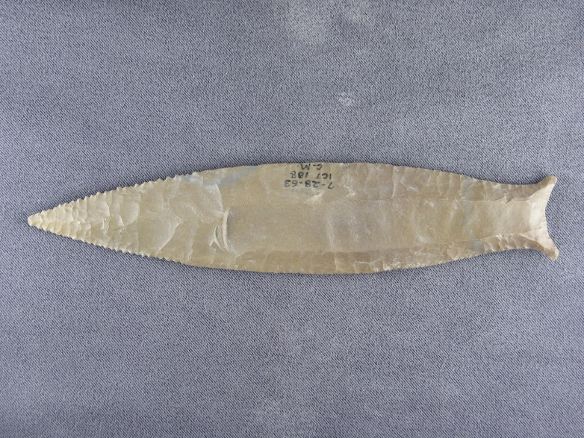
Flaking Techniques
Direct percussion and pressure flaking.
Larry Kinsella demonstrating direct percussion.

Slide 10
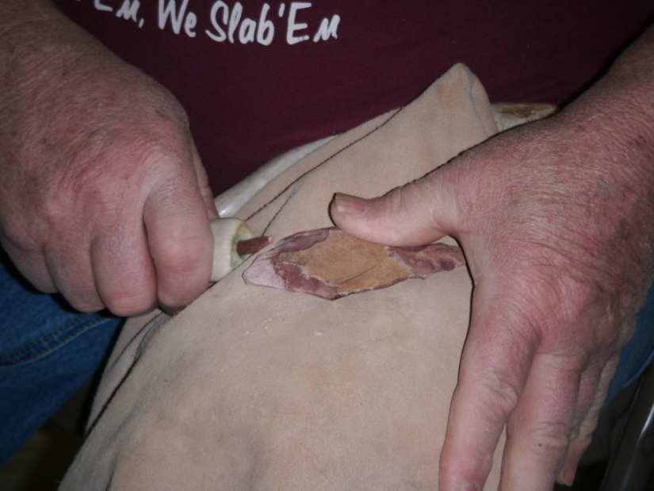
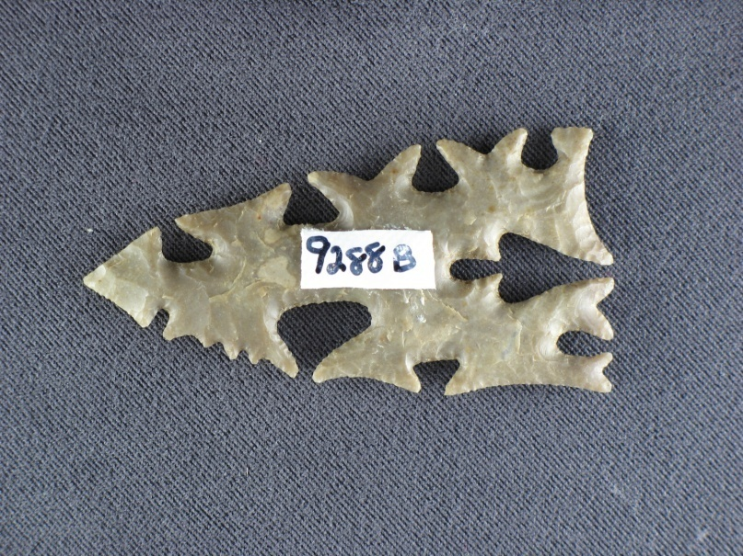
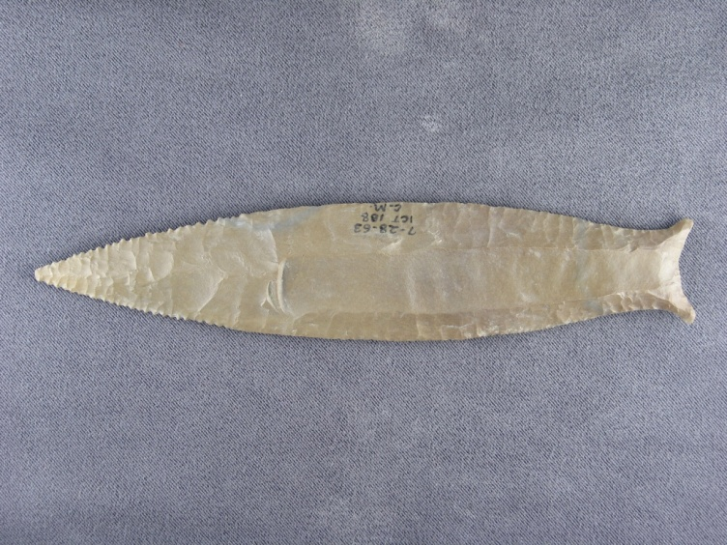
Larry Kinsella demonstrating pressure flaking.

Slide 11
Conclusions
My findings show that
  Aesthetic and functional purposes can change the how the quality of a tool is measured.
  The material can affect what techniques are used and what tool is made.
  The shape of a tool can be used to judge the quality of a tool and skills of a tool maker.
  The flaking techniques can indicate functional or aesthetic purposes and can affect the overall quality of the tool.

Slide 12
Acknowledgements
My advisor, Dr. Cory Willmott for all of her help and encouragement throughout this project.
Larry Kinsella and Mike Dothager for all of their help in identifying artifacts and expertise.
Eric Barnett for all of his help with creating the display.
Dr. Julie Holt for giving me the idea to create a museum display and all of her help and encouragement.
Everyone in the Anthropology Club for all of their support and encouragement.
The University Museum, Anthropology Teaching Museum and St. Louis Science Center for all of the artifacts in my display.

